Slide 1


InViz – Instant Visualization of Cybersecurity Events
Fraunhofer Center for Experimental Software Engineering
College Park, MD
All content copyright Fraunhofer USA, 2014

Slide 2
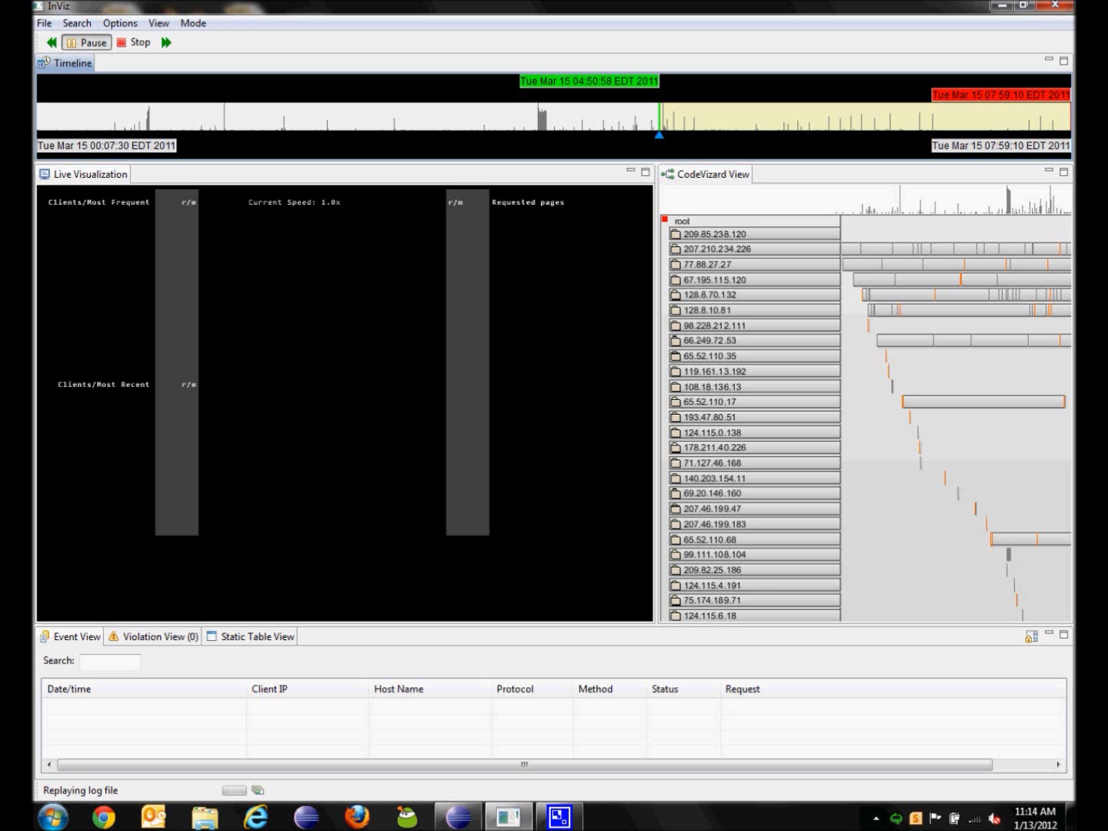
Timeline and playback controls
InViz displays events from logs in a number of views.
Live View
Historical View
Event details

Slide 3
LIVE VIEW
The InViz live view uses novel visualization techniques to display many dimensions of information simultaneously.
Graphical information is more easily understood, thus helping even inexperienced personnel identify anomalous activity quickly.

Slide 4
InViz visualizes events in:
Real-time – e.g. from a syslog client or a tail service
Replay mode – from an existing log file, e.g. a webserver log
As events are received or replayed, they are launched across the screen.
Colors, shapes, size, and frequency all have meaning.

Slide 5
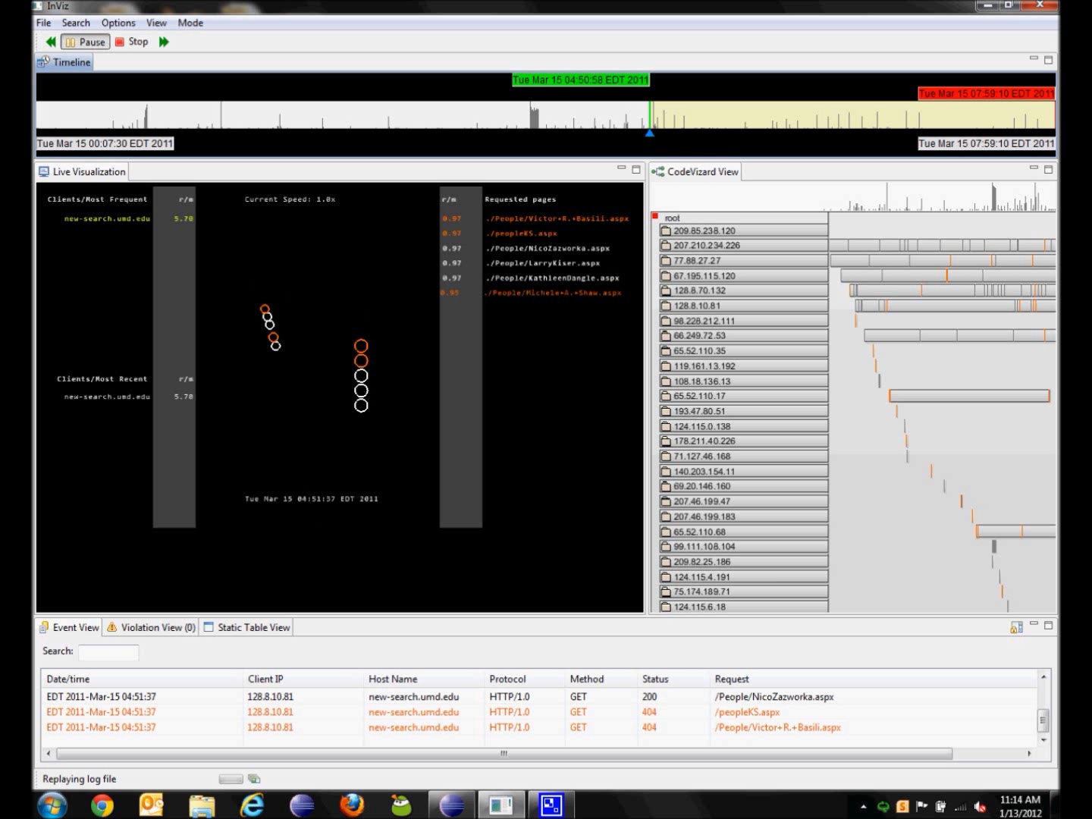
Clients making server requests
Example from IIS 7.0 webserver events
Requested resources
Shapes
Circles are web pages
Squares are images
Triangles are scripts
Colors
White are successful HTTP responses (1xx, 2xx, 3xx)
Orange are errors (4xx, 5xx)

Slide 6
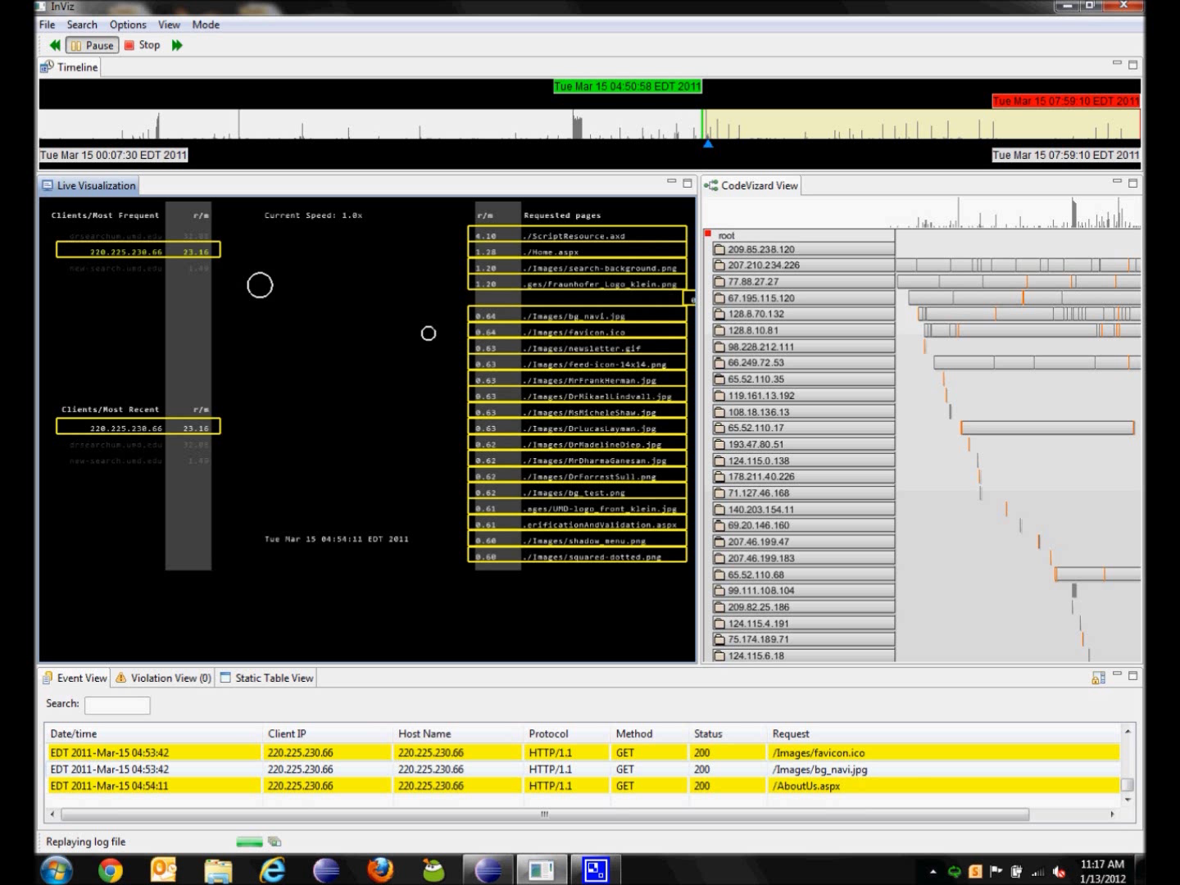
Highlighting and filtering
Clicking on a client will highlight the client’s requests
Clicking on a resource will highlight all the clients that have requested it

Slide 7
HISTORICAL VIEW
The InViz historical view displays events over a period in time, allowing the user to examine patterns of behavior.
The display is ordered by requester (e.g. the client IP), and the user can drill down to further levels of detail for each requester.

Slide 8
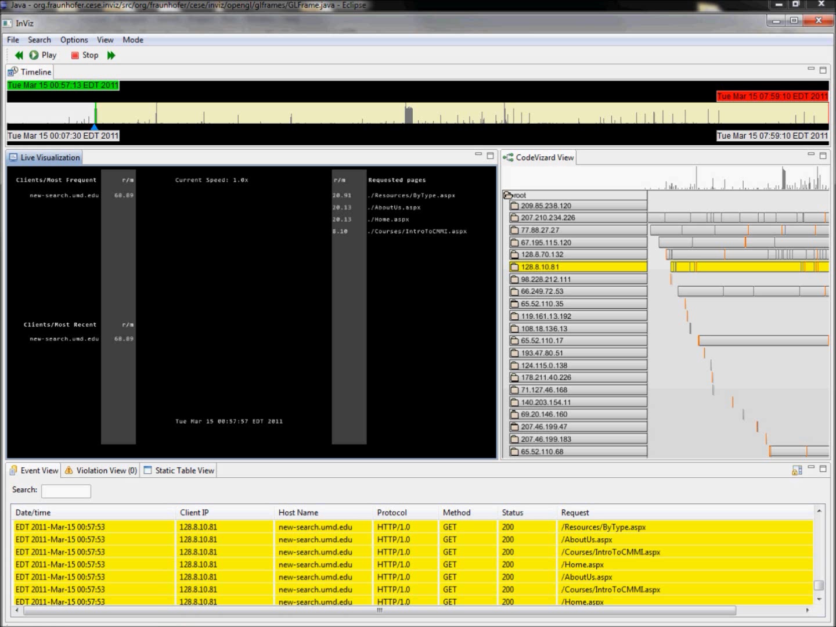
Example from IIS 7.0 webserver events
The vertical bars along the top reflect the “timeline” of past events
The horizontal labels represent client IPs
The horizontal bars represent the events from each IP over time
The width of the bar is the period of time from first request to last request
The vertical ticks represent events
The highlighted client is a search crawler.
We will look in more detail at its history of requests to the webserver.
Expanding an IP shows the resources requested over time.

Slide 9
ATTACK INVESTIGATION EXAMPLES
The following attacks occurred on the Fraunhofer public webserver running IIS 7.x. The webserver logs were investigated using the InViz tool.
Using InViz, non-experts in security were able to quickly identify the anomalous behavior, investigate, and determine the impact of the attacks.

Slide 10
ATTACK INVESTIGATION EXAMPLE 1
Naïve webmail entry point scanner
The attacker crawls the webserver, then modifies the URLs in an attempt to find unsecured entry to webmail.

Slide 11
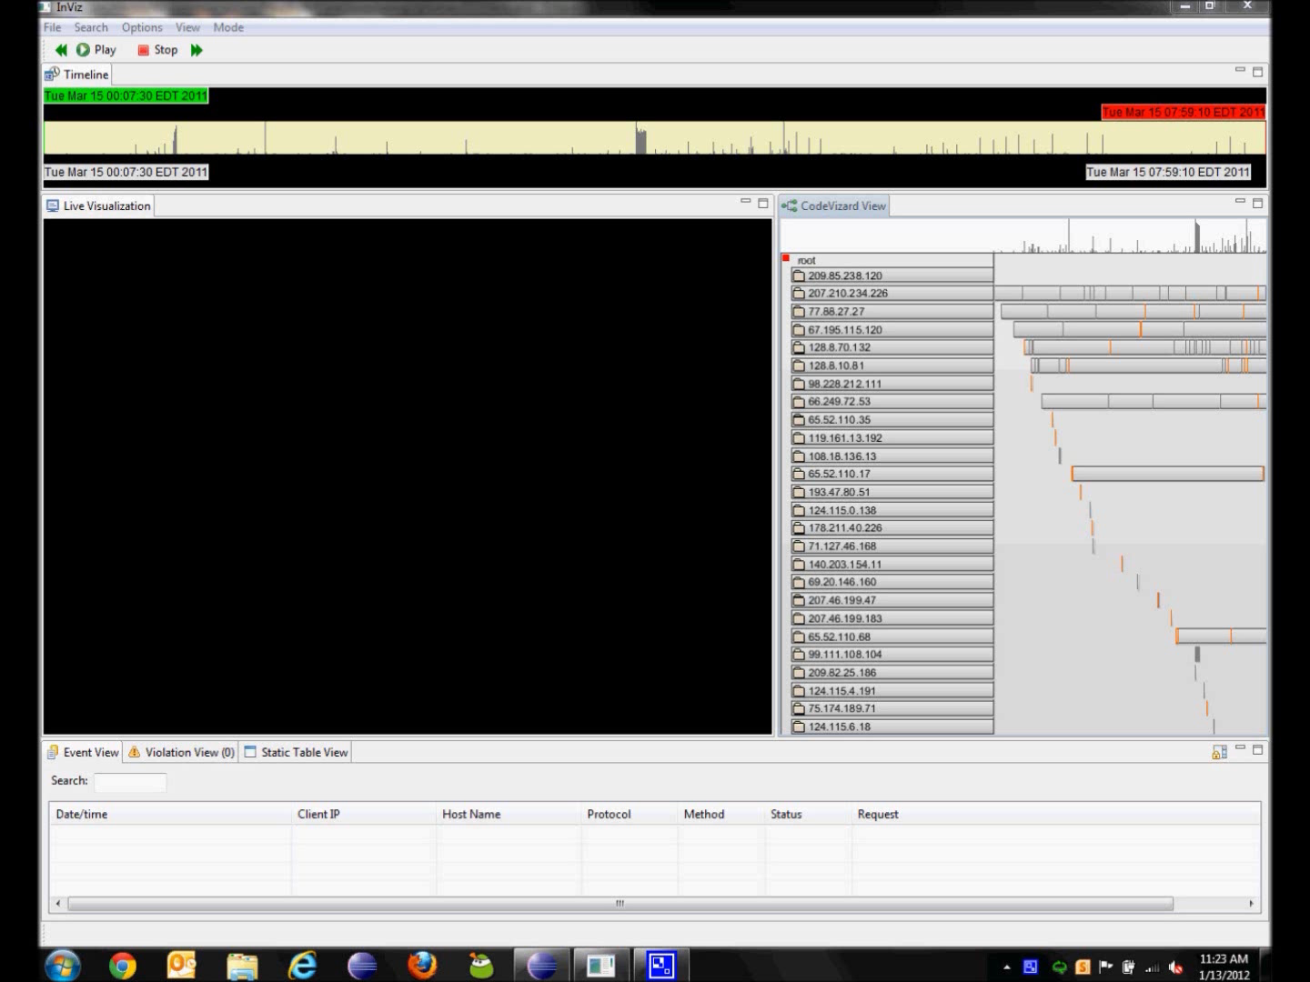
The timeline view indicates an abnormally large number of events in a short time.
We tell InViz to replay from this spot.
All requests from the same IP
Requested resources contain suspicious names and escape characters

Slide 12
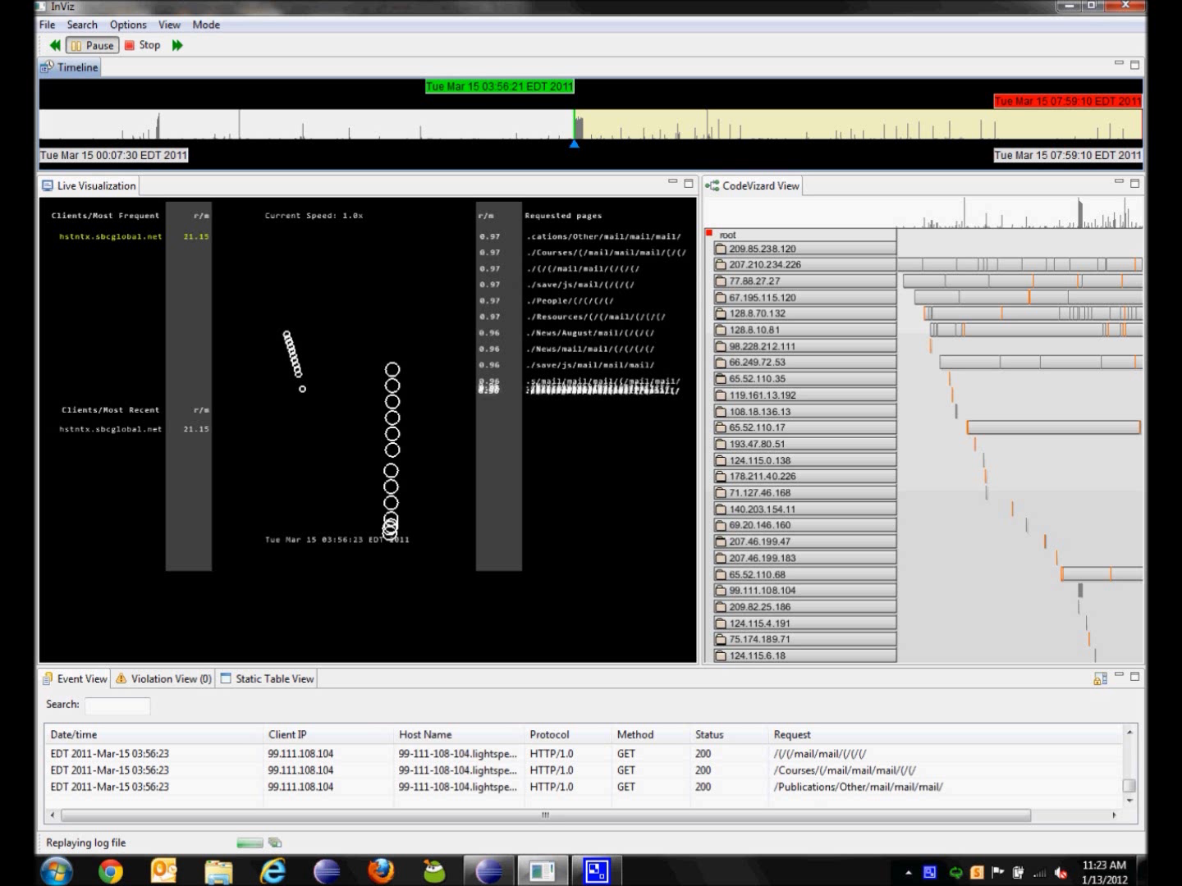
We increase the playback speed to 8x real time.
A single client is requesting ~280 pages/minutes
IP resolution indicates what is likely a residential client in Houston
Event details suggest an attempt to find an unsecured access to webmail

Slide 13
ATTACK INVESTIGATION EXAMPLE 2
Probing for unsecured webapp admin
The attacker makes requests for the admin pages of phpMyAdmin – a popular web-based mySQL database manager.
The attacker makes ~30 requests in a minute, all of which return status 404.

Slide 14
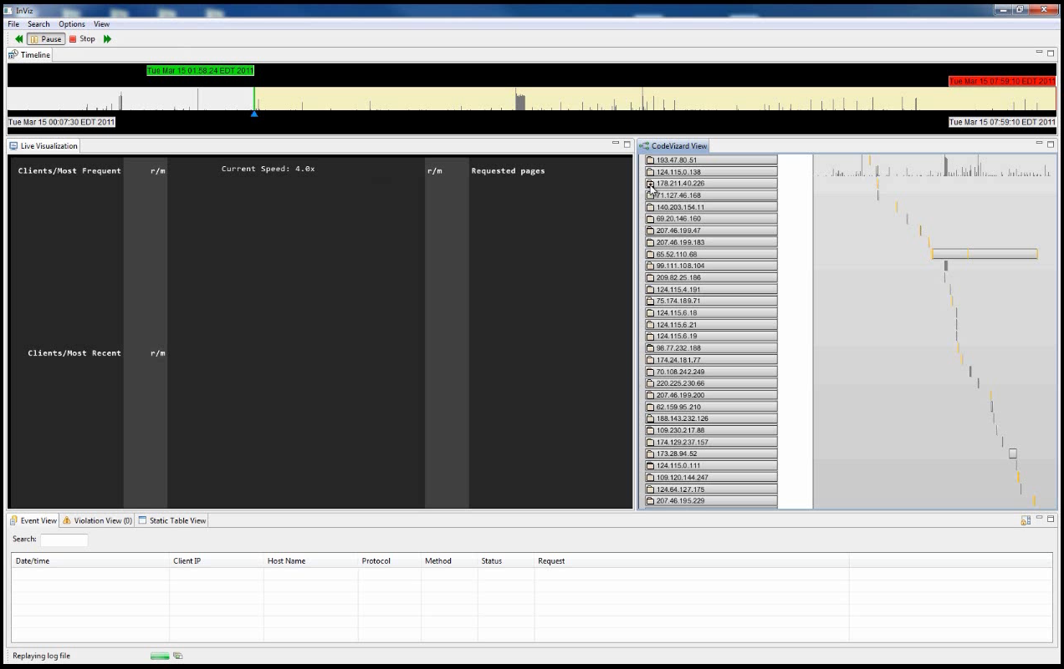
This behavior can be seen in real time in the live view
The historical view shows a single client sending multiple requests for phpMyAdmin, all resulting in 404 responses

Slide 15
ATTACK INVESTIGATION EXAMPLE 3
Accessing remotely included shells
The attacker requests two known PHP shells – c99.php and r57.php.
Often, these shells have been injected through PHP Remote File Inclusion (CWE-98, CAPEC-193).
InViz can be customized to scan for strings that are potentially malicious or abnormal for the operating environment.

Slide 16
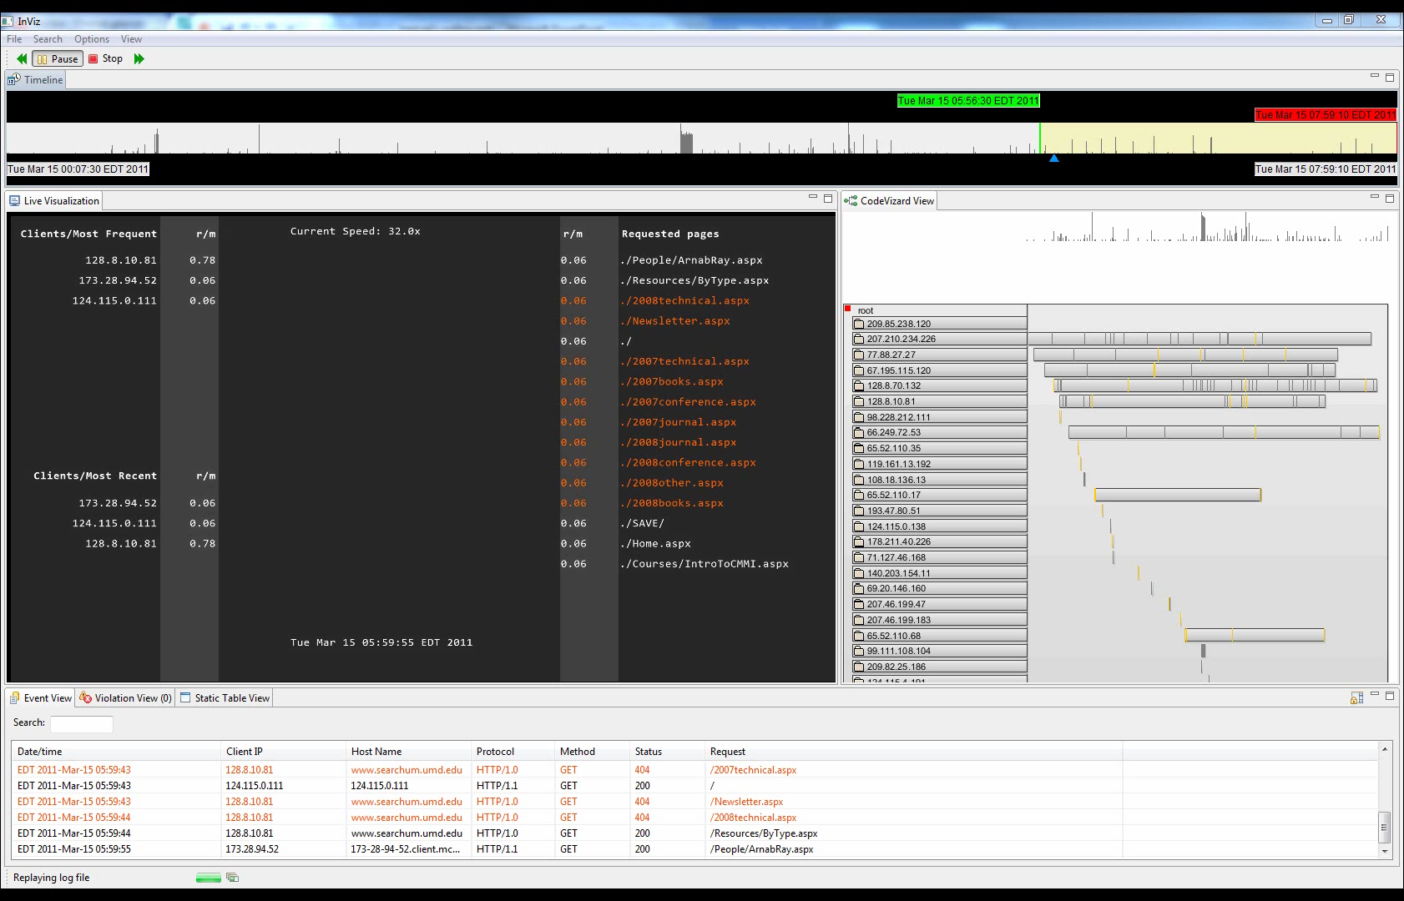
Request for r57.php is flagged
InViz has been customized to show any request involving r57 and c99 as “violations.”
This view shows only those events identified as violations

Slide 17
inviz@fc-md.umd.edu
Inquiries, collaborations, partnerships
Updates and videos
www.fc-md.umd.edu/inviz
Lucas Layman
llayman@fc-md.umd.edu
Frank Herman
fherman@fc-md.umd.edu
All content copyright Fraunhofer USA, 2014

