Slide 1
A Global Perspective on Cyber Attacks
Prof. Kathleen M. Carley
kathleen.carley@cs.cmu.edu
Ghita Mezzour

Slide 2


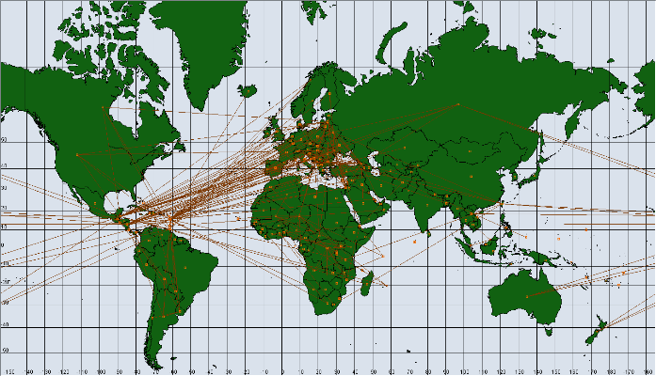
Context Overview
Characterizing
CyberSpace
Validate
Simulation
Global Map
Policy

Slide 3

Symantec’s WINE telemetry data
  From ~10 million customer machines worldwide
  Use thesaurus for threat attributes
    AV: type, IPS: type, infrastructure
IP victim, IP attacker, threat name
IP, threat name
AV telemetry
IPS telemetry
Focus

Slide 4
Cyber Threat Propagation Mechanisms
Fake applications
  E.g., Fake anti-virus
  Manual download by user, drive-by-downloads, spam
Exploit
  E.g., Apache Struts CVE-2013-2251 Code Execution
  A program that takes advantage of a software vulnerability. propagation mechanism depends on how they are used with other malware
Web attack
  E.g., Adobe Flash CVE-2011-1140 3
  Special case of an exploit, typically used within a drive-by-download
Other
  E.g., Alcarys worm
  Viruses, Trojans, Worms

Slide 5
Threats & Attacks
Threat reports do not equal cyber incidents at the machine level
  For example, a machine infected with a given threat (malware) for a long time may send multiple threat reports over time, but there is only one infection.
“Threat” - number of unique threat (malware) families that the machine reports
“Attack” - the number of machines that attacked the victim computer (for each threat family)

Slide 6

Illustrative Measures
Threats encountered
  Avg # of threats by Symantec machine
  # of threats reported by all Symantec machines in a country/ # of Symantec machines in country
  Total & by threat type (AV & IPS)
Attacks encountered
  Avg # of attacks encountered by Symantec machine
  # attacks encountered: # (attacker machine, threat)
  Total & by threat type (IPS)
Attacks transmitted
  Avg # of attacks transmitted by a computer
  # attacks transmitted: (# victim machine, threat)
  Total & by attack infrastructure (IPS)
Attacker 1
Attacker 2
# threats encountered: 2
# attacks encountered: 3
Attacker 3
Victim
Notes:
Country level measures

Slide 7
Attack Network
Cyber attack network
  Avg # of attacks by a computer in country i on a computer in country j
  (# of attacks by computers in country i on computers in country j)/ (# of computers in i * # Symantec computers in j)
  Total, infrastructure * type, (IPS)
Country i
Country j
Symantec machine
Edge weight from i to j = 4 /(6*3) =0.2222
other machine
threats
Notes:
Attack in dashed line is not recorded in data

Slide 8
Non-Attack Data
ICT development index
  ICT development index [ITU 2010] that combines 11 indicators (fixed telephone lines per 100 inhabitants, mobile cellular telephone subscriptions per 100 inhabitants, international Internet bandwidth per Internet user(bits/s), % of households with a computer, % of households with Internet access, % of individuals using Internet, fixed broadband Internet subscriptions per 100 inhabitants, active mobile broadband subscriptions per 100 inhabitants, adult literacy rate, secondary gross enrolment ratio, tertiary gross enrolment ratio)
Cyber Research
  # cyber security papers during 2002-2011[SCOPUS]
Region
  Africa, Asia, Eastern European, Western European and others (includes US, Canada, N. Zealand), Latin America
Corruption [transparency international]
  Index of corruption in the public sector
  High index value: low corruption
Software piracy rate [Business software alliance]
  Number of units of pirated software installed divided by total number of units of installed software
GDP per capita [world bank]
Alliance Network [correlates of war]
Hostility Network network [Center for International Development & Conflict Management, Department of Peace and Conflict Research]

Slide 9
Relative Prevalence
Threats encountered . Total = 24.52 M
Threats encountered (AV). Total = 9.75 M
Attacks encountered.
Total ~ 35.9 M
Attacks transmitted.
Total ~ 35.9 M

Slide 10
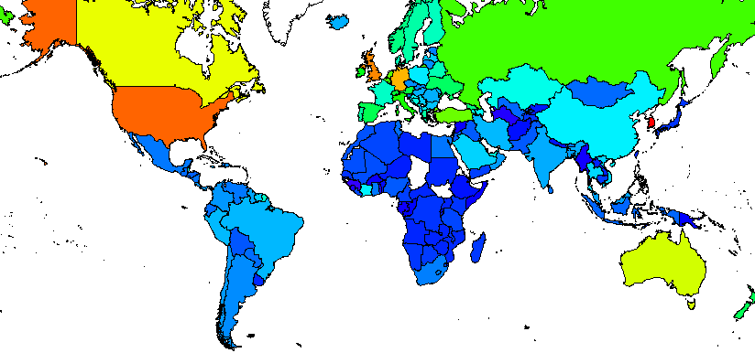
Web Site Threats Encountered

Slide 11
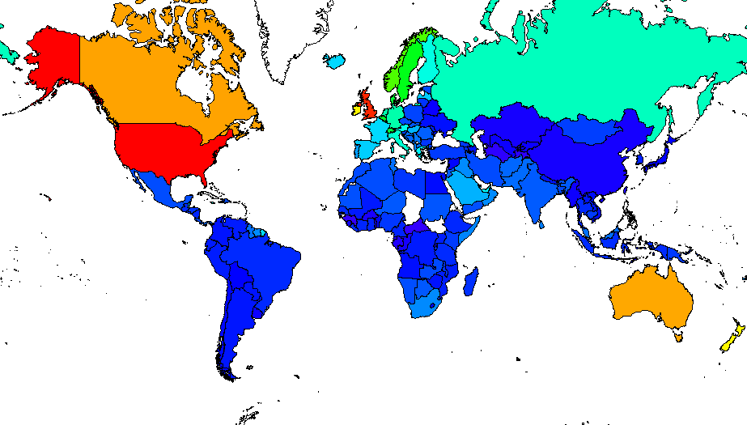
Fake Application Threats Encountered

Slide 12
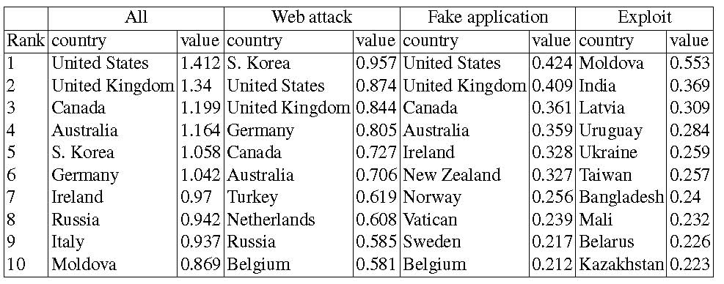
Top Countries –
Threats Encountered (IPS)
Top countries for web attacks & fake applications
  High ICT development
Top countries for exploits
  Middle ICT development

Slide 13
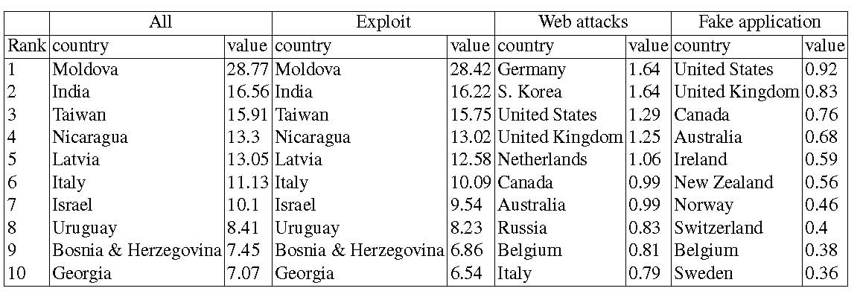
Top Countries –
Attacks Encountered (IPS)
Top countries for web attacks & fake applications
  High ICT development
Top countries for exploits
  Middle ICT development
Notes:
Somewhat different set of countries, but general observation about relationship to ICT still holds

Slide 14
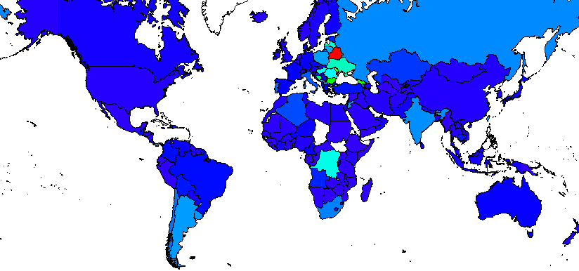
Exploits Transmitted – “Purportedly”
Belarus

Slide 15
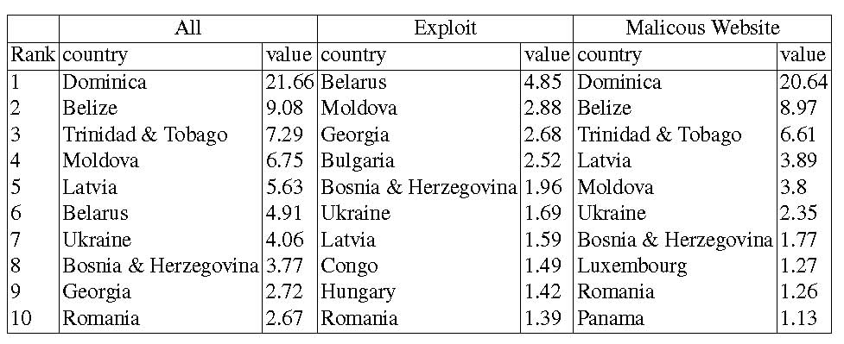
Top Countries –
Attacks Transmitted (IPS)
Top countries
  Middle ICT development
  Many Eastern European countries

Slide 16
IPS Threats Encountered - Regression
Web attack
  Resources or exposures: more attacks
  Western Europe & North America encounter more attacks
  Africa encounters fewer attacks
 | Web attack | Fake app | Exploit
ICT | 0.149*** | 0.0128 | 0.130
ICT² | -0.0101 | 0.0000154 | -0.0156*
GDP | -0.0860 | 0.103 | -0.148
africa | -0.0944** | -0.110 | 0.171
eastEuro | 0.0463 | -0.0401 | 0.281**
westEuro+ | 0.214* | 0.268** | 0.175
asia | -0.0586 | -0.0994 | 0.280**
between |  |  | 1.695***
intercept | -0.733*** | -1.646*** | -0.993***
R² | 0.593 | 0.446 | 0.287
="* p<0.05 ** p<0.01 *** p<0.001
Fake app
  ICT & GDP not significant separately, but significant when tested for jointly: more fake app attacks in countries with more resources
  Western Europe & North America encounter more attacks
Exploit
  Eastern Europe & Asia encounter more attacks
  Structural position in attack network
Notes:
westEuro+ (wester europe, north america, n. Zealand, australia)

Slide 17
IPS Attacks Encountered - Regression
Web attack
  Similar to results when using threat granularity in slide 25
Fake app
  Similar to results when using threat granularity in slide 25
Exploit
  Resources: more exploits
  Cyber security experience: less exploits
  Structural position in attack network
 | Web attack | Fake app | Exploit
ICT | 0.169*** | 0.0462 | 0.932**
ICT² | -0.0106 | -0.00174 | -0.0665*
GDP | -0.108* | 0.115 | -0.758*
africa | -0.0949** | -0.105 | 0.00357
eastEuro | 0.0576 | -0.0604 | 0.251
westEuro+ | 0.237* | 0.337** | 0.387
asia | -0.0915* | -0.123 | 0.247
between |  |  | 4.840**
intercept | -0.670*** | -1.716*** | -0.230
R² | 0.573 | 0.510 | 0.254
="* p<0.05 ** p<0.01 *** p<0.001
Notes:
Web attack and fake app: regression results are very similar whether we use the threat granularity or the attack granularity. For web attacks & fake apps, the two granularities are very similar
Exploits: regression results are very different depending on which granularity is used. For exploits, actually, this granularity is more appropriate

Slide 18
IPS Attacks Transmitted - Regression
Exploit
  Good ICT: more attacks
  Corruption
  Corruption with good ICT infrastructure: more attacks
  Western Europe & North America transmit fewer attacks
  Asia transmits fewer attacks
  Tit-for-tat : countries that receive also transmit
  Structural effects
Web attack
  Good ICT: more attacks
  Africa less likely to transmit
  Eastern Europe more likely to transmit
 | Exploit | Web attack
ICT | 0.375*** | 0.720**
ICT² | -0.0144 | -0.0410
corruption | 0.269** | -0.00194
ICTxcorruption | -0.0430** | -0.00538
africa | -0.178 | -0.842*
eastEuro | 0.163 | 1.042**
westEuro+ | -0.336* | 0.314
asia | -0.240* | -0.441
Exploits received | 0.319***
betweenness | 2.194*
intercept | -5.256*** | -7.608***
R² | 0.645 | 0.535
* p<0.05 ** p<0.01 *** p<0.001
Notes:
Be careful that high corruption index means little corruption in the country

Slide 19

Cyber Attack Network
Notes:
Only kept edges with large weight

Slide 20
Proliferators
First stage proliferator is a country that incorporated cyber security in its military prior to 2000.
Proliferation likelihood refers to the likelihood that that country will seeks to develop cyber capabilities

Slide 21
Timeline of Incorporating
Cyber Security in Military
Country | Year
Albania | 2010
Argentina | 2004
Austria | 2008
Australia | 2009
Belarus | 2001
Brazil | 2008
Canada | 2010
China* | Early 90s
Colombia | 2005
Denmark | 2009
Estonia | 2008
Country | Year
Finland | 2009
France | 2008
Georgia | 2005
Germany | 2009
India* | Late 90s
Iran | 2010
Israel* | Late 90s
Italy | 2010
N. Korea* | 90s
S. Korea* | 1996
Malaysia | 2007
Myanmar | 90s
Country | Year
Netherlands | 2011
Norway | 2010
Pakistan* | Late 90s
Poland | 2011
Russia* | 90s
Switzerland | 2010
Taiwan* | 2000
Turkey | 2010
UK | 2009
US* | 90s
Ukraine | 2004
* First-stage proliferators
Notes:
Years correspond to different events for different countries. It may the year when they announced intentions to establish a military cyber security center, or the year when that center was actually established.
Sources:
1. C. G. Billo and W. Chang. Cyber warfare: An analysis of the means and motivations of selected nation states.
Technical report, Institute for Security Technology Studies. Darmouth College, November 2004.
2. J. Carr. Inside Cyber Warfare: Mapping the Cyber Underworld. OReilly, 2011.
3. J. Goetz, M. Rosenbach, and A. Szander. War of the future: National defense in cyberspace. In Der Spiegel,
volume 11, February 2009.
4. J. A. Lewis, K. Timlin, S. Deitz, A. Kempf, J. Rifkind, J. McGee, and A. Lukich. Cybersecurity and cyberwarfare.
preliminary assessment of national doctrine and organization. Technical report, Center for Strategic and International
Studies, 2010.
5. Nknews. N.korea trains up hacker squad. http://www.nknews.org/news_clipping/
n-korea-trains-up-hacker-squad/, 2011. Last accessed: January 2013.
6. G. O’Dweyer. Cyber defense takes center stage in nordic cooperation. In DefenseNews, November 2012.
7. G. O’Dwyer. Norway drafts cyber defense initiative. In DefenseNews, January 2010.
8. F. of American Scientists. Fapsi. https://www.fas.org/irp/world/russia/fapsi/ops.htm, 1997. Last
accessed: January 2013.
9. J. U. Ortiz. Argentina: The challenge of information operations. In IOSphere, 2008.

Slide 22
Send Stage Countries
Proliferation Likelihood
+
+
Enemy is First Stage Proliferator
Enemy is Second Stage Proliferator
+
+
+
Ally is Second Stage Proliferator
Ally is First Stage Proliferator
ICT

Slide 23
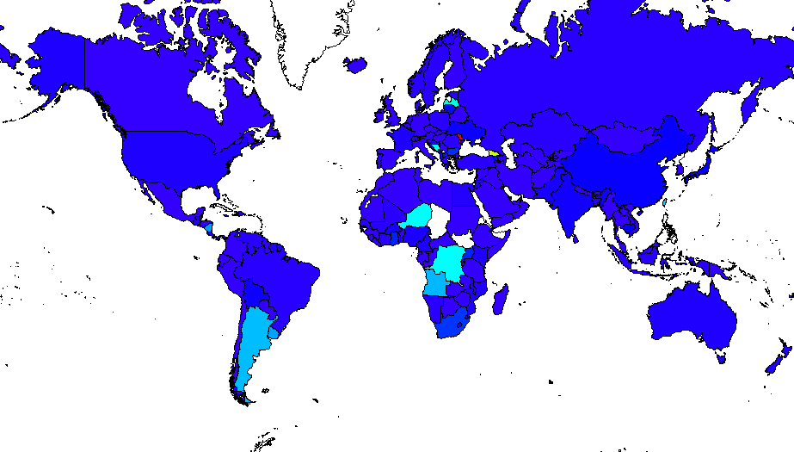
Exploits: Countries that act as wayports
Latvia
Moldova
Georgia
Croatia
Argentina
Niger
Dem. Rep of Congo
Angola

Slide 24
Summary
Global perspective on cyber attacks
ICT as preventative
For exploits
  Some countries are wayports
Countries whose enemies and allies developed military cyber early are more likely to develop the capability
Areas to watch
  Eastern Europe
  Central Africa
  Argentina

