Slide 1
Achieving Intrusion Tolerance through Automatic Response and Improved Forensics
Mohammad A. Noureddine
PERFORM Research Group
Collaborators: William H. Sanders, Wajih Ul Hassan, Pubali Datta, Adam Bates
Department of Computer Science
University of Illinois at Urbana-Champaign

Slide 2
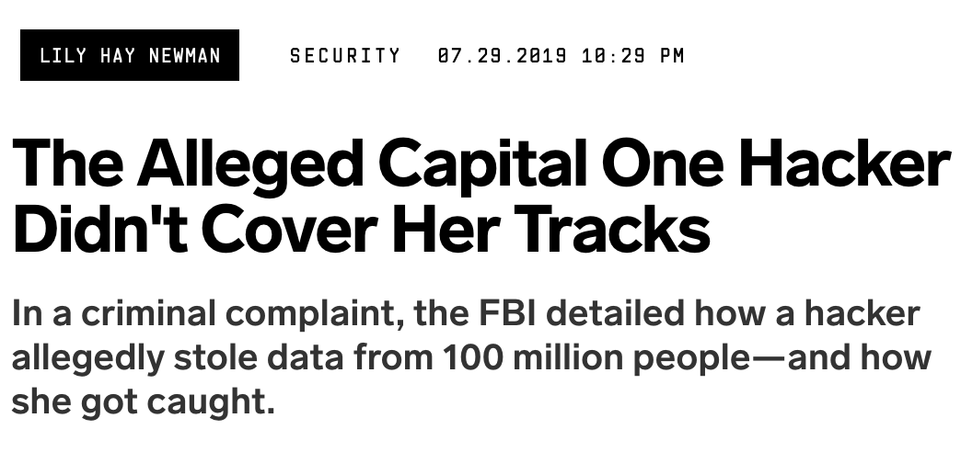
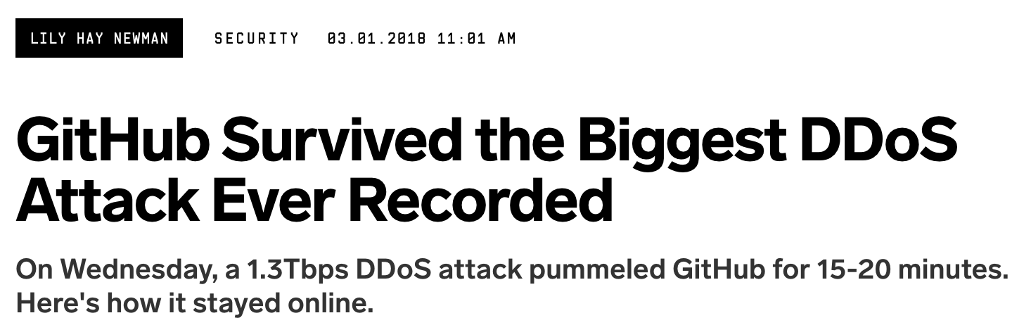
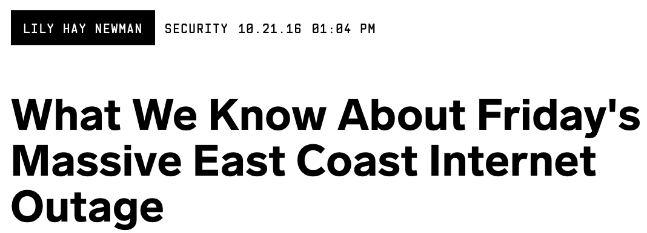
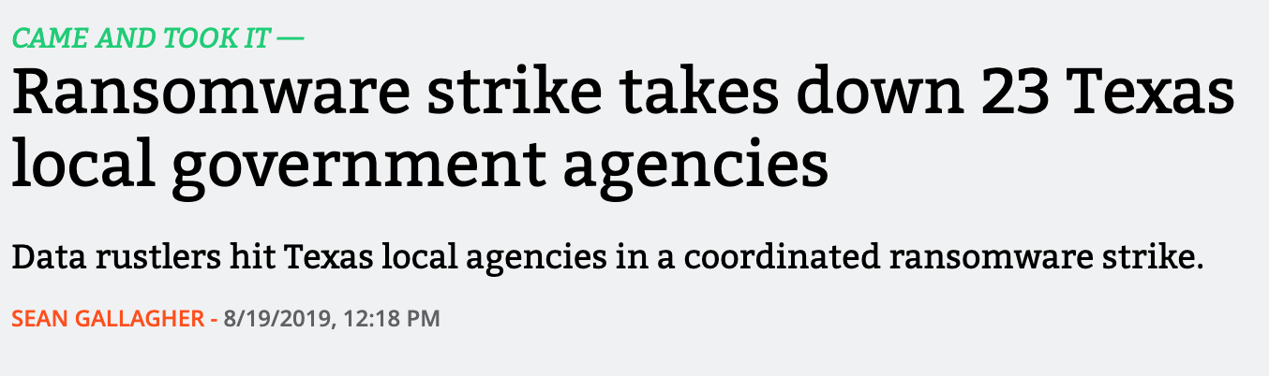
In the news

Slide 3
Resiliency

Slide 4
This Talk
RQ1:
How can we preserve acceptable operation during a state-exhaustion DDoS attack?
RQ2:
If an exploit is detected, how can we preserve the system’s identity?

Slide 5
This Talk
RQ1:
How can we preserve acceptable operation during a state-exhaustion DDoS attack?
RQ2:
If an exploit is detected, how can we preserve the system’s identity?

Slide 6
Key Observations in 2018
Majority of the attacks are multi-vector
TCP based attacks were the
second most common attack
vector.
Verisign Q2 2018 DDoS Trends Report: https://bit.ly/2LjUxmY

Slide 7
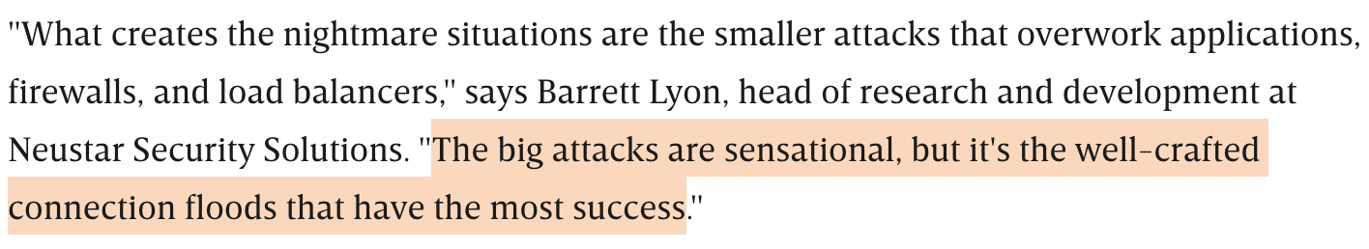
State-Exhaustion Attacks
Target resources on the victim server’s end
Harder to detect and mitigate
https://www.wired.com/story/creative-ddos-attacks-still-slip-past-defenses/

Slide 8
TCP State-Exhaustion Attacks

Slide 9
Current Defense Trends
Need more defenses that are on-premises
Involve users in the defense process
Image on the right: https://support.vagaro.com/hc/article_attachments/360002228693/2.png
Image on the left: https://xkcd.com/233/

Slide 10
Client Puzzles
Puzzle-based rate-limiting

Slide 11
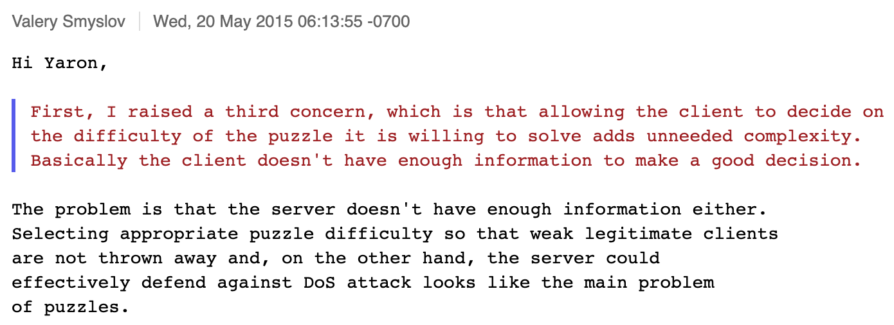
Why not Puzzles?
We don’t know what difficulty to select!
https://www.mail-archive.com/ipsec@ietf.org/msg05933.html
Notes:
Let the clients decide (RFC 8019): Favors powerful users.
Set fixed difficulty: How do we select this fixed difficulty?
Per-source difficulty: Need to maintain state.

Slide 12
Our Contributions
Model selecting puzzle difficulties as a Stackelberg game
Practical method for selecting model parameters
Open source kernel patch for Linux 4.13.0
Prototype puzzle-fair queueing with minimal state

Slide 13
Stackelberg Game Flow
Server selects puzzle difficulty
Server announces puzzles
Users select optimal sending rates
Solve for optimal server difficulty
Optimize users’ sending rates
Assume optimal puzzle difficulty

Slide 14
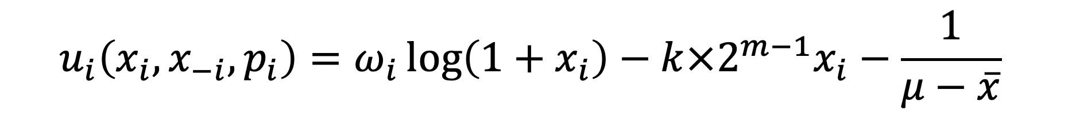
User Utilities
User i’s utility with puzzle p_{i} with k sub-puzzles and m bits
$$u_{i}\left(x_{i}, x_{−i},p_{i}\right)=ω_{i}\log\left(1+x_{i}\right)−k×2^{m−1}x_{i}−\frac{1}{μ−\overline{x}}$$
User sending rates
User’s valuation and benefit from the server’s service
Average time spent hashing to solve for puzzles
Average time spent waiting to receiver service (M/M/1 model)

Slide 15
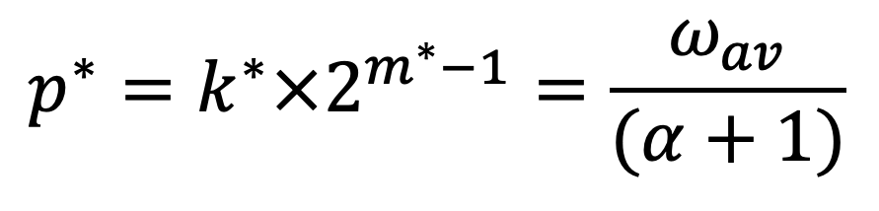

The Solution: Important Tradeoffs
Depends only on the average valuation
$α$ is the server’s asymptotic provisioning parameter
$$p^{∗}=k^{∗}×2^{m^{∗}−1}=\frac{ω_{av}}{(α+1)}$$
Users have high valuation → can generate harder puzzles
If server is well provisioned → Can issue easier puzzles

Slide 16
Obtaining Parameter Values
Users can typically tolerate 400ms delay

Slide 17
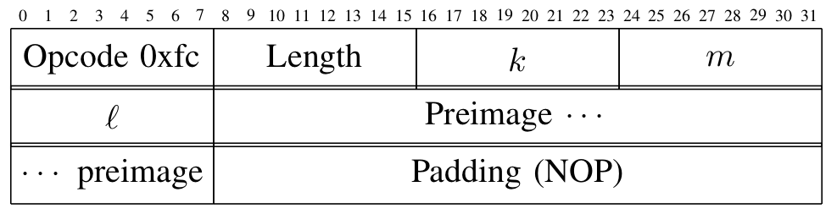
Implementation: Do Not Break TCP!
Patch the TCP stack in the Linux kernel
Include puzzles and solutions in TCP Options

Slide 18
Evaluation: Puzzles Outperform Cookies

Slide 19
Evaluation: Attackers Rate-Limited

Slide 20
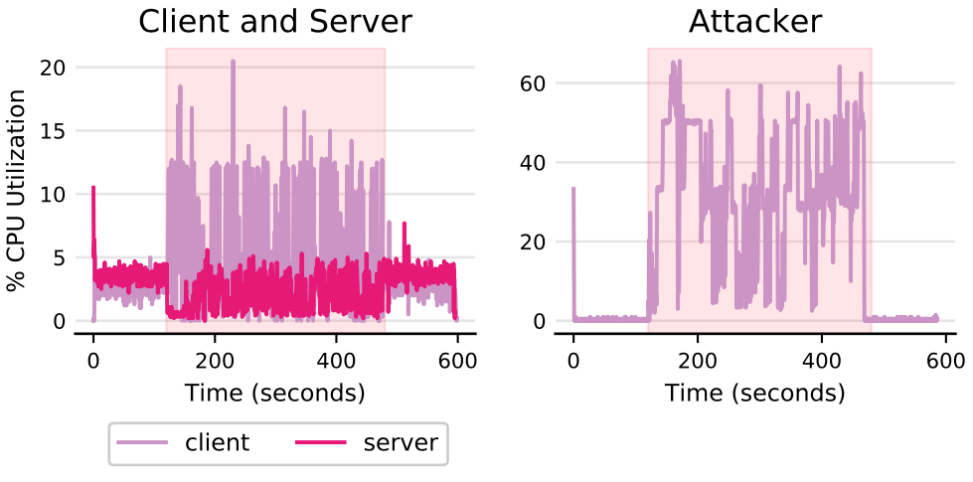
Evaluation: CPU Impact

Slide 21
This Talk
RQ1:
How can we preserve acceptable operation during a state-exhaustion DDoS attack?
RQ2:
If an exploit is detected, how can we preserve the system’s identity?

Slide 22

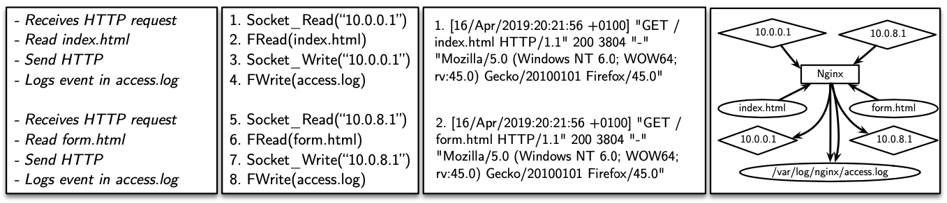

Analysis Using System Logs
Leverage system-level auditing (auditd) for forensics
Consider the following nginx example

Slide 23
System level auditing: the challenges
Two major problems with system logs-based forensics
  Dependence explosion problem
    Can generate false positives and confuse analysts
    high-fanout applications like web servers, mail servers, etc.
    Execution-units are mangled
  Semantic gap
    System logs do not contain application-specific information
    We loose the semantics of the application logs

Slide 24
Back to our example
Assume 10.0.0.1 is a malicious IP address
Backward analysis:
  What did 10.0.0.1 read?
Forward analysis:
  What did 10.0.0.1 write?

Slide 25
Universal Provenance
Preserves and enhances the causal reasoning strengths of system-level auditing
Adds the rich semantic context of application logs
  Addresses the semantic gap
Identifies individual units of execution
  Addresses dependence explosion

Slide 26
wLog’s architecture

Slide 27

Key observation: Logging behavior
Developers encode high-level applications as log statements
Finding 2: About half of the logged snippets are logged due to unexpected situations, while the other half are due to recording normal execution information at critical execution points.
Qiang Fu, Jieming Zhu, Wenlu Hu, Jian-Guang Lou, Rui Ding, Qingwei Lin, Dongmei Zhang, and Tao Xie. 2014. Where do developers log? an empirical study on logging practices in industry.
Notes:
These statements contain
Critical forensic information
Information that allows discerning execution units

Slide 28
Logging Behavior In Action
IPC – via system-level audits

Slide 29
Static Analysis
Identify logging procedures
Identify call sites to these procedures
Concretize logging strings using symbolic execution
Build temporal paths between these log message strings

Slide 30
Case Study I: Phishing
An employee using a personal device receives a phishing email with a link to a movie torrent
The employee clicks on the link and downloads the torrent
The torrent downloads and installs malware on the machine
The security analysts discovers the malware and would like to trace it back to to its origin.

Slide 31
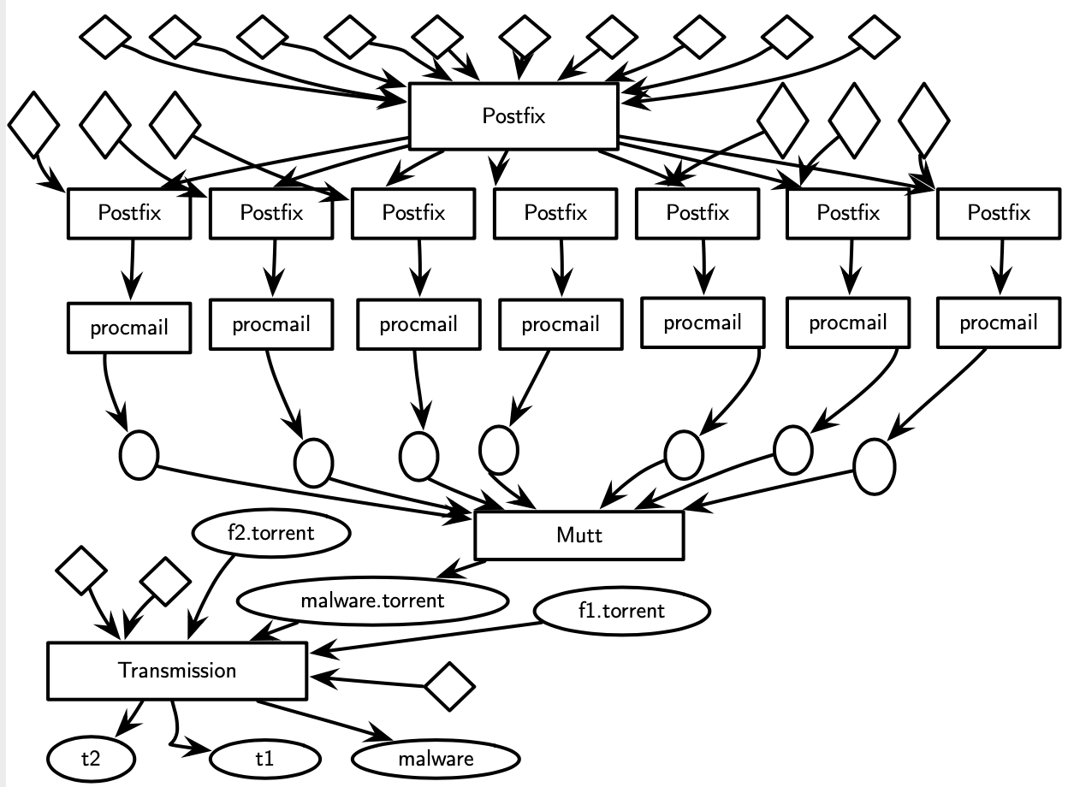
Case Study I: System Audit

Slide 32
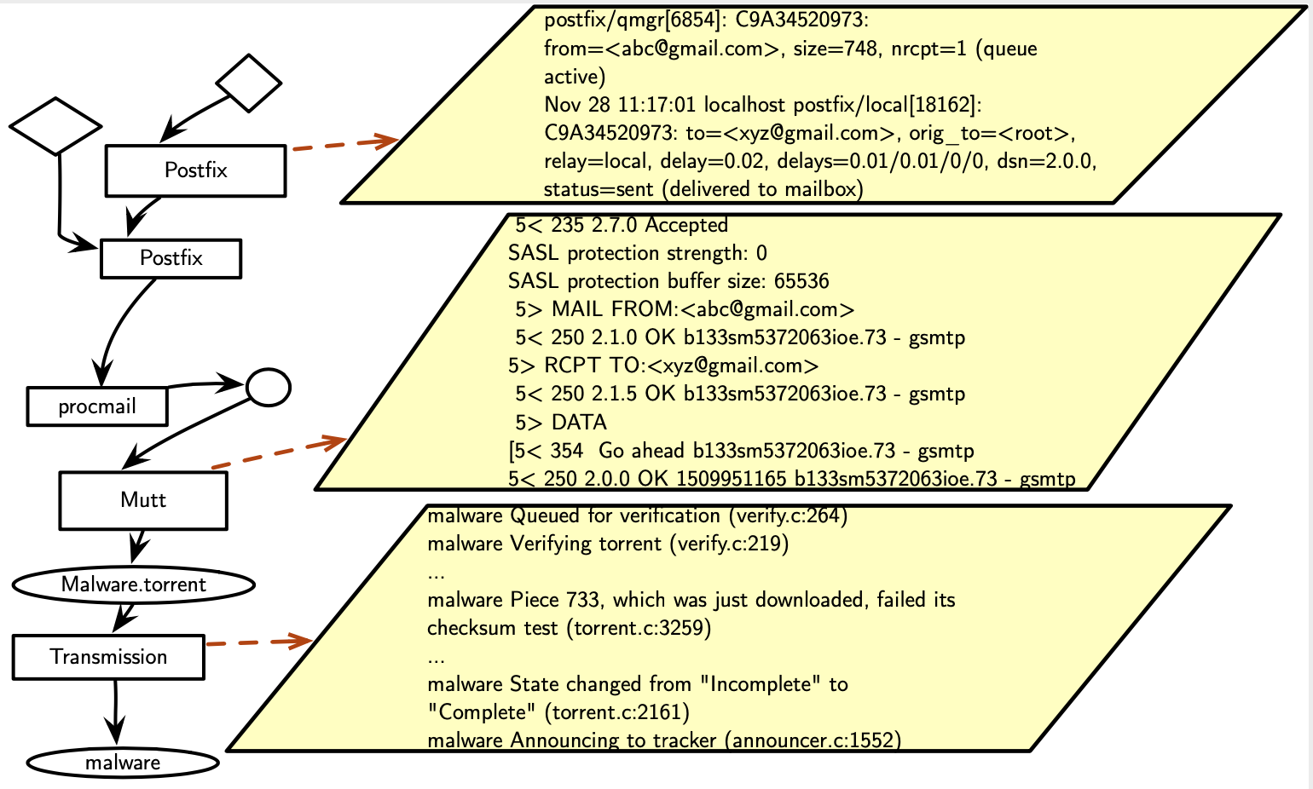
Case Study I: wLog

Slide 33
Case Study II: Website Defacement
An attacker gains unauthorized access as an admin to a web server
The attacker uses the stolen credentials to launch a website defacement attack by modifying index.html
The security analyst would like to investigate the source of the attack.

Slide 34
Case Study II: System audit

Slide 35
Case Study II: wLog

Slide 36
Conclusions
RQ1: Client puzzles can be made effective using a combination of
  Theoretical studies and modeling
  Practical considerations and evaluation
RQ2: Enhance auditing by grafting system logs with application logs
Kernel Patch: https://github.com/nouredd2/linux
DETER scripts: https://github.com/nouredd2/puzzles-utils

Slide 37
wLog’s architecture

Slide 38
Queueing: Puzzles can be Fair
Perform weighted fair queueing based on each users’ sending rate and chosen puzzle difficulty
Only need 5 bits of state per user
Limited state with expiration timers and fallback to Equilibrium behavior

Slide 39
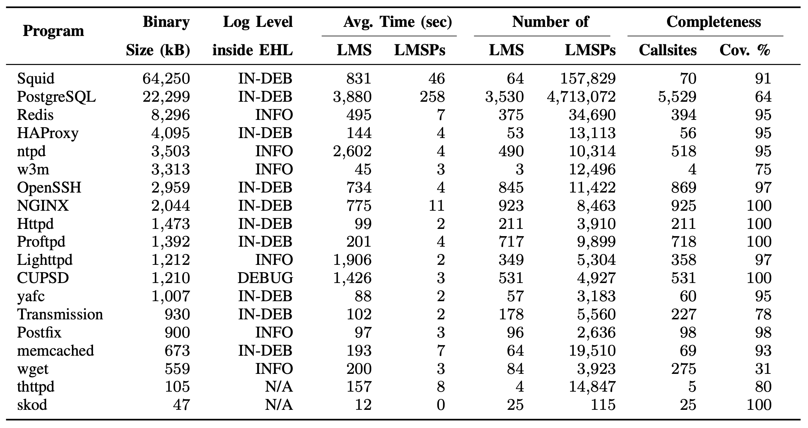
Runtime Analysis

Slide 40
The need for better forensics
Attacks are becoming more subtle and complex
  Exemplified by Advanced Persistent Threats
Actors can lurk in systems for extended periods of time
  Weeks to months of “dwell time”
We require ways to
  Trace the root-cause of a detected threat
  Explore the extent of the impact of that threat

Slide 41
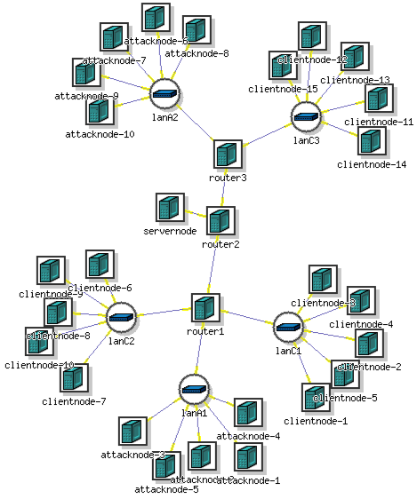
Testbed Setup: DETER Experiments
30 nodes deployment on DETER
  3 routers
  10 botnet machines
  15 clients
  1 powerful server
  1 sync server (for DETER’s management)

Slide 42
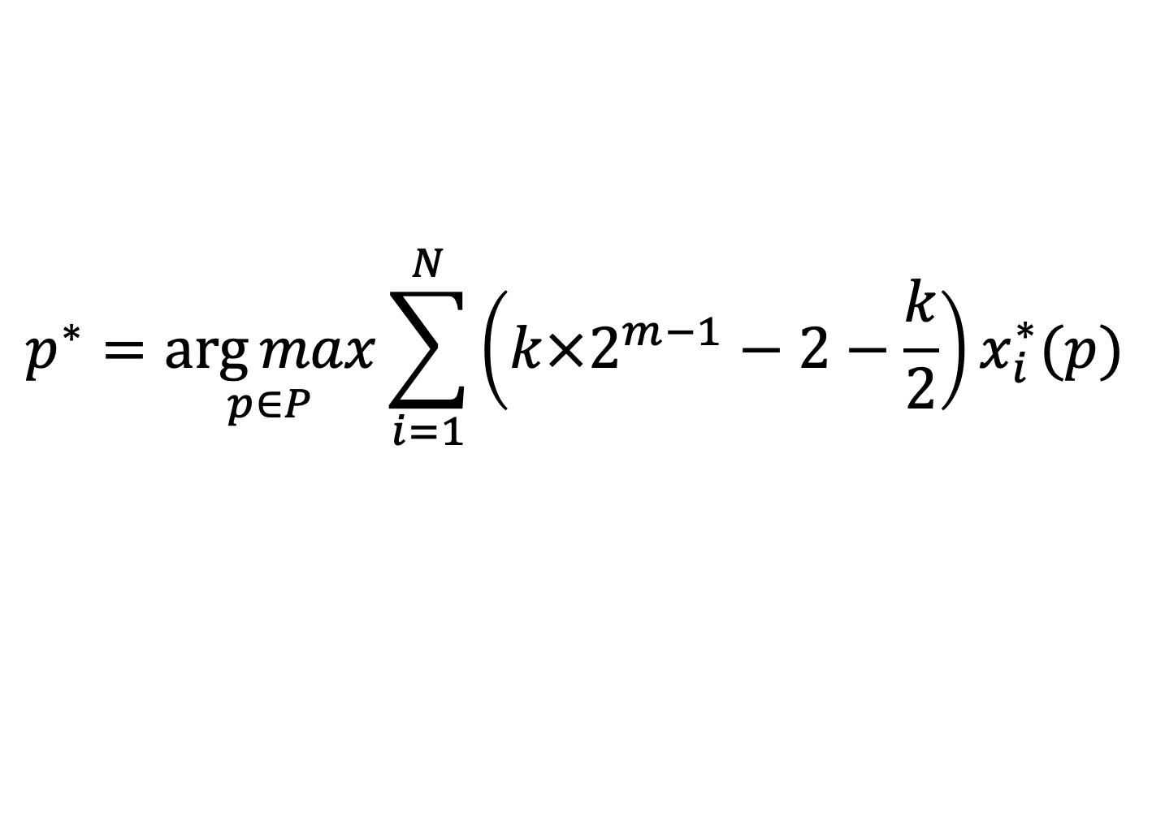
Server Utility and Optimization
Minimize time spent generating and verifying puzzle
Maximize rate-limiting impact
$$p^{∗}=\underset{p∈P}{\arg{max}}\sum_{i=1}^{N}{\left(k×2^{m−1}−2−\frac{k}{2}\right)x_{i}^{∗}(p)}$$

Slide 43
Peephole Concretization

Slide 44
Under the Hood
Server
Client
Server

Slide 45
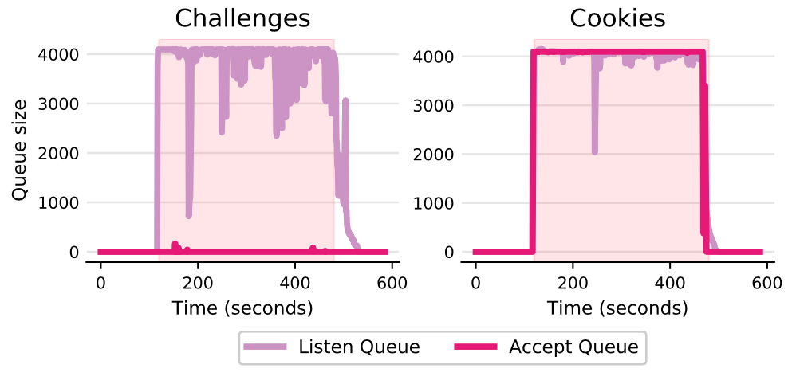
Evaluation: Room for New Connections

Slide 46
User Equilibrium
Solve for the optimal sending rate for each user I
But wait, where are the attackers?
  TCP does not and cannot really tell!

Slide 47
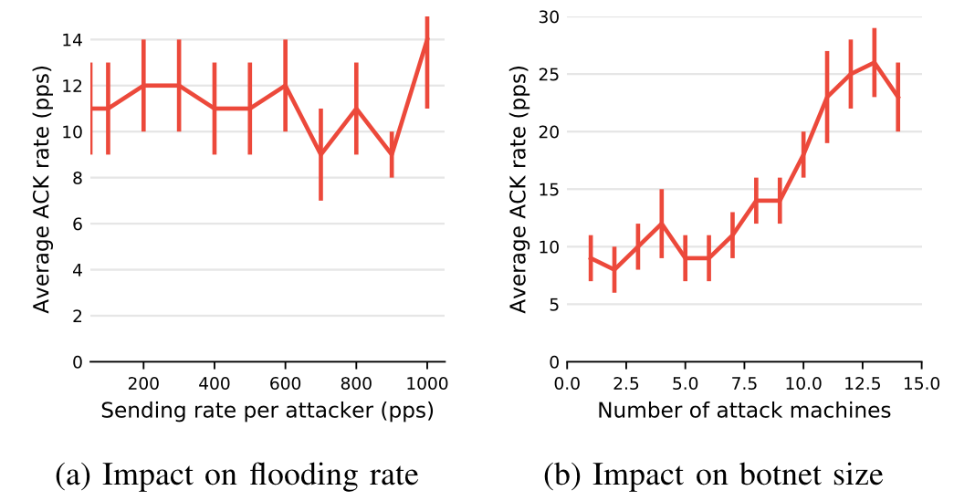
Evaluation: Need Larger Botnets

Slide 48
SYN Cookies

