Slide 1
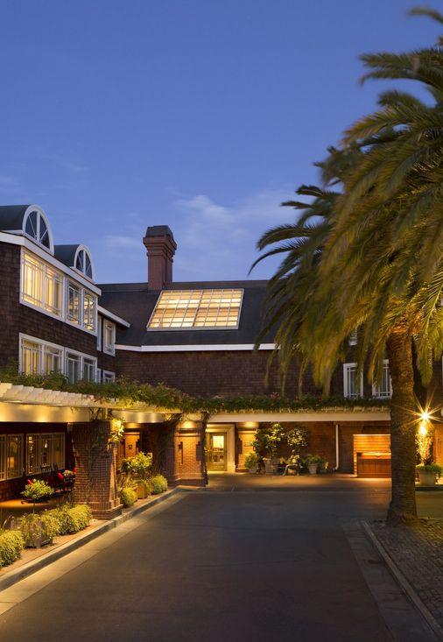
C3E FALL 2019
September 16-19, 2019
SRI International - Menlo Park, CA
Group block at the Stanford Park Hotel
https://cps-vo.org/group/c3e/registration
Registration code: GoldenPoppy!

