Slide 1
Human Machine Teaming:
The Importance of Common Ground
Corey K. Fallon
Cognitive Scientist
Notes:
Image: Abstract Data Visualization – Stock Photo

Slide 2

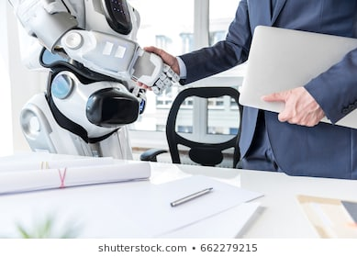
Transitioning Tools to Teammates
What are the characteristics that a machine needs to posses to be considered a true teammate?
Notes:
“Spreadsheet Document Information Financial Startup Concept" by Rawpixel.com
“Man with laptop is shaking hands with android” by Olena Yakobchuk
Cyber security areas of interest

Slide 3
Autonomy
Machine Teammate’s ability to function independently from the human
Machine Teammate that lacks autonomy
  Completely dependent on human’s direction
  Cannot take initiative
  Cannot adapt without specific directions
  Burden is on human to provide clear instruction
Levels of Automation (Parasuraman et al. 2000)
  Level 10: The computer decides everything, acts autonomously, ignoring the human
  …
  Level 5: Executes suggestion if the human approves
  …
  Level 1: The computer offers no assistance

Slide 4

Autonomy: Necessary but not Sufficient
A machine teammate with high autonomy can perform tasks independently
Does this mean the human is free to engage in other tasks?
Not Necessarily. . .
Now instead of performing the task the human has assumed the role of machine monitor.
  Humans are not good at sustained attention
  The more reliable the technology the harder it is to effectively monitor the technology
Notes:
“Overworked and tired businesswoman sleeping over a laptop in a desk at work in her office” by Antonio Guillem

Slide 5
Establish and Maintain Common Ground
Common Ground (Baber et al., 2018)
  The knowledge and assumptions that agents share and know they share
    Roles and Functions of the teammates
    Competencies of the teammates
    Task goals
    Awareness of each members concerns
  Not a complete shared awareness
Some Benefits
  Allows teammates to predict each other’s behavior
  Allows team to adapt to changes more efficiently

Slide 6


Coordination Costs are a barrier to Common Ground
Machine . . .
uses unfamiliar jargon
requires large amount of
detailed information
requires
communication in unfamiliar format
communicates at
inappropriate times

Slide 7
Communications through Cognitive Artifacts
May Reduce Coordination Cost
Nemeth et al. (2006)

Slide 8
Design Considerations to Support Common Ground: Observe
Monitor
Learn
Predict
The machine should be able to monitor its own performance, changes in the operational environment, progress toward task goals and resources available to complete the tasks.
The machine teammate should have the ability to learn task goals, new ways of performing a task and human’s work preferences both implicitly through interaction with the human and through explicit instructions from the human.
The machine should be able to anticipate the human’s actions, needs and upcoming events based on what it monitors and learns about the human’s preferences and the task environment.

Slide 9
Design Considerations to Support Common Ground: Communicate
Practice Etiquette
The machine’s communication with the human should be consistent with the norms, expectations and terminology used by the human.
The cost in time and energy required for the human to communicate with the machine teammate should be minimal.
The machine should be able to communicate its rational for its actions and recommendations as well as its status, knowledge of the team, task and environment to the human teammate in multiple modalities.
When the machine must adapt to new events or challenges in the task environment, it should communicate its change in a predictable way.
Control Cost
Be Observable
Adapt Consistently

Slide 10
Design Considerations to Support Common Ground: Act
Direct
The machine should be able to direct the human when appropriate, including directing the human’s attention to important developments.
The machine should be able to flexibly take direction from the human such as responding to new goals and task assignments administered by the human.
The machine should be given autonomy to offer support and act without specific, explicit instructions and oversight from the human when task demands require the machine’s unique strengths.
Be Directable
Take Initiative

Slide 11
Some Cyber Security Use Cases
A Machine Teammate to Help Manage Alerts
  Cyber analysts are inundated with alerts
  A machine teammate could act independently of the human to triage and prioritize alerts
  Importance of Common Ground
    The machine teammate must be able to communicate its reasoning and process for prioritization
A Machine Teammate to assist with selecting the appropriate analysis or analytic
  May be challenging for the analyst to choose the appropriate tool or analytic
  A machine teammate could provide recommendations to the analyst
    Machine would have access to a database of analytics, visualizations.
    Recommendations based on associations between this information and various tasks and problems investigated by analysts.
  Importance of Common Ground
    Machine teammate must have knowledge of the task goals and current activities

Slide 12
Some Cyber Security Use Cases (cont.)
A Machine teammate that tracks and displays both the human’s and machine’s information provenance.
  The analyst needs to document the team’s analysis path to help build an argument for a particular conclusion
  Analyst needs to calibrate trust in their machine teammate
  The machine teammate can preserve and present information about past analysis activities
    Saves time by helping analyst build a narrative of their findings
    Helps analyst understand machine teammate’s process (i.e. facilitate trust calibration)
  Importance of Common Ground
    The machine teammate must be able to monitor team progress and process
Nguyen et al. 2016

Slide 13
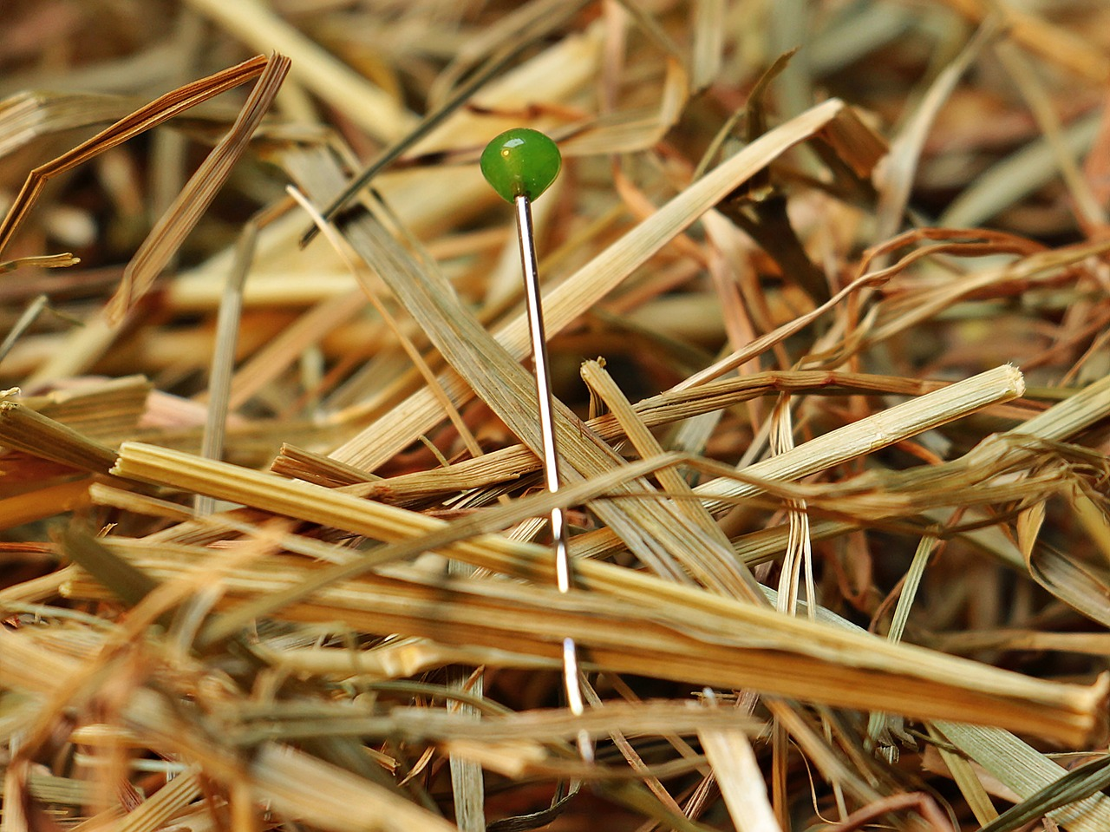
Some Cyber Security Use Cases (cont.)
A Machine teammate that helps analyst separate signals from noise.
  Analyst tasked with identifying cyber security threats is inundated with data (e.g. hundreds of thousands of records)
  A machine teammate can assist with information acquisition by highlighting the most relevant indicators of a potential threat.
  Importance of Common Ground
    Machine teammate must have knowledge of the indicators of a potential cyber threat
    The machine teammate must be able to communicate its reasoning and process for determining which data rise to the level of concern.

Slide 14
References
Amershi, S., et al., (2019). Guidelines for human-AI interaction. CHI.
Baber, C., Cook, K., Attfield, S., Blaha, L., Endert, A., Franklin, L. A (2018). Conceptual Model for Mixed-initiative Sensemaking. CHI Sensemaking Workshop, 1 – 8
Bruemmer, D.J., Walton, M.C. (2003) Collaborative Tools for Mixed Teams of Humans and Robots. Idaho National Engineering and Environmental Lab, Idaho Falls
Johnson, M., Bradshaw, J. M., Feltovich, P. J., Jonker, C. M., Riemsdijk, M. B., Sierhuis, M. (2014). Coactive Design: Designing support for interdependence in joint activity. Journal of Human-Robot Interaction.
Klein, G., Feltovich, P. J., Bradshaw & Woods, D. D. (2005) Common ground and coordination in joint activity In W.R. Rouse & K.B. Boff (Eds.), Organizational simulation. New York: Wiley. 139-178.
Klein, G., Woods, D. D., Bradshaw, J. M., Hoffman, R. R. & Feltovich, P. J. (2004). Ten challenges for making automation a “team player” in joint human-agent activity. IEEE Intelligent Systems.

Slide 15
References (cont.)
Lyons, J.B., Mahoney, S., Wynne, K.T., Roebke, M.A. Viewing Machines as Teammates: A Qualitative Study. (2018) In: AAAI Spring Menlo Park, CA: AAAI
Miller C.A. Human-computer Etiquette: Managing Expectations with Intentional Agents. (2004) Communications of the ACM, 47(4), 31–34
Nemeth, C., O’Connor, M., Klock, P. A. & Cook, R. (2006). Discovering healthcare cognition: The use of cognitive artifacts to reveal cognitive work. Organizational studies, 27(7): 1011-1035.
Nguyen et al. (2016). SenseMap: Supporting browser-based online sensemaking through analytic provenance. IEEE Conference on Visual Analytics Science and Technology (VAST), 23-28
Parasuraman, R., Sheridan, T.B., Wickens, C.D. (2000) A Model for Types and Levels of Human Interaction with Automation. IEEE Transactions on Systems, Man, and Cybernetics Part A: System and Humans 30(3), 286- 297

Slide 16

Corey Fallon
Cognitive Scientist
Visual Analytics
corey.fallon@pnnl.gov
www.pnnl.gov

Slide 17
Back Up

Slide 18
High-Level Dimensions
Machine
Teammate
?
?
Cost Control
Shared Mental Model
Attention Management
Mutual Predictability
Goal Negotiation
Agency
Benevolence

Slide 19
Common Ground and Autonomy:
Two High-Level Dimensions
Machine
Teammate
Common
Ground
Autonomy
Hypothesized
Relationship
Cost Control
Shared Mental Model
Attention Management
Mutual Predictability
Goal Negotiation
Agency
Benevolence

Slide 20
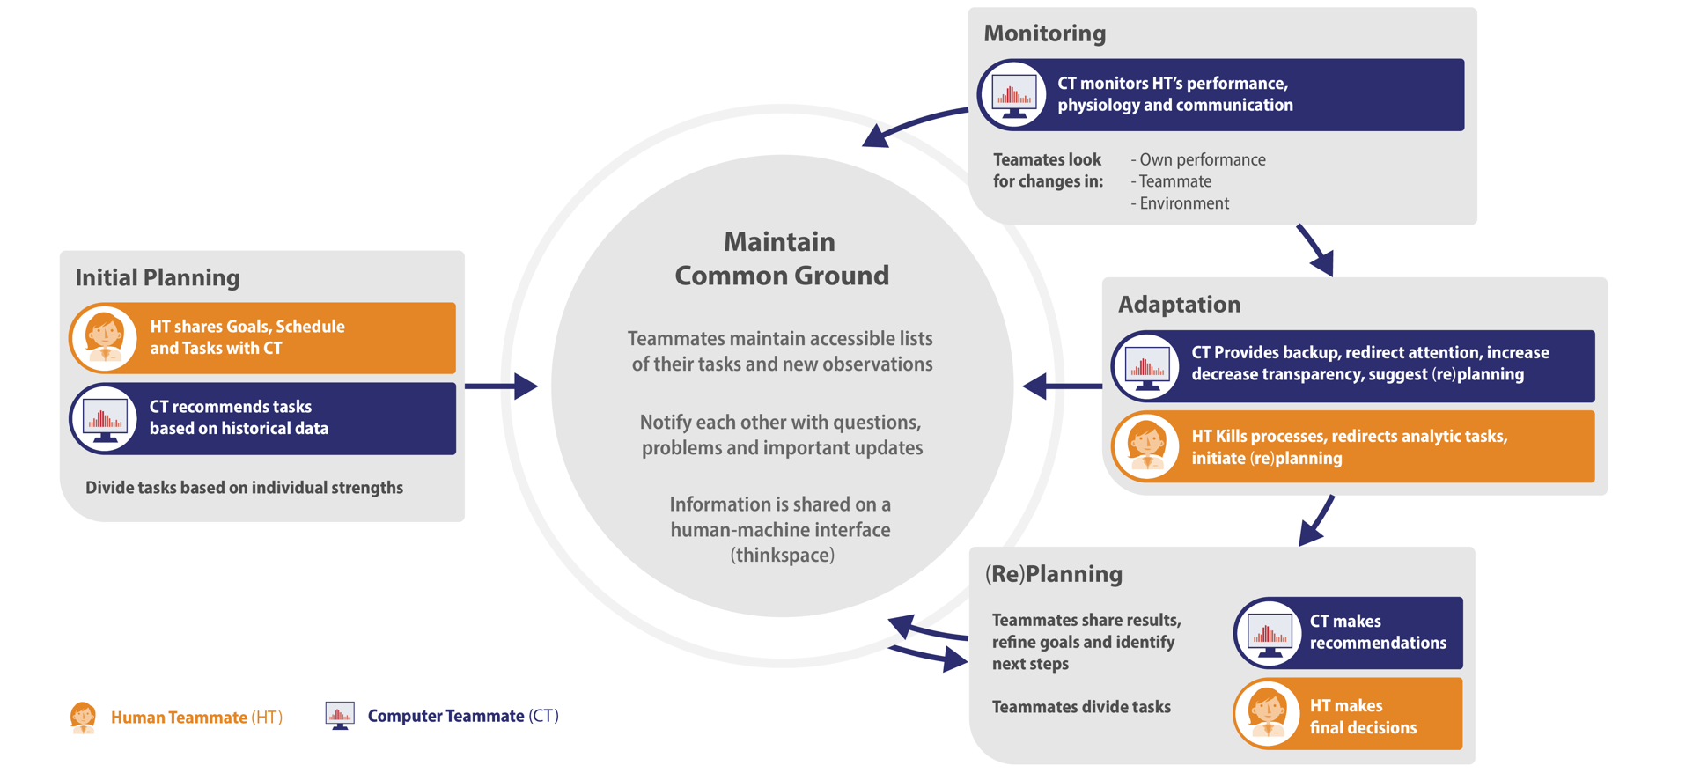
Maintaining Common Ground
Common Ground is in a constant state of decay and must be maintained Klein et al. (2005)

