Slide 1
Decision Making and Risk Management Track
Antonio Sanfilippo
Pacific Northwest National Laboratory

Slide 2
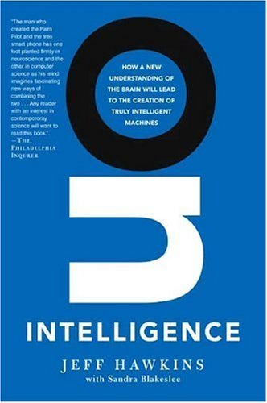
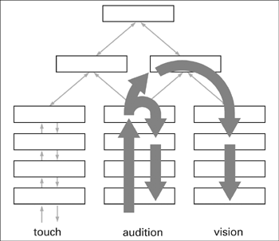
Memory and Prediction Form the Foundations of Human Intelligence
The human brain provides a unique framework for memory and prediction
Information flows up and down sensory hierarchies in the neocortex to form predictions and create a unified sensory experience
Notes:
There is now strong evidence from biophysics and neuroscience that human intelligence emerges as a framework for memory and prediction based on the hierarchical structure of the neocortex. The different layers of such a framework provide a mechanism in which data acquired through sensory perception are organized into information patterns through a process of abstraction. These patterns are stored in our brain and form our experiential knowledge – things that we sensed and done. If a response is needed by the organism, e.g. we need to cross the street or make a telephone call, we match the pattern that describes the situation we are in with those pattern stored in our brain which form our experiential knowledge and use what seems to us the best match to project from in order to take the most appropriate action.

Slide 3
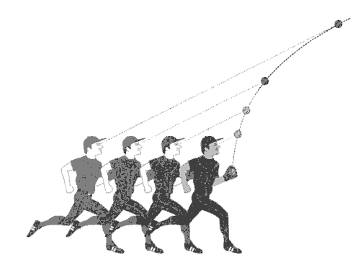
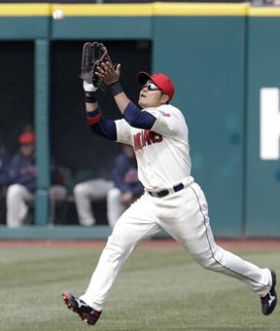
Human Decision Making ⬅ Experience + Perception + Creativity
Human decision making emerge as a process of
Pattern storage
Recognition
Projection.
This process is rooted in our experience of the world and driven by perception and creativity
?
Notes:
So, human decision making emerges as a a process of pattern storage, recognition and projection. This process is rooted in our experience of the world and driven by perception and creativity. The last two words are very important. There is now strong evidence that the human brain does not work in a mathematical, logical or even statistical way, and the science of decision making has been moving steadily from rational choice models to more behavioral and most recently naturalistic models. Consider the simple case of a baseball player catching a flying ball. Given the limited processing power os the neocortex (seven slices of tissue, each the size of a credit card) it is extremely unlikely that the baseball player is making any complex calculation to figure out the trajectory of the ball. Rather, the player continuously monitors the trajectory to find in his experiential knowledge of flying ball catching which is the best way of responding. Being a baseball player, his experiential knowledge in this area would be quite developed as opposed to a laymen; so his flying ball catching abilities largely surpass those of the neophyte or amateur player.

Slide 4
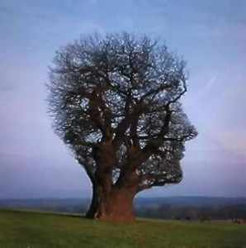
Intuition and Human Decision Making
The ability to focus “in the moment” and take quick decisions by insight and intuition make human judgment uniquely effective
Intuition and concepts constitute... the elements of all our knowledge (Immanuel Kant)
The only real valuable thing is intuition (Albert Einstein)
… much of our mental life is based on processes alien to logic: gut feelings or intuitions (Gerd Gigerenzer)
Intuition – We can’t trust it, but we can’t live without it (Gary Klein)
Notes:
So it is the ability to focus on the situation of concern and take quick decisions that make human decision making so uniquely effective. Just think of an experience fireman or warfighter: in an emergency situation there is no time for in-depth analysis and one must rely on intuition. This has long been recognized: as Gigerenzer (NDM guy) says much of our mental life is not based on logic but on intuition and gut feeling – or insights, as was characterized in gestalt pshychology. Intuition: we can live without it but at the same time we can’t fully trust it.

Slide 5
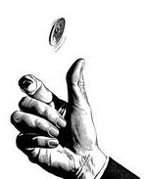
Limitations on Human Reasoning due to Cognitive Biases ?
Patterns of deviation in judgment that occur under risk (Kahneman and Tversky)
Simple heuristics that help balancing between judgment effectiveness and use of cognitive-processing and information resources can bias our judgment
Positive framing experiment
200 people are saved out of 600
All the people are saved (1/3 probability), or all die (2/3 probability)
Most subjects chose A over B
All the people are saved (1/3 probability), or …
400 of the 600 people die
Most subjects chose B over C, even though C=A
Notes:
Since K&T pioneering work on the psychology of decision making, there has bee increasing experimental evidence that human reasoning cab be hindered by cognitive biases. As we were discussing earlier, people used simple matching heuristics to achieve the best judgment effectiveness which saving on processing and information resources. Especially when decision making occurs under risk these heuristics can lead to cognitive biases that trigger patterns of deviation in our judgment. For example, in one of the experiments T&K carried out (reported in 1981) subject were first asked to choose between a disease outbreak recovery program A that would same 200 of 600 people, with program B that would save all with a 1/3 probability and none with a 2/3 probability. Most people chose the first program – the assurance that 200 people would be saved was judged as more appealing than the 2/3 possibility that all would die. However, when asked to choose between program B and program C in which 400 would die, most chose B even through A=C.

Slide 6
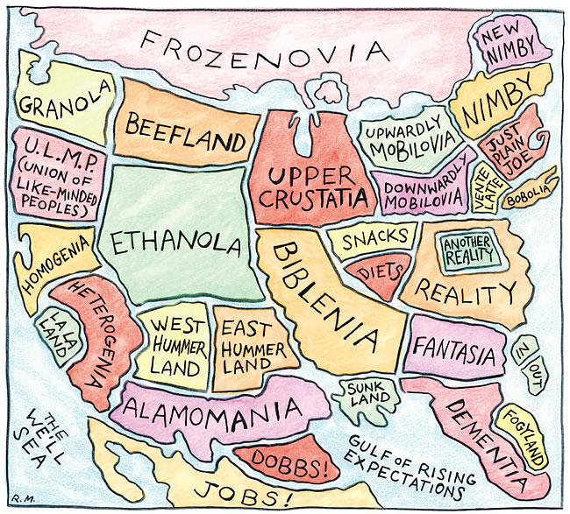
Limitations on Human Reasoning due to Cultural Biases
Our perception of risk reflects our individual commitment to specific cultural values, as opposed to alternative ones (Douglas and Wildavsky)
For example, the risks of HPV vaccination to prevent cervical cancer are more willingly accepted by those whose belief system is less concerned with the possibility that HPV vaccination may encourage adolescents to sexual promiscuity
Notes:
Cultural biases constitute another important limitation on human decision making. As Douglas and Wildavsky elaborated in the cultural theory of risk perception, our perception of risk is determined by our individual commitment to specific cultural values rather than others. For example, the risks of HPV vaccination to prevent cervical cancer are willingly accepted by those whose belief system is less concerned with the possibility that HPV vaccination may encourage adolescents to sexual promiscuity.

Slide 7
Over 100 Cognitive and Cultural Biases Have Been Identified*
Social biases
Group thinking, herd instinct, self-fulfilling prophesy, ultimate attribution error, …
Memory biases
Hindsight bias, cryptomnesia, reminiscence bump, rosy retrospection, …
Decision Making biases
Neglect of probability, positive framing, illusion of control, focusing effect, …
Probability/belief biases
Gambler fallacy, ostrich effect, recency effect, stereotyping, well-traveled road effect, …
*http://en.wikipedia.org/wiki/Cognitive_biases
Notes:
More than 100 cognitive and cultural biases have been discussed in the literature on decision making.

Slide 8
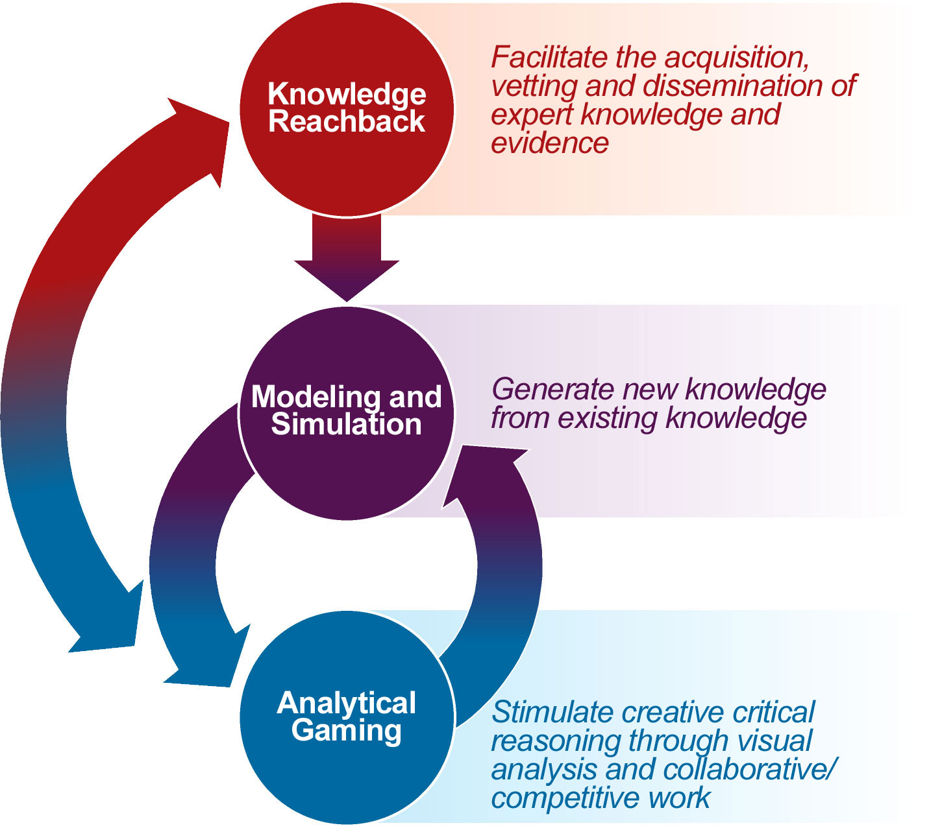
Increase the Effectiveness of Human Decision by Eliminating/Mitigating Biases
Provide additional information when needed
Stimulates creative critical reasoning through collaborative and competitive work
Use computer intelligence to enhance the human decision making process
Notes:
So the question is how can we best exploit the gifts of human decision making while eschewing patterns of deviation on human judgment cause by cognitive and cultural biases? Two main avenues: provide more information when there is not enough experiential knowledge. Stimulate creating critical reasoning through collaborative work. Information technology can help with both.

Slide 9
Questions We Will Address at this Workshop
What aspects of decision-making and risk management are unique to cybersecurity?
What are the parallel analytic strengths and pathologies in cyberspace and how do they manifest themselves?
How do cognitive and cultural biases affect human decision-making in cybersecurity?
Methods and practices
What methods can be used to reduce human biases on decision-making in cybersecurity? E.g. social intelligence techniques such as crowdsourcing
What aspects of social networking can be applied to cybersecurity for predictive analysis or problem solution?
How can methods and practices that improve human decision-making be applied by cybersecurity practitioner?
Are these methods and practices within reach?
What technologies can implement these methods and practices?
Will these technologies be accepted by cybersecurity practitioners?

Slide 10
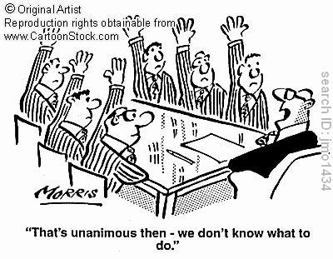
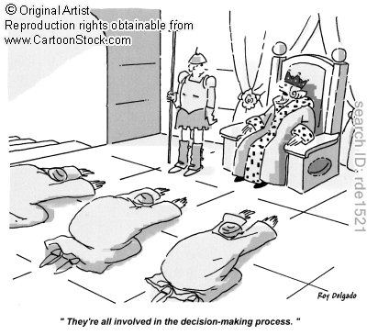
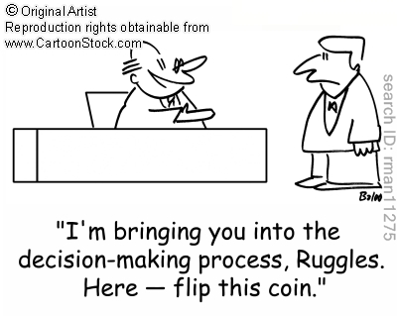
Thank you!

Slide 11
Track Discussion
Refine and add questions (if needed)
Take a question at a time
Discuss
Summarize discussion
Schedule
Monday 15:30 – 17:00 (Q1, Q2)
Tuesday 09:30 – 12:00 (Q2, Q3)
Tuesday 13:00 – 15:30: (Q3, Q4)
Wednesday 09:30 – 11:00 (tie loose ends and finalize track report)

