Slide 1

Developing the Foundations for a Science of Security and Privacy
Adam Tagert Ph.D.
actager@tycho.ncsc.mil
Science of Security & Privacy Technical Director
National Security Agency

Slide 2
Introduction
What is the Problem
What is Science?
3 Themes
Research Focus Areas
Become Involved

Slide 3
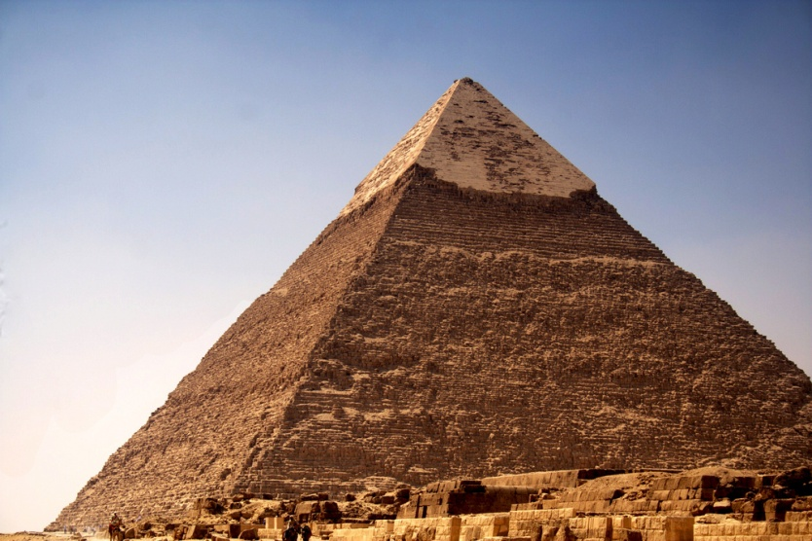
What is the Problem?
Best Practices
Do it Twice -> Possibly Different Results
Need to Move to Scientific Sound Approach
Science Needs to Catch up with the Engineering
https://www.flickr.com/photos/digitalurbanlandscape

Slide 4
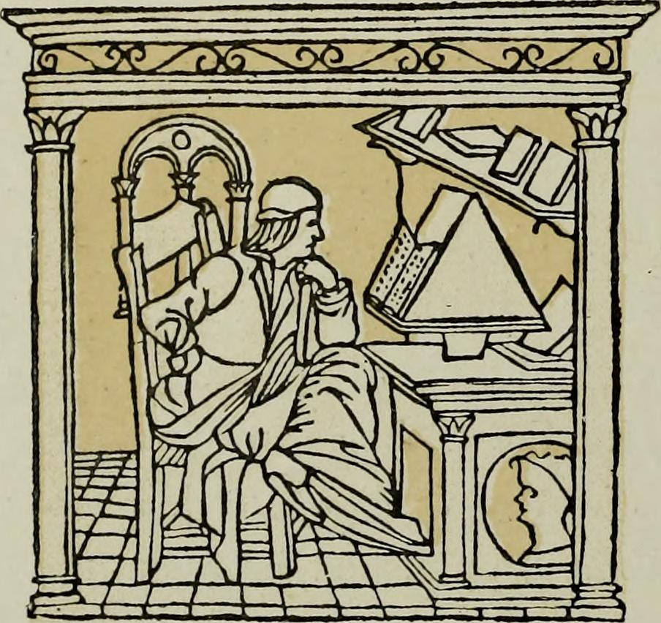
Science is…
A Philological Unanswered Question
Definition is mushy
Our goal with science:
  Rigorous Research
  Generalizable
  Predictable
  Foundational
  Explains the World/Cyberspace

Slide 5
Tackling the Problem
In the 2000s, recognition of problem
CNCI jump start funding
NSA signed up to lead the effort for the USG
Started in 2012

Slide 6
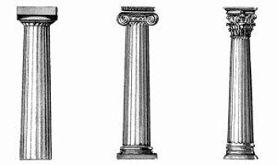
3 Pillars of
Nurture and Grow the SoS Community
Support Rigorous Research Methods
Fund Needed Foundational Research

Slide 7
1. Nurture and Grow Science of Security & Privacy Community

Slide 8

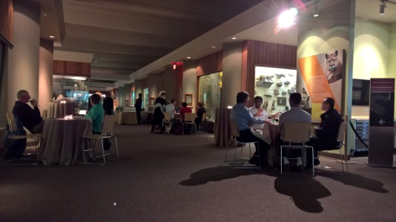
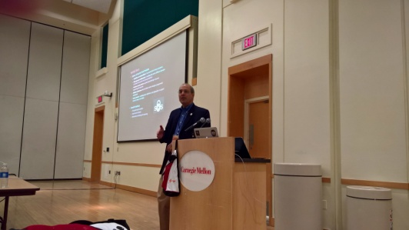

HoT-SoS
Annual Community Meeting: HoT-SoS
  Hot Topics in the Science of Security: Symposium and Bootcamp in the Science of Security
Brings Academia, Industry, Gov together
Usually in April
ACM In-cooperation
2017 -> In Maryland

Slide 9
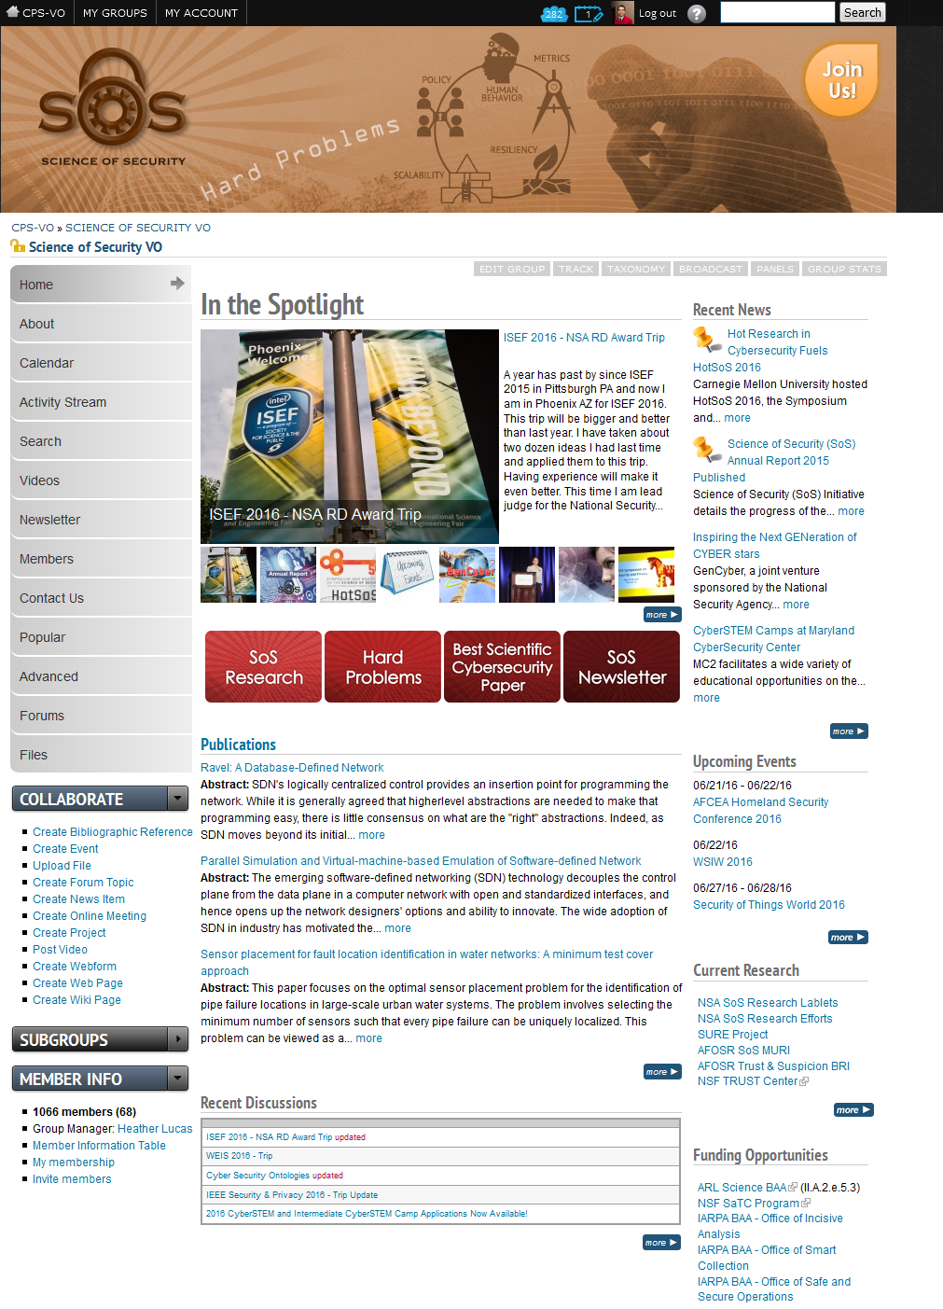
Virtual Organization
Online Collaboration on NSF Virtual Organization Platform
News, Publications, Research, Forums, Events, Collaboration
1000+ Members Joined
http://www.sos-vo.org

Slide 10
Workshops, Internships, Outreach
Other activities host workshops; have interns
Support other programs such as conferences
Curriculums
Graduating Students spread the culture

Slide 11
2. Promote Rigorous Research Methods

Slide 12

Best Scientific Cybersecurity Paper Competition
Annual Competition
Papers reviewed by NSA & External Distinguished Experts
Open to All
Papers Nominated by Public
Researchers visit NSA and Present Research

Slide 13
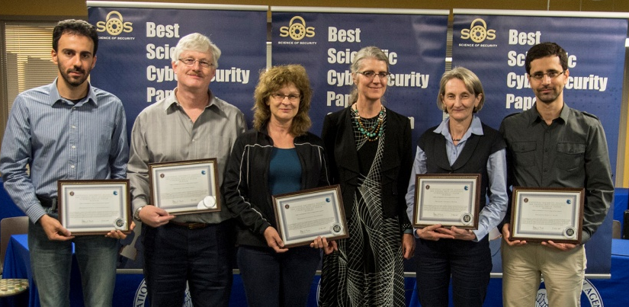
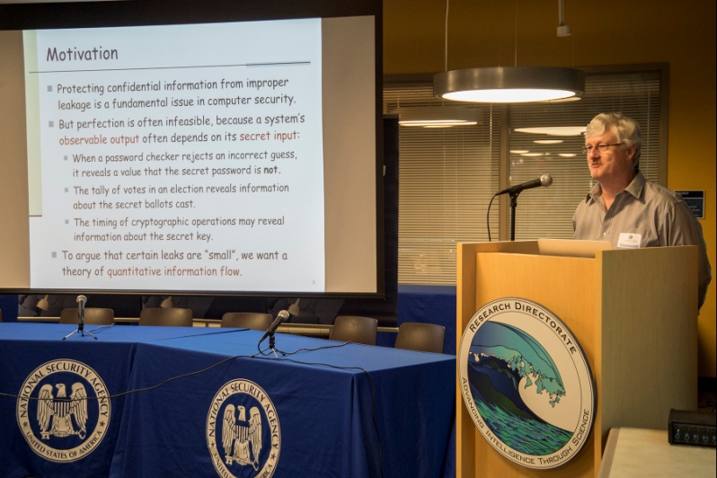

3rd Annual Competition
Additive and Multiplicative Notions of Leakage and Their Capacities, by Prof. Mario S. Alvim... (CSF)

Slide 14
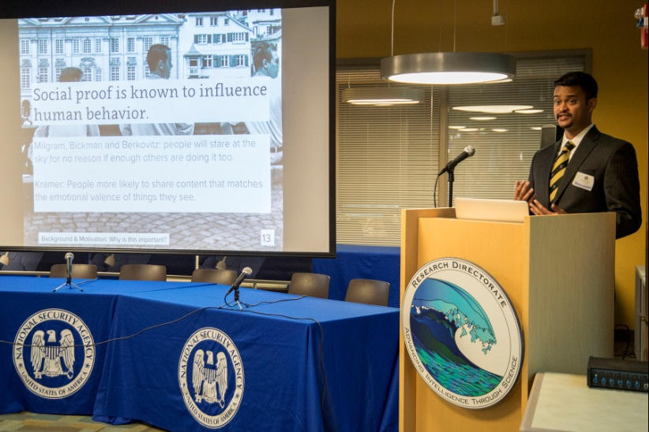
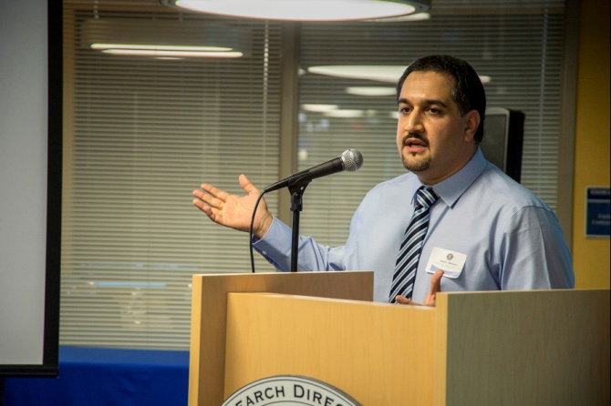
Also Honorable Mentions
Increasing Security Sensitivity with Social Proof: A Large-Scale Experimental Confirmation," by Sauvik Das…
Quantitative Evaluation of Dynamic Platform Techniques as a Defensive Mechanism,“ by Dr. Hamed Okhravi

Slide 15
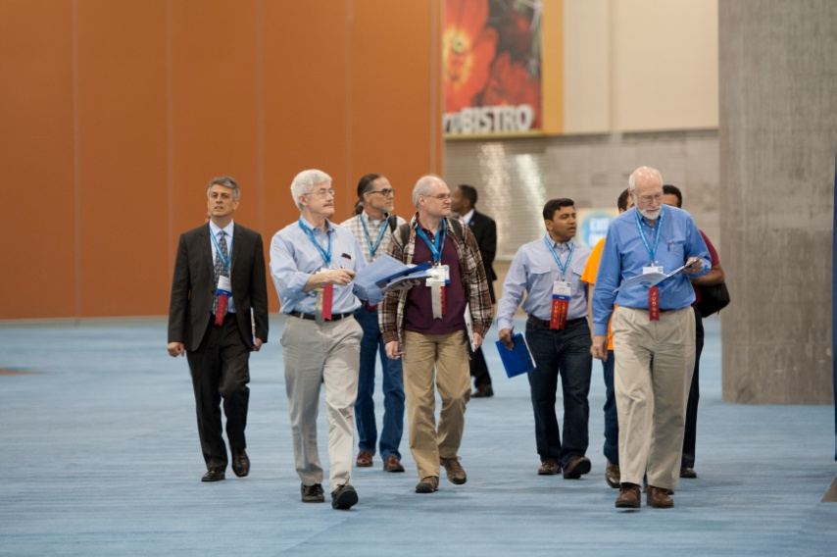

Intel ISEF
NSA Research Directorate Award at Intel International Science and Engineering Fair (ISEF)
Present Award to High School Research Projects in Cybersecurity

Slide 16
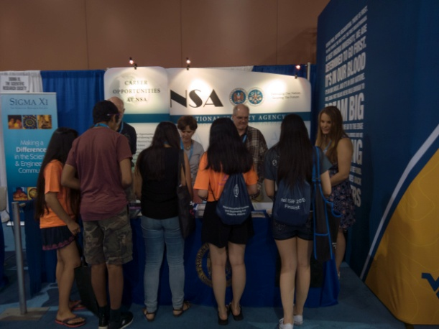
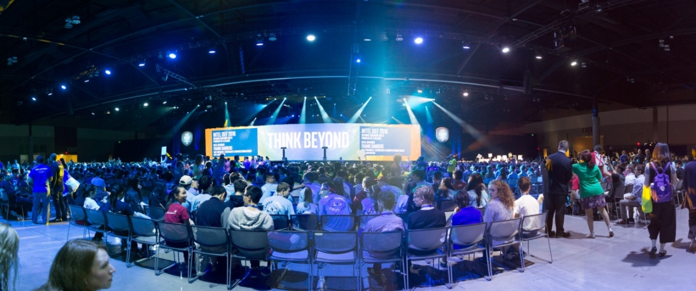
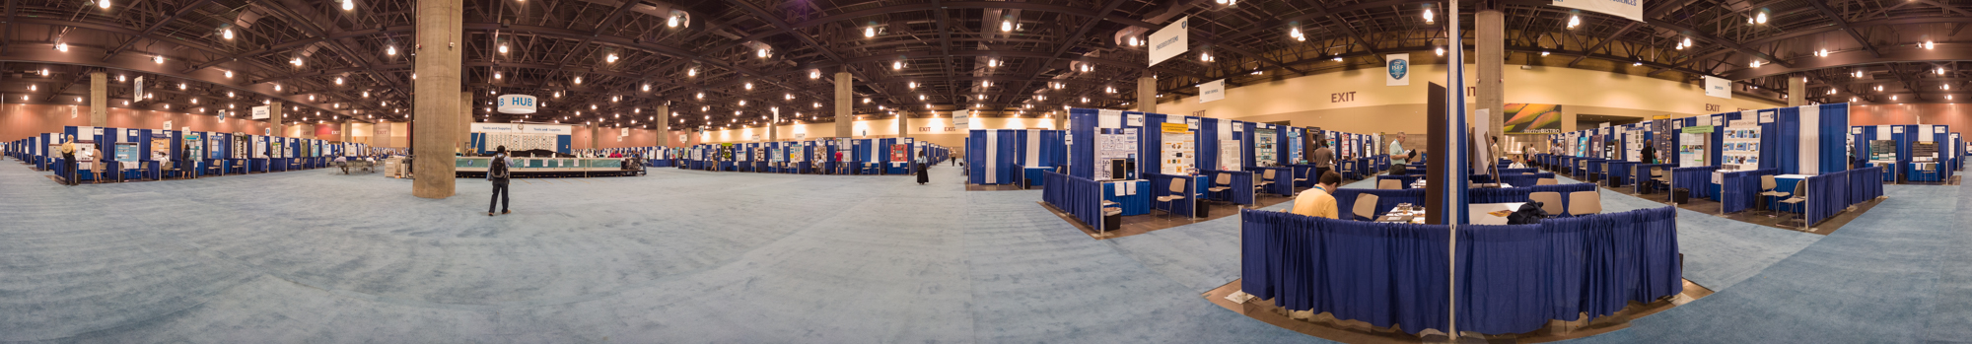
ISEF 2016
1750 Students; 80 Countries; Phoenix
4,000 Local Students Visit Plus others

Slide 17
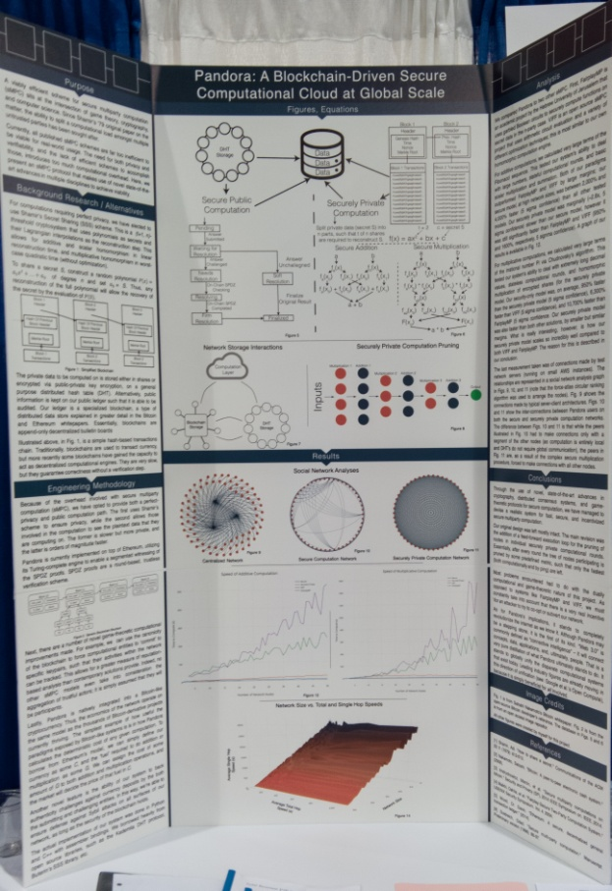
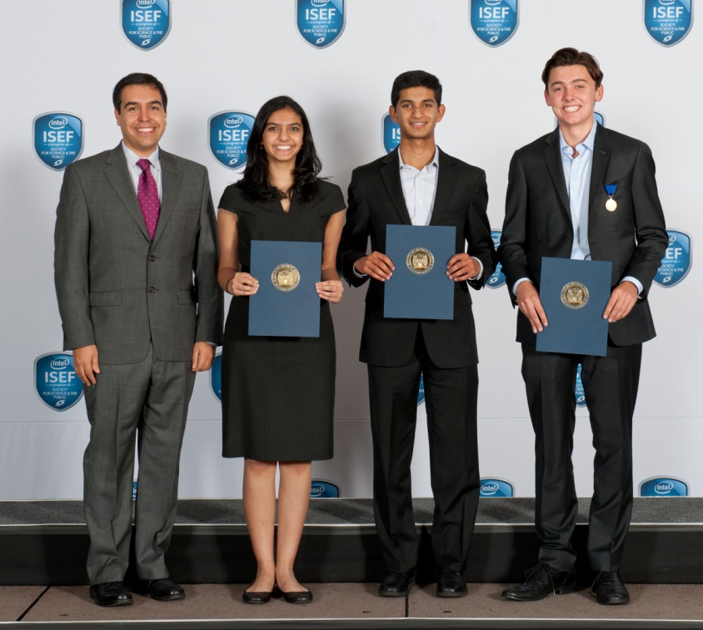
1st Place - $3,000
  Charles Noyes from Villa Park California for Efficient Blockchain-Driven Multiparty Computation Markets at Scale

Slide 18
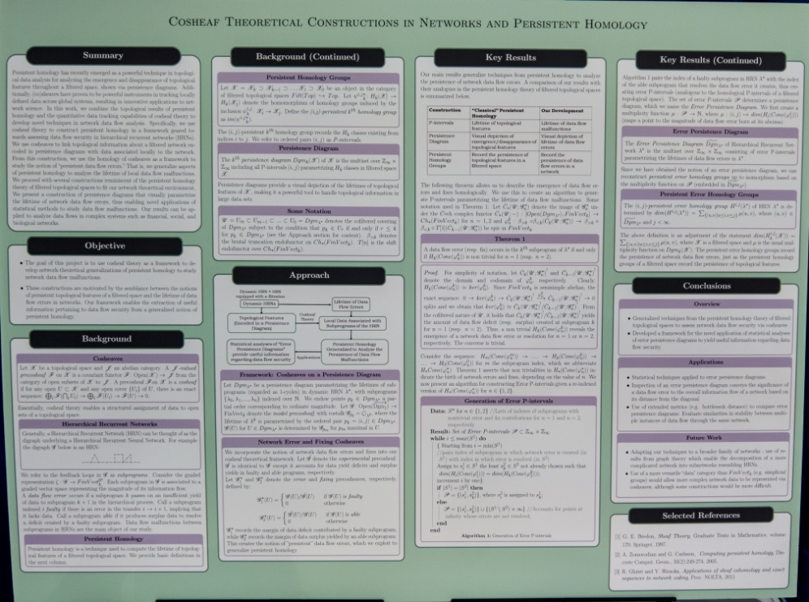
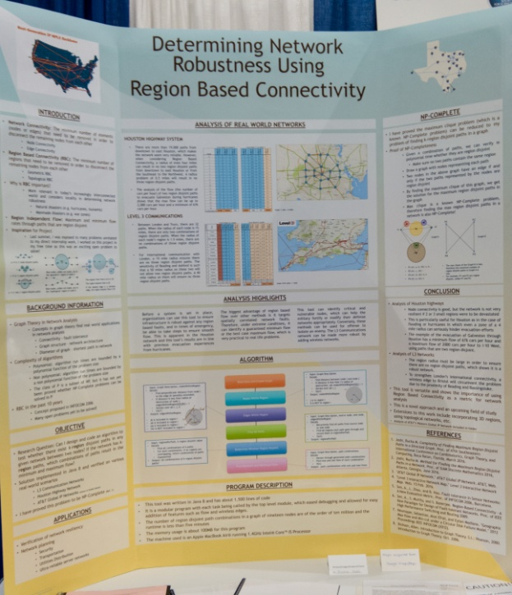
2nd Place - $1,000
  Karthik Yegnesh from Lansdale Pennsylvania for Cosheaf Theoretical Constructions in Networks and Persistent Homology
  Rucha Joshi from Austin Texas for Determining Network Robustness Using Region Based Connectivity

Slide 19
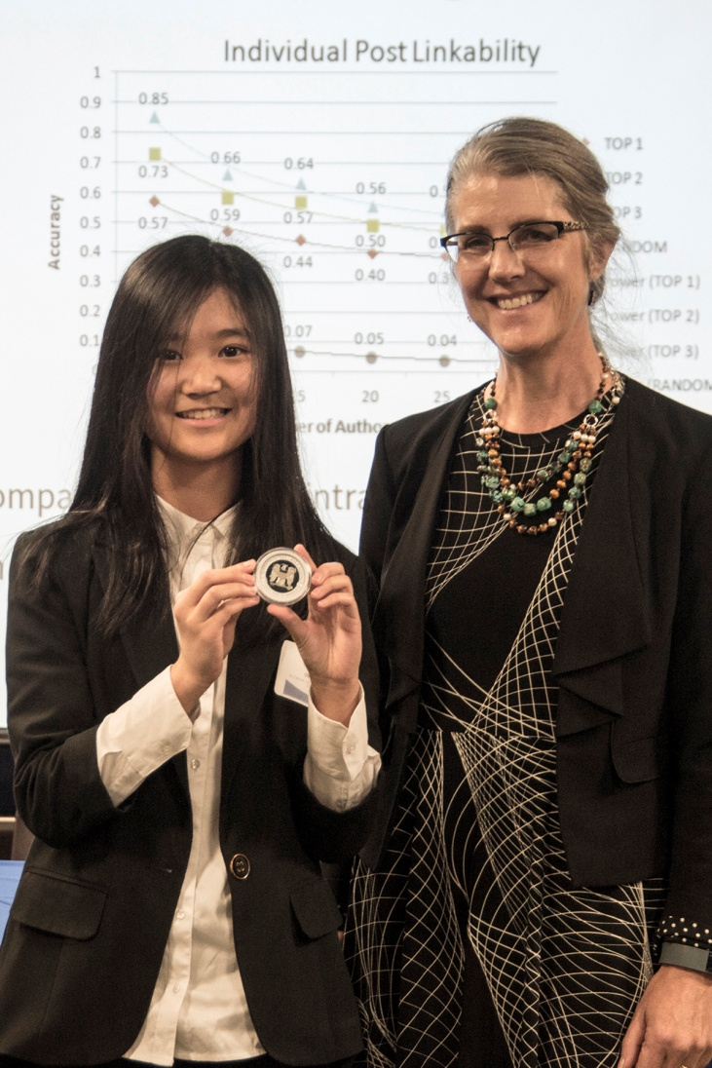
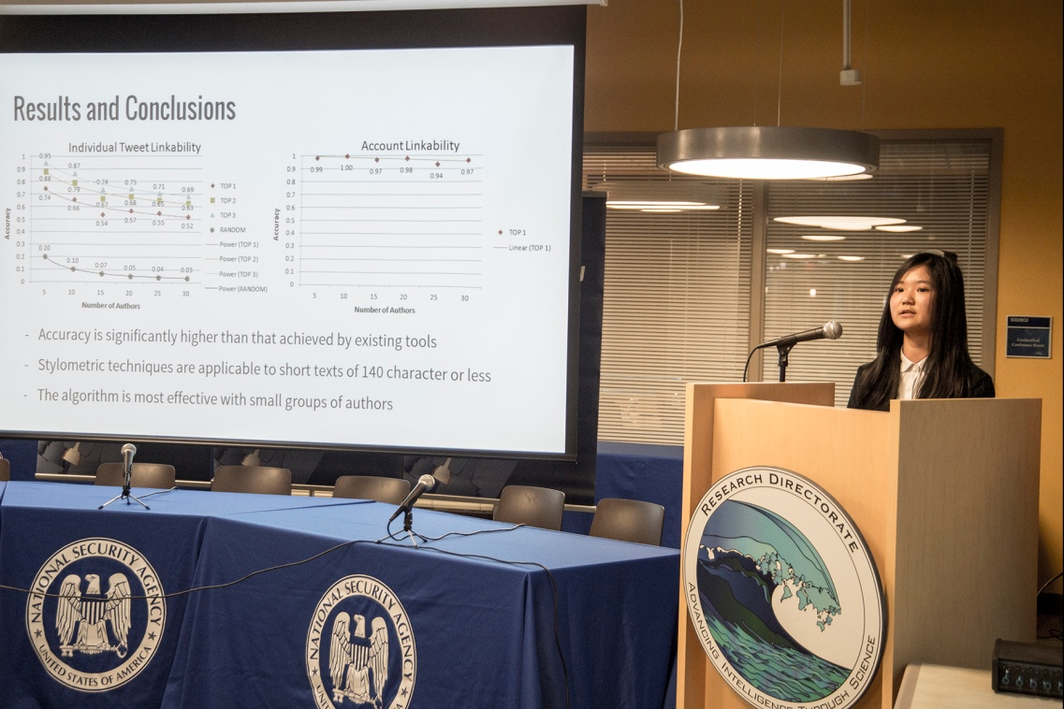
Visit NSA

Slide 20
3. Invest in Foundational Research

Slide 21





4 Lablets
Lablet – a small transdiciplinary lab
Competitive Selection
Began 2012 using an ARO grant to 3 universities
2014 – NSA contract with 4 Universities
  From a BAA
  About $8 million per year total
  20% of funding to other institutions (25 other Universities)
  For Research and to build a science
370 Published Papers

Slide 22
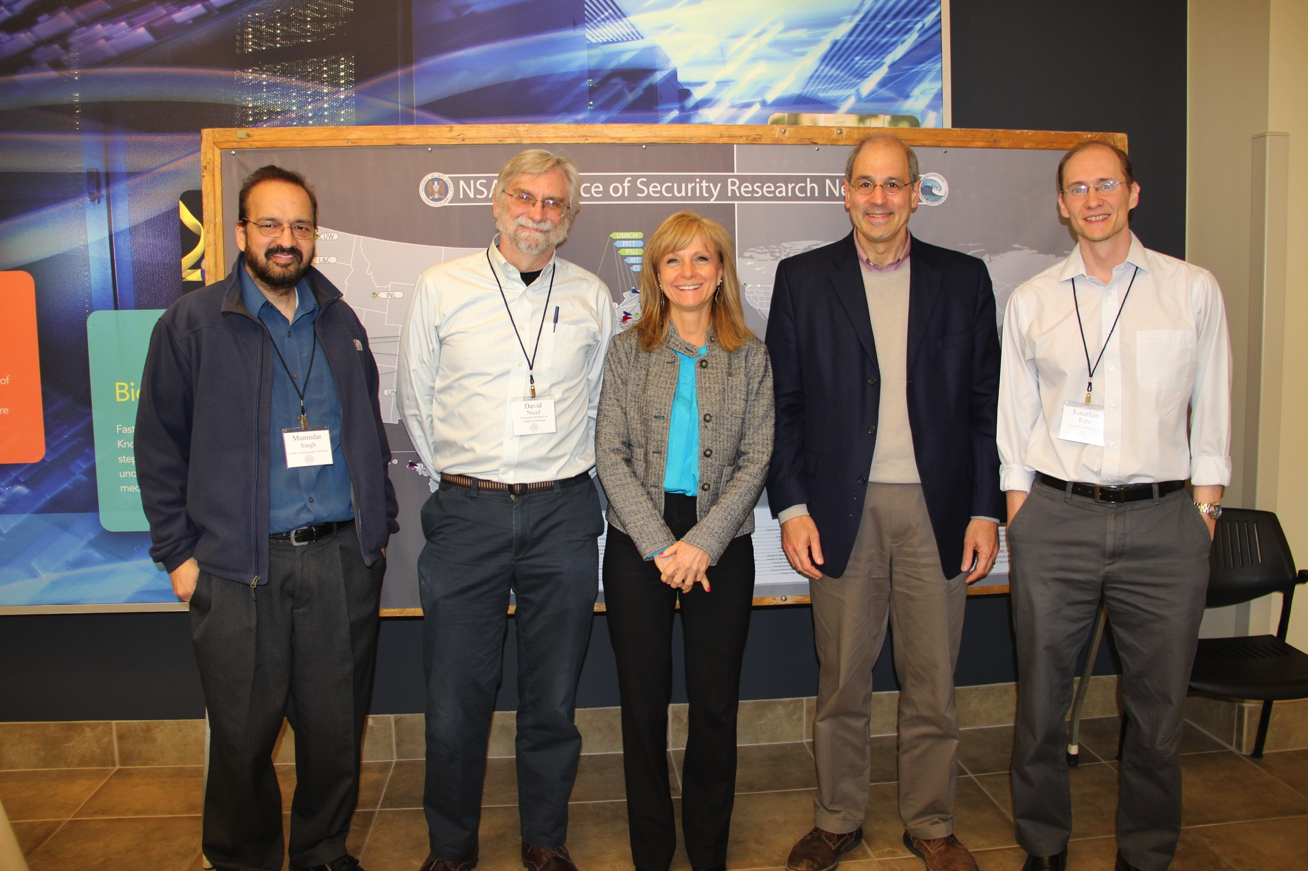
Lablet Funding Supports
Research
Salaries and/or Tuition of Professors, Researchers, Post-Docs, Ph.D. Students, Masters Students, and undergraduate research
Outreach activities for making a science

Slide 23
Science of SecUre and REsilient Cyber-Physical Systems (SURE)
Vanderbilt (Lead) ; MIT; University of Hawaii; UC Berkeley
Foundational Research on Cyber Physical Systems
Research Thrusts:
  Hierarchical Coordination and Control
    Cyber Risk Analysis and Incentive Design – Resilient Monitoring and Control
  Science of Decentralized Security
  Reliable and Practical Reasoning about Secure Computation and Communication in Networks
  Evaluation and Experimentation
  Education and Outreach
About $1 million / year
cps-vo.org/group/sure

Slide 24

5 Hard Problems
Goals & Rallying Points
A Measure for Progress
Developed with lablet PIs
Not all inclusive
Needed for improving cybersecurity situation
Progress Paper Posted

Slide 25
Science of Security Lablets

Slide 26
Science of Security Lablets and Sub-Lablets

Slide 27
Science of Security Lablets, Sub-Lablets, SURE

Slide 28
Lablets, Sub-Lablets, SURE, and Collaborators

Slide 29
Science of Security International Locations

Slide 30
Let’s Talk Research – Focus Areas
Access Control
Analyzing Adversary Supplied Code
Anomaly Detection
Internet of Things
Mitigation Development
Mobility / Android App Development
NIDS / Firewalls
PKI
Phishing
Privacy
Real Time Monitoring
Sandboxing
Secure Configuration
Secure Programming
Testing Environments
Workforce Training Development
End

Slide 31
Access Control
Developing methods to find anomalies using approach that provides faster results by trading some accuracy: expected use includes access control (CMU)
Study of Norms of information flows (sharing) and its use for collaboration. Norms include emergencies (NCSU)
Focus on access control for a formal automated framework in a resilient architecture (NCSU)
Home

Slide 32
Analyzing Adversary Supplied Code
Developing method [UberSpark] to enforce secure object abstractions on adversary-supplied code in C99 & Assembly (CMU)
Enabling proofs of safety of programs that execute adversary supplied code without code available for deep typing analysis – uses interface confinement [System M] (CMU)
Home

Slide 33
Anomaly Detection
Looking at redundancy-based anomaly detectors to recognize some high risk and difficult to detect attacks on web servers by studying information flows (NCSU)
Home

Slide 34
Internet of Things
IoT Tesetbed (VU)
IoT Simulator with Defenders and Attackers (VU)
Developed Software Tool for integrating threat modeling and risk analysis (VU)
Resilient SCADA algorithms (VU)
Developing a Resilience Measure in respect to multi-dimensional attack attributes (NCSU)
Developing a rigorous, model-based approach for analyzing security metrics of large CPS by developing foundational results on compositional analysis (UIUC/RICE)
Focus on IoT for a formal automated framework in a resilient architecture (NCSU)
Home

Slide 35
Insider Threat
Building model of humans work in cyber-human systems including insiders threats (UIUC / Newcastle)
Home

Slide 36
Mitigation Development
Developing a cost effective way detecting data races when code is updated (CMU/UNL)
Studying how ordinary computer people make security decisions (CMU/PITT/Berkeley)
Studying and modeling how non-malicious users circumvent security controls (UIUC/UPenn/Dartmouth)
Study of online PKI uses in CDNs, sharing of private keys and mitigations (UMD)
Home

Slide 37
Mobility / Android App Development
Frameworks that enable construction of secure mobile applications that have known security properties (CMU)
Study of Inter-Component communication in android apps and sandboxes. Extracting the architecture of android system with static analysis and sync with running apps. (CMU)
Studying Android Apps to see if information flows match Privacy Policies (CMU)
Developing metrics for graphical password strength (UMD/USNA)
Studying Android Apps to see when they become malicious (UMD)
Home

Slide 38
NIDS / Firewalls
Studying the Understandability of Firewall Policies and complexity (NCSU)
See Also Real-Time Monitoring
Home

Slide 39
PKI
Study of outline certificates being managed by CDNs and sharing of private keys (UMD)
Home

Slide 40
Phishing
Study of how people respond to phishing attacks with different types of warning messages (NCSU)
Developing models of how people detect phishing attacks (NCSU)
Home

Slide 41
Privacy
Study of norms of information flow in collaboration. Such as under what circumstances information can be shared (NCSU)
Analyzing Android apps to see if information flows match privacy policies. (CMU / UTSA)
Studying using automated analysis of privacy algorithms (CMU)
Home

Slide 42
Real Time Monitoring
Studying on how people type for extra verification on using “how” a password is entered as additional authentication (NCSU)
Anomaly detection in workflows in IoT (NCSU)
Study of Researcher reports about IDS and how IDS collaborate (NCSU/RIT)
Developing an architecture and software defined networking enabling load balancing across geographic distinct NIDS (NCSU / UNCC)
Study of user behavior in a cloud environments to get probabilities of compromised account (UIUC / NCSA)
Home

Slide 43
Sandboxing
Study of isolation techniques in networks, android. Security in docker images; built security vulnerability analyzer. (NCSU)
Home

Slide 44
Secure Configuration
Challenge of Linux configuration options; study on determining in which options certain bugs appear (CMU)
Using honey pots to study attacker behavior for different conditions such as presence of honest users or login banner (UMD)
Home

Slide 45
Secure Programming
Developing composable programming language so large programs can be made up of parts; focuses on the interaction between modules and authorization policies (CMU)
Develop cost effective way of detecting data races (CMU)
Framework to enable Secure mobile application with known security properties (CMU)
Study of stack traces to focus on security; prediction of vulnerability at the function level (NCSU)
HSR study on the challenges developers face in writing security and privacy programs (UMD)
Home

Slide 46
Testing Environments
32 Node IoT Test bed with network simulation (VU)
IoT Simulation Environment with attackers / defenders (VU)
Developing Software that generates large scale architectures from description (cloud size). Useful basis of testing threat scenarios / insider threat. (CMU)
Simulation analysis of CPS and verification (UIUC / RICE)
Home

Slide 47
Workforce Training Development
Study on how people make computer security decisions (CMU)
Modeling people of when they do work vs. security task to develop norms of behavior (NCSU)
Study on how people respond to phishing and alert messages (NCSU)
Mental models of people response to phishing attacks (NCSU)
Study on how users circumvent security controls to do work (UIUC/USC/UPenn/Dartmouth
HSR study on challenges developers face in writing secure code (UMD)
Developing metric for graphical password strength (UMD/USNA)
Study on how people choose and follow security advice (UMD)
Home

Slide 48
Summing Up

Slide 49
Getting Involved
Join the SoS –VO: http://www.sos-vo.org
  Contribute to discussion; learn about what’s going on
  Read Annual Report
  Find published Papers
Attend Hot-SoS 2017 in Maryland
TESTFLIGHT (JWICS)
Nominate Papers for the Competition
Email: actager@tycho.ncsc.mil
Apply Scientific Principles to Your Work

Slide 50
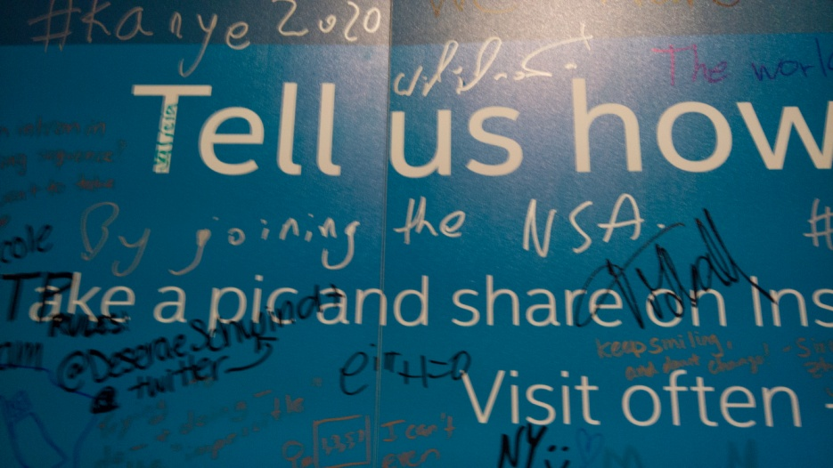
Thank You
Questions??

