Slide 1
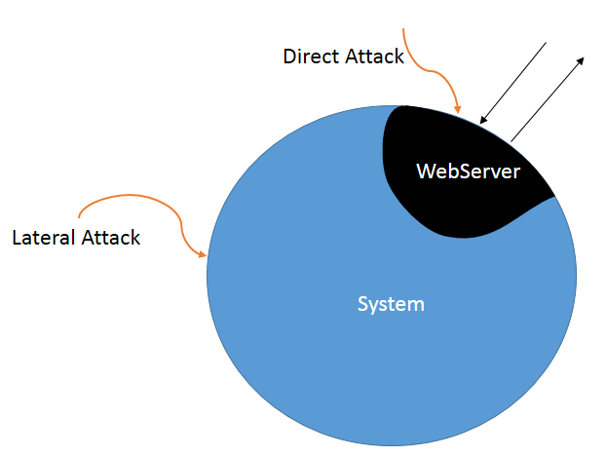
Diversity-based detection of Security Anomalies
Resilient
Architectures
Roopak Venkatakrishnan & Dr.Mladen A. Vouk
Motivation
Attacks on Web services up 30% in 2012-2013
Acceptance testing uses prior knowledge
External checking has limited applicability.
Diversity is pro-active, but an expensive solution, however may help identifying of difficult to detect attacks.
Types of Attacks
Inherent Vulnerabilities
Indirect Attacks
COTS based diversity approach along with the cloud may offer cost effective detection strategy.
Indirect Exploit – Linux/Cdorked.A
Infected modules for Apache & Nginx
Plugin sends redirect based on many conditions including a random factor
Avoided redirect for admins & in-memory operation
Back to back comparisons with a diverse system using Apache, Nginx & IIS could detect malware.
Zero Day Exploit – Nginx vulnerability
Allowed attacker to access restricted content
Caused due to improper parsing of request (inherent flaw).
Easily caught by back to testing with different web-servers
V1/31Mar2014
Science of Security
Lablet

