Slide 1
Anonymity in the Bitcoin Peer-to-Peer Network
Shaileshh Bojja Venkatakrishnan, Giulia Fanti, Pramod Viswanath

Slide 2
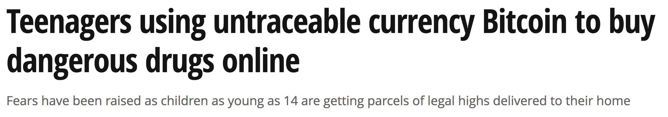


“Untraceable Bitcoin”
https://www.youtube.com/watch?v=k8LqlMzEe-I

Slide 3
This is false.

Slide 4
Bitcoin Primer
Blockchain
sd93fjj2
pckrn29
…
our transaction
Transaction
k_{A} sends k_{coin} to k_{B}
Alice
Bob
k_{A}
k_{B}
k_{coin}

Slide 5
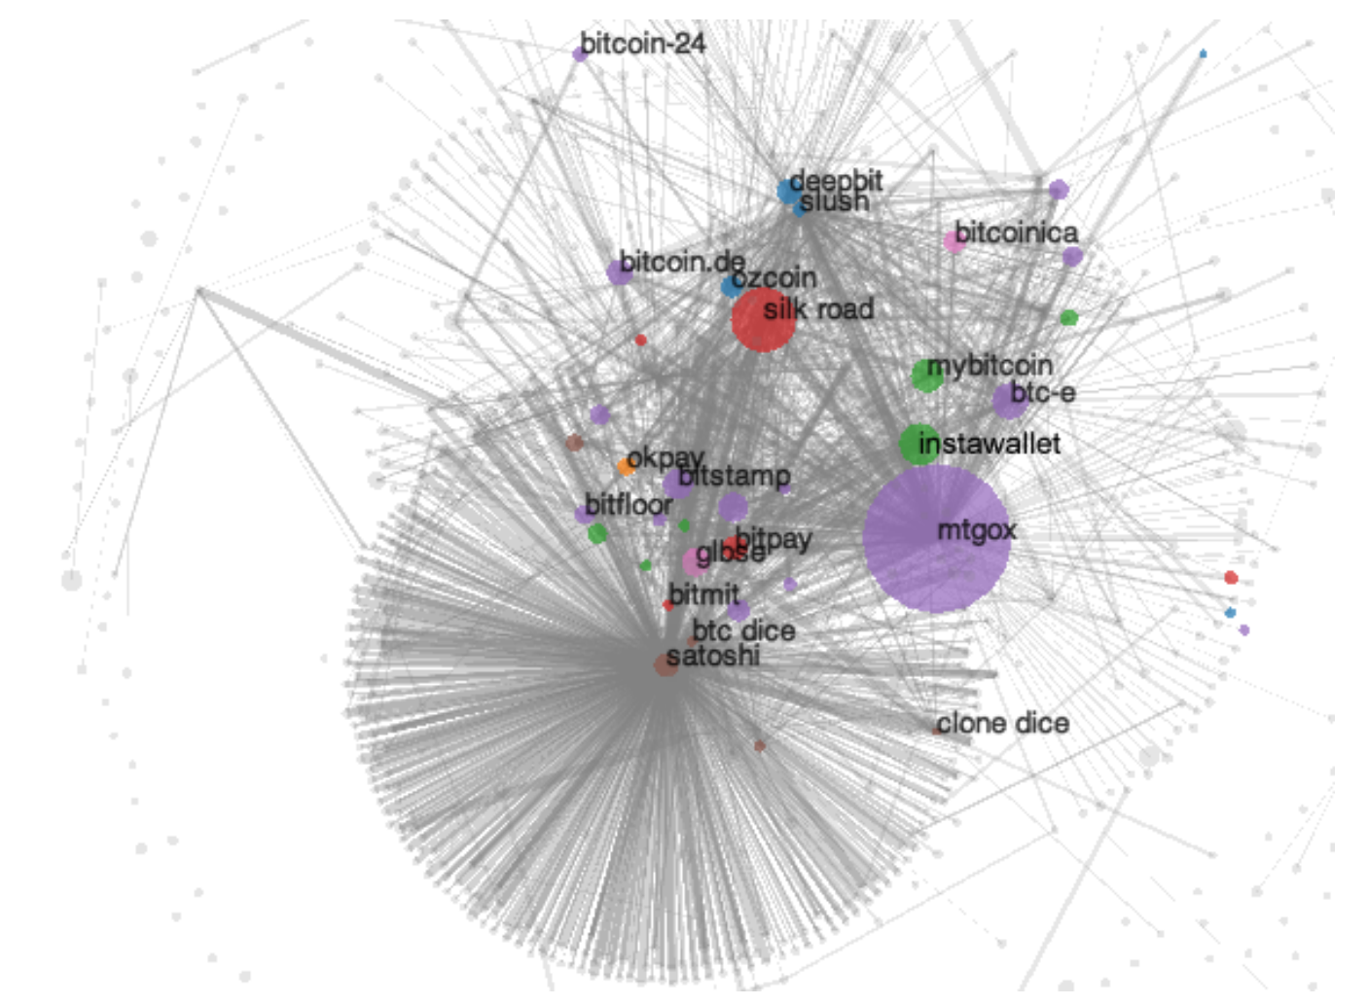
How can users be deanonymized?
What about the peer-to-peer network?
Blockchain
Meiklejohn et al., 2013

Slide 6
Attacks on the Network Layer
Eavesdropper
Biryukov et al., 2014
Koshy et al., 2014
Alice

Slide 7

Our Work
Analysis
Redesign
$$Pr(detection)$$
Dandelion
Under submission, 2017
Under submission, 2017
Notes:
Lightweight statistical methods

Slide 8
Analysis
How bad is the problem?

Slide 9
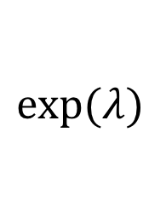
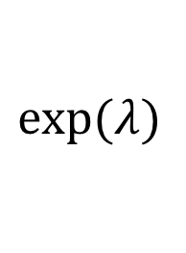
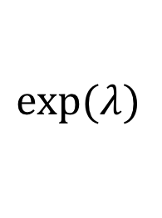
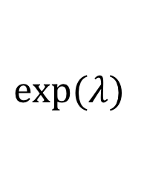
Flooding Protocols
Trickle (pre-2015)
Diffusion (post-2015)
(4)
(1)
$$exp⁡(λ)$$
$$exp⁡(λ)$$
(2)
(3)
$$exp⁡(λ)$$
$$exp⁡(λ)$$

Slide 10
Does diffusion solve the problem?

Slide 11
Results: d-Regular Trees
Theorem: The maximum-likelihood probabilities of detection for diffusion and trickle are asymptotically identical in d.

Slide 12
Results: Trees
Trickle
Diffusion
Probability of Detection
Number of Corrupt Connections

Slide 13
Results: Bitcoin Graph
Trickle
Diffusion
Probability of Detection
Number of Corrupt Connections

Slide 14
Diffusion does not have (significantly) better anonymity properties than trickle.

Slide 15
Redesign
Can we design a better network?

Slide 16
Adversarial Model
observe all
metadata
learn the
graph over
time
fraction p
of spies
honest-
but-curious

Slide 17
Metric for Anonymity
Recall
(Probability of
Detection)
Precision

Slide 18
Goal:
Design a distributed flooding protocol that minimizes the maximum precision and recall achievable by a computationally-unbounded adversary.

Slide 19
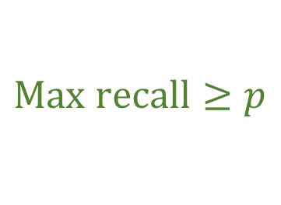
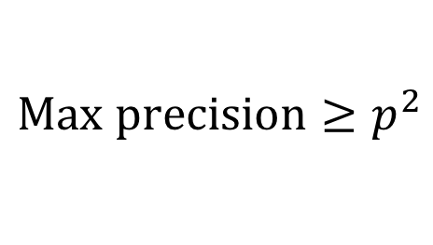
Fundamental Limits
1
$Max recall≥p$
Precision
$$Max precision≥p^{2}$$
0
1
Recall

Slide 20
Proposed Algorithm: Dandelion

Slide 21
How is Dandelion different from Tor?
1) Messages propagate over the same cycle graph
2) Cycle graph changes dynamically.
3) No encryption required.

Slide 22
Performance: Achievable Region
1
Flooding
Precision
Diffusion
Dandelion
p²
0
p
1
Recall

Slide 23
Practical Issues
Base Case
Constructing a Hamiltonian cycle
k=1
Rounds
k=1 rounds of
Degree-Checking
Base Case
Degree

Slide 24
Comparison with Alternative Solutions
Connect through Tor
I2P Integration (e.g. Monero)
Tor

Slide 25
Next Steps
Byzantine nodes
Other adversarial models
Practical demonstration of viability

Slide 26
Take-Home Messages
Bitcoin P2P anonymity = ☹.
Moving from trickle to diffusion did not help.
Dandelion may be a lightweight solution for certain classes of adversaries.

