Slide 1
Framework for Evaluating Information Flows in Multicore Architectures for High Assurance Systems
Ryan Bradetich
Center for Secure and Dependable Systems
University of Idaho

Slide 2
Agenda
Problem Statement
Secure System Architecture Progression
Framework Introduction
Multicore Architecture Analysis
Cell Broadband Engine Architecture (CBEA)
Intel Core i (Nehalem)
Freescale P4080
Question and Answers

Slide 3
Secure System Architecture Progression
Centralized processing – System High
Improved processing power – MLS
Commodity hardware – System High
Multicore architectures – MILS

Slide 4
2006 – Cell Processor
Memory
MIC
SPE
SPE
SPE
SPE
IOIF0
I/O
PPE
SPE
SPE
SPE
SPE
IOIF1
I/O
L2 Cache
Local
Store
L1 D
L1 I
SMT Core
SPU Core

Slide 5
2007 – Intel Core i
CPU-0
SMT
CPU-1
SMT
CPU-2
SMT
CPU-3
SMT
L1 D
L1 I
L1 D
L1 I
L1 D
L1 I
L1 D
L1 I
L2 Cache
L2 Cache
L2 Cache
L2 Cache
Shared L3 Cache
Quick Path
Interconnect
DDR3 Memory
Controller
I/O
Memory

Slide 6
2008 – Freescale P4080
Core
Core
Core
Core
L2 Cache
e500mc Core
Core
Core
Core
Core
L3 Cache
SDRAM
Controller
L1 D
L1 I
Memory
CoreNet Coherency Fabric
L3 Cache
SDRAM
Controller
SEC
PME
eLBC
Controller
Peripheral
Controllers
I/O
RIO
MU
2 x
DMA
QMan
BMan
On Chip
Network
Real-Time
Debug
FMan
FMan
3 x
PCIe
2 x
sRIO
10GE
4 x
1GE
10GE
4 x
1GE
SerDes

Slide 7
Agenda – Framework Introduction
Framework Steps
Identify components
Analyze information flows and identify safeguards
Apply security policy

Slide 8
Security Policy
Red
Networks
Red
Networks
Top Secret
Network
Top Secret
Network
Black
Network
Secret
Network
Guard
Guard
Secret
Network
Confidential
Network
Confidential
Network

Slide 9
CBEA
Memory
MIC
SPE
SPE
SPE
SPE
IOIF0
I/O
PPE
SPE
SPE
SPE
SPE
IOIF1
I/O
L2 Cache
Local
Store
L1 D
L1 I
SMT Core
SPU Core

Slide 10
CBEA – Identified Components
Hardware Component | Evaluated
PowerPC Processor Element | No
Synergistic Processor Elements (8) | Yes
Element Interconnect Bus | Yes
Cell Broadband Engine Interface Units (2) | Yes
Memory Interface Controller | Yes
Pervasive | Yes

Slide 11
CBEA – Individual Components
Memory
MIC
SPE
SPE
SPE
SPE
IOIF0
I/O
Element Interconnect Bus
PPE
SPE
SPE
SPE
SPE
IOIF1
I/O

Slide 12
CBEA – Summary
Not recommended for general purpose MILS multicore architecture
SPE are not intended for general purpose processing.
PPE must be trusted
Blocking MFC communication channels provide covert communication channels.

Slide 13
2007 – Intel Core i
CPU-0
SMT
CPU-1
SMT
CPU-2
SMT
CPU-3
SMT
L1 D
L1 I
L1 D
L1 I
L1 D
L1 I
L1 D
L1 I
L2 Cache
L2 Cache
L2 Cache
L2 Cache
Shared L3 Cache
Quick Path
Interconnect
DDR3 Memory
Controller
I/O
Memory

Slide 14
Intel Core i – Identified Components
Hardware Component | Evaluated
Processor Cores (4) | Partial
Shared L3 Cache | No
Quick Path Interconnect | No
DDR3 Memory Controller | No

Slide 15
Intel Core i
CPU-0
CPU-1
CPU-2
CPU-3
Shared L3 Cache
Quick Path
Interconnect
DDR3 Memory
Controller
I/O
Memory

Slide 16
Intel Core i - Interrupts
Processor
Core
SMM
(ring -2)
Processor
Core
SMM
(ring -2)
Hypervisor (ring -1)
(VMX Extensions)
Hypervisor (ring -1)
(VMX Extensions)
Guest OS
(ring 0 – 3)
Guest OS
(ring 0 – 3)

Slide 17
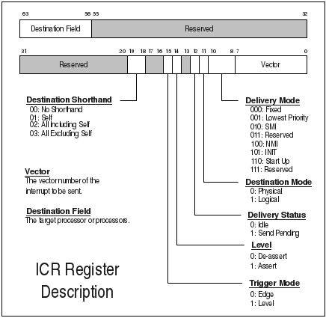
Core i – ICR Register Description

Slide 18
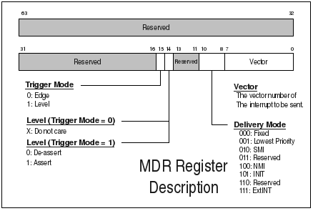
Core i – ICR vs. MDR
* SIPI Attack discovered
by Invisible Things Labs

Slide 19
Core i – SIPI Attack
CPU #0
(BSP)
CPU #1
(AP)
CPU #2
(AP)
CPU #3
(AP)
Shell Code
0xVV000
SIPI
Network
Interface
Untrusted
Driver
(Malware)

Slide 20
Core i – Summary
Not recommended for general purpose MILS multicore architecture
35 years of backwards compatibility
VMM (ring -1) added via VMX extensions
VMX extensions complex and error prone
VMX extensions do not address timing channels
SMM (ring -2) runs higher privilege than VMM
Microcode updates provide reconfigurability
TXT-trusted boot does not protect against SMM
SMM subject to cache poisoning via MTRR

Slide 21
Freescale P4080
Core
Core
Core
Core
L2 Cache
e500mc Core
Core
Core
Core
Core
L3 Cache
SDRAM
Controller
L1 D
L1 I
Memory
CoreNet Coherency Fabric
L3 Cache
SDRAM
Controller
SEC
PME
eLBC
Controller
Peripheral
Controllers
I/O
RIO
MU
2 x
DMA
QMan
BMan
On Chip
Network
Real-Time
Debug
FMan
FMan
3 x
PCIe
2 x
sRIO
10GE
4 x
1GE
10GE
4 x
1GE
SerDes

Slide 22
P4080 – Logical Partitions
Control Plane
SMP OS
Data Plane
AMP OS
Other Services
AMP OS
Core
MMU
Core
MMU
Core
MMU
Core
MMU
Core
MMU
Core
MMU
Core
MMU
Core
MMU
CoreNet Coherency Fabric
PAMU
PAMU
PAMU
Peripheral
Peripheral
Peripheral
Peripheral
Peripheral
Peripheral
CoreNet
Platform
Caches

Slide 23
P4080 – Identified Components
Hardware Component | Evaluated
e500mc Processor Cores (8) | Yes
CoreNet CoreNet Coherency Fabric CoreNet Platform Cache | Yes
DDR2/DDR3 SDRAM Controllers (2) | Yes
Enhanced Local Bus Controller Peripheral controllers | Yes
High Speed Peripheral Interface Complex PCI Express Controllers (3) RapidIO Message Unit Serial RapidIO Endpoints (2) Direct Memory Access Controllers (2) | Yes

Slide 24
P4080 – Identified Components (2)
Hardware Component | Evaluated
Data Path Acceleration Architecture Buffer Manager Queue Manager Frame Manager (2) Pattern Match Engine Security Encryption Engine | Yes
Real Time Debug | Yes

Slide 25
P4080 – Individual Components
Core
Core
Core
Core
Core
Core
Core
Core
L3 Cache
SDRAM
Controller
Memory
CoreNet Coherency Fabric
L3 Cache
SDRAM
Controller
SEC
PME
eLBC
Controller
Peripheral
Controllers
I/O
RIO
MU
2 x
DMA
QMan
BMan
On Chip
Network
Real-Time
Debug
FMan
FMan
3 x
PCIe
2 x
sRIO
10GE
4 x
1GE
10GE
4 x
1GE
SerDes

Slide 26
P4080 – DPAA Analysis
BMan requires QMan to mediate access to CoreNet.
DPAA provides direct portal access between DPAA components.
Covert communication channel using the Portal Query command.

Slide 27
P4080 – Grouped Components
Core
Core
Core
Core
Core
Core
Core
CoreNet + SDRAM Controllers
Memory
eLBC Controller +
Peripheral Controllers
I/O
DPAA
+
Processor
Core
On Chip
Network
Real-Time
Debug
SerDes

Slide 28
P4080 – Summary
Not recommended for general purpose MILS multicore architecture
Logical Partitioning architecture looked promising.
Peripherals is where the architecture fell down.

Slide 29
Framework summary
This framework shows how and why the hardware analysis can be separated from the security policy analysis. Initial component identification provides a roadmap and can foster intra-team and cross-team collaborations. Focus on information flows, safeguards, and shared components simplifies the analysis process. Consistent, reproducible, and peer-reviewable reports facilitate incremental analysis for minor hardware revisions. Safeguards organize and focus experiments on critical areas.

Slide 30
Agenda – Questions and Answers
Questions?

