Slide 1
Human Machine Teaming
Bill Streilein, Danko Nebesh and Sarah Joseph

Slide 2
Human-Machine Teaming Track: Focus Areas
Theory of Mind – “Theory of mind broadly refers to humans' ability to represent the mental states of others, including their desires, beliefs, and intentions”
Context – “As decision makers interact with a dynamic task, they recognize a situation according to its similarity to past instances, adapt their judgment strategies from heuristic-based to instance-based, and refine the accumulated knowledge according to feedback on the result of their actions”
Interactions – “...Challenges for making automation components into effective "team players" when they interact with people in significant ways”
Quantification – “Accurately and effectively measuring system performance of an HMT is crucial for moving the design of these systems forward”

Slide 3
Track Evolution
Theory of Mind
Context
Interactions
Quantification
Cyber Use Cases
Metrics
Sharing
Anthropomorphism
Research Directions

Slide 4
Cyber Use Cases for HMT
Security offices assistant
  Monitoring DDoS attack or Exfiltration of a large file
    Is there an attack?
    What should I do about it?
  Support analysis
    Investigate in more detail than normal for examples in which novel zero-day attacks are encountered.
    System thinks something bad is happening – user disagrees. What does the team do?

Slide 5
Cyber Use Cases for HMT
Dynamic honeypots.
  Where should you be putting your resources for honeypots?
  Having an agent allocate resources for honeypots.
Intermittent Monitoring
  How can you look at information once a day, once a week and quickly orient.
Network Monitoring - DDoS at Bank of America.
  60 people working together to keep bad traffic out.
  Could ML reduce number of people?
  Could MT reduce Human to human - high pressure communication?
  How can an agent pair with a novice user in a cybersecurity position?
  MT can draw analogies with historic data that users may not know about.
  Take advantage of computers good at bookkeeping capabilities.

Slide 6
Cyber Use Cases for HMT
Spear phishing
  MT can help identify suspicious inputs, emails.
  MT can form, ask, and evaluate authentication question.
Target data breach
  Can MT using ML identify and reduce false positives

Slide 7
Metrics - Data
Having a dataset that we can test against.
What data do we need?
  Historical
  Red/Blue
  Shared testbed – challenge style
Can we trust it?
What data do you show human? What data do you show MT? How can you measure it if you do not show all the data?
If MT fails, can I do an analysis with generated data?
is the data overtraining or non-representative?

Slide 8
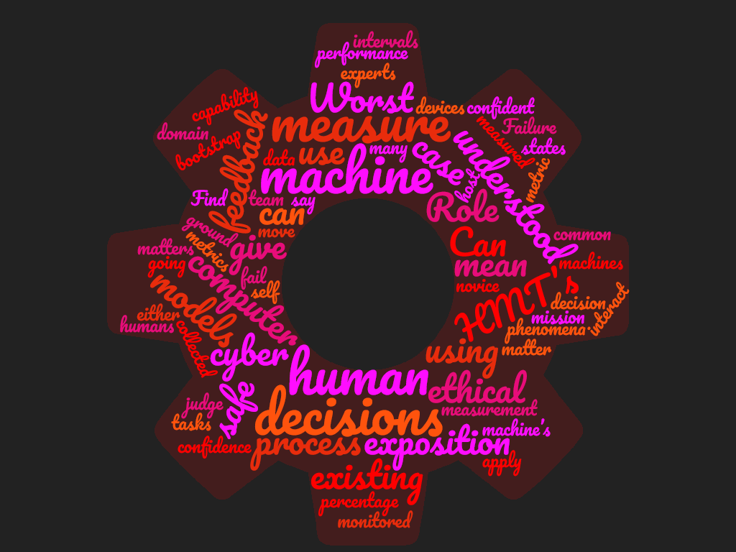
Metrics -

Slide 9
Metrics - Communication
What is the common ground?
What does it mean to be understood by a computer?
What does it mean to be understood by a human?
Failure states of the machines (When is it going to fail).
What percentage of the machine’s capability are you using?
How confident are you in either decision?
How do we move metrics to the information domain?
How many tasks can we monitor at once?
How do we discover hidden states and when do we show it to the human?
Prompts you to ask questions you should be asking.
How do you share information of multiple humans of different levels and job roles?
How do you test for failure and find the models that fit?

Slide 10
Metrics - effectiveness of human-machine team system
Is the team balanced (in terms of what)?
Need metrics beyond accuracy and speed, such as trust
What are the tools that are being used for human-machine teaming domains?
How do you measure cognitive load?
How do you train a human to know what capabilities they aren’t doing?
What % of the machine is being used?
What level of coverage for a job role is being utilized?
What are the confidence intervals on the decisions of the machine?
How do you move from cyber physical to the information domain
How many tasks can be monitored at once?
How do these apply to the team?
How do humans interact w/ these systems?
How do we instrument the human to give feedback to the machine
Can you measure how ethical a HMT’s decisions are?

Slide 11
Metrics - for judging effectiveness of human-machine team system.
  How do we instrument the human to give feedback to the machine
  Can you measure how ethical a HMT’s decisions are?
  How can cyber phenomena be measured? What metrics matter?
  What is self measurement for a machine or human to judge performance?
  How do we measure importance? Does a computer or a host say what matters?
  Find a metric for “mission importance” of devices
  How do you bootstrap a novice using data collected on experts?

Slide 12
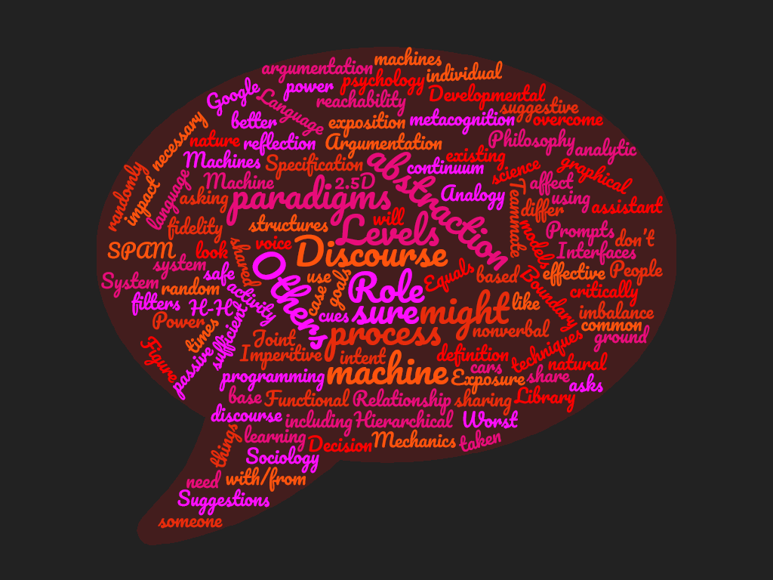
Sharing

Slide 13
Sharing
People + machine are better than an individual.
Power of using passive voice, and what it might do to power imbalance, where things are more suggestive in nature
  Suggestions from machines that would not be taken critically.
  Machines asking “are you sure”? At random times
  Prompts affect decision-making process
  Discourse, argumentation – with/from a system
  Interfaces? 2D, 2.5D, 3D, natural language, graphical?
  System randomly asks “are you sure?” – how might this impact analytic tradecraft

Slide 14
Sharing
I don’t need to understand how it works, but someone should.
  Semi-autonomous cars
  Antilock breaking
  SPAM filters
  Google assistant
Levels of abstraction of common ground
  Mismatch between H and MT
  Figure out how to overcome mismatch
  Levels of fidelity and abstraction necessary to gain/maintain trust

Slide 15
Sharing
What to share?
  Specification of goals
  Exposure of intent
  Joint activity
  Teammate continuum of what is shared
  Mechanics for sharing including nonverbal cues
  Boundary definition

Slide 16
Sharing
Relationship structures
  Equals?
  Hierarchical
  Role based
  Others
Analogy to programming paradigms
  Functional
  Imperitive
  Others

Slide 17
Sharing
Argumentation and Discourse
  What will it look like?
  What paradigms are effective?
  How does this differ from H-H discourse?
  What to base it on?
    Language
    Philosophy
    Developmental psychology
    Sociology
    Library science

Slide 18
Sharing
Role of machine learning
  What models do we use?
  Are existing techniques sufficient?
  Decision process exposition
  Worst case reachability
  Is it safe?
  Machine metacognition and reflection

Slide 19
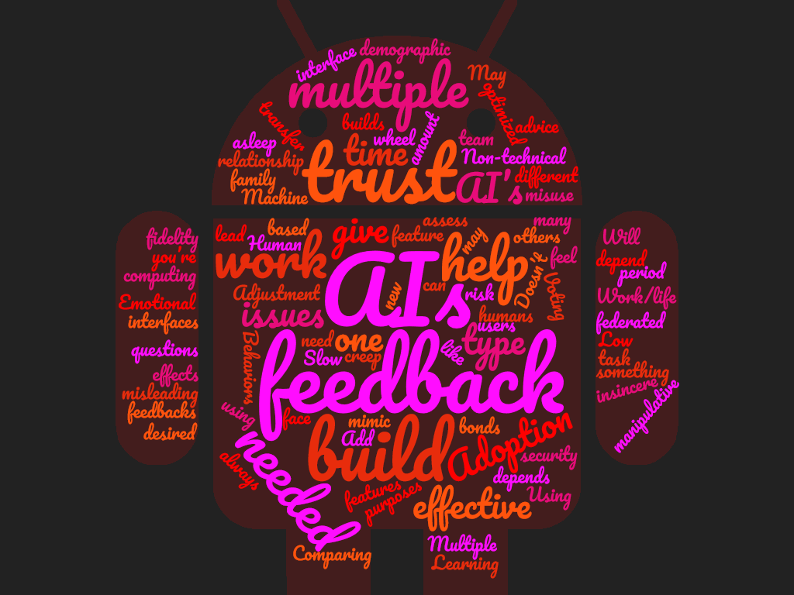
Anthropomorphism

Slide 20
Anthropomorphism
Will it help with work or a task.
Low fidelity, demographic effects.
An effective interface has emotional feedback.
  Effectiveness may depend on the type of work you’re doing.
  Emotional feedback. Adoption issues with interfaces that give emotional feedback.
  How can effective computing with emotional feedback help give security advice?
  What are the questions for using something with face feedback or other emotional feedbacks?

Slide 21
Anthropomorphism
Using multiple AIs to help in decision-making and to build more trust.
  Comparing the performance of AIs over a period of time.
  Learning the personalities of multiple AIs.
  Too many AIs could lead to misleading.
  Multiple AIs federated by one AI
How do you build trust with AI?
  May feel manipulative or insincere.

Slide 22
Anthropomorphism
Not always needed or desired, depends on work type
Doesn’t need to mimic humans
Behaviors needed
Human is like coach/quarterback
Machine is teammate/lineman

Slide 23
Anthropomorphism
Adoption issues
  Slow feature creep
  Adjustment time needed to build trust assess risk
  Non-technical users misuse – asleep at the wheel
  Have one AI you build relationship with
    Add new features
    Work/life team family based
      Do H & MT bonds transfer to others
    Voting amount multiple AI’s builds trust
    AI’s optimized for different purposes

Slide 24
Research Ideas (1/2)
Assumption:
  Machine Teammate must have capability for independent action and joint activity and not just be a tool or analytic.
  A cyber environment is one where the machine is working much faster than the human,
What is the appropriate framework for human machine teammate interaction to not just include task interaction but include trust and theory of mind. How does the human still participate? What are the touchpoints?
What information exchange needs to be supported base on elements of the task and goals? What is the mode of the exchange? How do we map the attributes to the information that needs to be shared?
What are the possible structures of sharing and interaction?
For a given task what is the appropriate composition of humans and machine teaming?

Slide 25
Research Ideas (2/2)
How do you have a discourse between the MT and H?
Sharing information can calibrate trust. What type of information needs to be shared? How much information should be shared? Context dependant.
How do we evaluate?
What would it take for a machine to explain why it didn’t do something?
Does the MT adhere to human ethics when looking at data? My AI is not working towards my best interests but is working ethically adhering to privacy expectations.

