Slide 1


Presented to:
2015 Software Certification Consortium
Sponsored by
Nuclear Regulatory Commission
Overview of Architecture Centric Virtual Integration
Using the Architecture Analysis & Design Language
Distribution Statement A - Approved for Public Release - Distribution Unlimited
This presentation includes with permission slides from other Architecture Analysis and Design Language Researchers/Users.
Presented by:
Bruce Lewis
US Army Software Engineering Directorate (SED), AMRDEC
Jan 26, 2014
Notes:
This is a summary presentation on the recommended JMR Mission System VIP. It is a program management more than a technology briefing and is primarily targeted at a JMR TD audience. The focus is on meeting long-term needs for DoD FVL mission systems, which is more focused than broad model-based development or AADL technologies. This is a roadmap for this purpose, although it could serve as an example for other kinds of product lines and acquisition initiatives. It supports a detailed workplan and Roadmap spreadsheet.

Slide 2
Contents
System Integration Issues
High Cost of Software Reliant System Integration
AADL & SAVI Virtual Integration
System Architecture Virtual Integration
Architecture Analysis & Design Language
Expected Cost Reduction
SAVI and JMR Demo Opportunities
Summary and Recommendations

Slide 3
Contents
System Integration Issues
AADL and SAVI Virtual Integration
SAVI and JMR Future Directions
Summary and Recommendations

Slide 4
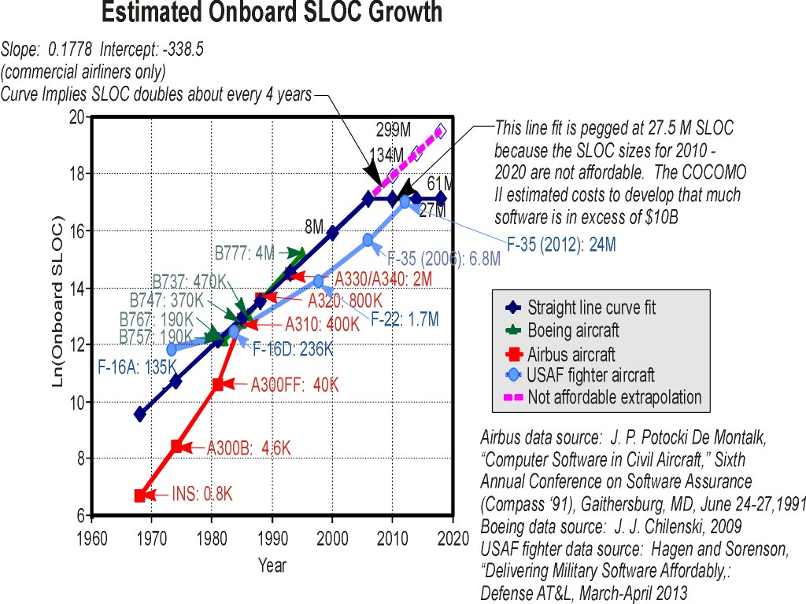
Problem: Software driving Complexity and Affordability
What can significantly reduce costs making the Next Gen affordable?

Slide 5
Significant Opportunity for
Rework Cost Reduction
Aircraft industry has reached limits of affordability due to exponential growth in SW size and complexity.
20.5%
300-1000x
Requirements
Engineering
Acceptance
Test
70% Requirements & system interaction errors
0%, 9%
80x
80% late error discovery at high rework cost
80% late error discovery at high repair cost
80% late error discovery at high repair cost
System
Design
System
Test
70%, 3.5%
1x
10%, 50.5%
20x
Software
Architectural
Design
Major cost savings through rework avoidance by early discovery and correction
A $10k architecture phase correction saves $3M
Integration
Test
Component
Software
Design
20%, 16%
5x
Unit
Test
Where faults are introduced
Rework and certification is 70% of SW cost, and SW is 70% of system cost.
(SAVI)
Where faults are found
The estimated nominal cost for fault removal
Sources:
NIST Planning report 02-3, The Economic Impacts of Inadequate Infrastructure for Software Testing, May 2002.
D. Galin, Software Quality Assurance: From Theory to Implementation, Pearson/Addison-Wesley (2004)
B.W. Boehm, Software Engineering Economics, Prentice Hall (1981)
Delivery Delays Not Known
Until Late into Project Schedule
Code
Development
Notes:
The data on the chart is based on Galin, Boehm data. Dabney’s NASA IV&V data has even higher rework multipliers.
Dabney, J.B., Return on Investment of Independent Verification and Validation Study Preliminary Phase 2B Report. 2003, NASA: Fairmont WV.
System-level problems reflect non-functional system properties ranging from system behavior & performance to reliability & safety. Late discovery results in high repair/rework cost.

Slide 6
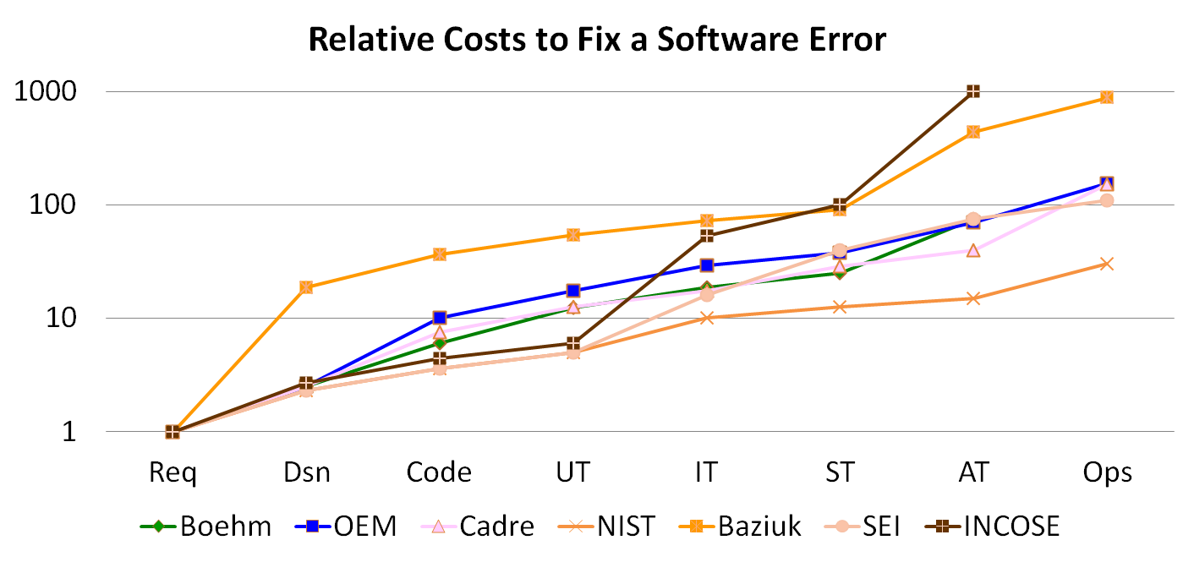
Survey of Relative Repair Cost
Notes:
This was provided by John Chilenski, Boeing Commercial Airplane, as an informal communication between SAVI project members.

Slide 7
Mismatched Assumptions Cause Many Issues
Physical Plant Characteristics
Lag, proximity
System Engineer
Control Engineer
System
Under
Control
Base types, Units
Ariane 4/5
Air Canada
Control
System
Data Stream Characteristics
ETE Latency (F16)
State delta (NASA)
Compute
Platform
Runtime
Architecture
Application
Software
Hardware Engineer
Application Developer
Distribution & Redundancy
Virtualization of HW
(ARPA-Net split)
Concurrency Communication
ITunes crashes on dual-cores
Embedded SW System Engineer
Why do system level failures still occur despite fault tolerance techniques being deployed in systems?
Notes:
We use many fault management techniques –many based on redundancy but system level faults still occur. Why?
Examples of mismatched assumptions are:
Assumptions about the physical plant: auto pilots are designed for aircraft of certain size. Different size aircraft have different lag of response behavior due to their size. This is taken advantage of in the rate at which auto pilots operate.
Measurement units: Ariane5 used software with a 16bit variable to represent a domain variable, thus, limiting its value range which was then exceeded by the physical system. (http://sunnyday.mit.edu/accidents/Ariane5accidentreport.html)
Air Canada: An example of mismatch in measurement unit (Gallons, Liters): http://googleblog.tobylaura.com/2009/05/liters-vs-gallons.html.
Concurrency: Itunes crashes randomly fails on dual core processors when ripping songs from CD. Itunes is multi-tasked, one task determining the Db levels, the other ripping, but no concurrency control on updating the song catalog. On a single processor system one task completes before the second starts. http://discussions.apple.com/thread.jspa?messageID=1235236&
Distribution, redundancy: 5 physical ARPA-net trunk lines became 5 logical trunklines when telecom companies went fiber optic. Within 3 months contractor dug up that fiber optic cable and damaged it, resulting in two ARPA-nets. http://www.thocp.net/reference/internet/internet2.htm
F16: In the migration to the Modular Mission Computer (MMC) architecture rate monotonic scheduling was introduced. During a simulated flight the pilot noticed “random blurriness of the screen”. It turned out that the target symbol of a tracked object was oscillating due to the fact that the latency of the target position data from the sensor to the display varied between 4 and 8 sampling frames.

Slide 8

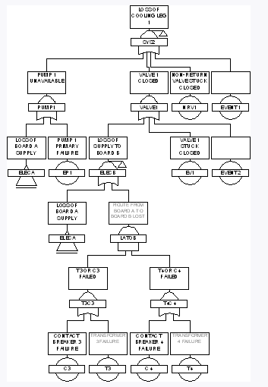
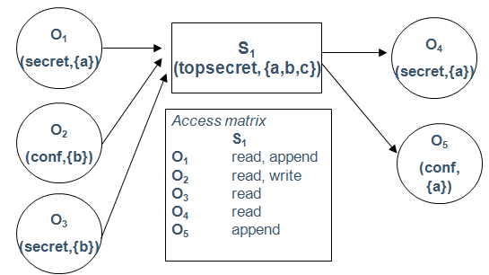

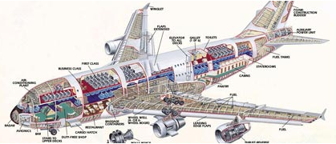
Potential Model-based Engineering Pitfalls
The Issues
Potential Solution
Inconsistency between independently developed analytical models
Architecture-centric model repository
System models
Generation from validated models
Confidence that model reflects implementation
System implementation
Notes:
Analytical models are used to predict system qualities, e.g., timing, reliability, security.
These models are typically developed independently by experts in Markov models, fault trees, Bell LaPadula, etc.
There is a need to validate that these models represent the same architecture, esp. as the architecture may evolve. Otherwise, the model analysis results have no validity and the models are quickly out of date.
Validation of expected system qualities based on models is not sufficient. We have to ensure that the implementation meets the quality requirements by ensuring that the implementation preserves the model semantics, and the model reflects the implementation in sufficient fidelity. The performance of the implementation is what counts.

Slide 9
Contents
System Integration Issues
AADL and SAVI Virtual Integration
SAVI and JMR Future Directions
Summary and Recommendations

Slide 10
Architecture Analysis & Design Language (AADL) History & Objectives
Came out of 3 DARPA programs on Architecture Design Language
Based on MetaH, ACME, and SAE industry member requirements
Key concepts from the beginning:
  Enable quantitative architectural analysis to virtually predict the effects of integrating software hardware and system components and enable generative approaches to build compliant systems.
  Focus – embedded real time safety & mission critical systems
  Provide stable core concepts with well defined semantics to enable consistent exchange across contractors and interpretation by analysis & generation tools. (Verification Suite to STD … )
  Easy to understand engineering terms backed by formal specification of the underlying semantics (Hybrid automata, temporal logic, Behavior Annex).
  Incremental refinement with analyzability of incomplete specs.
  Flexibility to support new domains & analysis dimensions through annex sublanguage extensions and property sets.

Slide 11
AADL Standards
SAE standard AS5506 Architecture Analysis & Design Language published.
  Nov 2004, Revision A 2009, Revision B 2012
SAE Annexes AS5506/1, June 2006. Includes Annexes for Graphics, Ada & C Programming Guidelines, Error Modeling, Meta Model/XMI
SAE Annexes AS5506/2, January 2011. Includes:
  Behavior Annex, Data Annex, ARINC 653 Annex
Draft annexes started includes Requirements Definition & Analysis Language, Synchronous Semantics may be added to Behavior Annex, Constraints with Subsets, Unit Conversions, Network, …

Slide 12
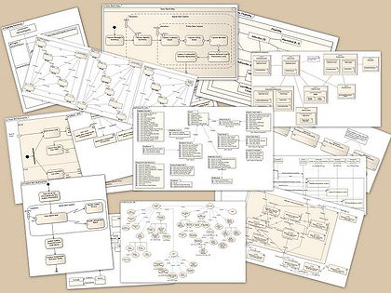

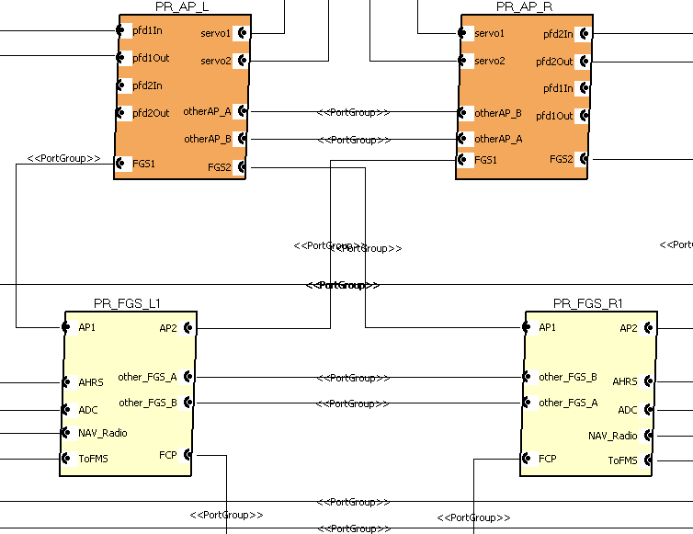
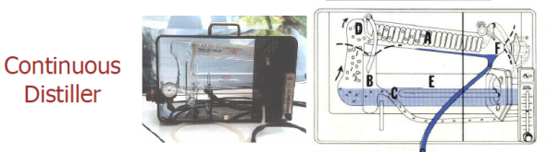
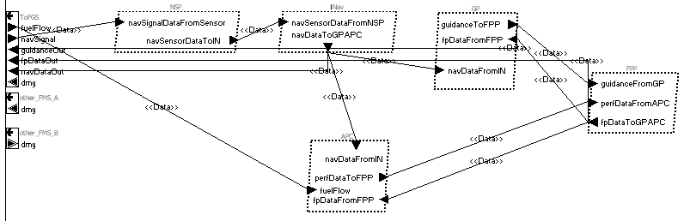
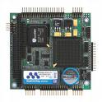

SAE Architecture Analysis & Design Language (AADL) for Embedded Systems
Software design architecture & software runtime architecture
The System
Control
Guidance
Embedded Application Software
Flight control & Mission
Physical platform
Aircraft
The Software
Deployed on
Utilizes
Physical interface
Platform component
Computer System
Hardware & OS
The Computer System
AADL focuses on interaction between the three major elements of a software-intensive system based on architectural abstractions of each.
Designed to support
Predictive Arch Analysis
Incremental development
Standard strong semantics
Analysis driven synthesis

Slide 13
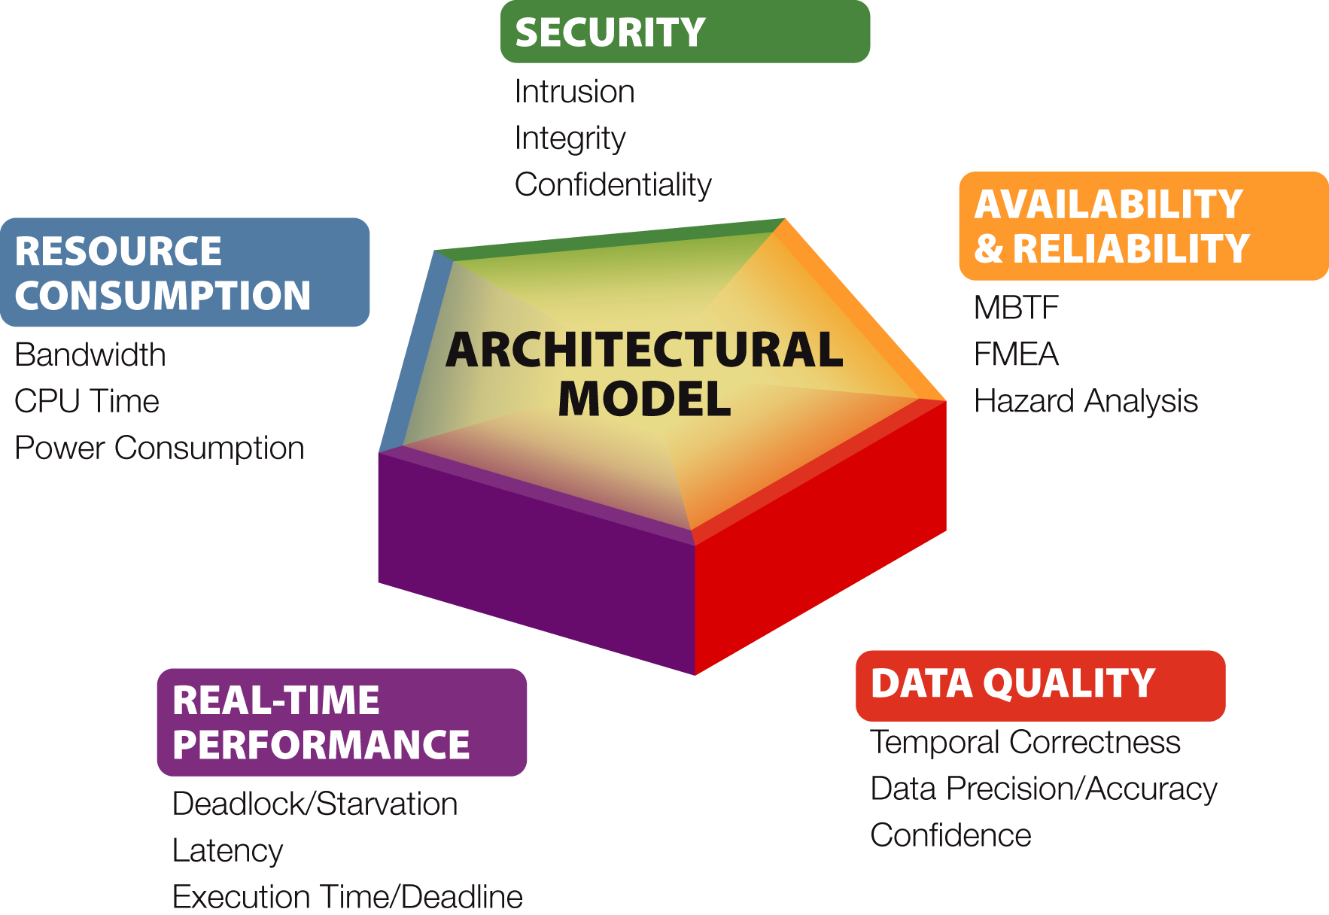
AADL supports: Single-Model, Incremental
Multi-Dimensional Analysis – Impact early discovery
Increased confidentiality requirement
change of encryption policy
Key exchange frequency changes
Message size increases
increases bandwidth utilization
increases power consumption
Increased computational complexity
increases WCET
increases CPU utilization
increases power consumption
may increase latency
Notes:
This slide automates an example of an architecture change that impacts many other architectural qualities. Yet this kind of analysis is not normally done because the models behind each domain do not support the other domains, they are only used for a short time, typically are not updated, they are expert based requiring the interaction of many experts, and each makes assumptions about the architecture that may be contradictory. They often capture the architecture at different levels of maturity and need updating.
The SAVI approach advocate a single model updated throughout the program, at each point in time to represent the current architecture to the degree it is defined. It builds strongly on the AADL capability for cross dimensional analysis. New analysis technology is needed to automate this process and more fully understand it’s potential.
Both the AADL standardization committee and the SEI are developing new approaches for system constraint analysis against requirements.
© 2007 Carnegie Mellon University
Presentation Title
1/24/2015

Slide 14
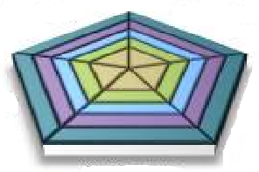
Multiple Dimensions of
Analysis & Generation
Security
  Confidentiality
  Integrity
  Availability
RC SMACCM
SEI Bell LaPadula/MILS
ParisTech Partitions for
safety & security
D-MILS (future)
Function & Behavior
  Interface (ICD) compliance
  Functional requirement specification
  Multi-layered operational modes
  Concurrency & interaction protocols
Safety
  Hazards/Risks
  Reliability
  FMEA, SSA
OSATE architecture consistency
SAVI Functional Integration
RDAL req/spec and verification
RC Resolute/Agree comp verif
AdaCore verification & generation
Architecture
Model
COMPASS Safety Impact
OSATE Safety Analysis & PRISM
from SAVI 4761, 6110 Demo
WW Tech Safety
Aerospace FMEA/Reliability
BLESS Theorem Prover
Timing & Resources
  Resource budgets & workloads
  Task schedulability
  Response time
  Latency variation
Integration
  Executive generation
  System configuration
  Safety assurance case
  Test case generation
ParisTech/ISEA Ocarina
ParisTech RAMSES
INRIA AADL/Polychrony
ESA TASTE Simulink/SCADE
ParisTech ARINC653 Generation
SEI assurance case generation
FUSED cross model consistency
COMPASS System/SW Coengineering
OSATE Compositional
Resource Analysis
OSATE End-to-end Latency
AADL Inspector Cheddar
UIUC ASIIST
MAST Scheduling
MASIW Avionics Workbench
Adventium Compositional Timing

Slide 15
Incremental Model Refinement and Verification
Predictive analysis
Actual system test
Virtual System Integration
Requirements
Engineering
Top-Level
Verification Items
Acceptance
Test
System
Design
High-level
AADL Model
System
Test
Software
Architectural
Design
Model-driven artifact generation
Conformance of models and systems
Detailed
AADL Model
Integration
Test
Component
Software
Design
Unit
Test
Specify Model-
Code Interfaces
→ generation of test cases
← updating models with actual data
Code
Development
Notes:
During the requirements phase requirements and assumptions about the embedded system can be captured in a simple high-level parts model, with system and subsystem interactions represented if known. Resource budgets, security and safety-criticality requirement can be associated with this model and validated for consistency.
During system design phase, the system design, the compute platform, the interface to the physical environment, and the key embedded software components are identified and decisions regarding the embedded system architecture approach may be made. The consequences of these decisions can be analyzed based on an architecture model that explicitly captures these aspects of the embedded system.
During software architecture design, the task and communication architecture of the embedded software system is refined and decisions regarding its deployment on a particular compute platform configuration can be analyzed. The consequences of these decisions on the performance, timeliness, safety-criticality, security, reliability, availability, and system stability can be analyzed and validated against the original requirements.
Software component are designed and coded in the context of a set of functional and non-functional specifications that have been recorded in embedded system architecture models and can be validated during unit test.
Having the evolving set of models of the system validated through analysis has several positive consequences on the test and integration phases. Potential problems can be discovered early in the development life cycle. Testing can be focused on validating assumptions made by the analyses to ensure that the analysis results still hold in the context of the implemented system. Models can become a source for driving the generation of tests.
Virtual system integration: Ariane 5, Ariane 4..
Relate to MDA: PIM and PSMs; SysML, UML,
-------
From Jackson: Systems engineering approach
Good ideas from systems engineering that provide a foundation for building dependable systems thinking.
Focus on properties of the systems as a whole and the interactions among its components
Software as a system component: Dependability is not an intrinsic property of software; software is one engineered artifact in a large system of many components…. Dependability is a balancing act between costs and benefits, and prioritization of risks.
Humans as components
Real-world properites
Testing is indispensable and no software system can be regarded as dependable if it has not been tested extensively (even though its correctness has been proven mathematically). Testing may find flaws that escape analysis since testing is exercising the system in its entirety (and analysis typically has to make various assumptions about its execution platofmr, external environment etc).
A dependability case will generally require many forms of analysis, including the validation of environmental assumptions, use models, fault models; the analysis of fault tolerance measures against models; schedulability analysis for temporal behaviors etc.
NDIA report from 2002: See 5.5.
Where % of errors were introduced
70% of all faults were introduced in requirements gathering and analysis, and architectural design
20% in coding and unit testing
10% integration and component/RAISE systems (for embedded systems and safety-critical systems this number might be higher, but if not, this is where we have significant problems).
Where the errors were found
3.5% in requirements gathering and analysis, and architectural design
16.5% in coding and unit testing
50.5% in integration and component/Raise System testing
9% Beta-test, and early customer feedback
20.5% Post-product release
If a fault is introduced in stage X, and detected in stage X, the cost is nominally 1.0
Faults detected
Requirements Gathering and Coding / Unit test Integration and Component Early Customer feedback Post product release
And analysis/Arch Design /System test Beta test
Faults introduced
Requirements Gathering and 1 5 10 15 30
And analysis/Arch Design
Coding / Unit test 1 10 20 30
Integration and Component 1 10 20
/System test
See table 5.2 on page 5.4

Slide 16



Formal Methods & AADL
Concurrency & mode logic: interface with Alloy: deNiz (U)
Simulink & AADL integration: Telecom Paristech, Project P (E), SEI (U)
Behavioral component interaction – AADL & BIP: VERIMAG (E)
Formal proofs & AADL – BLESS: Larsen (U)
AADL & Maude: Meseguer (UIUC) (U), U Leicester (E)
AADL & Timed Abstract State Machines (TASM): Lundquist Zhang
AADL & Timed Automata (Cheddar): Singhoff
AADL & Process Algebra: Sokolsky (U)
AADL & UPPAAL: Sokolsky, Lundquist (E)
AADL & timed Petri nets: Filali (TINA), Kordon (E)
AADL & Polychrony & Signal to System Synthesis Talpin Ma
AADL & FIACRE, Filali (E)
AADL & Formal Composition Analysis & System Synthesis, Miller/Cofer (U)
AADL 653 Annex formalized to AADL653 (C)
AADL Error Model Annex formalized in COMPASS: Noll (E)

Slide 17
Problem: Architectural Analysis
We are good at showing that components implement requirements
However, we are not good at describing system-level concerns
  Most serious problems tend to crop up in integration.
  All commercial avionics software incidents are due to integration problems caused by incorrect component-level requirements [Rushby]
We need better approaches for architectural reasoning.

Slide 18

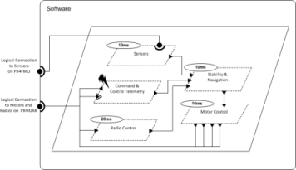
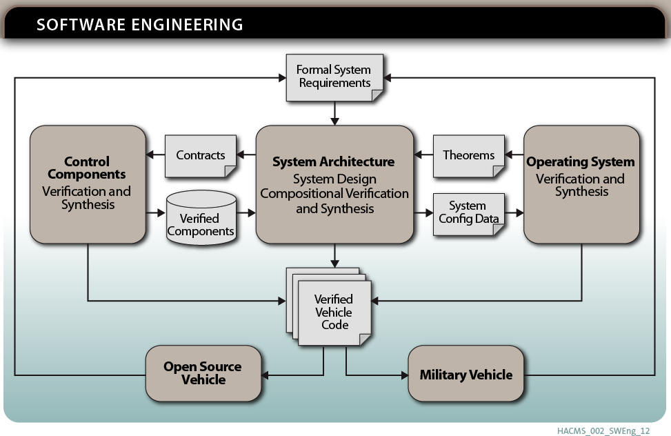
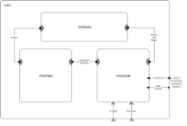
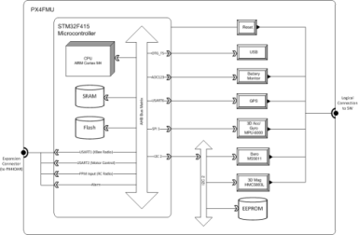
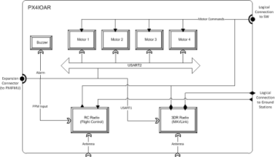
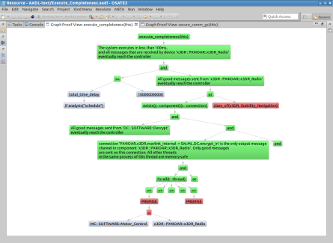
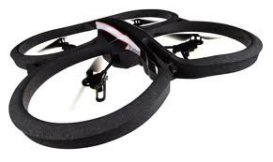
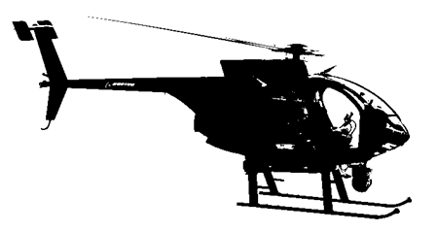
Secure Mathematically-Assured Composition of Control Models
Key Problem
Many vulnerabilities occur at component interfaces.
How can we use formal methods to detect these vulnerabilities and build provably secure systems?
TA4 – Research Integration and
Formal Methods Workbench
Rockwell Collins and
University of Minnesota
ARCHITECTURE-CENTRIC PROOF
Accomplishments
Created AADL model of vehicle hardware & software architecture
Identified system-level requirements to be verified based on input from Red Team evaluations
Developed Resolute analysis tool for capturing and evaluating assurance case arguments linked to AADL model
Developed example assurance cases for two security requirements
Developed synthesis tool for auto-generation of configuration data and glue code for OS and platform hardware
Technical Approach
Develop a complete, formal architecture model for UAVs that provides robustness against cyber attack
Develop compositional verification tools driven from the architecture model for combining formal evidence from multiple sources, components, and subsystems
Develop synthesis tools to generate flight software for UAVs directly from the architecture model, verified components, and verified operation system
Open source tools available at github.com/smaccm

Slide 19
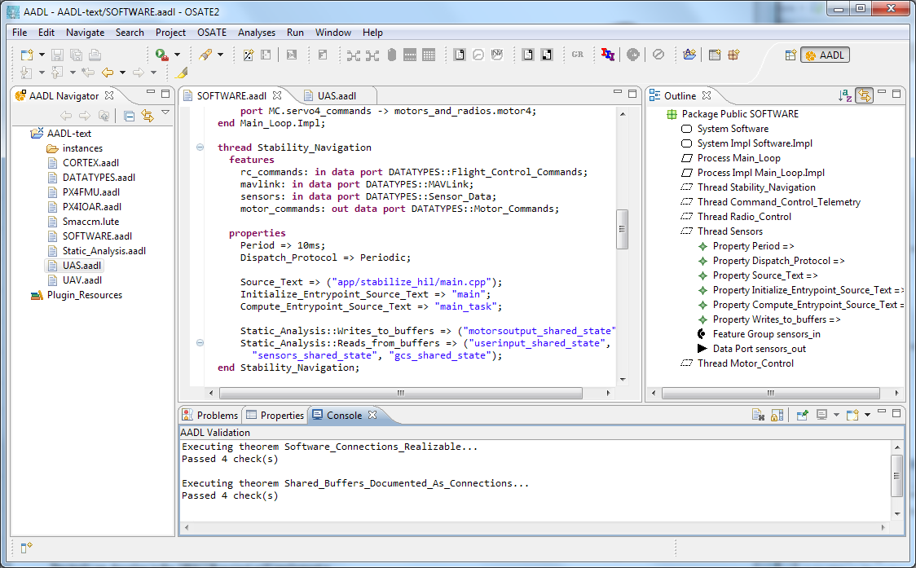

FM Workbench
OSATE
AGREE
Trans
Lute
Architecture Models
Compositional Analysis
Trusted Build
A
C
Assumption: Input < 20
Guarantee: Output < 2*Input
Assumption: none
Guarantee: Output = Input1 + Input2
B
Assumption: Input < 20
Guarantee: Output < Input + 15
Assumption: Input < 10
Guarantee: Output < 50

Slide 20

Some R&D Programs
Leveraging SAE AADL
P Project
Auto Code Gen
2011-2014
D-MILS
Design of Secure Systems
2013 - $4.9M
Compositional Timing Framework
OSD 2014
OpenGroup
Real-Time Forum
EU + US partners
2008-current
OPEES
Formal analysis
2011-2014
ESA COMPASS
System & SW Safety
2008-current
TOPCASED
Open Source Embedded
Systems Tool Framework
28 partners €20+M 2005-2009
AVSI SAVI
Analysis-based System Verification
12 partners $20M 2008-current
IST ARTIST2
Embedded Systems
Center of Excellence
2007-2012
ITEA SPICES
Model-Driven Embedded Systems Engineering
15 partners €16M 2006-2009
DARPA META, HACMS
Complex System
Engineering, Security
2010-current
Flex-eWare
Auto Code Generation
2007-2010
EC ASSERT
Proof-based Satellite
Architectures
ESA + 30 partners
€15M 2004-2007
ESA TASTE
System & SW
Validation & Generation
2010-current
PARSEC
Safety/security focus
2010-2013
Integrated Clinical
Environment
Device Certification
FDA KSU
2011-current
MASIW
Avionics Workbench
Design and Implement
2011-current
NASA CVFCS
AF SwPI
RC formal methods
PROARTIS
Partitioned RT systems
2010-2013 € 1.8M
RAMSES
Conforming Auto Code
Generation
2012-current
Notes:
TOPCASED: We are an official member; TOPCASED is tied to Eclipse
SPICES: uses AADL as a core element of their methodology approach; we will have joint workshops
US AVSI: 5 year pilot project starting in FY08. Members: Lockheed Martin (Ben Watson), Rockwell Collins (Mettenburg), Honeywell (Vestal), Boeing, BAE Systems, GE Avionics, FAA, AMRDEC, SEI
EC ASSERT: uses AADL and AADL UML profile; SEI as technical reviewer for EC; interaction with ASSERT partners (Axlog, Thales)
IST ARTIST2: US Affiliate members include Sha (UIUC), Janos S. (Vanderbilt), SEI. Focused Workshops (Beyond AutoSAR [2006], Research Challenges in Integrated Modular Avionics [2007])
USCar: formation of research project in model-based embedded systems. SEI invited to 2007 workshop.

Slide 21
D-MILS – European Union - $4.9M
Provide an environment for the design, analysis, verification, compositional implementation and certification of scalable, interoperable, and affordable trustworthy architectures. D-MILS uses an advanced time-triggered network architecture for communication among its nodes, providing, predictable, deterministic behavior for safety-, security-, and enterprise-critical operation.
D-MILS provides an end-to-end and top-to-bottom solution for certifiable highly-dependable systems that starts from a high-level, declarative (and graphical) language, the Architecture Analysis and Design Language (AADL), and provides a complete machine-processable chain of representations, usable within a verification framework providing sophisticated analysis and verification of probabilistic and non-probabilistic properties in both finite- and infinite state systems, all the way down to the automated compilation of the detailed resource, schedule, and interaction policy configurations of a distributed collection of single- and multi-processor MILS platform nodes.

Slide 22
AADL Provides a Platform for Research Integration into Practice
AADL Workbench OSD funded – provides domain specific user friendly interface for specifying architecture as well as graphical and textual interface, with AADL compiler. It integrates matured analysis methods from multiple domains for ease of use and generative integration. Builds on the SEI OSATE toolset. Maturing OSATE for industrial use. Will support certification related capabilities like …
  SEI research into requirements, safety and assurance cases.
  Army Aviation research providing maturation of analyses and demonstration. Also generative integration and security.
  DARPA, AF and OSD funded research formal methods (AGREE), model checking (Kind), CPS trade space (FUSED), timing (FASTAR) – each built on AADL.
  SAVI research analyses such as safety, functional correctness …
AADL Inspector integrates/matures many European research tools.
MASIF is a Russian developed toolset integrating many analysis and system implementation capabilities for aviation IMA architectures.

Slide 23














The Aerospace Vehicle Systems Institute
System Architecture Virtual Integration (SAVI)
AVSI | Motivation | SAVI Concepts | 2013 | 2014
Full Members
Airbus
Boeing
DoD
EADS
Embraer
GE Aviation
Goodrich (now UTC)
Honeywell
Rockwell Collins
Rolls Royce
Saab
United Technologies
Liaison Members
FAA
NASA
Aerospace
Valley
SEI
Current SAVI member
Joining SAVI now
Discussing rejoining SAVI
Participated earlier in SAVI
Associate Members
BAE Systems
Bombardier
Gulfstream
Lockheed Martin
Notes:
AVSI is an open international self-funded membership-based project-focused precompetitive research cooperative.
AVSI is not a bricks & mortar funding agency built around specific research interests.
AVSI provides equal benefit for equal contribution.
This is the list of current members at the various membership levels.
SAVI has enjoyed the contributions of most of these members.
These are the members currently involved in SAVI.
These are the former members rejoining SAVI now.
This is a former member rejoining SAVI either now or at the beginning of next year.
These are the former SAVI members.

Slide 24
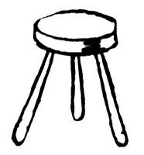
SAVI Objective and Themes
SAVI | Domain Model | Models | Safety | Future
Reduce costs/development time through early and continuous model-based virtual integration
  Shift to new paradigm
    Systems engineering in cross-domain context
    Models provide basis for improvements
    Models promote consistency – “absence of contradictions”
  Architecture-centric approach – start with models
    Meld with requirements for traceability
    Facilitate trade studies
  Virtual Integration – early and continuous integrated analysis
    Proof-based (consistency checked)
    Component-based (hierarchical models)
    Model-based (annotated models)
Proofs
Models
Components
Integrate, analyze … then build”
Notes:
That top objective is to use virtual integration to develop complex aerospace systems at lower cost and on schedule. This goal can be reached through model-driven virtual integration that begins during early requirements definition and continuously monitors system evolution for inter-model consistency. The SAVI approach can detect and correct errors and defects earlier in the development cycle than a traditional (“as-is”) integration approach.
Analyzable models initiate and sustain this architecture-centric paradigm rather than paper-trail documents. The analyzable character of model-defined systems encourages trade studies with quantifiable evidence supporting improvements in system elements before they are realized in hardware and software. An analytical history of design evolution provides traceability difficult to match in a document-driven approach.
The SAVI Virtual Integration Process (VIP) rests on the three principles shown in the sketch: (1) the annotated architectural model allows each change to be checked for consistency, (2) a hierarchical framework encourages questioning of all assumptions and leads to reuse of key elements, and (3) broader use of formal assessment tools is facilitated, in parallel with informed design judgments where formal analysis is not possible.
The “Integrate, analyze … then build” mantra for SAVI springs from this three-pronged approach and allows the VIP to attack system synthesis issues.

Slide 25
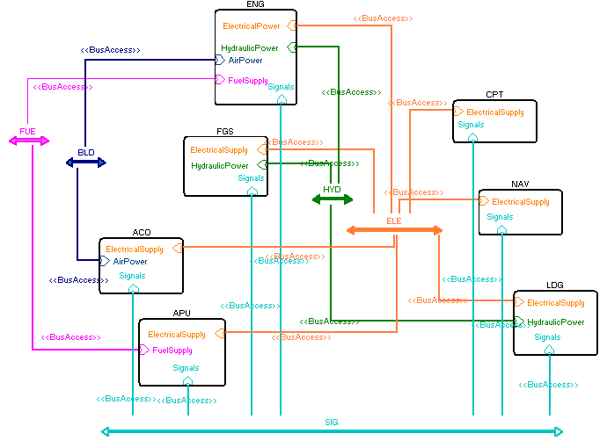
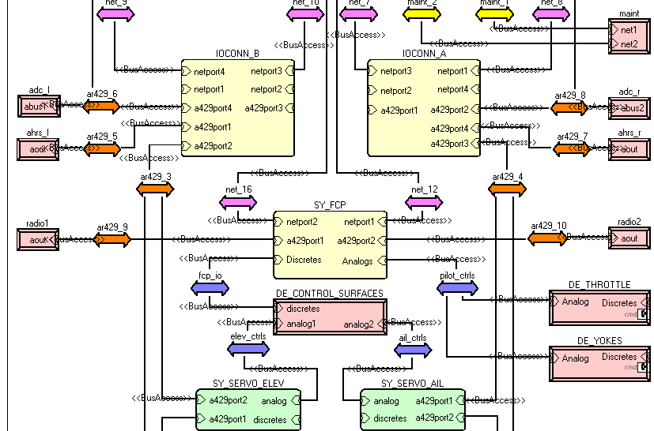
Demonstrated Development Using
System Architecture Virtual Integration (SAVI)
Aircraft: (Tier 0)
Aircraft system: (Tier 1)
Engine, Landing Gear, Cockpit, …
Weight, Electrical, Fuel, Hydraulics,…
LRU/IMA System: (Tier 2)
Hardware platform, software partitions
Power, MIPS, RAM capacity & budgets
End-to-end flow latency
OEM & Subcontractor:
Subsystem proposal validation
Functional integration consistency
Data bus protocol mappings
Subcontracted software subsystem: (Tier 3)
Tasks, periods, execution time
Software allocation, schedulability
Generated executables
  Mechatronics: Actuator & Wings
  Safety Analysis (FHA, FMEA)
  Reliability Analysis (MTTF)
Repeated Virtual Integration Analyses:
  Power/weight
  MIPS/RAM, Scheduling
  End-to-end latency
  Network bandwidth
Architecture-centric Development and Subcontractor Management
  Propagate requirements and constraints
  Higher level model down to suppliers' lower level models
  Verification of lower level models satisfies higher level requirements and constraints
Multi-tier system & software architecture (in AADL)
Incremental end-to-end validation of system properties
Notes:
SAVI now demonstrated on three phases, 58, 59, and 59S1, 61 is just completing.

Slide 26
SAVI Virtual Integration Process
AVSI | Motivation | SAVI Concepts | RoI | 2014
Higher Level Verification Checks
Higher Level Models
Refine Model(s)
Develop Verification Checks
Define Dependencies
Lower Level Model(s)
Incorrect Higher Level
Verification Check(s)
Incorrect Higher
Level Model(s)
Register
Dependencies
Incorrect Dependence
Definition
Incorrect Model(s)
Refinement
Perform Con-
sistency Checks
Incorrect Model
Refinement
Consistent?
Resolve Incon-
sistencies by
Incorrect Verification
Check
NO
YES
Perform Verification Checks
Consistency Checks
Resolve Non-compliance by
Models and Verification Checks sent to Integrator
NO
Compliant?
YES
Notes:
The SAVI VIP starts with a conventional development model and adds consistency checking into the process before performing normal verification checks.

Slide 27
SAVI ROI Study
Software increasingly dominates total system cost
SLOC explodes while weight and PCB count remain stable
  1995: $1.73B SW+HW/$0.805B SW= 2.15
    hardware more than doubles cost
  2010: $9.97B SW+HW/$6.43B SW = 1.55 (estimated)
    Used in original ROI study
  2026: $17.488B SW+HW/$15.558B SW= 1.12
    hardware only adds 12% to cost
SAVI investment in technology: $85.7 M (2009-2018)
 | 2010 ROI % per year | 2010 Total Cost Avoidance | 2010 NPV | 2026 ROI % per year | 2026 Total Cost Avoidance
Pessimistic (30% rework) | 2% | $99 M | $64 M | 73% | $531 M
Expected (40% rework) | 40% | $398 M | $256 M | 106% | $1.101 B
Optimistic (50% rework) | 144% | $1.193 B | $768 M | 136% | $1.842 B
Notes:
Discussion of Results
The most important points differentiating the Seer cost estimation model and the COCOMO II model are highlighted in this chart. Clearly, the hardware multiplier for the latter is difficult to justify, given the SEER results. But the dominant trends are present in both results. Of course, there are other, less meaningful questions such as:
Why do the SEER models give the same ROI for Hardware + Software and for Software alone?
The likely reason is that the COCOMO II has a gentle exponential increase (an exponent of 1.1) in cost as SLOC size grows. SEER-SEM has an larger, linear growth for large SLOC sizes.
What should be made of the fact that the SEER model gives a positive RoI even for the 1995 example airplane?
Airplane systems (and their software dependence) had grown to the point that SAVI would have been worth doing from that point forward, although most (> 2/3) of the benefit would have been on the hardware side, in 1995. Of course, this point is moot because distributed computing necessary to enable SAVI was not available in 1995.

Slide 28
Sensitivity to Assumptions
Assumed error discovery (triangular probability distribution)
Cocomo II Results with Monte Carlo runs
(hardware effects proportional to software effects)
Expected %
of errors
discovered/
corrected
Even at 10% discovery/correction of software errors the RoI lower bound (for a triangular distribution) is ~+4%/year
26 Jan, 2015
Used with SAVI permission © AVSI
28
Notes:
Sensitivity to Assumptions
This chart is based on the 2010 RoI work and therefore does not include SEER-H hardware improvement; it is based purely on COCOMO II estimates with Monte Carlo estimates added (10 Monte Carlo runs for each point). These data do not match the SEER-SEM plus SEER-H RoI estimates done in 2011, but the trends are unchanged.

Slide 29
Contents
System Integration Issues
AADL & SAVI Virtual Integration
SAVI and JMR Future Directions
Summary and Recommendations

Slide 30
MSAD Schedule
FY14
FY15
FY16
FY17
FY18
FY19
1Q
2Q
3Q
4Q
1Q
2Q
3Q
4Q
1Q
2Q
3Q
4Q
1Q
2Q
3Q
4Q
1Q
2Q
3Q
4Q
1Q
2Q
3Q
4Q
JCA V1.0 Development
JCA Sustainment
Products
Behavior Model
Data Model
Guidance Documents
JCA Revs to FACE Tools
Architecture Centric Virtual Integration Process (ACVIP)
Products
Analysis Tools
Demo Models
Model Translators / Interfaces
Notional FVL Requirements Model
Process Definition
Process Maturation
Baseline Objective MEP Definition
Tasks
Assimilate MS ETA Results
Coordinate with Community
Compile Supporting Docs
Functional Decomposition
Mission Set Allocation
Semi-annual Updates
Architecture Implementation Process Demonstrations (AIPDs)
Focus Areas
JCA / FACE / ACVIP Maturation
  Model Based Approaches
    Single Truth Model
    Model Based Sys Eng (MBSE)
    Model Based Acquisition
Infrastructure Technologies
  Multi-core processors
  Deterministic protocols (e.g. TTP, AFDX)
  High speed databuses (e.g., Fiber, Wireless, GbE, VPX)
  Safety, Security and Airworthiness Certification
  Reliability
  Commonality
  Resiliency, Fault Tolerance , FDIR
JCA Demo /
ACVIP Shadow
Tasks
Model Based Acquisition
AADL Modeling / Analysis
JCA Model Refinement
Lab Integration / Testing
Report Generation
Process Refinement
Mission Systems Architecture Capstone Demonstration

Slide 31
Capability Milestones
JCA Demo
STRT | RFP | PDR | CDR | INTG | QUAL
JMR TD P2 MSA Demo
STRT | RFP | PDR | CDR | INTG | QUAL
FVL Acq #1
STRT | RFP | PDR | CDR | INTG | QUAL
ACVIP Hdbk
AMA Hdbk
Demo/eval/validate
Tool Capabilities
Requirements
Mdl Consistency
Optimize
User Interface
Func Interop
Timing
Safety/Reliability
Info/CyberSecurity
System integr
Certif. assurance
PO ACVIP Lab
Tech Transition
Capability sets are subdivided into multiple specific subtasks and tools.
Individual subtasks and deliverables have different milestones.
Details in next section.
Acquire & develop,
In testing
Internal shadow,
Limited capability
Demo maturity,
Limited capability
FVL Ready
Notes:
This is a graphical illustration that shows approximately when some useful amount of capabilities within each capability area will be available, mature, and useable by whom for what purpose. We will be doing a shadow of the JCA Demo with the OSATE GUI, FACE functional interoperability type-checking (plus additional architectural type-checking possible with AADL), end-to-end latency and processor plus switched ethernet schedulability analysis, and perhaps at least one safety analysis (e.g. FMEA) depending on what safety/fault data is mentioned in the RFP and/or available from the suppliers (or that we can make up notional data for).
Unfortunately, this really doesn’t show any fine detail. Each of these tool capability areas actually consists or 3 to 6 individual capabilities, ranging from existing and pretty mature to non-existing and technically challenging and risky to develop.

Slide 32
Contents
System Integration Issues
AADL & SAVI Virtual Integration
SAVI and JMR Future Directions
Summary and Recommendations

Slide 33
Summary
Aviation systems now have a system affordability issue driven by software system complexity impacting system integration and verification costs.
  Other RT safety critical domains, space, automotive, medical, autonomous, nuclear domains are facing the same issues
The SAE International AADL industry standard suite was developed to virtually integrate SW, HW, and mechanical systems to predictive analyze and verify, and automate system generation & integration.
  The well-defined semantics of AADL and its annexes have turned it into a technology platform for architecture-led research in incremental and iterative system development & verification to reduce rework cost and facilitate more rapid delivery
JMR and SAVI, an international Aerospace industry initiative, are maturing and adopting an architecture-centric model-based practice of virtual system integration, predictive analysis & verification.
  Other countries have heavily invested in this architecture-centric virtual integration practice (ACVIP) to SW system engineering

Slide 34
Recommendations
Encourage use of AADL as a research platform to provide direct access to industry and accelerate transition of results.
Use the AADL Workbench to ease transition to industry.
Leverage and develop analyses for your top integration and safety issues.
Create assurance methods and certification methods that leverage architectural analytical analysis and generative integration.
Working with AADL, we can demonstration results in SAVI and JMR with assurance and certification methods you would add.
Training programs for AADL, analysis methods, and qualification/certification can be potentially cross leveraged.
Consider AADL/ACVIP/SAVI application for existing system upgrades and modernization.

Slide 35
BACKUP SLIDES

Slide 36
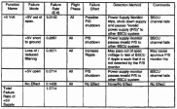



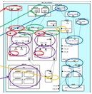
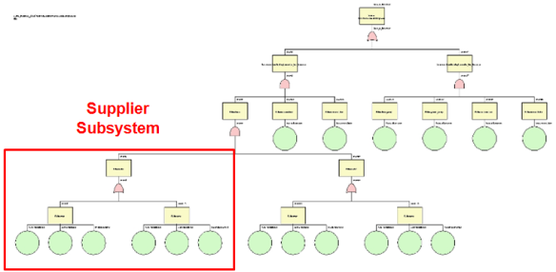

Iterative Safety Analysis Process with AADL
Functional Hazard Assessment
System in Environment
Propagation points,
Hazards
FHA Report
Consistency
Preliminary System Safety Assessment
System as Subsystems
Error sources
propagations, flows,
Composite error state
PSSA & other reports
(FMEA, FTA, DD, MA)
Refinement of Architecture Layers/Tiers
Consistency
System Safety Assessment
Subsystem
Implementations
Redundancy logic detection
Composite error state
SSA Report
(FMEA, FMES, CCA)
AFE61
COMPASS Project
Notes:
The Error Model Annex lets us perform architecture fault modeling at several levels of abstraction.
We start with a system FHA by representing the system in its operational context and the hazards with Error Model annotations.
As the architecture is refined one tier at a time, we refine the AADL model and Error Model annotations with additional safety related information and perform PSSA and FHA of the subsystems at each level. The model-based approach allows us to check for consistency between the information used in the PSSA and FHA at a given level with those at the next higher level.
As the design of the system evolve we will be able to demonstrate (in AFE61) how this safety analysis approach can be extended to support SSA.

Slide 37
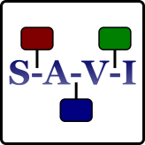

AADL & Safety Evaluation – Tool Overview
SAVI | Error Model | Evaluation | Case Study | Future
Architecture centricity enables generative technologies to support analyses
FHA
Spreadsheet
Use error
propagations
FTA
CAFTA
OpenFTA
Use composite
behavior
Error flows
Markov Chain
PRISM
Use error flow
Error behavior
SPN/SANs
Stochastic
Petri Nets and Activity Nets
Use error flow
Error behavior
FMEA
Spreadsheet
Error behavior
Propagations
“traditional” methodologies (a la ARP 4754/4761)
Notes:
Can add in addition to Markov chains – work at ESA on Petri Net analysis

Slide 38
From As-Is to To-Be → Single Truth
Problem: Multiple truths
  Models from multiple design teams contain multiple interdependent properties
  Each design team identifies different ways of modeling (abstracting) these common properties - multiple models and tools
  Models are developed at different times
As-Is
Distributed Annotated Architectural Reference Model - Verification
Model Repositories
Data Exchange Layer
Consistency checks after each mod
Consistency checks after each change
To-Be
Notes:
This chart looks at the integration issues, but from a more fundamental and pragmatic perspective. Currently, we build interface control documents (ICDs) based upon specification of how the system is to be built and how all disciplines think the functions will be performed by individual elements. Our “as-is” documents are intended to largely allow specialty analysts to improve their individual parts of the system. Sometimes these models share properties that are crucial, but the specialists do not necessarily share all modifications they make with other specialties. The “as-is” document-based integration process is designed to utilize ICDs to ferret out contradictions. But this type of integration often takes place late in the development cycle when these “unexposed shared properties” have wreaked havoc in the program manager’s cost/schedule.
The VIP proposed by SAVI, through its Distributed Annotated Architectural Reference Model (usually simply called a “single-truth model”), provides a tailored and structured Data Exchange Layer supporting data flow to/from Model Repositories. This infrastructure allows the VIP to perform consistency checks on the architectural elements after modifications. Since this work is done earlier than it is in physical or logical integration (the “as-is” approach), the cost of “getting the system right and keeping it right” should be driven down.

Slide 39
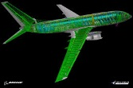


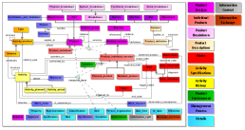

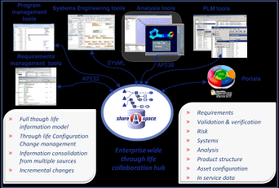
AFE-61 Model Focus
SysML
Enterprise Architect
AADL
Profile
3D Solid
Geometry
SolidWorks, NX
Correspondence
Pub-Sub
Excel
AADL
OSATE
Hazard
Table
Excel
Translator
Consistency
Checking
LUTE
Requirements
DOORS, Excel
Fault Tree
CAFTA
FMEA
Excel
Markov
Chains
PRISM
SAVI MR/DEL
Standards: PLCS/DEX, STEP, ReqIF, XMI, OLCS, Eclipse
Proprietary: Intentional SW, The Mathworks
SVN
Eurostep Share-A-space®
Notes:
Here we see the specific tools, models and data repositories that AFE-61 focused on. We are using Share-A-space® and Eclipse as the standards based data exchange solutions to link up tools, model, data and repositories. We’ve been able to link up and analyze, for example, shared properties in solid geometry and architecture models – something that is rarely done, if ever, between these two domains. This is a powerful capability for cross-domain inter-model consistency checking which is a cornerstone of SAVI.
For expediency (limited resources and time), AFE-61 chose to implement the SysML-AADL translation with an existing tool developed under the DARPA META program (and expanded under SAVI). This translator will be discussed later in this presentation.
….(CLICK TO ADVACE TO NEXT SLIDE)….
1:30 min

Slide 40
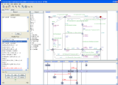
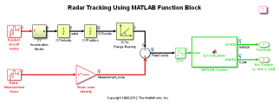
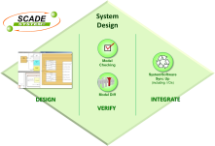
Model Vision Across Supply Chain
RTES
Analysis
ASIIST
Correspondence
Pub-Sub
Excel
SysML
Enterprise Architect
3D Solid
Geometry
SolidWorks, NX
AADL
OSATE
CPU
FSB
Host
Bridge
Local
Memory
Hazard
Table
Excel
Main
Memory
PCI
Bus
Bridge 1
Bridge 2
PCI
Bus
Peripheral 1
Peripheral 2
Network
Adapter
Network
Bus
Constraint
Analysis
LUTE
Switch
Behavior
UPPAAL
Requirements
DOORS, Excel
Fault Tree
CAFTA
FMEA
Excel
Markov
Chains
PRISM
SAVI MR/DEL
Standards: PLCS/DEX, STEP, ReqIF, XMI, OLCS, Eclipse
Proprietary: Intentional SW, The Mathworks
2N Translation
Exchanges
Simulink
Behavior
Modelica
PDM/PLM
TeamCenter,
Enovia,
Windchill
ERP
SCADE
SVN
Proprietary
Eurostep Share-A-space®
Notes:
Using a data exchange standard, such as PLCS/DEX, STEP, ReqIF, XMI OLCS and Eclipse (shown), reduces the number of translators to “2N,” or twice the number of nodes in the model set ecosystem. This significant reduction in data interchanges creates a more robust data exchange infrastructure.
The SAVI vision calls for integrating a broad spectrum of tools, models, file types and data repositories. Here we see in the top half of the slide a model set that includes many domains: requirements, architectures, fault trees, constrain and real time embedded system analysis, solid geometry, behavior, Markov Chain, hazard table analysis and publisher-subscriber relationship models.
The bottom half of the slide shows, along with other tools and models, examples of data repositories such as Product Data Management and Product Lifecycle Management (PDM,PLM) systems and Subversion. In addition, we see a need to view results and reports of data repository data and metadata analysis.
…(CLICK TO ADVANCE SLIDE)….
3:00 min

Slide 41

Dependencies Are Key
AVSI | Motivation | SAVI Concepts | 2013 | 2014
Project
Management
Systems
Software
Electrical
D
D
D
D
Mechanical
Manufacturing
Mechanical
Test &
Evaluation
Structures
Aerodynamics
Propulsion
Each dependency needs to be identified, tracked and checked throughout the life cycle

Slide 42
AVSI | Motivation | SAVI Concepts | RoI | 2014
There is No Magic
A typical commercial airplane development program should cost ~$10B in 2007
  $2B/year x 5 years = $10B
  “The development cost of the A380 had grown to €11 billion when the first aircraft was completed.” http://en.wikipedia.org/wiki/A380
In aerospace, rework is in the 50% range
50% rework x $10B = $5B opportunity
About half of this opportunity, $2.5B, will be related to airplane systems
Most of that will be related to software
There is a large opportunity
26 Jan 2015
Used with SAVI permission © AVSI
42
Notes:
There Is No Magic
To better understand the motivation for investigating the business case for improving the integration process, the SAVI team noted the facts of commercial aircraft development as summarized in this chart. It is quite obvious that the target opportunity in dollar cost alone is huge. And this dollar-oriented motivation does not address the opportunity cost of significant schedule impacts when integration leads to major system revisions at a very late date. Our investigations of the software impacts led to a solid conclusion that software costs were major drivers in this overall savings opportunity.

Slide 43
Towards Analyzable Requirements Specification
Best practice industry study for FAA [2009]
  Primarily textual shalls , tables, and diagrams, MS Word and DOORS
FAA Requirements Engineering Management (REM) Handbook [2009]
  Draws on SpecTRM, Rockwell Collins experience with model checking
  11 step process with avionics and medical device examples
Requirements Definition and Analysis Annex
  Separation of concerns: problem (requirements) / solution (design)
  Incorporates concepts from SysML, KAOS, URN, FAA REM Handbook
  Goals, requirements, refinement, decomposition, verification, risks
  Semantics: validation of requirement specifications, verification of formally specified requirements
  Extensible with respect to constraints, use cases, and traceability links
  Demonstrated on FAA REM Handbook process with medical device example
  Applicable to AADL and other ADLs

Slide 44
Summarized Case for
Architecture Centric Virtual Integration
Problem: Costs to develop complex RT Software Reliant Systems accelerating rapidly with size, already reaching affordability limits (10B) for advanced aircraft.
Underlying Issue: A major part of this cost is driven by composition and interaction complexity resulting in errors driving rework at high cost multipliers.
  70% of errors introduced in requirements and design, 3% found
  80% of errors not discovered until system integration, 20X-1000X
  20% of errors introduced in coding, 16% found, not the big issue.
  Key Concept: Architecture Centric Virtual Integration Process (ACVIP)
  Reducing integration errors through early, predictive and incremental virtual integration and enhanced qualification.
  Predictive architectural analysis across multiple system qualities.
  Across a single integrated consistent architectural specification.
Enabling Advancement: Architecture language with strong semantics, plus verification methods leveraging ACVIP.
Research Task: Excellent opportunity for experimental application of ACVIP paradigm in Joint Multi-Role Aircraft, prepare for FVL.

Slide 45
Architecture Centric Model Based Virtual Integration
Current - Build then Test - Applied with best SWE. Not proving effective for increasingly complex systems. Difficult to modify. Many side effects. (50% detailed requirements change after CDR)
Future - Integrate then Build – New paradigm. Keep best SWE but add ability to predictively compose system, subsystem, SW and HW components into an architecture via models before we build the system to achieve the required system behavior and qualities.
Upgrades process - Integrates component models across system suppliers using a standardized language with well defined meaning supporting tool and analysis interoperability across analysis domains.
Requires - a language (tools and a process) to describe the integrated software and hardware components and to quantitatively predict the integrated system execution behavior and constraints.
Supported - Architecture Analysis & Design Language (AADL) provides the capability. Industry standard, research demonstrations on SAVI and CAAS and Apache.
Critical – Key competitive advantage on cost/schedule/rapid change/robustness/trade space optimization

Slide 46
Past Results
SAVI | Error Model | Evaluation | Case Study | Future
Several proof of concept phases have researched the feasibility of the SAVI VIP, exploring topics including:
  Model-based vs. document based systems acquisition
  SAVI return on investment (RoI)
  Architectural description language capabilities and extensions
  Inter-domain tool integration
  Model repository attributes for virtual integration
  Model data exchange protocols and technologies
  IP protection in an integrated, multi-participant modeling environment
  Assurance methods

Slide 47
Past Results
SAVI | Error Model | Evaluation | Case Study | Future
Several proof of concept phases have researched the feasibility of the SAVI VIP, exploring topics including:
  Model-based vs. document based systems acquisition
  SAVI return on investment (RoI)
  Architectural description language capabilities and extensions
  Inter-domain tool integration
  Model repository attributes for virtual integration
  Model data exchange protocols and technologies
  Scalability
  IP protection in an integrated, multi-participant modeling environment
  Assurance methods
SAVI Members have concluded that there is compelling evidence to justify development of the SAVI VIP

Slide 48
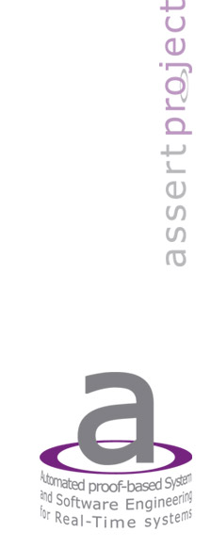
The ASSERT process
System
Model
(AADL)
The source code for each
subsystem, as generated
by the tools’
code generators
ASN.1 Code
generators
As created in Stood
(and asn2aadlPlus)
Data Models
(ASN1)
The encoders and decoders
of the ASN.1 messages
SDL
The messages exchanged
between subsystems
The semantically equivalent
types of the messages per tool
Lustre
ObjectGeode
SCADE
ASN1 compiler
(asn1c)
C code
C code
mapping
C code
C code
mapping
C code
Behavior
Data structures
Behavior
Data structures
Data structures
Encoder/decoder
AADL container
AADL Container
AADL Runtime

Slide 49
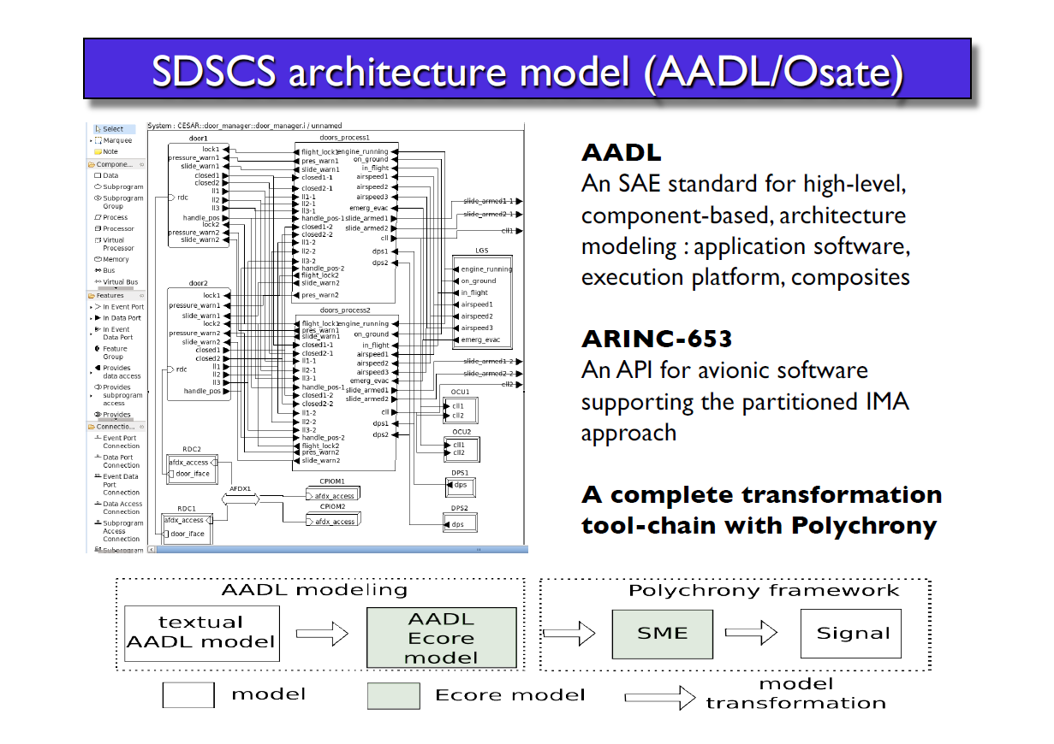

Slide 50
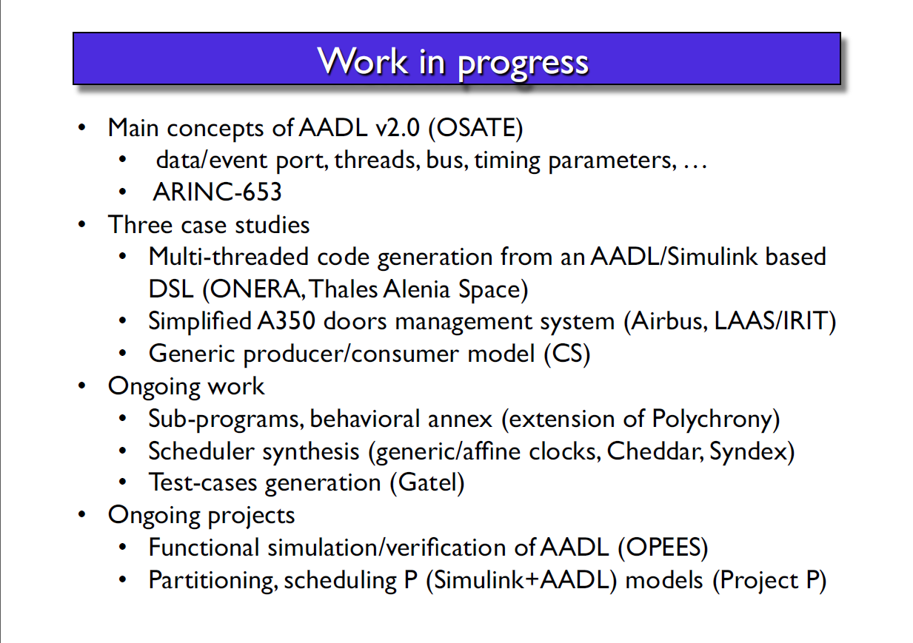

Slide 51
AADL Tools
Open Source AADL Tool Environment (OSATE) (US) – Reference toolset for the language standard and various analysis tools. Research platform for many projects.
AADL Compliance Test Suite (R) – OS toolset to ensure single interpretation of specification, improve tools and evaluate limitations.
STOOD – Commercial toolset for developing AADL specifications or HOOD specifications, graphical, documentation, transformation. (E)
AADL Inspector – Commercial toolset for multiple forms of analysis with developing ties to formal analysis and code generation. (E)
OCARINA – OS toolset for architecture generation and integration of components from AADL specs in the high integrity domain. (E)
MASIW – (restricted but AADL editor OS) AADL Based Toolset for IMA System Design and Integration from Ispras-gosniias. System design support through implementation (with support for safety and certification in future). (R)
BLESS – (OS) Theorem prover for AADL specifications based on AADL Behavior Annex. (U)

Slide 52
AADL Tools Part 2
Requirements Definition & Analysis Toolset – Open People, provides a design environment for requirements including goals, requirements, formalization, verification, tracing to architecture. (E)
COMPASS – Restricted to EU. Formalizes AADL to SLIM and performs 10 plus forms of safety analysis. (E)
Consumption Analysis Toolbox – Open People, develops power consumption from AADL specifications of the SW and the HW. (E)
FUSED – Trade-space optimization toolset which incorporates AADL as one dimension. Used to formally verify consistency between diverse models. (U)
SysML to AADL – toolset to enable using Enterprise Architect SysML editor (graphical) to develop AADL specifications (at the higher level). Bidirectional (U).
TASTE – (restricted) Toolset incorporating AADL designed for system engineers developing or upgrading satellite systems. Goes from system specification to implementation with no coding except for device drivers. (E)

Slide 53
AADL Tools 3
REAL – (OS) Requirements Enforcement Analysis Language. A language and tools for writing constraints on AADL models. (E)
Lute – (OS) An extension of REAL by Rockwell Collins to create constraints on AADL specifications. (U)
AGREE – (OS) Assume-guarantee reasoning on contracts attached to AADL models. Part of Rockwell’s formal methods for architecture composition. Integrates into OSATE. Counter examples may feed into test generator.
Resolute - (OS) Theorem prover for structural properties of AADL. Step by step verifications integrate into assurance case. Part of Rockwell’s formal methods for architecture composition. (U)
ASIIST – (OS plus Commercial) – AADL analysis toolset for I/O hardware data flow analysis with high level graphical manipulation of connections for trade-off analysis . (U)
RAMES – OS toolset for architecture generation with incremental transformation and analysis to model constraints. (E)

Slide 54
AADL Tools 4
RTEdge Microkernel – Commercial toolset supporting generation of a safety critical real time runtime system for a subset of AADL with formal analysis of timing. (C)
AADL to Polychrony, AADL to Signal – ( ) transforming AADL into formal modeling languages for system timing and system synthesis. Analysis of safety critical GALS architectures. (E)
AADL to Maude – toolset to enable transformation into the Maude formal language and back for synchronous systems analysis applied to asychronous architectures for model checking. GALS architectures. (U)
AADL 653 Annex to AADL653 – (Restricted) transformation into a formal language for model checking 653 configurations. (C)

Slide 55
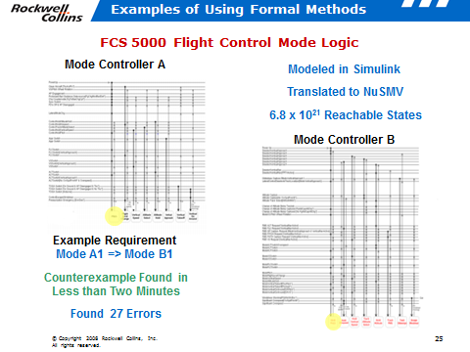
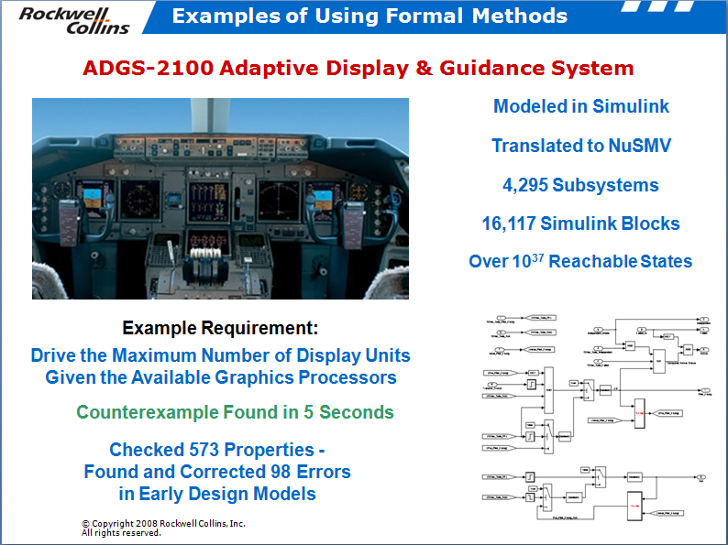
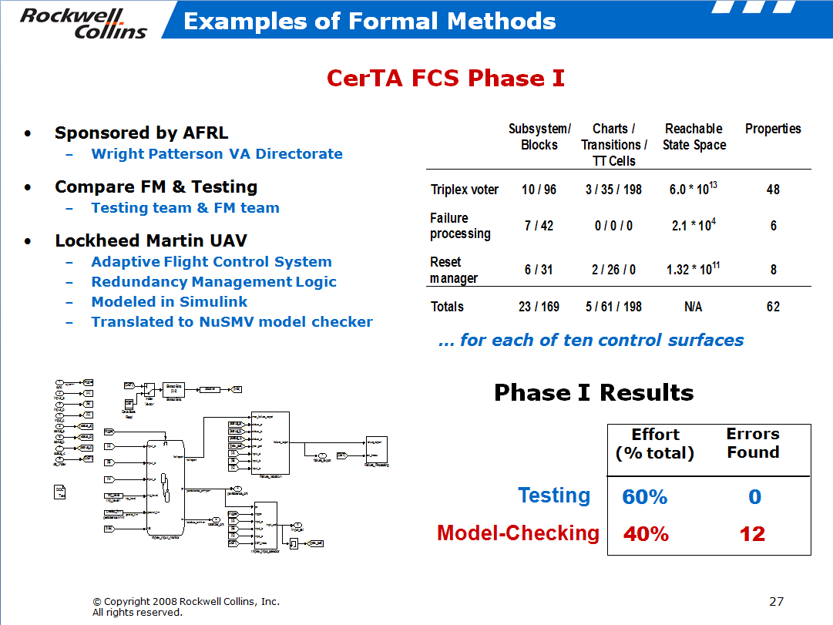
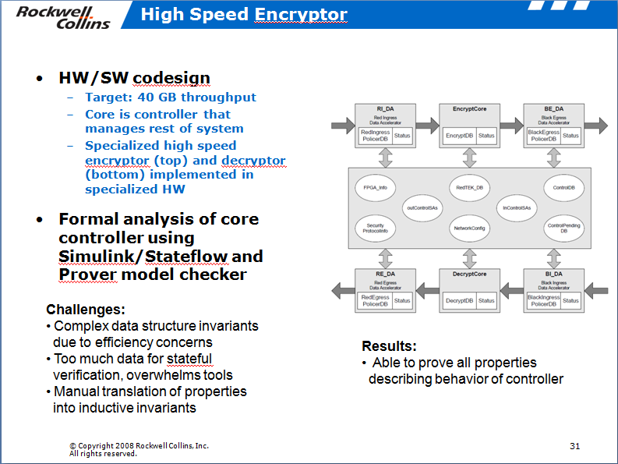
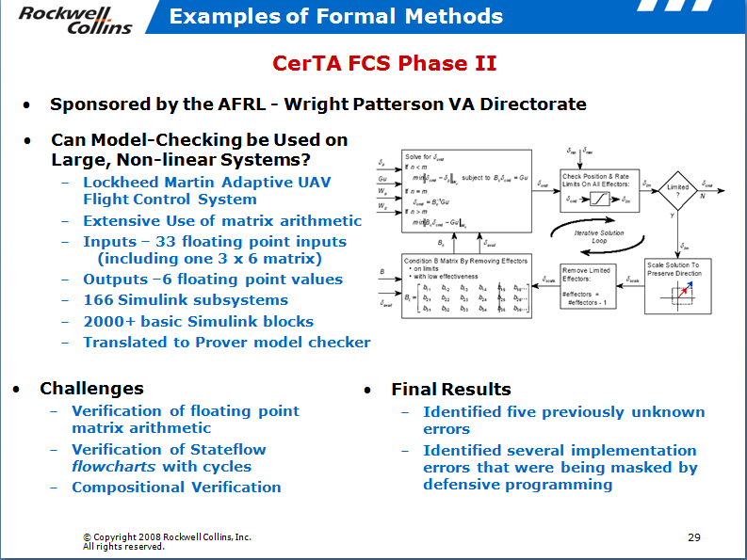
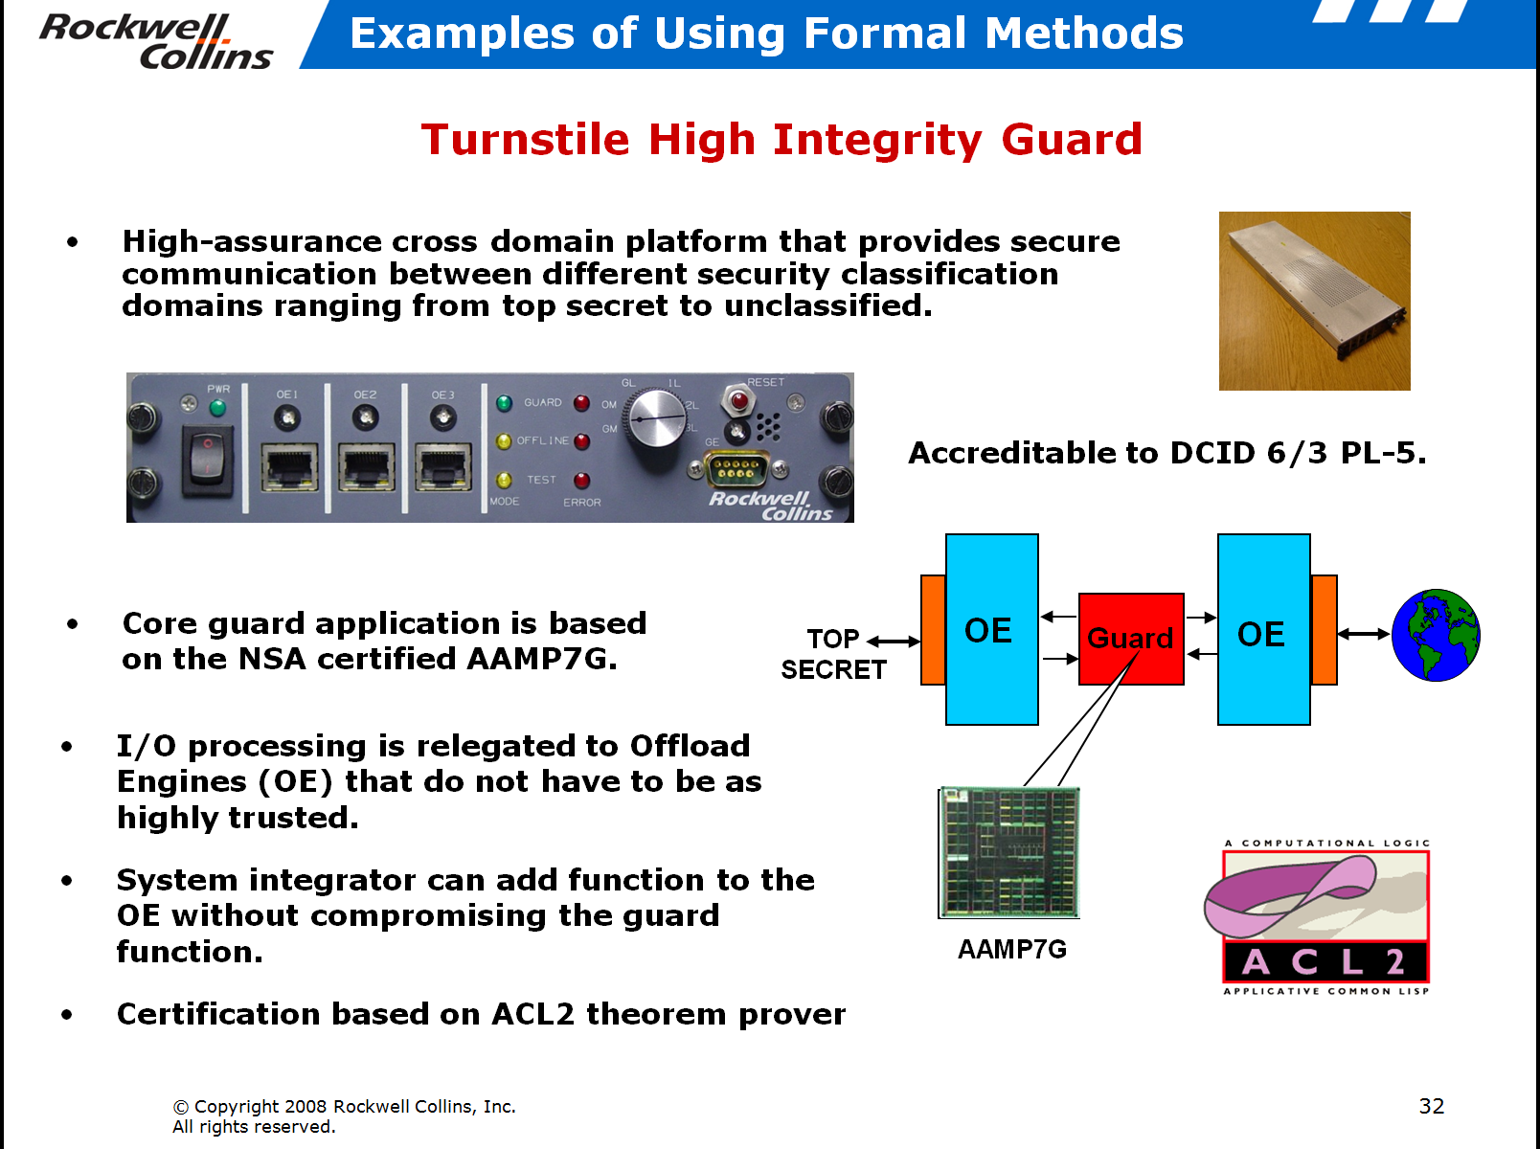

MBD Formal Analysis Efforts
Notes:
Note: not a one man show! Collins continues to use this technology.

Slide 56



