Slide 1



Analytics for Cybersecurity of
Cyber-Physical Systems
Policy-Governed Secure Collaboration
Nazli Choucri
Professor of Political Science Faculty Affiliate, Institute for Data, Systems, & Society (IDSS)
July 9-10, 2019
Project Overview & Year 1 Progress Report.
Prepared for: SoS Lablet Quarterly Meeting, July, 2019, Kansas City.

Slide 2
Project-in-Brief
Problem
Cybersecurity policies & guidelines are in text form
That form encourages “passive” compliance – rather than “active” performance.
It also obscures embedded knowledge – underutilized assets – with opportunity costs.
Purpose
Introduce analytics for CPS cybersecurity to enhance value of guidelines & directives.
Develop & demonstrate with Analytics for Cybersecurity of Smart Grid.
Extend the approach to Long-Chain Analysis of Dynamic & Mobile Infrastructure.
Test-bed centers on cybersecurity focusing on NIST reports, data, guidelines, directives, etc.
Expected product is platform of tools for analytics of cybersecurity
Applications include support for NIST Cyber Security Framework (CSF)
Approach

Slide 3
Outline & Agenda
 | FOCUS
Motivation | EXORD & National Policy
Problem | Burdens & Opportunity Costs of Policy Texts
Purpose & Approach | Capture Full-Value of Policy Texts – End-to-End
Research Design | Platform of Analytical Tools for Risk Analysis
Relevance to SoS Program | Connections & Contributions to Hard Problems
Results – Year 1 | Foundations for Cybersecurity Analytics
What Next? | Year 2 Work Plan - PLUS

Slide 4
Outline & Agenda
 | FOCUS
Motivation | EXORD & National Policy
Problem | Burdens & Opportunity Costs of Policy Texts
Purpose & Approach | Capture Full-Value of Policy Texts – End-to-End
Research Design | Platform of Analytical Tools for Risk Analysis
Relevance to SoS Program | Connections & Contributions to Hard Problems
Results – Year 1 | Create Foundations for Cybersecurity Analytics
What Next? | Year 2 Work Plan - PLUS

Slide 5
Executive Order 13800 of May 11, 2017
Strengthening Cybersecurity of Federal Networks & Critical Infrastructure (82 FR 22391).
“…identify authorities & capabilities that agencies could employ to support the cybersecurity efforts of critical infrastructure entities”
“… support the cybersecurity risk management efforts of the owners & operators of the critical infrastructure.”

Slide 6
Executive Order 13873 of May 15, 2019
Securing the Information and Communications Technology & Services Supply Chain (84 FR 22689).
Assessments and Reports. (Sec. 5.) Assess:
(i) threats enabled by information and communications technologies or services … designed, developed, manufactured, or supplied …. by … a foreign adversary; and
(ii) threats to the United States ….critical infrastructure, and … entities from information and communications technologies or services ….. controlled by… a foreign adversary.

Slide 7
NDAA on Protection of Critical Infrastructure
2019 John S. McCain National Defense Authorization Act*
“Pilot program on modeling & simulation in support of military homeland defense operations in connection with cyber-attacks on critical infrastructure.” (Section. 1649)
  “(A) to assess defense critical infrastructure vulnerabilities & interdependencies to improve military resiliency;
  (B) To determine the likely effectiveness of attacks described in subsection (a)(1), & countermeasures, tactics, & tools supporting responsive military homeland defense operations….”;
2018 National Defense Authorization Act**
“Assessment of Defense Critical Electric Infrastructure.” (Section. 1643)
  “…assess the strategic benefits derived from, & the challenges associated with, isolating military infrastructure from the national electric grid & the use of microgrids.’’
* Public Law No: 115-232; ** Public Law No: 115-91.

Slide 8
On Importance of Analytics & Metrics
2019 US National Intelligence Strategy*
  “…develop quantitative methods & data analysis techniques & tradecraft to improve the IC’s ability to identify, analyze, & forecast changing conditions & emerging trends across multiple portfolios.”
2018 US DoD Cyber Strategy**
  “…The Department will work … to reduce the risk that malicious cyber activity targeting U.S. critical infrastructure ….. We will streamline our public-private information-sharing mechanisms & strengthen the resilience & cybersecurity of critical infrastructure networks & systems.”
https://www.dni.gov/files/ODNI/documents/National_Intelligence_Strategy_2019.pdf;
** https://media.defense.gov/2018/Sep/18/2002041658/-1/-1/1/CYBER_STRATEGY_SUMMARY_FINAL.PDF

Slide 9
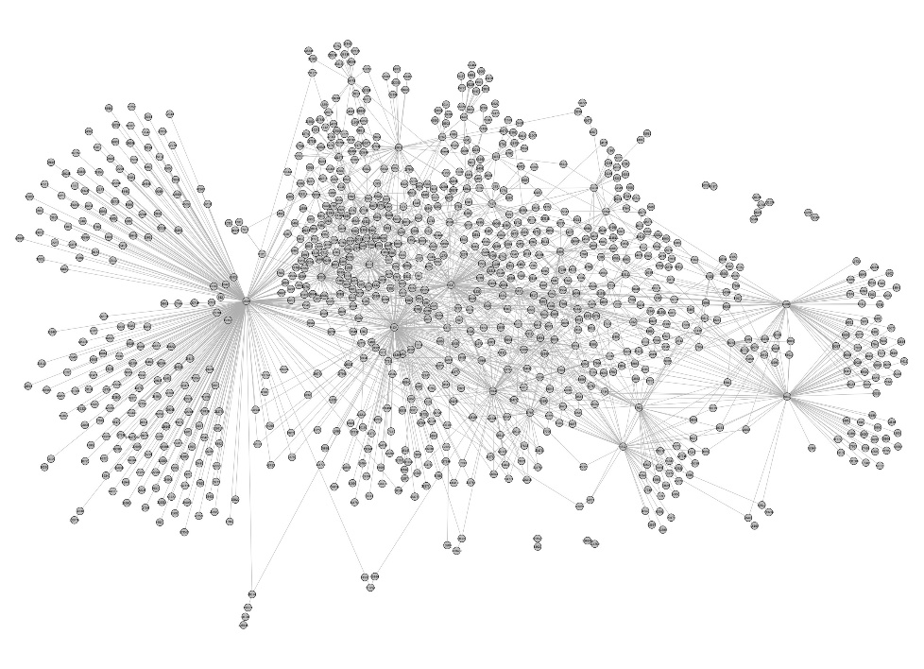
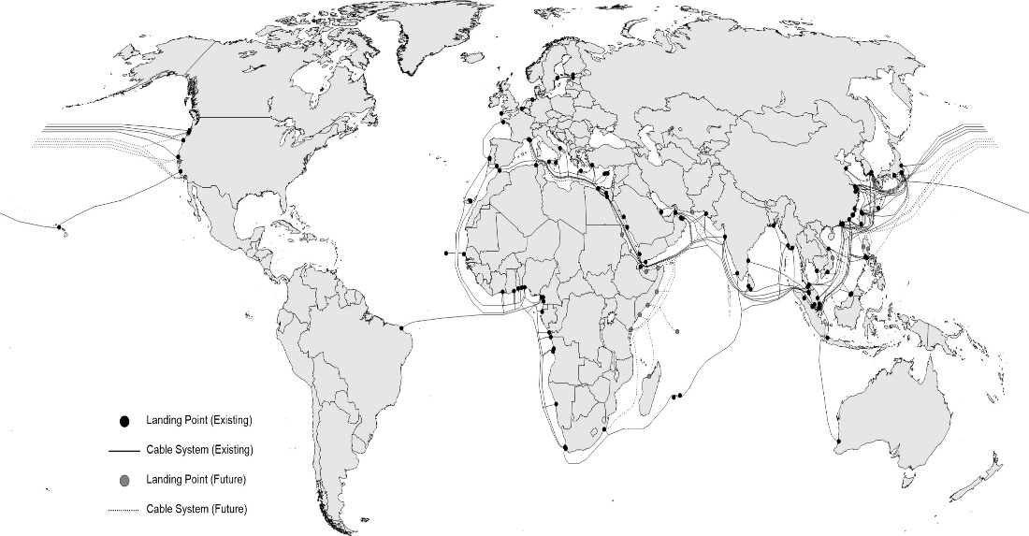
Imperatives for Securing the Long-Chain of Cyber-Physical Global Communication Infrastructure
“…foreign adversaries are increasingly creating and exploiting vulnerabilities in information and communications technology and services … in order to commit malicious cyber-enabled actions, including economic and industrial espionage against the United States and its people.”¹
Executive Order, May 2019 ¹.
Global network of undersea communication cables with partial Chinese ownership. Source: Constructed from Telegeography.com ²
Autonomous Systems (AS) nodes for Internet access in China. Source: Constructed from data in RIPE ³ for a specific date in 2018.
Cybersecurity of complex long chain global communication infrastructure is difficult to assess & analyze, let alone to protect. Prevailing risks & vulnerabilities may far exceed any acceptable level.
¹ Exec. Order 13873. “Securing the Information & Communications Technology & Services Supply Chain,” 84 FR 22689. May 15, 2019.
² “How can I download the KML or a CSV of the dataset?” Telegeography/www.submarinecablemap.com https://github.com/telegeography/www.submarinecablemap.com (accessed April 16, 2019).
³ Country ASNs: China, RIPEstat Data API, December 15, 2018. [Online]. https://stat.ripe.net/data/country-asns/data.json?resource=cn&lod=1&starttime=2018-12-15T12:00:00
⁴ ASN Neighbours for Autonomius System Numbers (ASNs) identified in [34]. December 15, 2018. [Online]. https://stat.ripe.net/data/asn-neighbours/data.json?resource=<resource>&starttime=<starttime>T12:00:00. Note Replace <resource> with ASN & <starttime> for ISO8601 or Unix timestamp. See https://stat.ripe.net/docs/data_api#asn-neighbours for details.

Slide 10
Outline & Agenda
 | FOCUS
Motivation | EXORD & National Policy
Problem | Burdens & Opportunity Costs of Policy Texts
Purpose & Approach | Capture Full-Value of Policy Texts – End-to-End
Research Design | Platform of Analytical Tools for Risk Analysis
Relevance to SoS Program | Connections & Contributions to Hard Problems
Results – Year 1 | Foundations for Cybersecurity Analytics
What Next? | Year 2 Work Plan - PLUS

Slide 11
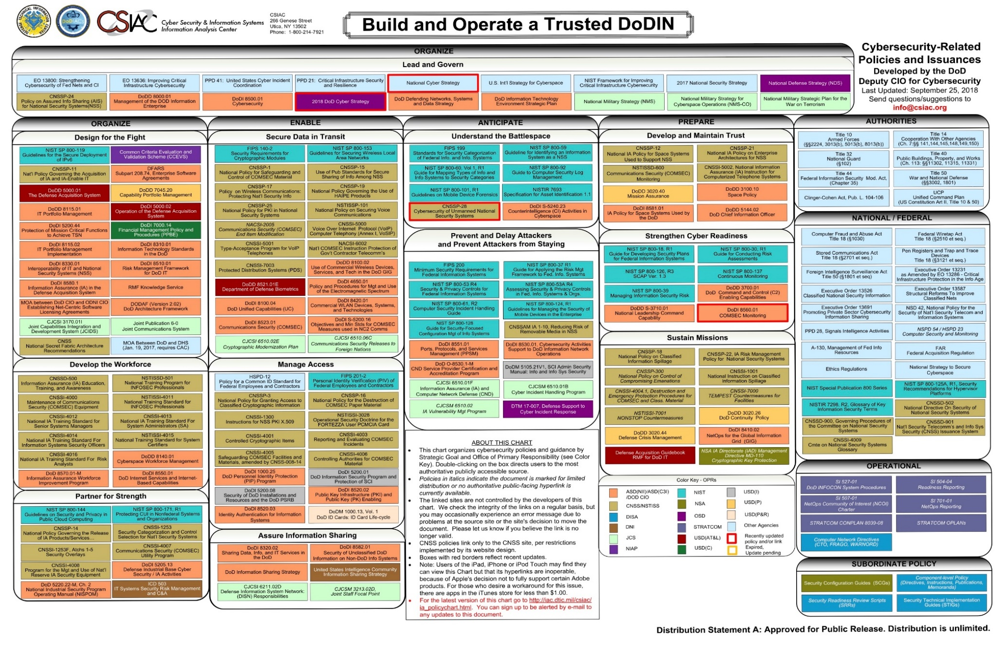
Cybersecurity Related Polices & Issuances

Slide 12
Problem
High opportunity costs are embedded in cybersecurity guidelines.
  Policy guidelines & directives are transmitted in text form.
  Difficult to aggregate & integrate or understand policy-technology complexities.
  User is passive reader & tends to focus on checklist.
  Considerable knowledge is generated in process of establishing guidelines.
  Text impedes locating interactions, feedback, specialized views, etc..
  Knowledge of key cybersecurity factors is “lost”.
  Loss of embedded knowledge creates major opportunity costs.
  It is lost to managers, security experts, & policy analysts who deal with text-form.
  It is lost to all others seeking to increase cybersecurity & reduce risk.
Result:
  Creates undue & unexpected barriers to implementation.
  Impedes operational & pragmatic action.

Slide 13
Outline & Agenda
 | FOCUS
Motivation | EXORD & National Policy
Problem | Burdens & Opportunity Costs of Policy Texts
Purpose & Approach | Capture Full-Value of Policy Texts – End-to-End
Research Design | Platform of Analytical Tools for Risk Analysis
Relevance to SoS Program | Connections & Contributions to Hard Problems
Results – Year 1 | Create Foundations for Cybersecurity Analytics
What Next? | Year 2 Work Plan - PLUS

Slide 14
Capture Full-Value of Policy Texts – End-to-End
Test Bed – smart grid of power systems
1
Problem
  Policies & guidelines in text form obscure dynamics, feedback, delays & other critical features of policies & guidelines.
2
Database & Metrics
  Challenge is to construct “text-to-data” for cybersecurity analyses based on logic & evidence in sector-specific & sector-independent policy reports & data by NIST & other agencies.
3
Research Design
  Create “data-to-metrics functions & capabilities to capture “as is” system, vulnerabilities & risks, & manage capability maturity gap.
4
Expected Products
  Platform for cybersecurity analytics to support users of guidelines with adaptation tools
5
Mission Specific
  Provide a generic approach with linked data & method to manage cybersecurity risks for mission-specific requirements

Slide 15
Policy-Focused Approach
PURPOSE
LOGIC
PLATFORM
PROCESS
DECISION SYSTEM
Presidential Executive Orders on NIST Cyber Security Framework
Leverage Existing Policies, Standards, and Guidelines
Construct Platform for Cybersecurity Analytics
Steps to Identify Targets & Manage Impacts of Damages
1
2
3
Platform Use for Pragmatic Applications to Cybersecurity
5
4
“Support the cybersecurity risk management efforts of the owners and operators of the critical infrastructure.”
  Draw on analyses & empirical evidence provided by NIST reports and databases.
Develop tool suite for various analyses of system architecture.
  Establish “ground truth” using platform & tool suite
Identify critical gaps, select preferred future system state, & define corrective measures.

Slide 16
Outline & Agenda
 | FOCUS
Motivation | EXORD & National Policy
Problem | Burdens & Opportunity Costs of Policy Texts
Purpose & Approach | Capture Full-Value of Policy Texts – End-to-End
Research Design | Platform of Analytical Tools for Risk Analysis
Relevance to SoS Program | Connections & Contributions to Hard Problems
Results – Year 1 | Foundations for Cybersecurity Analytics
What Next? | Year 2 Work Plan - PLUS

Slide 17
Research Design
Multi-methods data-based platform of analytics for cybersecurity.
Base Period (Year 1)
Mid-term (Year 2-3)
Mid-Long term (Year 3-4)
Long-term (>Year 4)
Build Text-to-Data Foundations for Cybersecurity Analytics
Construct CPS Structured Model of Operations & information
Create Network Views of overall CPS Architecture
Apply Interactive Drill-Down Tools for Exploratory & Base Analysis
Formalize SoS policy analytics & applications of pragmatics
A
B
C
D
E
Identify policy relevant ecosystems
Map system properties.
Identify nodes centrality & salience
Examine threat diffusion & impacts
Extend platform to other CPS systems
Formalize rules to extract data from text.
Design internally consistent structure to organize, metricize, link and manage data.
Create base design structure matrix (DSM)
Cluster & partition DSM to identify critical system properties
Identify control points & relevance,
situate human vs. technical operations.
Examine functions & centrality of nodes & assess vulnerabilities
Explore resilience of CPS whole & parts.
Provide interactive tools for on-demand targeted analysis
Formalize platform for enterprise-wide CPS analysis.
Use Live-Virtual-Constructive environment for evaluation & validation.

Slide 18
Outline & Agenda
 | FOCUS
Motivation | EXORD & National Policy
Problem | Burdens & Opportunity Costs of Policy Texts
Purpose & Approach | Capture Full-Value of Policy Texts – End-to-End
Research Design | Plof Analytical Tools for Risk Analysis
Relevance to SoS Program | Connections to Hard Problems & Contributions
Results – Year 1 | Foundations for Cybersecurity Analytics
What Next? | Year 2 Work Plan - PLUS

Slide 19
Connections to SoS Hard Problems
Address the hard problem of policy-governed secure collaboration at the enterprise level (applied to smart grid).
1
Resilient Architectures
  Generate linked database of operations, standards & guidelines
  Design approach database to align enterprise functions to generic system-properties .
  Provide system-of-system database of critical documents.
2
Scalability & Composability
  Enable “full package” for different risk types, levels & time scales.
  Provide methods with tools to deep dive into database for customized insights & analyses.
  Create decision supports with methods to identify, analyse & record risk & its responses.
3
Policy Governed Secure Collaboration
  Conduct targeted enterprise-relevant analysis
  Address system-level complexity & heterogeneity due to policy landscapes.
  Identify points of power & control created by design decisions & policies.
4
Security-Metrics-Driven Evaluation, Design, Development & Deployment
  Identify & implement operational responses & actions.
  Use metrics to assess, deploy & develop capabilities – People, Policy & Procedures.
  Implement cybersecurity framework– Executive, Business/Process, Operations level.
5
Understanding & Accounting for Human Behaviour
  Establish independent monitoring of key enterprise functions.
  Timely, uniform & accurate accounting of business processes.
  Identify potential violations of policy directives & systematically prevent occurrences.

Slide 20
Contributions to SoS Program
  Policy Analytics
  Provide replicable methods for cybersecurity policy analytics of system & enterprise
  Focus on text-to-model analysis & network views of cybersecurity of CPS
  Extend applications beyond cybersecurity of smart grid.
  Education
  Demonstrate multi-methods for cybersecurity policy of complex systems.
  Provide “end-to-end” road map & document all applications step-by step
  Explore advantages & constraints of multi-method approach
  Outreach
  Connect to diverse communities.
  Introduce SoS initiative to United States Air Force in discussions on collaboration.
  Highlight CPS project to “Cybersecurity” graduate course, & to research programs at MIT
  Develop collaboration with select industries (such as Schneider Electric)
  Envisage e-Lab for cybersecurity (extension of smart grid)

Slide 21
Outline & Agenda
 | FOCUS
Motivation | EXORD & National Policy
Problem | Burdens & Opportunity Costs of Policy Texts
Purpose & Approach | Capture Full-Value of Policy Texts – End-to-End
Research Design | Platform of Analytical Tools for Risk Analysis
Relevance to SoS Program | Connections & Contributions to Hard Problems
Results – Year 1 | Foundations for Cybersecurity Analytics
What Next? | Year 2 Work Plan - PLUS

Slide 22
Foundations for Cybersecurity Analytics
Year 1: Policy-based data & metrics for cybersecurity analytics.
A. Identify Cybersecurity Policy Ecosystem
  Locate key policy texts for cybersecurity of CPS application case.
  Identify critical content & boundary conditions of cybersecurity policy-systems.
B. Develop Data Extraction & Linkage Methods
  Identify & extract value-added of policy documents & guidelines.
  Develop process of “text-as-data” for construction of structured model.
C. Implement “Text-to-Data” Strategy – Inputs for Year 2
  Verify internal consistency of data extraction & linkages to support metrics.
  Generate output of process from policy texts to text-as-data.

Slide 23
Foundations for Cybersecurity Analytics
Year 1: Policy-based data & metrics for cybersecurity analytics.
A. Identify Cybersecurity Policy Ecosystem
  Locate key policy texts for cybersecurity of CPS application case.
  Identify critical content & boundary conditions of cybersecurity policy-systems.
B. Develop Data Extraction & Linkage Methods
  Identify & extract value-added of policy documents & guidelines.
  Develop process to “text-as-data” for construction of structured model.
C. Implement “Text-to-Data” Strategy – Inputs for Year 2
  Verify internal consistency of data extraction & linkages to support metrics.
  Generate output of process from policy texts to text-as-data.

Slide 24
Cybersecurity Related Polices & Issuances

Slide 25
CPS Cybersecurity Policy Ecosystem
Policies & Guidelines
Goals
Mission Specific
② NIST Risk Management*
Enterprise Security & Risk Management
support
NIST Supply Chain Risk Mgmt.*
Toward
Smart Grid
Cybersecurity
US-CERT Cyber Resilience Review (CRR)*
support
support
ICS-CERT Cybersecurity Evaluation Tool (CSET)*
goal
supports
Compliance to
Federal Regulations
Presidential Executive Orders & NDAA
directive
⑥ NERC CIPs#
is a type of
support
regulation
Compliance to
Technical Requirements
orders creation
& use of
① NIST CSF*
support
framework
refers
refers
is a type of
refers
③ NIST SP800:53*
Implementation of Capability Maturity Models
security controls
⑧ DoE/DHS C2M2#
is a type of
⑦ NIST NVD*
provides input
refers
method
database
refers
④ NIST IR7628#
supports
guidelines
⑨ CVSS*
supports
refers
* Sector-All
method
# Electricity Smart Grid Focus
⑤ NIST SP1108#
Note: Refer to slide “Basic Policy Documents for “Text-to-Data”” for identification of document indicated by circled number.
SG model

Slide 26
Use of Text-to-Data for each Research Phase
Use of text-to-data for platform of cybersecurity analytics.
Build Text-to- Data Foundations for Cybersecurity Analytics
Construct CPS Structured Model of Operations & information
Create Network Views of overall CPS Architecture
Apply Interactive Drill-Down Tools for Exploratory & Base Analysis
Formalize SoS policy analytics & applications of pragmatics
A
B
C
D
E
2017-2019 Executive Orders
Revisit National Security Requirements & Mandates
2017-2019 NDAA
Identify National Security Requirements & Mandates
2018-2019 Security Strategies
① NIST CSF*
Cybersecurity Framework
Framework Functions
Framework Functions Applicability
Enterprise Cybersecurity Profile
② NIST SP 800-37 Rev. 1*
Enterprise Risk Management
③ NIST SP 800-53 Rev. 4*
Security &
Privacy Controls
④ NISTIR 7628r1#
Logical Interface, Vulnerabilities Types, & Impacts on Security Objectives
Security Requirements
⑤ NIST SP 1108 Rev. 3 #
Smart Grid Reference Model
⑥ NERC CIPs#
Federal Compliance Requirements
⑦ NIST NVD*
Vulnerability Identification
⑧ DoE/DHS C2M2 Model#
Smart Grid Cyber Capability Maturity
⑨ NIST CVSS*
Impact & Vulnerability
Quantification
* Sector-All
# Sector-Specific (Electricity smart grid)
Note: Refer to slide “Basic Policy Documents for “Text-to-Data” for identification of document indicated by circled number.

Slide 27
Scale & Scope of Basic Linked Database
Multi-dimensional linked database.
Over 15 interdependent dimensions
Spread over multiple dimensions in over 600+ pages
Current text burdens to reader to extract information.
Smart Grid CPS | Count
Core Elements
Domain | 7
Actor | 47
Logical Interface between Actors | 122
Logical Interface Categories | 22
Security Objectives for Smart Grid
Types {Confidentiality, Integrity, Availability} | 3
Impact Level {Low, Moderate, High} | 3
Security Requirements identified | 180
Families of Security Requirements | 19
Types of Security Requirements | 3
Smart Grid CPS | Count
Vulnerability
Types of Logical Interface | 53
Categories of Vulnerabilities | 4
NIST Cybersecurity Framework | Count
Core Data
Functions | 5
Categories | 23
Sub-Categories | 414

Slide 28
Foundations for Cybersecurity Analytics
Year 1: Policy-based data & metrics for cybersecurity analytics.
A. Identify Cybersecurity Policy Ecosystem
  Locate key policy texts for cybersecurity of CPS application case.
  Identify critical content & boundary conditions of cybersecurity policy-systems.
B. Develop Data Extraction & Linkage Methods
  Identify & extract value-added of policy documents & guidelines.
  Construct process of “text-as-data” for construction of structured model.
C. Implement “Text-to-Data” Strategy – Inputs for Year 2
  Verify internal consistency of data extraction & linkages to support metrics.
  Generate output of process from policy texts to text-as-data.

Slide 29
Year 1 – Summary & Highlights
Policy Ecosystem: Complex, vast & expansive
Multiple agencies are involved in creation policy frameworks & guidelines.
Such documents cross reference each other & are updated regularly.
Undue & unexpected barriers to implementation impede operational & pragmatic action.
CPS Test Case: Smart grid for electrical power systems
Focus on electrical smart grid CPS as it is a critical & essential input to other CPS.
Use of technology, measurement, & standards on CPS cybersecurity from NIST.
Relevance to national cybersecurity policies & DoD-SoS
Accomplishments: From “policy-as-text” to “text-as-data”
Focused on national cybersecurity policies for securing CPS.
Identified core policy documents for smart grid CPS & research design.
Developed operational strategy for data extraction & linkage from core documents.
Extracted data & created DSM of “as-is” smart grid NIST reference model.
Future Plan: From “text-to-data” to “data-to-metrics” & design structures
Focus on smart grid CPS DSM analysis planned for Year 2.
Explore Long-Chain of Cyber-Physical Global Communication Infrastructure.

Slide 30
Outline & Agenda
 | FOCUS
Motivation | EXORD & National Policy
Problem | Burdens & Opportunity Costs of Policy Texts
Purpose & Approach | Capture Full-Value of Policy Texts – End-to-End
Research Design | Suite of Analytical Tools for Risk Analysis
Relevance to SoS Program | Connections & Contributions to Hard Problems
Results – Year 1 | Foundations for Cybersecurity Analytics
What Next? | View of Year 2 - PLUS

Slide 31
Plan for Year 2
From Text to Data to Metrics
A. Establish Network Basis for Year 2
  Pre-test select tools of platform for cybersecurity analytics (“simple case”).
B. DSM as Platform
  Explore use of design structure matrix (DSM) segments for cybersecurity analytics to assist users with adaptable functions to support implementation.
  Utilize DSM to examine sector-specific & sector-independent properties.
C. Implement “Text-to-Data” & “Data-Metrics” Strategy
  Establish & validate “text-to-data” for base design structure matrix (DSM).
  Identify & extract distribution of vulnerabilities & security requirements, toward maturity gap management.

Slide 32
Plan for Year 2
From Text to Data to Metrics
A. Establish Network Basis for Year 2
  Pre-test select tools of platform & tools of cybersecurity analytics.
B. DSM as Platform
  Explore use of dependency structure matrix (DSM) segments for cybersecurity analytics to support users with adaptation functions to assist implementation.
  Utilize DSM to highlight, examine sector-specific & sector-independent properties.
C. Implement “Text-to-Data” Strategy
  Establish & validate “text-to-data” for base design structure matrix (DSM).
  Identify & extract distribution of vulnerabilities & security requirements, toward maturity gap management.

Slide 33
International Law for Cyber Operations: Networks, Complexity, Transparency
Framed as a legal system in an international context & not on the basis of cyberspace & its distinct properties.
Understanding the Tallinn Manual 2.0 is a daunting challenge given its scale & scope.
  150+ rules, aggregated into 20 chapters & 4 parts.
  500+ pages of text with numerous cross references.
But it is an “easy case” with all-in-one-document.
Schmitt, Michael N., and NATO Cooperative Cyber Defence Centre of Excellence (Tallinn). 2017. Tallinn manual 2.0 on the international law applicable to cyber operations. Cambridge: Cambridge University Press.

Slide 34
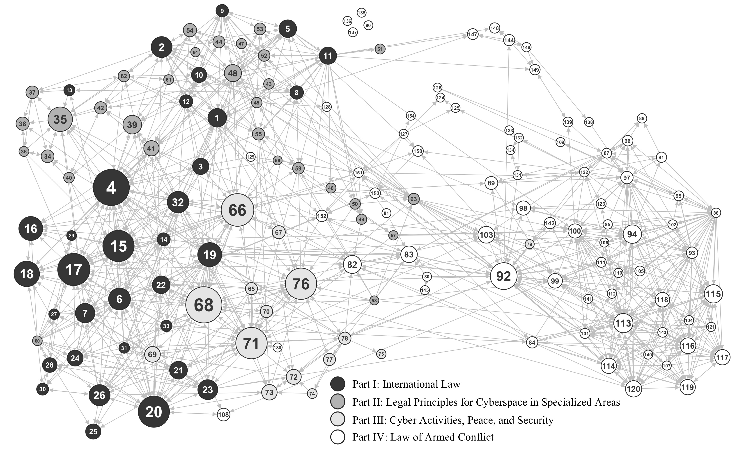
International Law for Cyber Operations: Networks, Complexity, Transparency
DSM matrix transformed into network views of system & connections among components – node centrality view

Slide 35
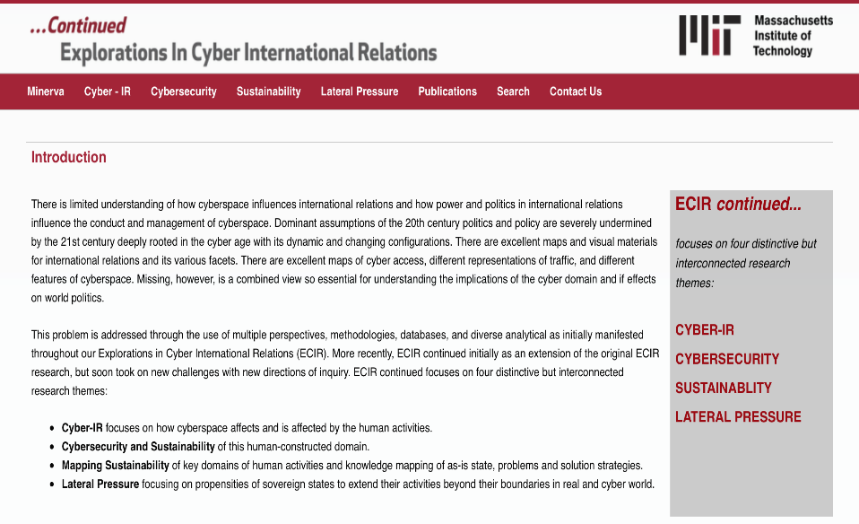
End-Note:
We are interested in strengthening our collaboration with US DoD-SoS
  On-going project on Policy Governed Secure Collaboration for CPS cybersecurity.
  Upcoming problem of Long-Chain Analysis of Dynamic & Mobile Infrastructure.
Submitted two White Papers.
  “Analytics for Cybersecurity of Smart Grid”.
  “Cybersecurity of Undersea Cables”.
http://ecir.mit.edu
Continued ECIR @ MIT
  MIT-wide group, initially funded by DoD.
  Political Science Department.
  Sloan Management School.
  Computer Science (CSAIL).
  Institute for Data, Statistics, & Society.

Slide 36
Analytics for Cybersecurity of
Cyber-Physical Systems
Policy-Governed Secure Collaboration
Nazli Choucri
Professor of Political Science Faculty Affiliate, Institute for Data, Systems, & Society (IDSS)
July 9-10, 2019
Project Overview & Year 1 Progress Report.
Prepared for: SoS Lablet Quarterly Meeting, July, 2019, Kansas City.

