Slide 1
What to Talk About in Cyberspace
Interacting with a machine teammate
John Gersh
Principal Cognitive Engineer
Intelligent Systems Group
JHU/APL
john.gersh@jhuapl.edu
Computational Cybersecurity in Compromised Environments (C3E) Workshop
Menlo Park, CA
17 September 2019

Slide 2
Why is this hard?
The cyber domain is complex and unphysical
Cyber human-machine teaming inherits all the depiction issues of cyber situation awareness
Any depiction will be based on a metaphor
Dialogue involves navigating levels of abstraction
Machine processes may be opaque
Any interaction medium will have to address these issues.
Some media may address some issues better than others in context

Slide 3
What’s to talk about?
Situation:
What’s happening?
What happened?
What’s going to happen?
Plans:
Here’s my goal
Here’s my intent
Explanation
Here’s why I did / will do / am doing that
Here’s why you should to that
Team Status:
How’s it going?
How am I doing?
How are you doing
Here’s my job
Here’s how well I can do it
Direction
Here’s your job
What I expect you can do
What I authorize you to do.
What I forbid you to do.
What I suggest you do
Dos and don’ts
All in context of common ground
All of this is two-way!
Any item may be framed as a negative!

Slide 4
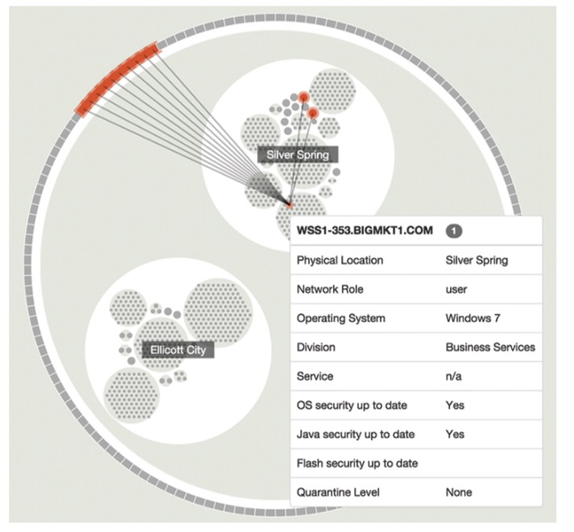
Grand Question #1
What metaphors should we use?
Remember: a metaphor is useful to the degree that its target resembles its source
How will we depict them?
How will we turn conceptual metaphors into sensory ones?
What affordances will make sense?
Is the metaphor a (cognitive) attack surface?
E.g.: Maneuver in the cyber terrain
Arendt, D. L., Burtner, R., Best, D., Bos, N., Gersh, J. R., Piatko, C. D., & Paul, C. L. Ocelot: user-centered design of a decision support visualization for network quarantine. IEEE Visualization for Cyber Security (VizSec), 2015

Slide 5
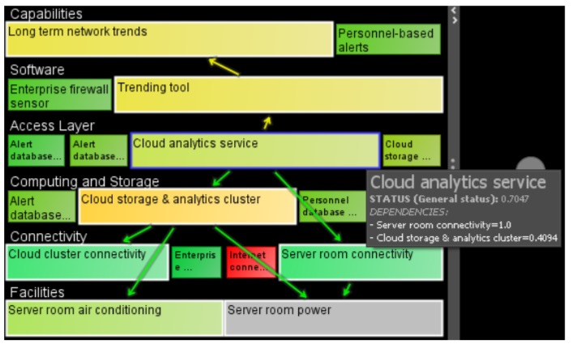
Grand Question #2
How will we depict and navigate levels of abstraction?
Overview and detail in many dimensions
Linked representations from mission goals to information to computing services to transistors
Multidimensional!
Peterson, E. Dagger: Modeling and visualization for mission impact situation awareness. 2016 IEEE Military Communications Conference (MILCOM)

Slide 6
Example: How should we depict this dialogue?
I’m worried about bots spreading disinformation on Facebook
What should I do?
Let me know if you find any, but don’t do anything about them
From any source?
Only non-US
OK, here’s what I’ll do:
OK
I found 4,219
Show me their topics
OK, here
Here’s the plan for dealing with this subset of them
OK I did; here’s the result
Dialogue Notes:
Natural language used here for convenience in presentation
Most dialogue elements (and all indexicals) involve direct interaction with or depiction by the machine partner.

Slide 7
Example: How should we depict this dialogue?
I’m worried about bots spreading disinformation on Facebook
What should I do?
Let me know if you find any, but don’t do anything about them
From any source?
Only non-US
OK, here’s what I’ll do:
OK
I found 4,219
Show me their topics
OK, here
Here’s the plan for dealing with this subset of them
OK I did; here’s the result

Slide 8
Example: How should we depict this dialogue?
It looks like you’re checking out this anomaly. We saw this one like it last week.
Are there any others matching the pattern?
Yes, these
If they’re attack precursors, what’s vulnerable?
This mission capability
Why?
The attack would disable these servers, providing information to these decision makers
If it happens again, here’s the plan for dealing with it.
Aye, aye, ma’am.

Slide 9
One more thing to consider…
There is no such thing as an autonomous system.

