Slide 1
Continuous Reasoning with Gradual Verification
Jonathan Aldrich
July 2024
Work done with Jenna (Wise) DiVincenzo, Conrad Zimmerman, Ian McCormack, Hemant Gouni, Long Nguyen, Mona Zhang, Jacob Gorenburg, Joshua Sunshine, and Éric Tanter. Preliminary work sponsored by the US National Science Foundation; ongoing work sponsored by the US Department of Defense.

Slide 2
The Challenge: Enabling Continuous Reasoning
We live in exciting times for automated theorem proving!
We are now able to verify complex system code. Examples: CompCert, seL4
Enabled by advances in separation logic, proof assistants, SMT solvers, and other tools
Consequence: software that is far more secure & far higher quality
But modern software development involves continuous code evolution
Necessary to provide new features…and to maintain functionality in a changing software environment
If code changes, proofs must change with it – Continuous Reasoning
How can we minimize the cost of evolving code and proofs together?

Slide 3
Continuous Reasoning: A Closer Look at the Problem
Our setting: Hoare Logic style proofs
Specifications as preconditions, postconditions, and loop invariants in code
An automated proof assistant automatically verifies the code against the specifications
e.g. using Dijkstra’s Weakest Preconditions, aided by an SMT Solver
Example tools: Dafny, Chalice
When code evolves, proofs about that code will be broken
The old specifications may be inconsistent with the new code if its structure and properties changed
The old specifications may be incomplete if the new code adds functionality

Slide 4
Continuous Reasoning: Our Approach
Code,
Spec, & Tests
evolution
Evolved Code & Tests
Evolved Code & Tests
Static & Dynamic Verification Results
Proof Maintenance
Specification Increments
Continuous Assurance
Proof Repair
Evolved Code & Tests
Building support for Continuous Assurance into Integrated Development Environments
Leveraging Gradual Verification as part of a Proof Maintenance system
Designing a Proof Repair system that leverages a wide variety of development artifacts to suggest fixes to proofs

Slide 5
Our “Secret Weapon”: Gradual Verification
Gradual verification is a new approach to verification that is designed to deal with incomplete specifications
int findMax(Node l)
requires
ensures max(result,l) && contains(result,l)
{
int m = l->val;
Node curr = l->next;
while(curr != NULL) {
if(curr->val > m) {
m = curr->val;
}
curr = curr->next; }
return m;
}
?
?

Slide 6
Our “Secret Weapon”: Gradual Verification
Gradual verification is a new approach to verification that is designed to deal with incomplete specifications
Specifications can be gradually extended over time to verify more program properties.
int findMax(Node l)
requires
ensures max(result,l) && contains(result,l)
{
int m = l->val;
Node curr = l->next;
while(curr != NULL) {
if(curr->val > m) {
m = curr->val;
}
curr = curr->next; }
return m;
}
? && l != NULL
?

Slide 7
Our “Secret Weapon”: Gradual Verification
Gradual verification is a new approach to verification that is designed to deal with incomplete specifications
Code is verified statically to the extent possible
Missing specifications are treated optimistically
The programmer never gets an error because specifications are missing, only because they are inconsistent – no false positives!
Dynamic checks are inserted for any statically unverified assertions
All errors will be caught either statically or at run time
Initial work done in an NSF-supported project

Slide 8
Properties of Gradual Verification
All specification violations are caught either statically or at run time
If a specification doesn’t have ?, and it verifies, the code is correct
Soundness
Conservative extension
If your specs are a subset of a correct spec, you won’t get any errors
Run time checking cost
increases as you add specs
decreases as specs become statically verifiable
Gradual Guarantee
[Siek et al. 2015]
Pay as you go
Formal investigation in [Bader et al. ’18], [Wise et al. ’20], [Zimmerman et al ’24]

Slide 9
Gradual Verification and Continuous Assurance
Gradual verification is a new approach to verification that is designed to deal with incomplete specifications
Hypothesis: better support for incomplete specifications helps with evolving verified code
We can erase just the incorrect parts of old specs and then work based on the resulting incomplete specifications
Tool support for incomplete specifications provides better, earlier feedback to developers so they can complete those specifications more quickly
Hypothesis: combining static and dynamic checks helps with evolving specifications
Dynamic checks distinguish between specs that are incorrect and those that are correct but unverifiable
Run-time information can help suggest repairs to address incompleteness beyond what we could do with purely static information

Slide 10
Semantics of Gradual Formulas
int withdraw(int balance, int amount)
requires (balance >= amount) ∧ ?
ensures (result >= 0) ∧ ?
{
return balance - amount;
}
What does a gradual formula mean?
$$\tilde{φ} ∷= φ | φ\text{ ∧ ?}$$
$$γ$$
$\tilde{F}ormula$ Galois Connection $𝒫(Formula)$
$$α$$
$γ\left(φ\right)=\left\{ φ \right\}$
$γ(φ$ ∧ ?$)=\left\{ satisfiable φ^{′} \right| φ^{′}⇒φ \}$
Must be satisfiable so we don’t accept a procedure by making the precondition false
result >= 0
result >= 1
result == balance – amount
...

Slide 11
Checking approach, conceptually
Adapts the Abstracting Gradual Typing methodology [Garcia et al. 2016]
set of all precondition concretizations
set of possible
postcondition
concretizations
set of all postcondition concretizations
symbolic execution
Is at least one postcondition possible?
$$γ$$
$$γ$$
Gradual precondition
(balance < amount) ∧ ?
Gradual postcondition
(result >= 0) ∧ ?
Verification tool

Slide 12
Ensuring all specifications are executable
Heap ownership
Essential part of static verification: what heap cells does a function look at / modify?
Not obvious how to check dynamically!
Our approach: dynamically track what cells the currently executing method owns
Disjunction: support “if cond then X else Y” instead of “X or Y”
checking X or Y is exponential – try all combinations to see if ownership works
Recursive predicates
Describe properties of recursive heap data structures – nontrivial to check dynamically
Our approach: execute as functions, use heap ownership to ensure termination

Slide 13
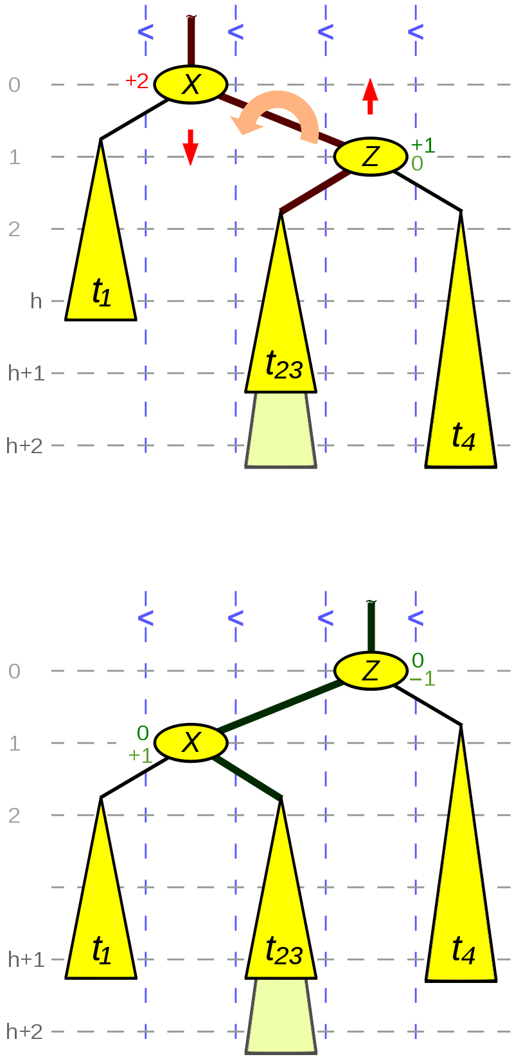
[RQ1] Can Gradual Verification Help with Specifying Code?
Case study: verifying AVL trees
Found an implementation of AVL trees in C
Started with ? everywhere
Added specifications incrementally
“Natural” order: specify data structure invariant, then “rotate” helper functions
Wikipedia helpfully provides a diagram expressing the pre- and post-conditions of rotateLeft
(Partially) verify the code…checks OK statically!
Run the code – error found!

Slide 14
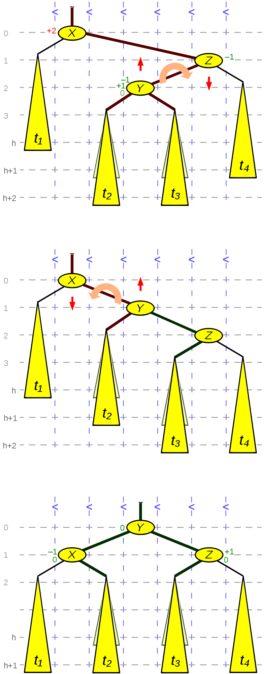
Oops! rotateRight is used twice. Compare:
Our original spec only considered the first use of rotateRight
The second use is part of a double rotation
A more generic precondition is required!
h
h+1
h
h or h-1!

Slide 15
Observations
Our initial spec wasn’t general enough
But it was sufficient to statically verify rotateRight()
Notice: no annoying (“false positive”) warnings because the spec is incomplete
The ability to run the spec demonstrated an error
The precondition was violated on some calls to rotateRight()
Delayed identification of the error could be costly
Might have verified getBalance(), rotateLeft() & much of insert() before finding the problem
Then, we’d have to modify these proofs after fixing the rotateRight() spec
Old story: finding errors early is good!
New story: running your spec can help find errors early!

Slide 16
Project Plan
Continuous Assurance
Proof Maintenance
Proof Repair
Formative Evaluation & Refinement
Summative Evaluation
SoS Community Activities & Reporting
start
year 1
year 2
year 3
We are here!

Slide 17
Current Progress: Building Continuous Assurance IDE Support
Continuous Integration: test on every compile
Continuous Assurance: test and verify on every compile
Objective: find problems earlier, so they are cheaper to fix
Running verifier → find broken specifications
Running tests → find tests that break, and properties that break dynamically
Goal: show that providing immediate feedback makes developers more productive
Provide a proof debugger to help understand & fix errors
Visualize the way symbolic execution works to help developers fix problems
Goal: show our debugging IDE is more productive that the status quo
Some initial progress: an empirical study studying existing debugger visualizations
Next meeting: expect a demo!

Slide 18
Conclusion: Continuous Reasoning with Gradual Verification
Code,
Spec, & Tests
evolution
Evolved Code & Tests
Evolved Code & Tests
Static & Dynamic Verification Results
Proof Maintenance
Specification Increments
Continuous Assurance
Proof Repair
Evolved Code & Tests
Hypothesis: supporting incomplete specifications and leveraging both static and dynamic checking can support highly productive continuous assurance, proof maintenance, and proof repair
Work in progress, so far: building Continuous Assurance into the IDE
Research questions re: continuous feedback, proof debugging visualizations

