Slide 1

A Research Agenda for Scientific Foundations of Security
David Evans
University of Virginia
NITRD Post-Oakland Program
25 May 2011
Artwork: Giacomo Marchesi

Slide 2

2½ years ago…
NSF/IARPA/NSA Workshop on the
Science of Security
http://sos.cs.virginia.edu/

Slide 3
Philosophical Questions
(Usually Not Worth Discussing*)
Is there science in computer system security?
Yes, but of course there should be more.

Slide 4
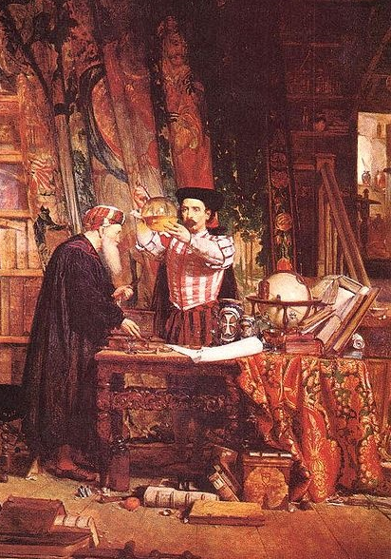
Alchemy (700-~1660)
Well-defined, testable goal (turn lead into gold)
Established theory (four elements: earth, fire, water, air)
Methodical experiments and lab techniques (Jabir ibn Hayyan in 8th century)
Wrong and unsuccessful...but led to modern chemistry.

Slide 5
Realistic Goal?
Can we be a real science like physics or chemistry?
Unlikely – humans will always be a factor in security.
How far can we get without modeling humans?
How far can we get with simple models of human capabilities and behavior?

Slide 6
Some Questions a Science of Security Should Be Able to Answer
Resilience: Given a system P and an attack class A, is there a way to:
  Prove that P is not vulnerable to any attack in A?
  Construct a system P' that behaves similarly to P except is not vulnerable to any attack in A?
Establishing Improvement
How can we determine if a system Q is “more secure” than system P?

Slide 7
Meaning of “Science”
Systematization of Knowledge
  Ad hoc point solutions vs. general understanding
  Repeating failures of the past with each new platform, type of vulnerability
Scientific Method
  Process of hypothesis testing and experiments
  Building abstractions and models, theorems
Universal Laws
  Widely applicable
  Make strong, quantitative predictions

Slide 8
TrustVisor [McCune et al.]
ConScript [Meyerovich and Livshits]
Outside the closed world: On using machine learning for network intrusion detection [Sommer and Paxson]
USENIX Workshop on Offensive Technologies (WOOT '11) SoK Papers
Citation Count (Google scholar)
Oakland 2010 Papers [SoK Papers]

Slide 9
Meaning of “Science”
Systematization of Knowledge
  Ad hoc point solutions vs. general understanding
  Repeating failures of the past with each new platform, type of vulnerability
Scientific Method
  Process of hypothesis testing and experiments
  Building abstractions and models, theorems
Universal Laws
  Widely applicable
  Make strong, quantitative predictions

Slide 10
Experimentation
Security experiments require adversary models
  Coalesce knowledge of real adversaries
  Canonical attacker models (c.f., crypto)
Shared data and source code [NIH model?]
Design for reproducibility
Anupam Datta, Jason Franklin, Deepak Garg, Limin Jia, and Dilsun Kaynar. On Adversary Models and Compositional Security. [in IEEE S&P SoS Issue]
meaningfulness and robustness

Slide 11
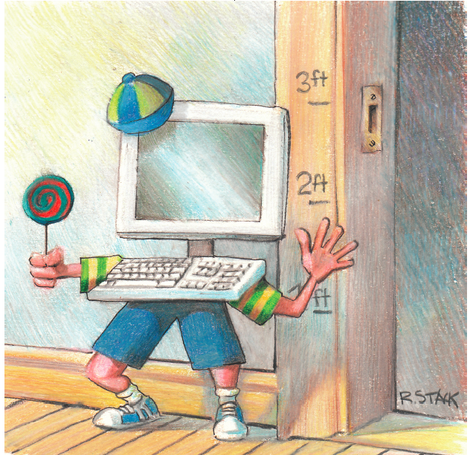
Metrics

Slide 12
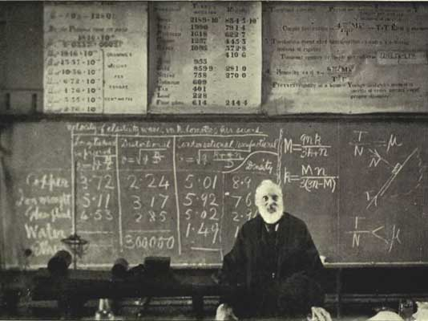
“When you can measure what you are speaking about, and express it in numbers, you know something about it, when you cannot express it in numbers, your knowledge is of a meager and unsatisfactory kind; it may be the beginning of knowledge, but you have scarcely, in your thoughts advanced to the stage of science.” Lord Kelvin

Slide 13
Large increases in cost with questionable increases in performance can be tolerated only in race horses and [computer security].
Lord Kelvin

Slide 14
Metrics: Promising Approaches?
Comparative metrics
Attack Surface [Howard; Manadhata & Wing, TSE May 2011]
Experimental metrics
more systematic “red team” approaches
Economic metrics
Active research community; WEIS
Epidemiological metrics
model spread over network, but need assumptions
Entropy/Computational complexity metrics
Define attacker search space; automated diversity

Slide 15
Meaning of “Science”
Systematization of Knowledge
  Ad hoc point solutions vs. general understanding
  Repeating failures of the past with each new platform, type of vulnerability
Scientific Method
  Process of hypothesis testing and experiments
  Building abstractions and models, theorems
Universal Laws
  Widely applicable
  Make strong, quantitative predictions

Slide 16
Formal Methods and Security
Lots of progress in reasoning about correctness
Systems fail when attackers find ways to violate assumptions used in proof
  Need formal methods that make assumptions explicit in a useful way
  Combining formal methods with enforcement mechanisms that enforce assumption
Jason Bau and John C. Mitchell. Security Modeling and Analysis.
Degabriele, Paterson, and Watson. Provable Security in the Real World.
[in IEEE S&P Magazine SoS issue]

Slide 17
Formal Methods vs. Complexity
(Loosely) Due to Fred Chang
Pessimist’s View
Complexity
Deployed Systems
Formal Techniques Capability
2011
Time

Slide 18
Formal Methods vs. Complexity
(Loosely) Due to Fred Chang
Optimist’s View
Complexity
Deployed Systems
TCB of Deployed
Formal Techniques Capability
2011
Time

Slide 19
Formal Methods Approaches
Refinement: Can we develop refinement approaches (design → ... → implementation) that preserve security properties the way they are used to preserve correctness properties now?
Program analysis: What security properties can be established by dynamic and static analysis?
How can computability limits be overcome using hybrid analysis, system architectures, or restricted programming languages?

Slide 20
Summary
Systematization of Knowledge
  Ad hoc point solutions vs. general understanding
  Repeating failures of the past with each new platform, type of vulnerability
Scientific Method
  Process of hypothesis testing and experiments
  Building abstractions and models, theorems
Universal Laws
  Widely applicable
  Make strong, quantitative predictions
Valuable and achievable: need the right incentives for community
Progress in useful models; big challenges in constructing security experiments
Uncertainty if such laws exist; long way to go for meaningful quantification.

Slide 21
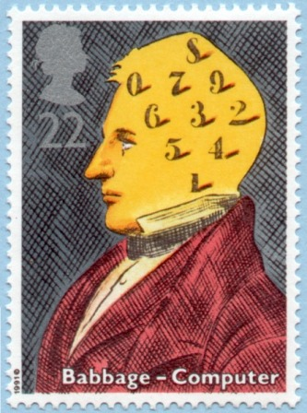
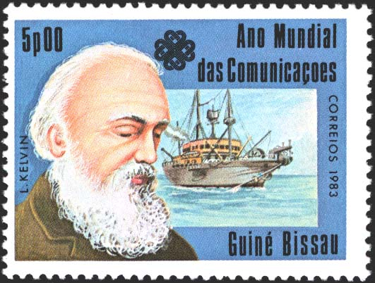
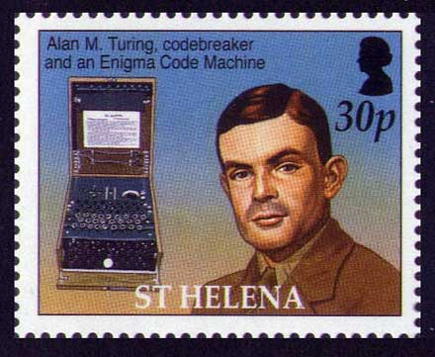
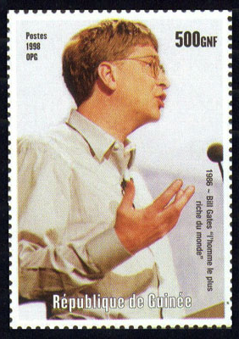
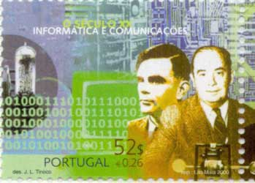
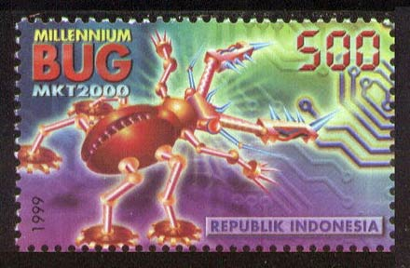
“In science there is only physics; all the rest is stamp collecting.” Lord Kelvin
David Evans
http://www.cs.virginia.edu/evans

