Slide 1
Automated Rapid Certification of Software
Dr. Raymond Richards
May 1, 2019

Slide 2
Proposers’ Day Announcement

Slide 3
Automated Rapid Certification Of Software (ARCOS)
Automate the evaluation of software assurance evidence to enable certifiers to rapidly determine that the risk of software deployment is acceptable.

Slide 4
Software certification practices are unsustainable
Software in military systems continues rapid growth.
Functionality implemented in software approaching 90%
Certification costs are not proportional to size of change
CERT
Current certification practices are a barrier to software deployment.
Growth in embedded software requires better certification practices.
Waivers to certifications result in higher operating costs and impacts operations.

Slide 5
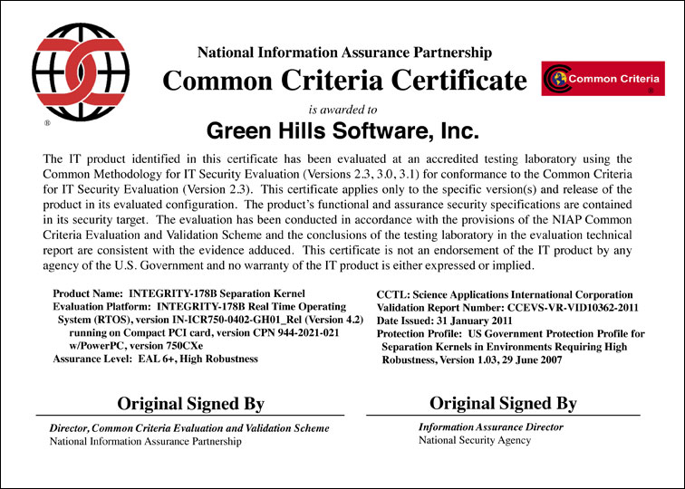
Current software certification practices are unsustainable
Our ability to produce software has outpaced our ability to certify software
The cost and time needed to certify software is an impediment to fielding new capability
Software certification cost is a major consideration in managing a systems lifecycle.
Certification example: Multi-level secure operating system certified for F22 and F35 in accordance to the Common Criteria
Previously certified in safety critical avionics
Evaluation underway by April 2006
Certificate awarded January 2011

Slide 6
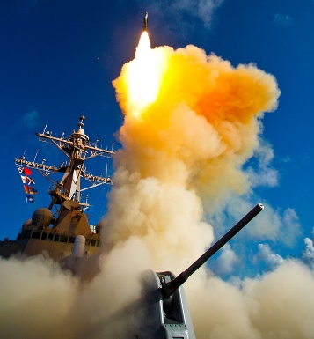
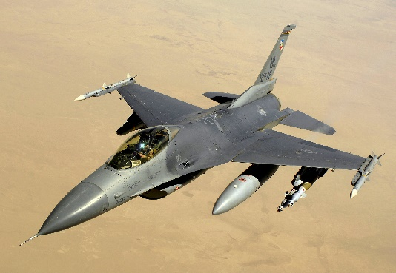
Certifications today
Evaluate evidence against certification criteria
Test data
Simulation/emulation data
Software quality assurance (SQA) evidence
Analytical evidence
Certifications of integrated software intensive systems
All components evaluated in the context of the system
No reuse of evaluation effort when components are reused
Evaluators judge evidence against certification criteria
Arguments can be philosophical and not technical
Evaluators rely on experience, judgement, and expertise on where to drill down
military.com
wikipedia.org
wikipedia.org

Slide 7
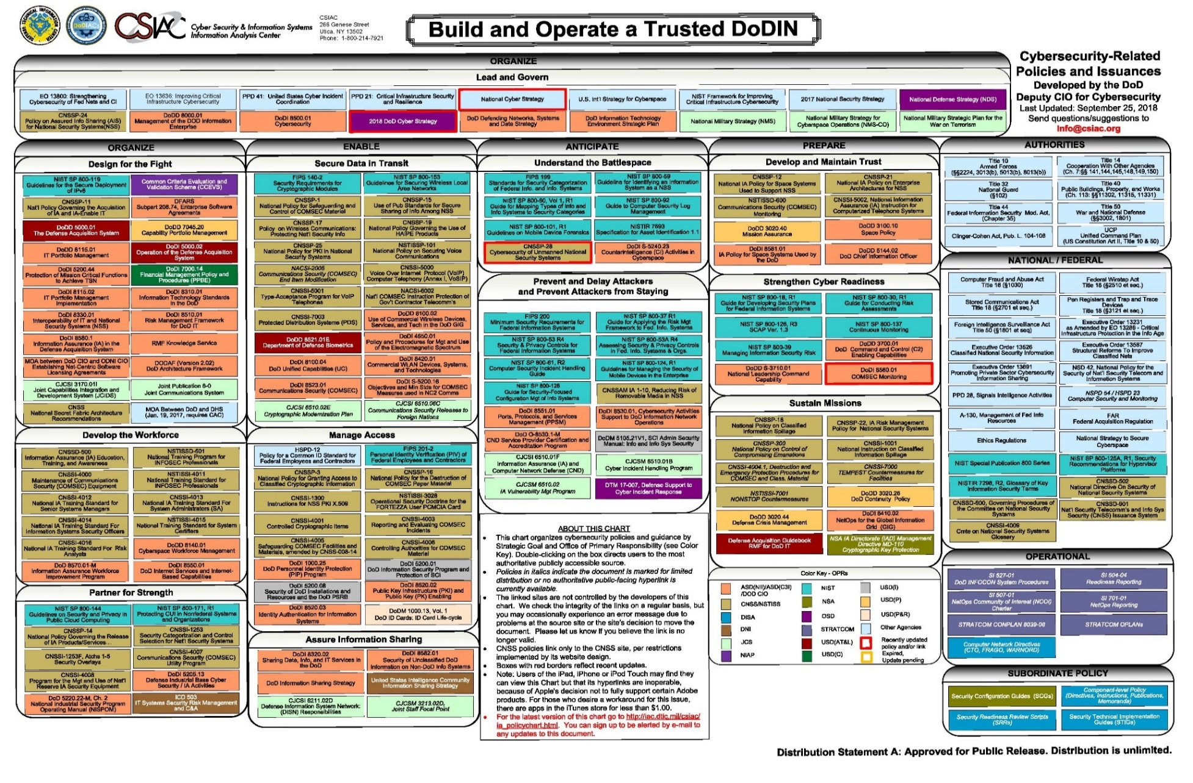
Cyber Policy

Slide 8
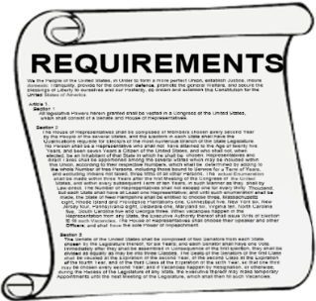
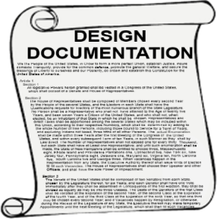
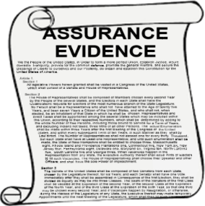
Software certifications today
Design, Build, and Document
Test and Generate Assurance Evidence
Evaluate
Assurance Evidence
Human
Human-driven activities produce implementation and assurance evidence in human readable documents
Assurance evidence captured in human readable documents
Manual activity evaluates whether or not criteria are met
Evidence:
Test
Analysis
Simulation/Emulation
Software Quality Assurance (SQA)
ATO: Authority to Operate
Distribution Statement A: Approved for Public Release, Distribution Unlimited

Slide 9
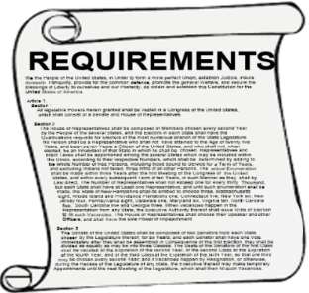
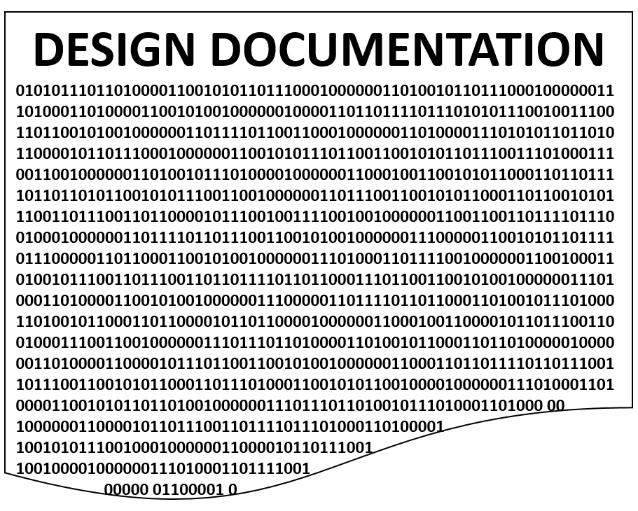
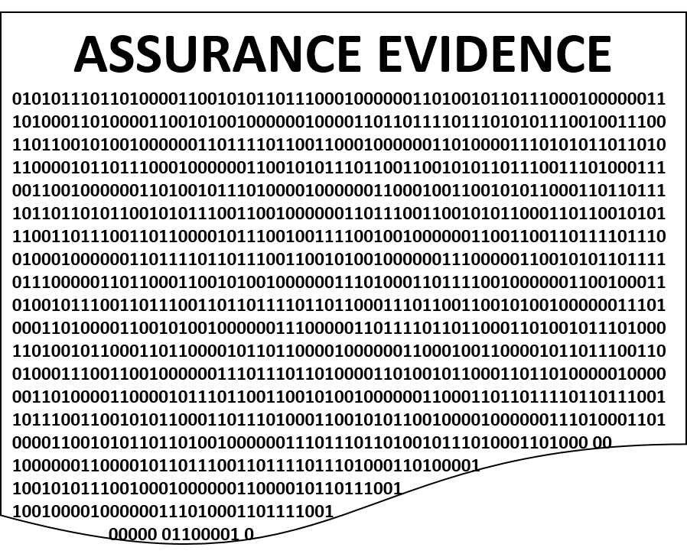
Automated software certifications of tomorrow
Design, Build, and Document
Test and Generate Assurance Evidence
Evaluate
Assurance Evidence
Co-generation of assurance evidence with documentation and implementation artifacts
Implementation and assurance evidence maintained in binary formats
Automated generation and validation of assurance case arguments
Human
Automated
Evidence Generation
Evidence Evaluation
ATO
Distribution Statement A: Approved for Public Release, Distribution Unlimited

Slide 10
The time is ripe to automate certification
Technological advances in artificial intelligence, data analytics, and formal methods present the opportunity to greatly accelerate certification
Model-based Design
Probabilistic model checking
Semantic-aware big code analytics
Formal methods proven trusted components
Assurance case languages:
DoD Digital Engineering Strategy
GSN (Goal Structured Notation)
Resolute
A standardized language (GSN Community Standard)
Broadly used in Europe
Traffic Management
Nuclear Power Plants
Patent Claims and Legal Arguments
Used by FAA for their Proof of Concept tool qualification
Developed on HACMS program, transitioned to SEI
Expressly developed to assure digital systems
Binds argument to architectural model
Tool support to reason over the architectural structure to validate argument
Distribution Statement A: Approved for Public Release, Distribution Unlimited

Slide 11
Summary
Current software certification practices are unsustainable
Impeding the deployment of new or upgraded capabilities
Maintaining and evaluating assurance cases across system lifecycles will support mission assurance
Leveraging compositionality
Evaluate mission assurance in the relevant context
During development vast amounts of evidence on the design and performance for complex systems is generated
We can mine this corpus of evidence for assurance
Thorough evaluation of system capabilities
Reduce cost and increase speed of deploying new capabilities

