Slide 1

2014 Workshop
13 - 15 January, West Point, NY
SPECIAL CYBER OPERATIONS
COMPUTATIONAL CYBERSECURITY
RESEARCH AND ENGINEERING
in COMPROMISED ENVIRONMENTS
Computational Cybersecurity in Compromised Environments (C3E)

Slide 2
C3E Participant Distribution

Slide 3
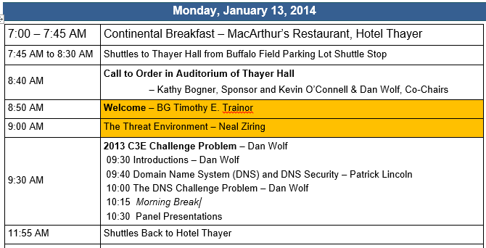
Monday - January 13th (Morning)

Slide 4
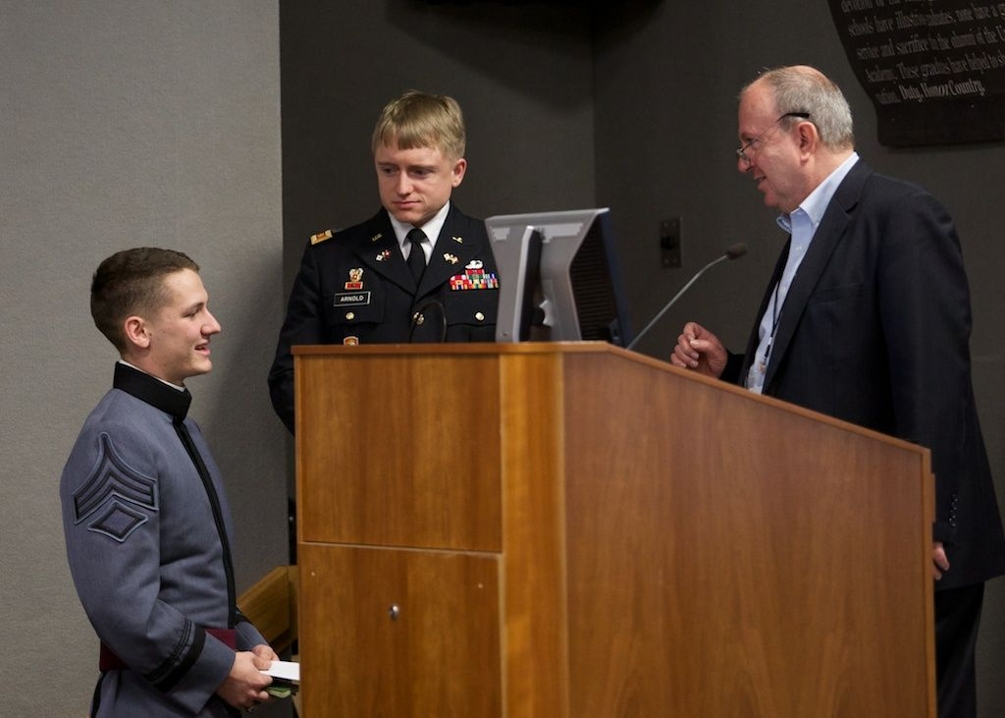
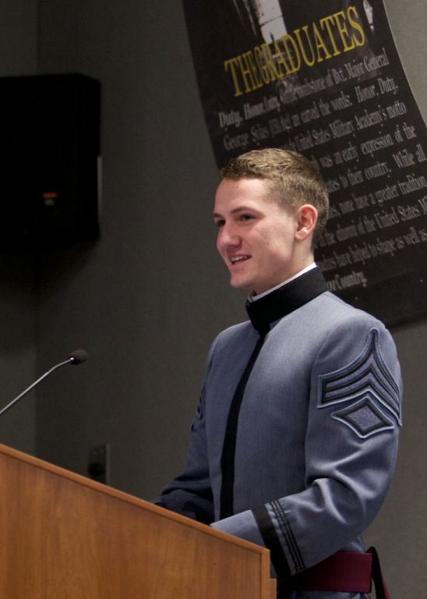
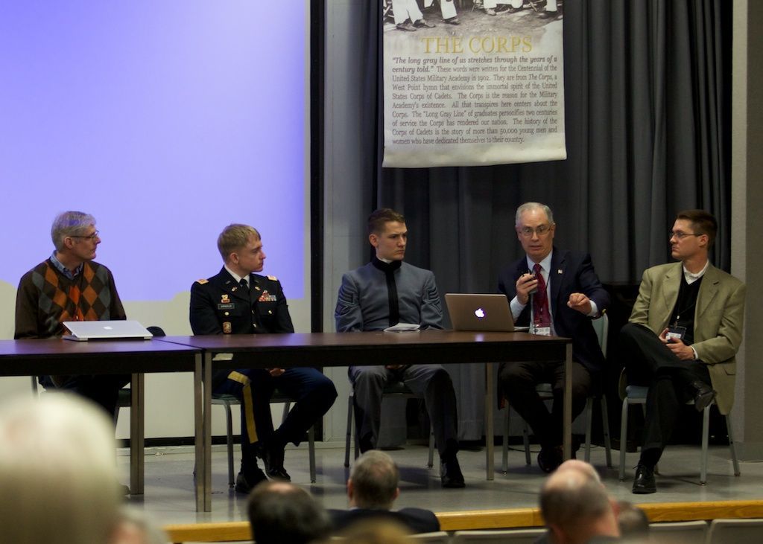
Challenge Problem Panelists
West Point
  Cadet John Zeidier (Team Leader)
  MAJ Todd Arnold
Soar Technologies
  Van Parunak
Galois, Inc.
  David Burke
Boston University – Draper Labs
  Sang (“Peter”) Chin
SRI
  Patrick Lincoln
CMU/SEI
  Scott McMillan

Slide 5
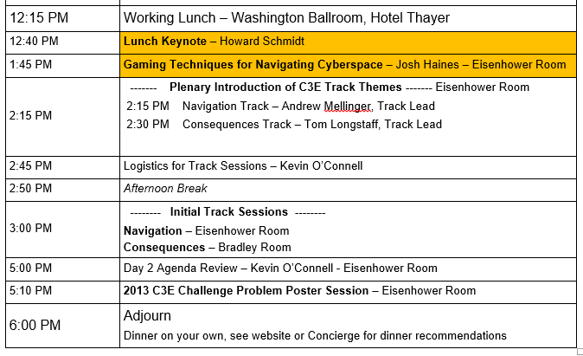
Monday - January 13th (Afternoon)

Slide 6
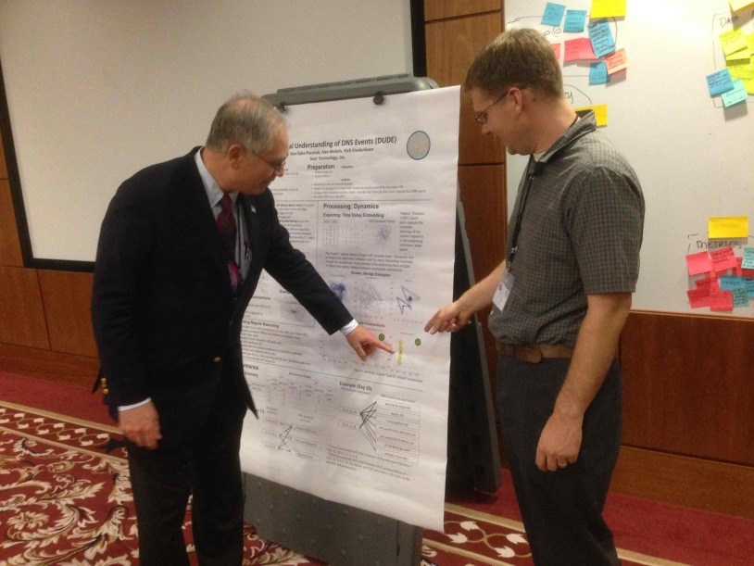
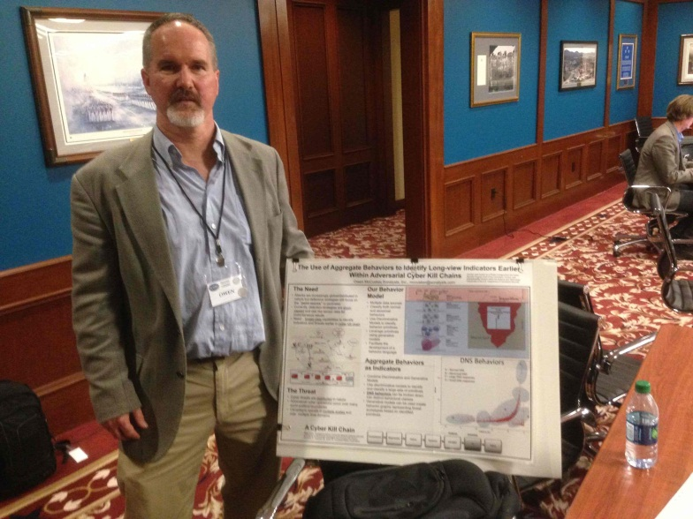
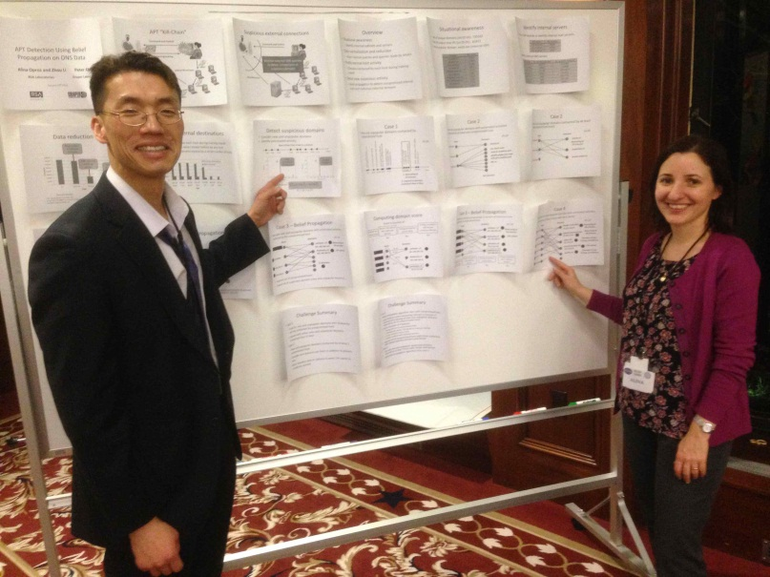
Challenge Problem Poster Session
Soar Technologies
  Van Parunak
Draper Labs - Boston Univ - RSA Labs
  Sang (“Peter”) Chin
Sonalysts
  Owen McCusker

Slide 7
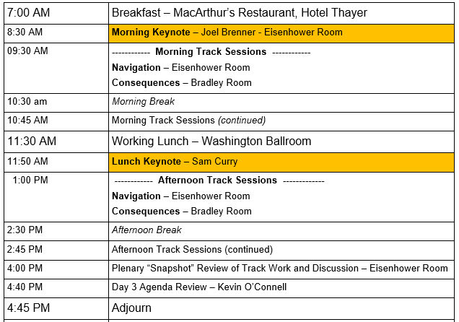
Tuesday - January 14th

Slide 8
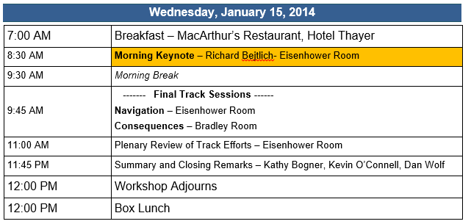
Wednesday- January 15th

Slide 9
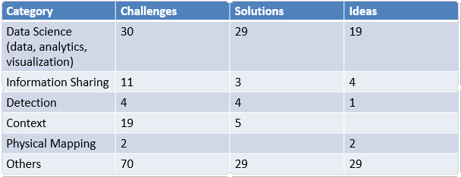
Navigating Cyberspace Track – Objective & Process
Objective: - What analytic methods and tools are available to help analysts understand what is going on in cyberspace?
Process: Developed by research at Carnegie Mellon’s Software Engineering Institute (SEI).
  Used to generate, categorize, and prioritize ideas, challenges and solutions related to Navigating Cyberspace
Example Methods Used:
  Initial Brainstorming
  Affinity Groupings
  Creativity Matrixes
  Cost vs. Value Diagram
  Mock Research Proposals

Slide 10
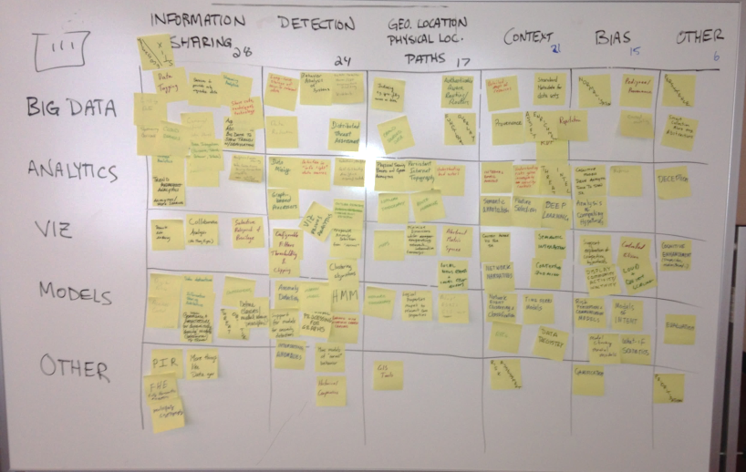
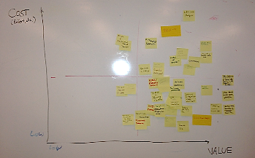
Navigating Cyberspace Track – Initial Outcomes
Navigation Track Activity yielded four recommended Research Projects
Proposed Research Projects
1 | Provenance and Network Narrative
2 | Certifying Trusted Analytics
3 | Augmenting Network Analysts
4 | Certifying Trusted Analytics and Models for Information Sharing

Slide 11
Cyberspace Consequences Track – Objective & Process
Objective: How do we help understand and describe the priorities and consequences of actions taken in cyberspace, especially those in response to threat?
Process: Attacker Defender Exercise –
  Leverage data from workshop presentations/exercises in predicting the consequences of an attack constructed by attackers with varying motivations.
  The techniques each team uses for cyber prediction will be captured and evaluated based on the success of the teams.
Roles
  Moderators – Track Leads
  Attackers – Construct attacks unique to their specific motivation (DoS, Theft, Hacktivist etc.)
  Defenders – Develop methods for thinking about Consequences

Slide 12

Cyberspace Consequences– Initial Outcomes
Critical Question: What & Where are the most important assets?
Sharing information worked to our advantage
Methods for Response Strategy
  Organization curve
Evaluating Methods for Reponses
  An index of Response type Pros and Cons
  Augment analysis of Competing Hypothesis
Potential
Response Cost
Attack Sophistication

Slide 13
Exit Poll Survey Ideas and Insights
“The presentations added a lot of concrete material to the theoretical scaffolding of my research into the strategic aspect of cybersecurity.” – 2014 Participant
Did you learn something from someone from a different field or endeavor that could be applied to you field of expertise?
Did you learn something you will take back and apply?

Slide 14
Exit Poll Survey People
“The Workshop is developing a community. Partnerships and teaming are happening.”
- 2014 Participant
Did you make a potentially enduring connection with someone from another discipline?
Did you meet Someone new with whom you can see collaborating with in the future?
Did you rekindle former relationships that could help you in your work?

Slide 15
Exit Poll Survey Support
“C3E always brings together a nice cross section of thought leaders from different backgrounds and Domains; which generates fresh thinking/ideas.”
- 2014 Participant
Did you find the Challenge Problem helpful in supporting your mission?
Did you find the conference well run?

Slide 16
2014 Exit Poll Comments:
Great Workshop! It gets better every year!
-- 2014 Participant
“The C3E Program continues to provide thought provoking ideas that break barriers needed for innovation.”
- 2014 Participant
Were You Glad You Came?
“I learned numerous things to take back to my team as well as built new collaboration for the future.”
- 2014 Participant
“Emphasis not just on theory, but bringing theories and ideas to practice: Tremendously valuable.”
- 2014 Participant

Slide 17
The C3E Team
Sponsors: Kathy Bogner, Brad Martin
Co-Chairs: Kevin O’Connell, Dan Wolf
Consequences Track:
Track Lead: Tom Longstaff
Co Track Leads:
  Carl Landwehr
  Charles Nelson
  Patti O’Neill-Brown
  Chip Willard
Navigation Track:
  Track Lead: Andrew Mellinger
  Co-Track Leads:
    Donna Dodson
  Matthew Gaston
  Patrick Lincoln
  Scott McMillan
  Laurie Williams
Reporter Team:
  Nick Carey, Lisa Coote, Michael Maass, Taylor Morton, John Slankas, Gabe Stocco, Gabriel Weaver, Josh Wheeler
C3E Staff: Lonnie Carey, Lisa Coote, Anne Dyson

Slide 18
C3E Workshop Partcipants
Yanif Ahmad | Deborah K. Gracio | Dusko Pavolic
Edward J Baranoski | Joshua Haines | Vern Paxson
Richard Bejtlich | Jim Hays | Max Planck
Kathy Bogner | Jason Hong | Antonio Sanfilippo
Joel Brenner | Angelos Keromytis | Howard Schmidt
Tamas Budavari | Joe King | Claudio Silva
David Burke | Carl Landwehr | John Slankas
Nick Carey | John Launchbury | Mike Smith
Lonnie I. Carey, Jr. | Patrick Lincoln | Gabe Stocco
Doug Carson | Brian Lindauer | Bill Streilein
Marco Carvahlo | Tom Longstaff | Ivan Sutherland
Sang Chin | Michael Maass | Alex Szalay
Byron Collie | Victor Marek | Shelly Theiss
Byron Cook | Brad Martin | Michael Van Putte
Lisa Coote | Owen McCusker | Ralph Wachter
Steve Crocker | Jeremy Mineweaser | Beth Walton
Sam Curry | Taylor Morton | Gabriel Weaver
Chris Daverse | Jeff Moulton | Josh Wheeler
Donna Dodson | Danko Nebesh | Chip Willard
Anne Dyson | Charles Nelson | Laurie Williams
George Economou | Kevin O'Connell | Alex Wissner-Gross
Paul Ferrell | Patti O'Neill-Brown | Dan Wolf
Ed Giorgio | Alina Oprea | Neal Ziring
Jonathan Gloster | Van Parunak | Scott Zoldi

Slide 19
C3E: Moving Forward
Topics to start considering for next year’s workshop:
Challenge Problem Data
Track Themes
Types of Participants

Slide 20
SPECIAL CYBER OPERATIONS
COMPUTATIONAL CYBERSECURITY
RESEARCH AND ENGINEERING
in COMPROMISED ENVIRONMENTS

