Slide 1
Data Driven Decisions
Colonel Benjamin A. Ring, Ph.D., U.S. Army
Chief, Applied Research & Development, US Cyber Command

Slide 2
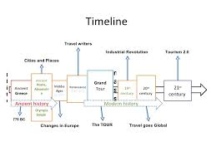
“Things have never been more like the way they are today in history”
GEN Dwight D. Eisenhower
History of Warfare:
History of Cyber:

Slide 3
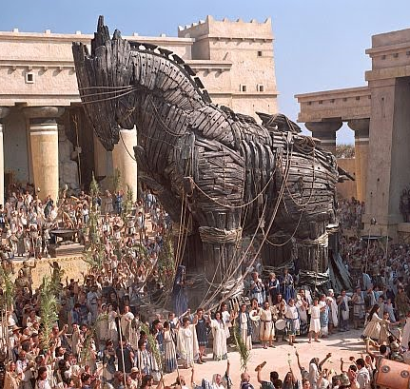
“Quidquid id est, timeo Danaos et dona ferentes” (Whatever it is, I fear the Greeks, even those bearing gifts)
virgil

Slide 4
“If you want to attack an army, besiege a walled city, assassinate individuals, you must know the identities of the defending generals, assistants, associates, gate guards, and officers.”
Sun Tzu

Slide 5
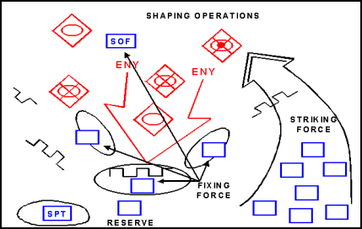
Other Terms
Staging
Deploy
Cache
foo & bar
snafu
DMZ
Ping
Code
ATT&CK, Kill Chains
Reconnaissance
Infiltration
Exploitation
Overwatch
Actions on Objective
Command & Control

Slide 6
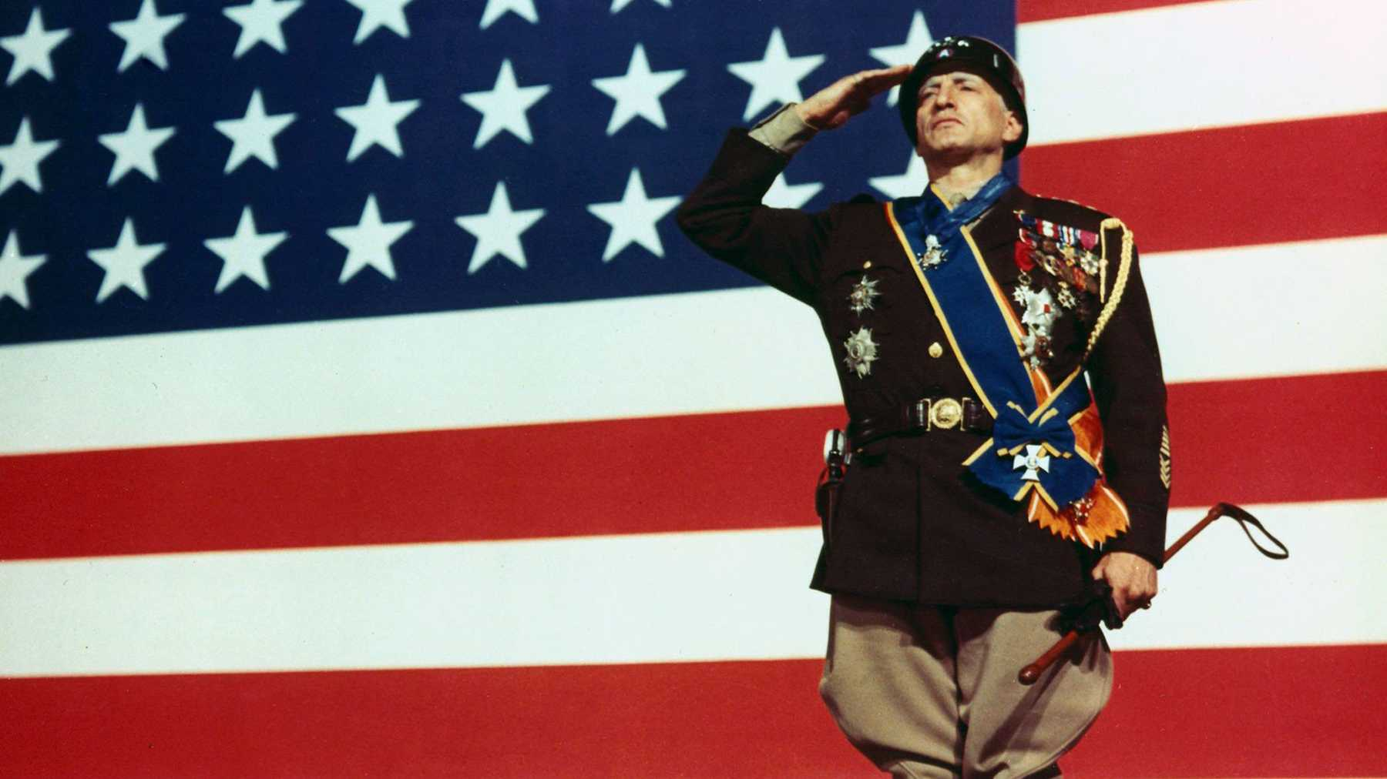
“Be willing to make decisions. That’s the most important quality in a good leader.”
General George S. Patton

Slide 7
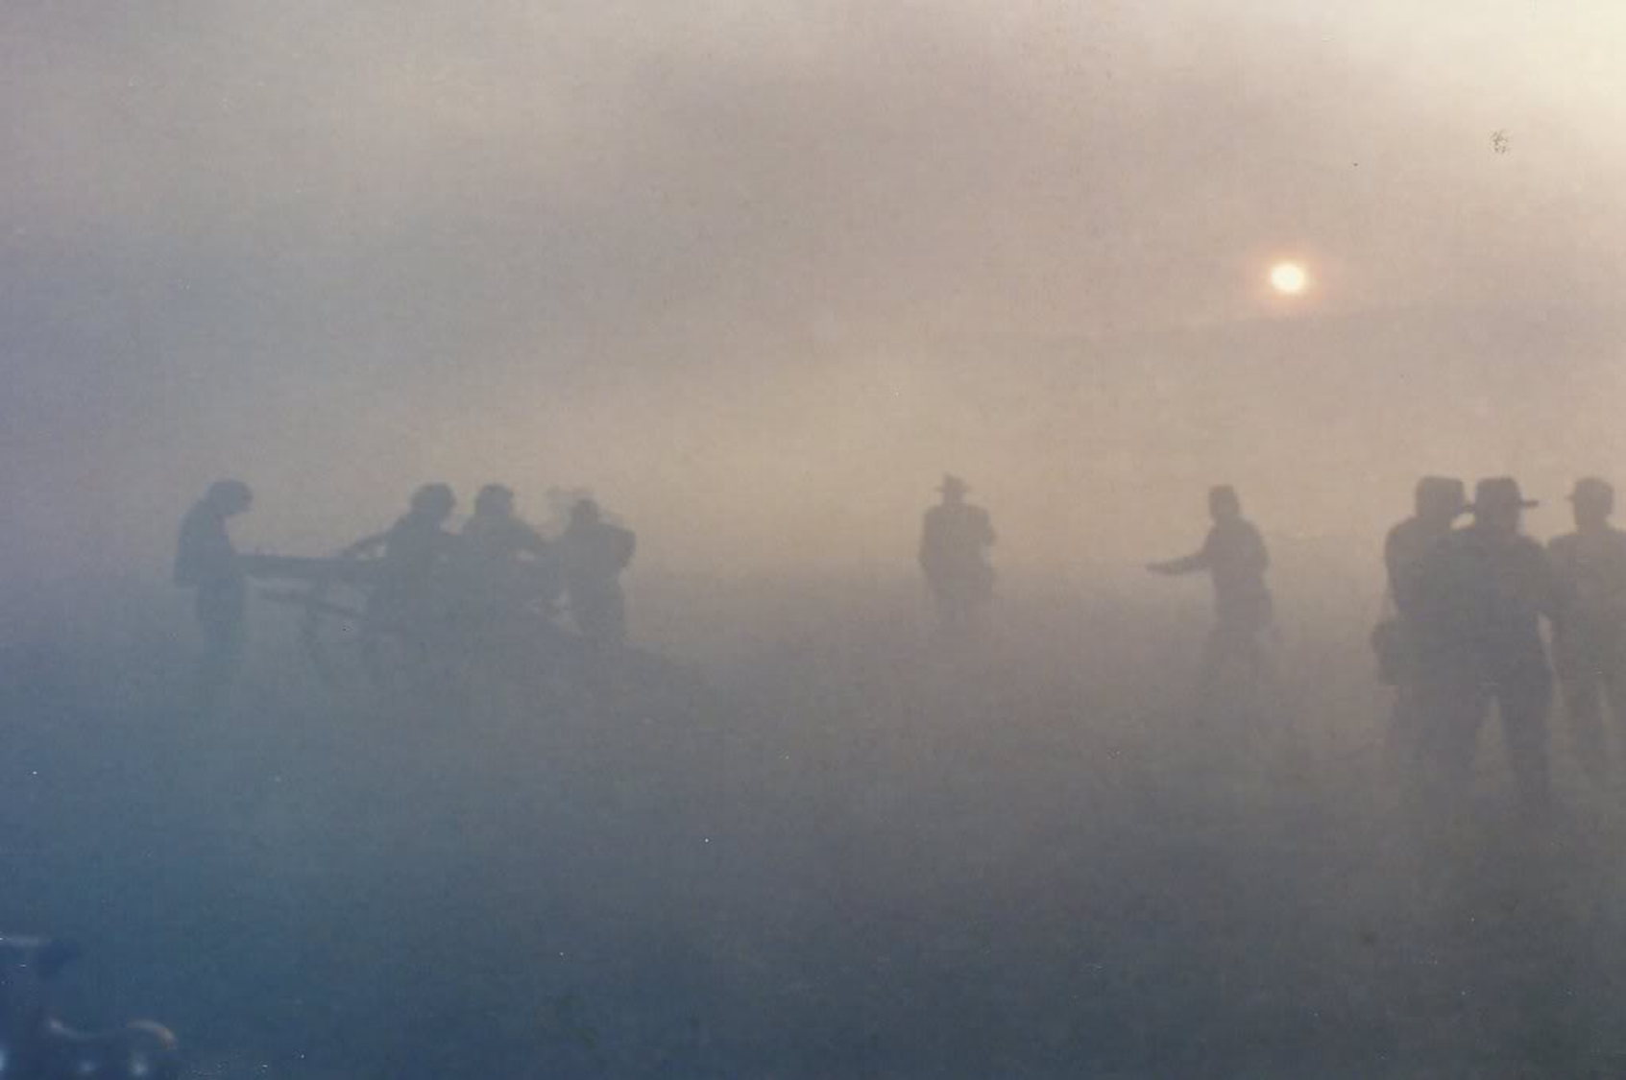
“War is the realm of uncertainty; three quarters of the factors on which action in war is based are wrapped in a fog of greater or lesser uncertainty.”
Carl von Clausewitz

Slide 8
“We all make mistakes. We know we make mistakes. I don't know any military commander, who is honest, who would say he has not made a mistake. There's a wonderful phrase: 'the fog of war.' What "the fog of war" means is: war is so complex it's beyond the ability of the human mind to comprehend all the variables. Our judgment, our understanding, are not adequate. And we kill people unnecessarily.”
Robert Macnamara

Slide 9
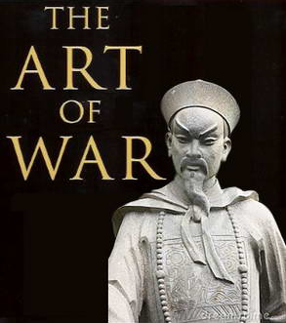
“Know thy self, know thy enemy. A thousand battles, a thousand victories.”
Sun Tzu

Slide 10
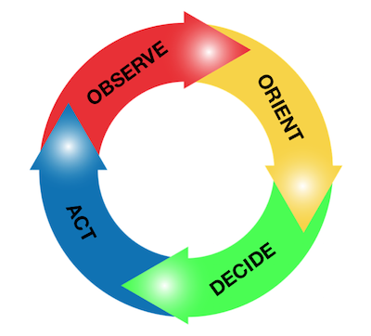
“In order to win, we should operate at a faster tempo or rhythm than our adversaries — or, better yet, get inside [the] adversary's Observation-Orientation-Decision-Action time cycle or loop ... Such activity will make us appear ambiguous (unpredictable) thereby generate confusion and disorder among our adversaries — since our adversaries will be unable to generate mental images or pictures that agree with the menacing, as well as faster transient rhythm or patterns, they are competing against.”
Colonel John Boyd

Slide 11
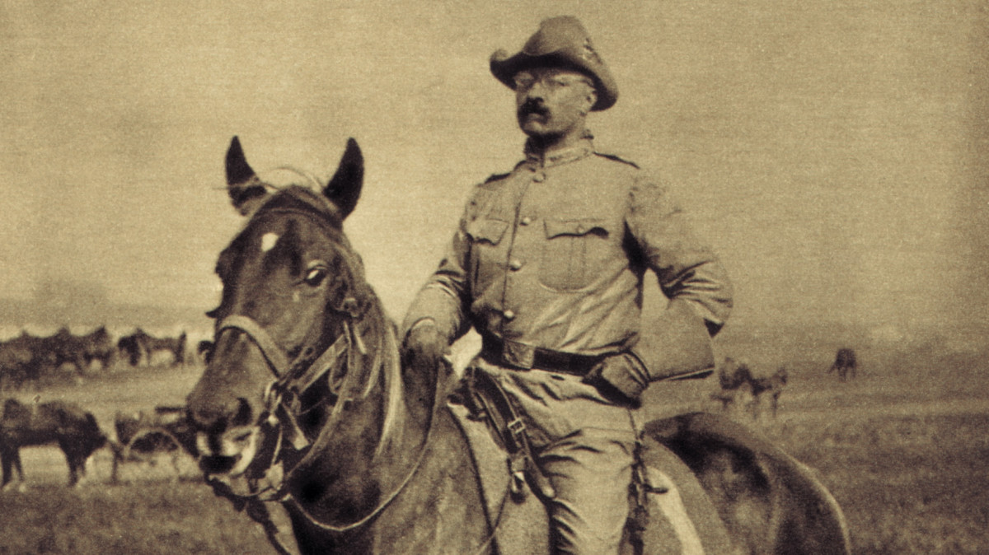
“The Rowan alluded to here is the man who carried The Message to Garcia”
Theodore Roosevelt

Slide 12
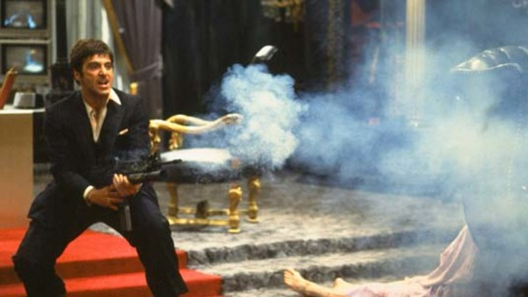
“Whoever said the pen is mightier than the sword obviously never encountered automatic weapons”
GEN Douglas MacArthur

Slide 13
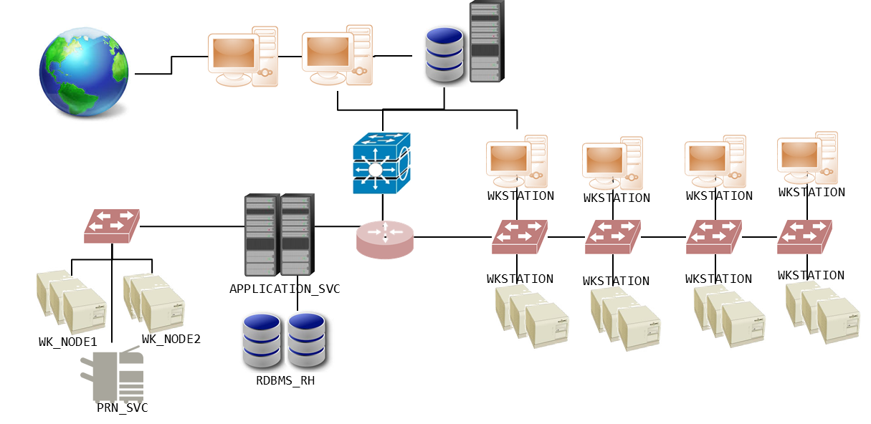
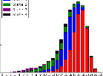
Data Driven Decisions
UNCLASSIFIED//NONE
Terrain Assessment
Threat Assessment
Mission Analysis planning provides the roadmap to develop requirements. This is the starting point for the data science process.
PLAN
Terrain and Friendly Analysis
Situational Template
Threat Doctrinal Template
Information Requirements (IR) & Technical Questions
Data Engineering
Data Science
Manage limited resources to sense, transport, store data
Develop analytic solutions to process & automate information
Prioritizing requirements enables leaders to make data management and capability development decisions for automating analytic solutions.
EXECUTE
Unified Analytic Environment
Collect
Prepare
Process
Visualize
Integration with operations ties automated solutions with commander critical information requirements (CCIR) to drive human decisions and steer organization action.
feedback & guidance
CCIR
feedback & guidance
ASSESS
Decide
assess
Operations/ Action
assess
UNCLASSIFIED//NONE

Slide 14
Questions

Slide 15
“The good general must know friction in order to overcome it whenever possible, and in order not to expect a standard of achievement in his operations which this very friction makes impossible”
Carl von Clausewitz

Slide 16
Attack where your enemies are not prepared; go to where they do not expect.
Sun tzu

Slide 17
For the machine is not a thinking being, but simply an automaton which acts according to the laws imposed upon it
Ada Lovelace

Slide 18
Nothing ages so quickly as yesterday's vision of the future.

