Slide 1
Identity Challenge
August, 2012
ForrestHunt, Inc.
Austin, Texas 78746-6224

Slide 2
The Challenge
Clinic in Bethesda MD 20014
  Address is 4408 East Madison Ave.
Man at Clinic
  Partial phone number: 212 998-75xx
  Has contagious disease
Find him
  Or a place to start looking

Slide 3
The Database
Named Nodes offer facts:
  Name, Address, Phone, Credit card (or SS#, etc.)
  From seven major sources
  Many blank fields
Numbered Edges offer links:
  Between two nodes
  With quality numbers
  Treated as undirected links: A --> B = B --> A

Slide 4
Database Anomalies
There are 345987 Nodes
  But only 345986 Node names
  One Node name is used twice:
    CCTR-a95c7942-7d7a-43b7-9fff-1e01218b7b46
There are 58047 Edges
  That reference 68986 Node names
  Edges fail to use all available Nodes
62 Family names (mostly from Tolkien)

Slide 5
Path finding
Node “SEED-1” is unknown phone number
Node “SEED-2” is the Clinic
Find a path between them
  SEED-1 → Edge_X → NodeA
  NodeA → Edge_Y → NodeB
  and so on
  NodeN → Edge_Z → SEED-2
We found a minimal-length path, with 4 Edges

Slide 6
The one and only path
Unknown phone = 212 998-75xx
  by phone number (Edge_1)
Gloriana Brandybuck phone = 212 998-7506
  by name (Edge_2421)
Gloriana’s Credit Card = 5334 8565 9749 3120
  by Credit Card (Edge_9716)
CCTR @ 18 Wayback Road, Bethesda
  by city & zip (Edge_58045)
The Clinic @ 4408 East Madison, Bethesda
Possible men: Will Took-Brandybuck, Hamfast Took, Tollman Took

Slide 7
It seems too easy
A few hours from scratch
  Skilled programmer using
  Any suitable language
    LISP, ACL2, Java, etc.
Standard Graph reachability algorithm
  Requires only 20 milliseconds
Found only one path
  Of ANY quality
  Edge numbers monotonic increasing
  Few and obvious matching criteria

Slide 8
Check the path
Examine the surround (the “Frontage Road”)
There are 130 matching phone numbers
  Five-step path from each to Clinic
  All paths pass through Gloriana
Eliminate one Edge:
  From Gloriana’s phone to credit card
  No paths remain
Path indeed requires that Edge

Slide 9
Other checks
Path references the Duplicate Node
  Duplicate obviously wrong
    Quality of Edges to it don’t make sense
  Could eliminate duplicate, but we ignored it
Phone digit swaps?
  Swap pairs of digits
    No matches for one or two digit swaps
    Only one match for three digit swaps
  Big separation of phone numbers
We failed to find where Gloriana is now

Slide 10
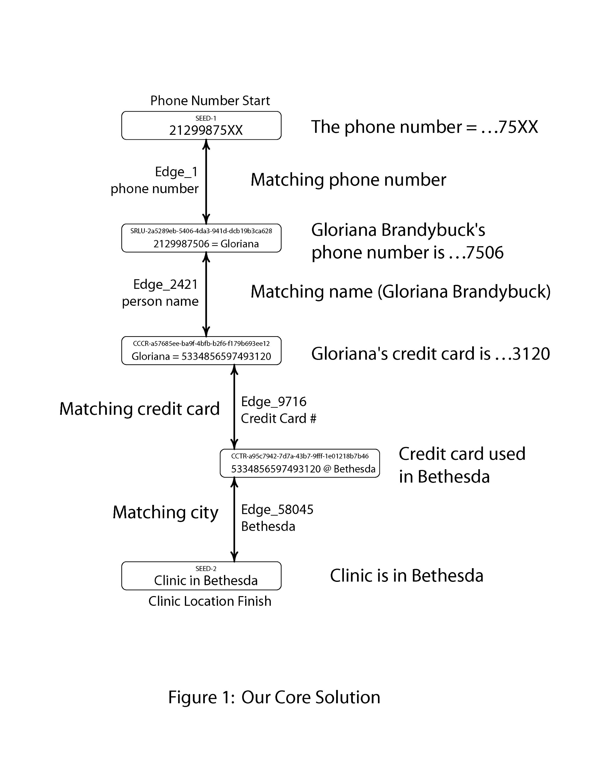

Slide 11
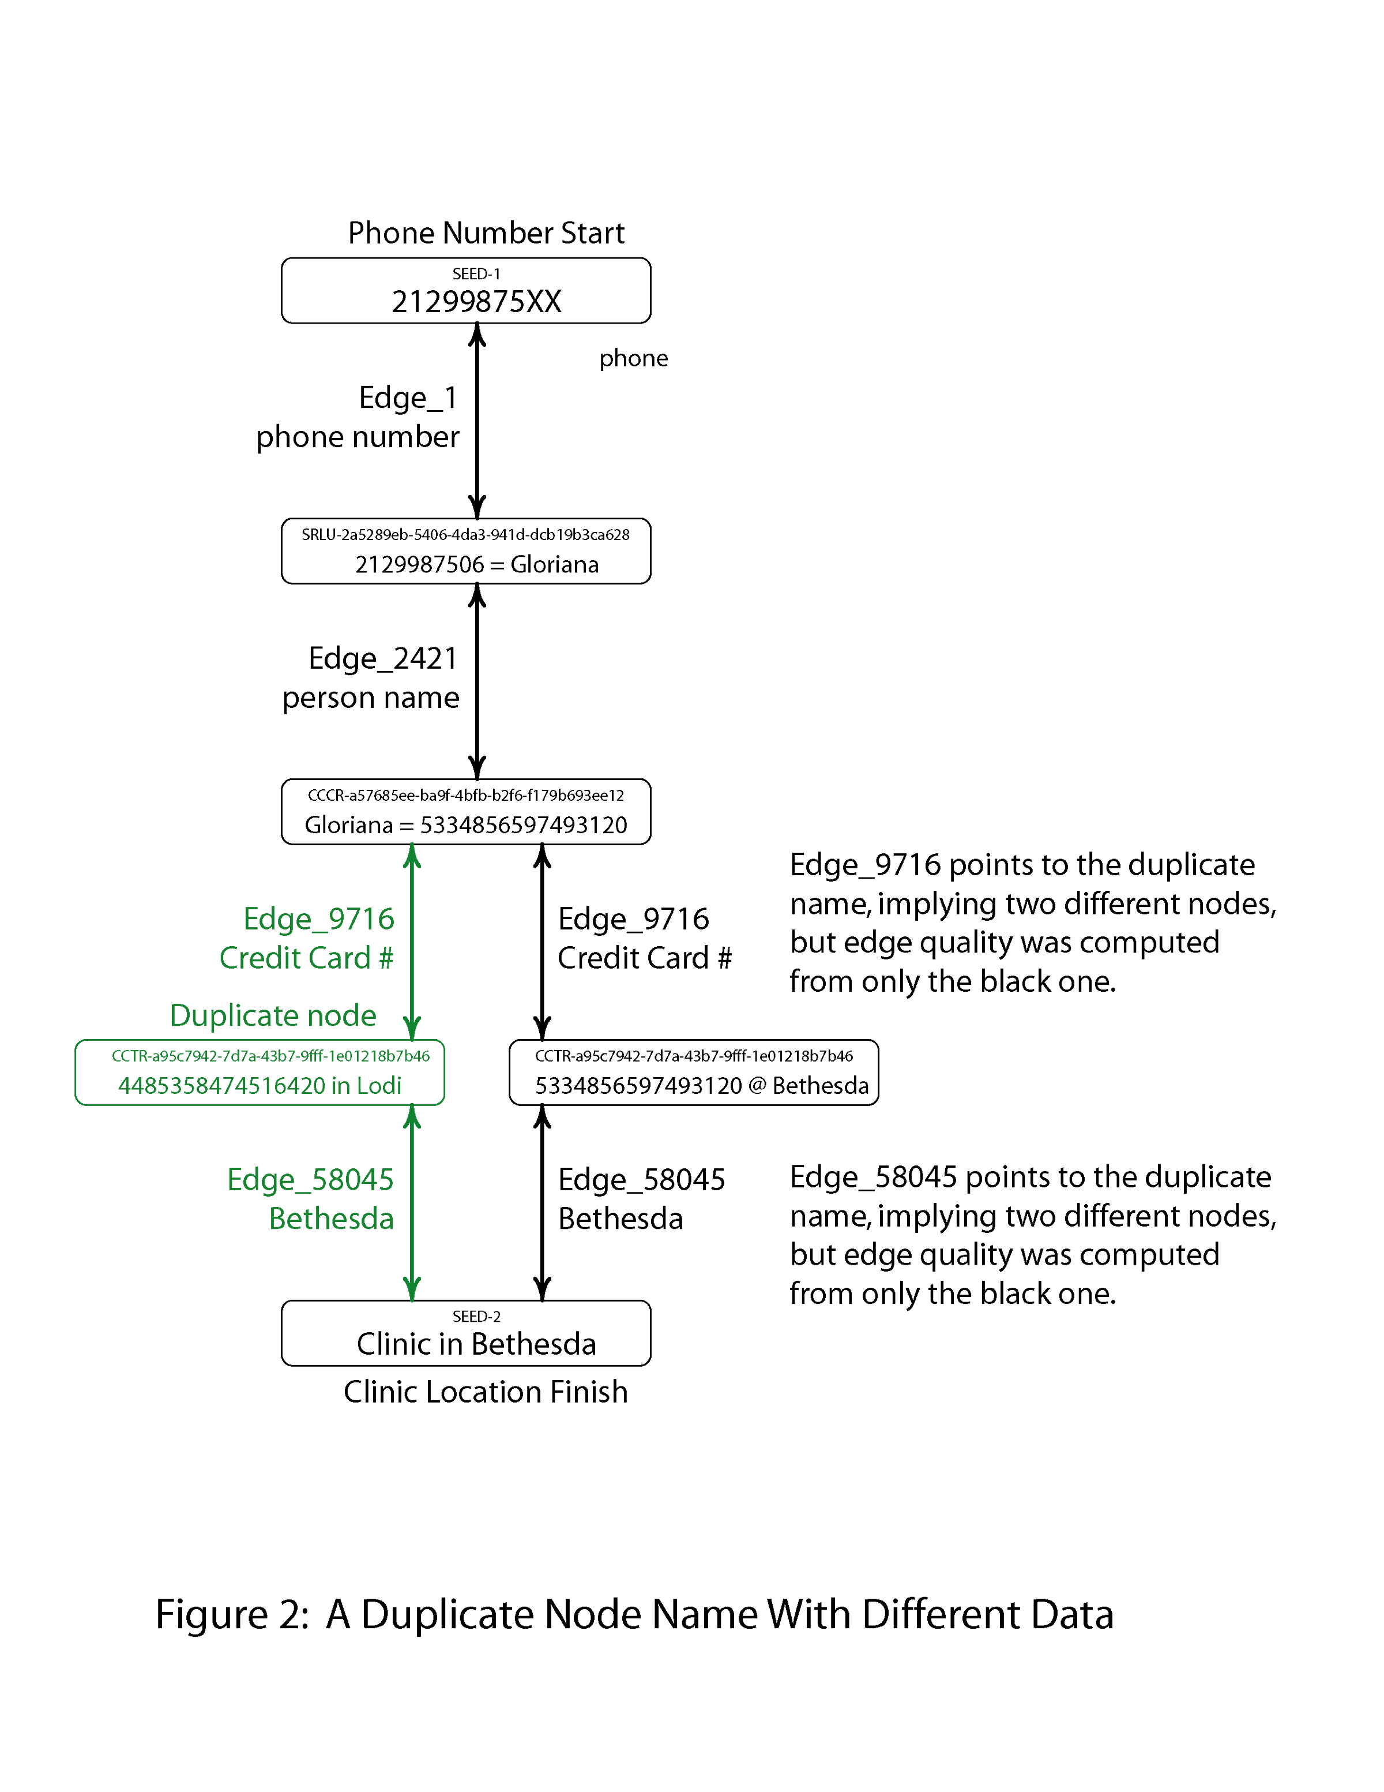

Slide 12
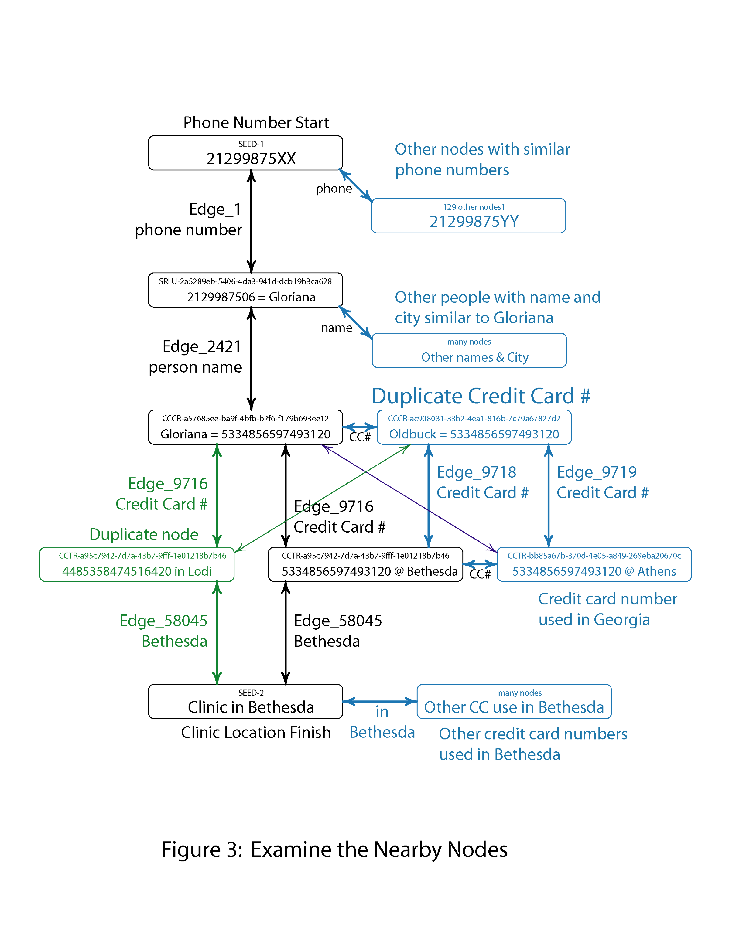

Slide 13
This “toy” problem
Fits in laptop computer
Any topology-aware Language adequate
Well known Graph algorithms
Hard part done in advance
  Finding links
  Computing Match Quality Scores

Slide 14
For “real” problem
Massive data sets
  Three to six orders of magnitude bigger
  On secondary storage
  Unique object storage – memory footprint must be small
Finding links
  Will require sorting, categorizing big data sets
  Dynamically adjustable quality criteria
  Winnowing of data critical for in-memory search
Man-machine interface
  Providing programmability and control
  Controlling search types
  Presenting results
  Will need to be “in-line” with other tools, like Unix pipe

Slide 15
Ideas
Quality numbers inside Nodes
  How sure are we of name, address, and numbers?
Uncertainty of quality in Edges
  Error bars
  Match is in range A to B

Slide 16
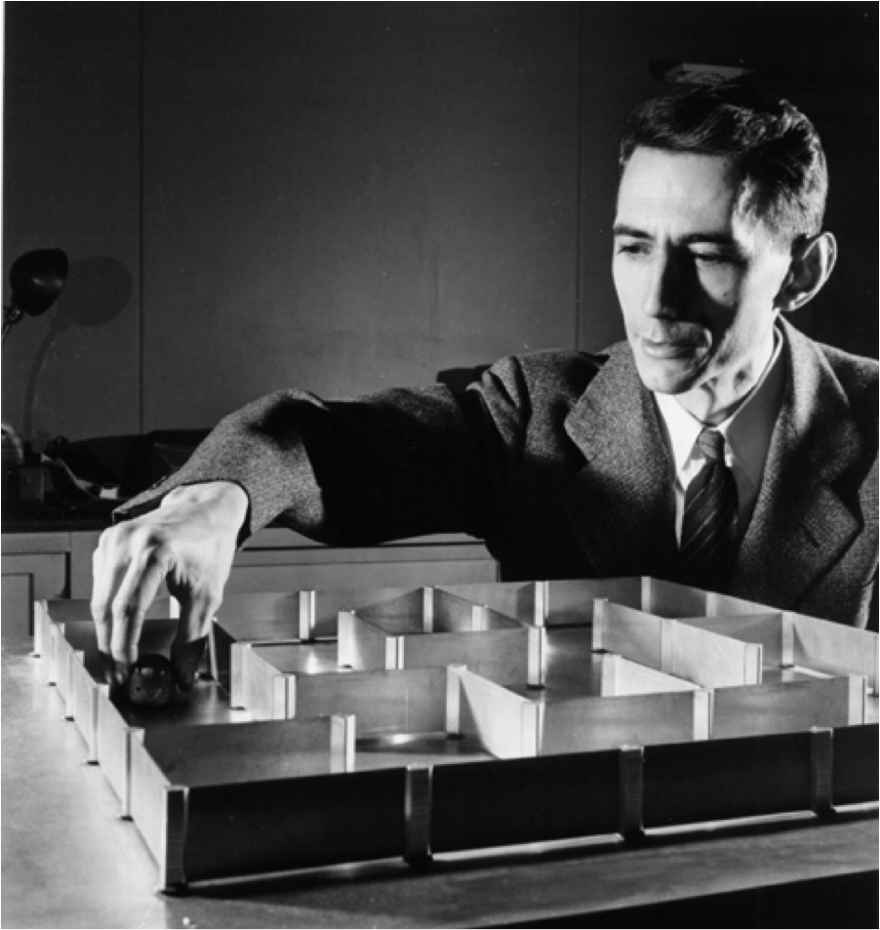
Shannon’s mouse (1950)

