Slide 1
Integrated Environment for Development and Assurance
Software Engineering Institute
Carnegie Mellon University
Pittsburgh, PA 15213
Peter H. Feiler
Jan 26, 2015
Notes:
Title Slide
Title and Subtitle text blocks should not be moved from their position if at all possible.

Slide 2
Copyright 2015 Carnegie Mellon University
This material is based upon work funded and supported by the Department of Defense under Contract No. FA8721-05-C-0003 with Carnegie Mellon University for the operation of the Software Engineering Institute, a federally funded research and development center.
Any opinions, findings and conclusions or recommendations expressed in this material are those of the author(s) and do not necessarily reflect the views of the United States Department of Defense.
NO WARRANTY. THIS CARNEGIE MELLON UNIVERSITY AND SOFTWARE ENGINEERING INSTITUTE MATERIAL IS FURNISHED ON AN “AS-IS” BASIS. CARNEGIE MELLON UNIVERSITY MAKES NO WARRANTIES OF ANY KIND, EITHER EXPRESSED OR IMPLIED, AS TO ANY MATTER INCLUDING, BUT NOT LIMITED TO, WARRANTY OF FITNESS FOR PURPOSE OR MERCHANTABILITY, EXCLUSIVITY, OR RESULTS OBTAINED FROM USE OF THE MATERIAL. CARNEGIE MELLON UNIVERSITY DOES NOT MAKE ANY WARRANTY OF ANY KIND WITH RESPECT TO FREEDOM FROM PATENT, TRADEMARK, OR COPYRIGHT INFRINGEMENT.
This material has been approved for public release and unlimited distribution.
This material may be reproduced in its entirety, without modification, and freely distributed in written or electronic form without requesting formal permission. Permission is required for any other use. Requests for permission should be directed to the Software Engineering Institute at permission@sei.cmu.edu.
Carnegie Mellon® is registered in the U.S. Patent and Trademark Office by Carnegie Mellon University.
DM-0002100

Slide 3
Outline
Challenges in Safety-critical Software-intensive systems
An Architecture-centric Virtual Integration Strategy with SAE AADL
Improving the Quality of Requirements
Architecture Fault Modeling and Hazard Analysis
Incremental Life-cycle Assurance of Systems
Summary and Conclusion
Notes:
Suggested Agenda Format
As a format for an Agenda, inactive agenda items can be made grey if creating builds.

Slide 4
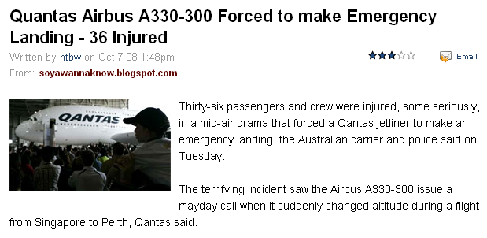
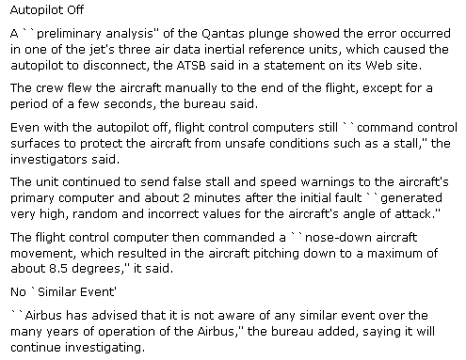
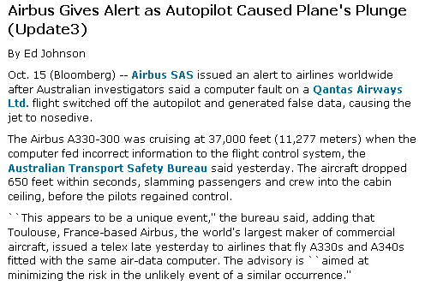
We Rely on Software for Safe Aircraft Operation
Embedded software systems introduce a new class of problems not addressed by traditional system modeling & analysis
Notes:
Incident occurred on Oct 7, 2008.
Original articles shown on slide from Bloomberg website.
More details at http://en.wikipedia.org/wiki/Qantas_Flight_72

Slide 5
Mismatched Assumptions in System Interactions
System Engineer
Control Engineer
Physical Plant Characteristics
Lag, proximity
Hazards
Impact of system failures
Measurement Units, value range Boolean/Integer abstraction
Air Canada, Ariane, 7500 Boolean variable architecture
System
Under
Control
Control
System
System User/Environment
Data Stream Characteristics
Latency jitter affects control behavior
Potential event loss
Operator Error
Automation & human actions
Application Developer
Compute
Platform
Runtime
Architecture
Application
Software
Hardware
Engineer
Distribution & Redundancy
Virtualization, load balancing, mode confusion
Concurrency Communication
ITunes crashes on dual-cores
Embedded SW System Engineer
Embedded software system as major source of hazards
Why do system level failures still occur despite fault tolerance techniques being deployed in systems?

Slide 6
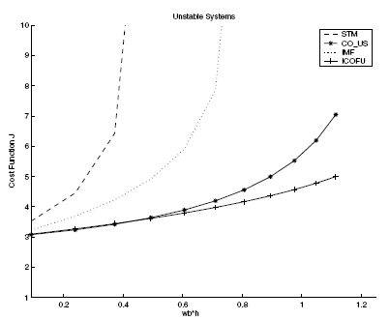
Multi-Fidelity End-to-end Latency in Control Systems
System Engineer
Control Engineer
Operational
Environment
System
Under
Control
Control
System
Common latency data from system engineering
  Processing latency
  Sampling latency
  Physical signal latency
Impact of Scheduler Choice on Controller Stability
  A. Cervin, Lund U., CCACSD 2006
Notes:
The problem is that system engineers and control engineers due not think about the impact of software on end-to-end latency

Slide 7
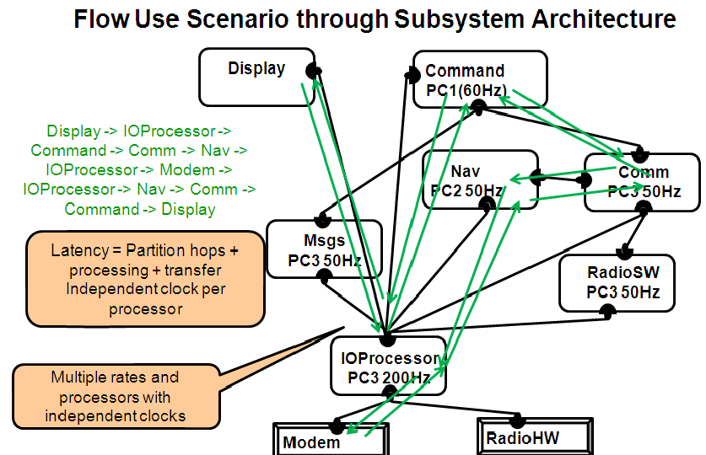
Software-Based Latency Contributors
Execution time variation: algorithm, use of cache
Processor speed
Resource contention
Preemption
Legacy & shared variable communication
Rate group optimization
Protocol specific communication delay
Partitioned architecture
Migration of functionality
Fault tolerance strategy
Notes:
Here is a list of latency contributors due to choices in the the software runtime architecture.

Slide 8
The Symptom: Missed Stepper Motor Steps
Stepper motor (SM) controls a valve
  Commanded to achieve a specified valve position
    Fixed position range mapped into units of SM steps
  New target positions can arrive at any time
    SM immediately responds to the new desired position
Safety hazard due to software design
  Execution time variation results in missed steps
  Leads to misaligned stepper motor position and control system states
  Sensor feedback not granular enough to detect individual step misses
Software modeled and verified in SCADE
Full reliance on SCADE of SM & all functionality
Problems with missing steps not detected
Software tests did not discover the issue
Time sensitive systems are hard to test for.
Two Customer Proposed Solutions
Sending of data at 12ms offset from dispatch
Buffering of command by SM interface
No analytical confidence that the problem will be addressed
Other Challenge Problems
Aircraft wheel braking system
Engine control power up
Situational Awareness & health monitoring
Notes:
Suggested Agenda Format
As a format for an Agenda, inactive agenda items can be made grey if creating builds.

Slide 9
Time-sensitive Auto-brake Mode Confusion
Auto-brake mode selection by push button
  Three buttons for three modes
  Each button acts as toggle switch
Event sampling in asynchronous system setting
  Dual channel COM/MON architecture
  Each COM, MON unit samples separately
    Button push close to sampling rate results in asymmetric value error
    COM/MON mode discrepancy votes channel out
    Repeated button push does not correct problem
    Operational work around (1 second push) is not fool proof
Avoidable complexity design issue
  Concept mismatches: desired state by event and sampled event processing
  Desirable solution: State communication by multi-position switch
Notes:
Here is a list of latency contributors due to choices in the the software runtime architecture.

Slide 10
Outline
Challenges in Safety-critical Software-intensive systems
An Architecture-centric Virtual Integration Strategy with SAE AADL
Improving the Quality of Requirements
Architecture Fault Modeling and Hazard Analysis
Incremental Life-cycle Assurance of Systems
Summary and Conclusion
Notes:
Suggested Agenda Format
As a format for an Agenda, inactive agenda items can be made grey if creating builds.

Slide 11
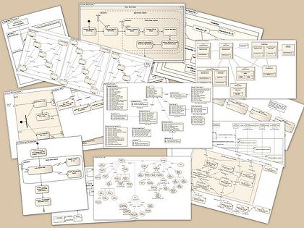

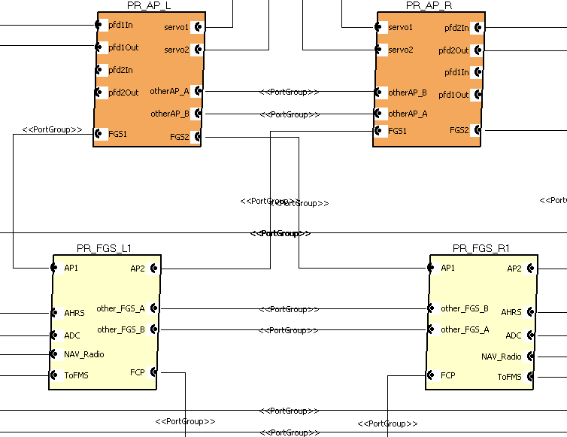
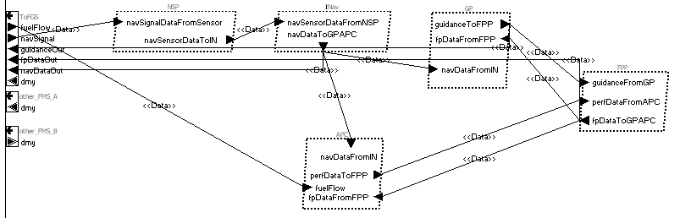
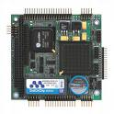

SAE Architecture Analysis & Design Language (AADL) for Software-reliant Systems
SW Design & Runtime Architecture
The Mechanical System
Command & Control
Physical platform
Aircraft
Embedded Operational Avionics & Mission
Software
Deployed on
Utilizes
The Software System
Physical interface
Platform component
Computer System
Hardware & OS
The Computer System
AADL focuses on interaction between the three elements of a software-reliant mission and safety-critical systems.

Slide 12
Architecture-Centric Quality Attribute Analysis
Single Annotated Architecture Model Addresses Impact Across Operational Quality Attributes
Safety
& Reliability
Security
Intrusion
Integrity
Confidentiality
MTBF
FMEA
Hazard
analysis
Architecture Model
Auto-generated analytical models
Data
Quality
Resource
Consumption
Data precision/
accuracy
Temporal
correctness
Confidence
Real-time
Performance
Bandwidth
CPU time
Power consumption
Execution time/
Deadline
Deadlock/starvation
Latency

Slide 13
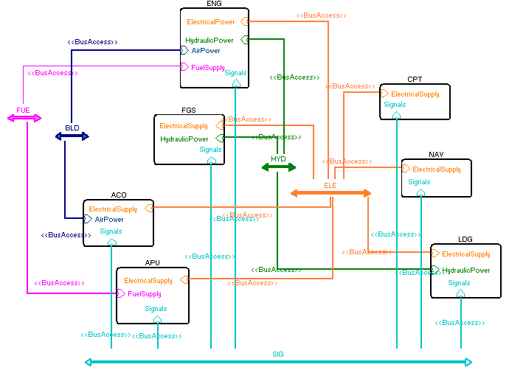
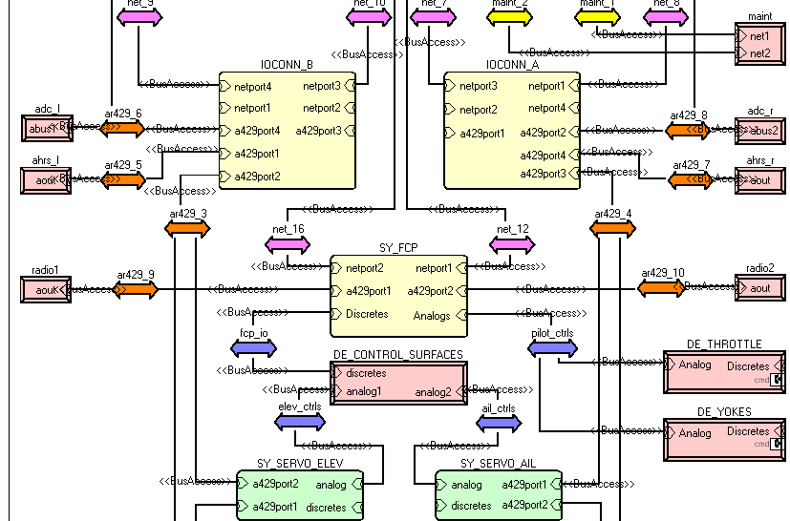
Early Discovery and Incremental V&V through System Architecture Virtual Integration (SAVI)
Aircraft: (Tier 0)
Aircraft system: (Tier 1)
Engine, Landing Gear, Cockpit, …
Weight, Electrical, Fuel, Hydraulics,…
LRU/IMA System: (Tier 2)
Hardware platform, software partitions
Power, MIPS, RAM capacity & budgets
End-to-end flow latency
System & SW Engineering:
  Mechatronics: Actuator & Wings
  Safety Analysis (FHA, FMEA)
  Reliability Analysis (MTTF)
Subcontracted software subsystem: (Tier 3)
Tasks, periods, execution time
Software allocation, schedulability
Generated executables
OEM & Subcontractor:
Subsystem proposal validation
Functional integration consistency
Data bus protocol mappings
Repeated Virtual Integration Analyses:
  Power/weight
  MIPS/RAM, Scheduling
  End-to-end latency
  Network bandwidth
Proof of Concept Demonstration and Transition by Aerospace industry initiative
  Architecture-centric model-based software and system engineering
  Architecture-centric model-based acquisition and development process
  Multi notation, multi team model repository & standardized model interchange
Multi-tier system & software architecture (in AADL)
Incremental end-to-end validation of system properties

Slide 14
Rapid Architecture Trade Study
Help designers to choose the best Architecture
Best reliability, avoid potential failure/error
Meet timing and performance requirements
Analyze operational quality attributes from three perspectives
Safety/Reliability
Latency
Resources and Budgets

Slide 15
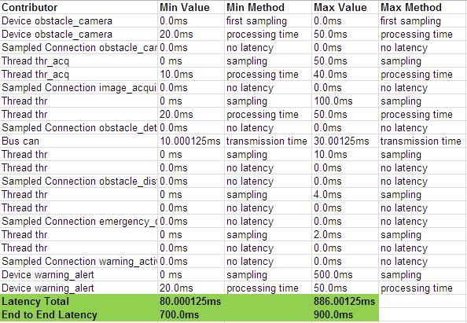

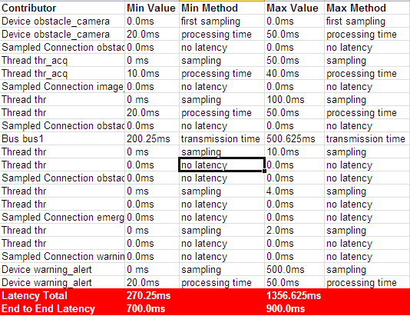

Latency Analysis results
Architecture
Alternative 1
Architecture
Alternative 2

Slide 16
Analysis Summary
 | Architecture 1 | Architecture 2
Latency
Resources Budgets
Safety
Cost
What is the “best” architecture?

Slide 17
Outline
Challenges in Safety-critical Software-intensive systems
An Architecture-centric Virtual Integration Strategy with SAE AADL
Improving the Quality of Requirements
Architecture Fault Modeling and Hazard Analysis
Incremental Life-cycle Assurance of Systems
Summary and Conclusion
Notes:
Suggested Agenda Format
As a format for an Agenda, inactive agenda items can be made grey if creating builds.

Slide 18
Certification & Recertification Challenges
Certification: assure the quality of the delivered system
  Sufficient evidence that a system implementation meets system requirements
  Quality of requirements and quality of evidence determines quality of system
Certification related rework cost
  Currently 50% of total system cost and growing
Recertification Challenge
  Desired cost of recertification in proportion to change
Improve quality of requirements and evidence
Perform verification compositionally throughout the life cycle

Slide 19
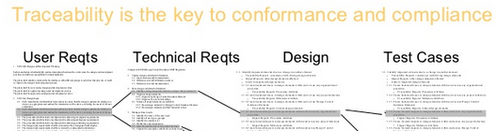
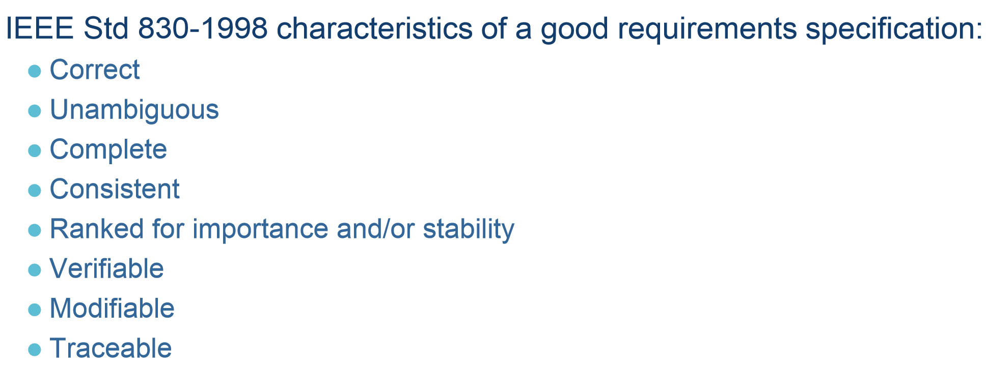
Requirement Quality Challenge
There is more to requirements quality than “shall”s and stakeholder traceability
IEEE 830-1998 Recommended Practice for SW Requirements Specification
Requirements error | %
Incomplete | 21%
Missing | 33%
Incorrect | 24%
Ambiguous | 6%
Inconsistent | 5%
Browsable links/Coverage metrics
System to SW requirements gap [Boehm 2006]
How do we verify low level SW requirements against system requirements?
When StartUpComplete is TRUE in both FADECs and SlowStartupComplete is FALSE,
the FADECStartupSW shall set SlowStartupInComplete to TRUE

Slide 20
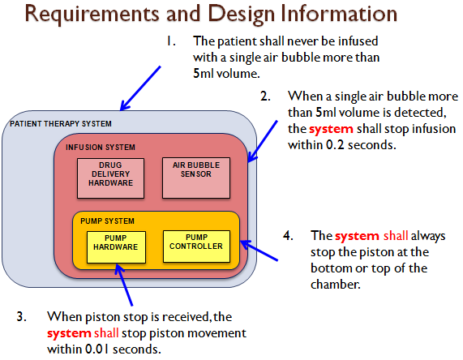




Mixture of Requirements & Architecture Design Constraints
Requirements for a Patient Therapy System
Typical requirement documents span multiple levels of a system architecture
We have made architecture design decisions.
We have effectively specified a partial architecture
Adapted from M. Whalen presentation

Slide 21
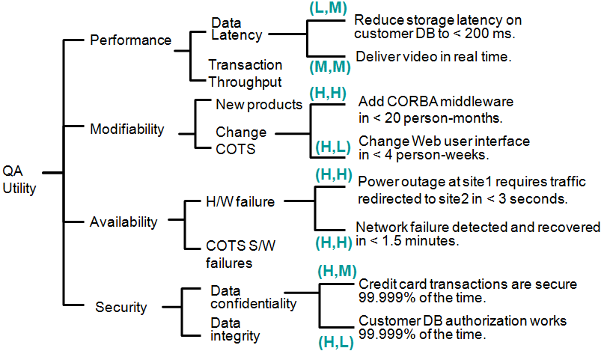
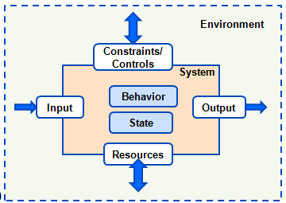
System Specification and Requirements Coverage
Quality attribute utility tree
Developmental Requirements
Modifiability
Assurability
…
Environmental Assumptions
Requirements
Guarantees
Assumptions
Mission Requirements
Dependability Requirements
Function
Reliability
Behavior
Safety
Precondition
Postcondition
Invariant
Performance
Security
…
…
Implementation constraints
Exceptional condition
Interaction contract: match input assumption with guarantee

Slide 22
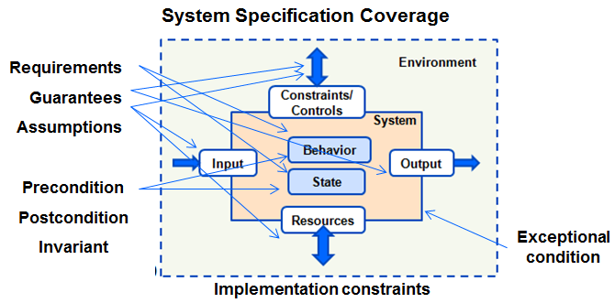
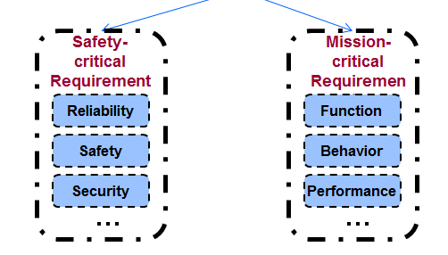
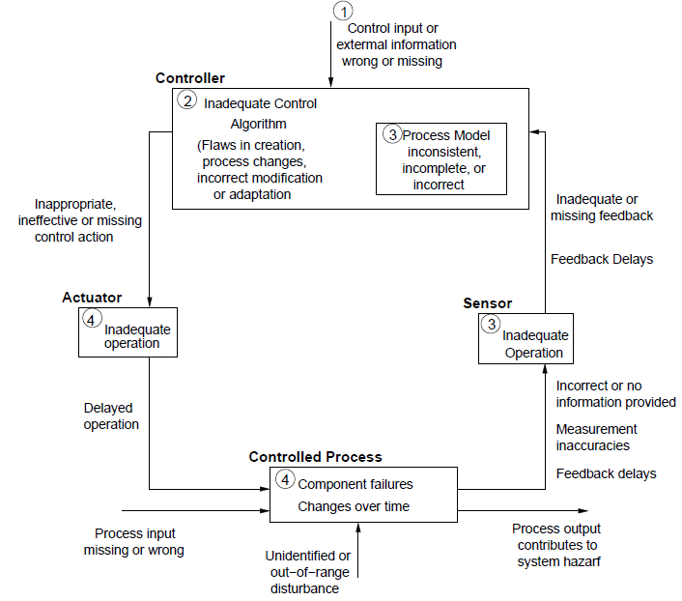
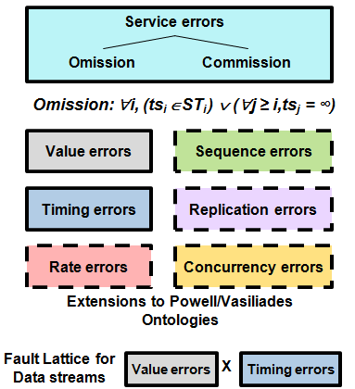
Architecture-led Requirement & Hazard Specification
Error Propagation Ontology
Control System
Behavior
Output
Input
State
Leveson pattern
System Under Control
Behavior
Actuator
Sensor
State

Slide 23
Outline
Challenges in Safety-critical Software-intensive systems
An Architecture-centric Virtual Integration Strategy with SAE AADL
Improving the Quality of Requirements
Architecture Fault Modeling and Safety
Incremental Life-cycle Assurance of Systems
Summary and Conclusion
Notes:
Suggested Agenda Format
As a format for an Agenda, inactive agenda items can be made grey if creating builds.

Slide 24
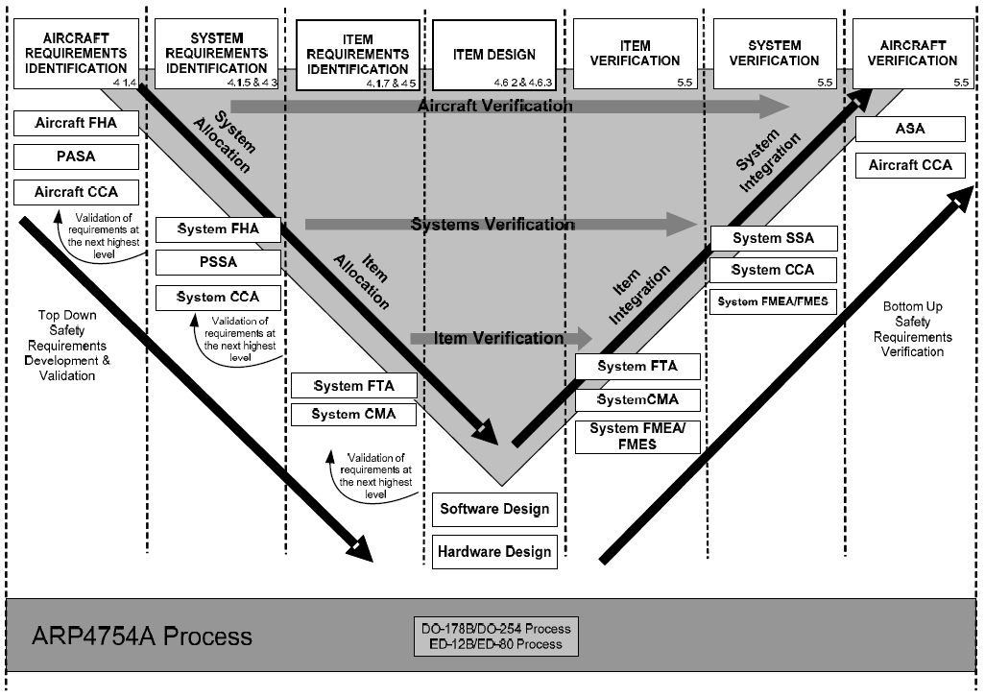
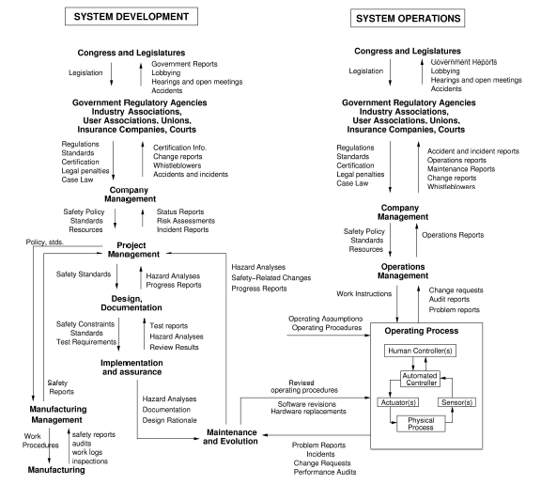
Safety Practice in Development Process Context
System Theoretic Hazard Analysis (STAMP/STPA) [Leveson MIT]
Labor-intensive
Early in system engineering
Rarely repeated due to cost
Focus on System Engineering Largely Ignores Software as Hazard Source
Notes:
This diagram provides an overview of the development "V" within 4754A. This cannot be interpreted as a "waterfall", rather each phase separation is traversed back and forth many times. As you will see, supporting this iterative nature of the process is a central goal of SAVI
Per the document structure provided before, the "item level" development is passed to HW/SW guidance within DO-254 and DO-178

Slide 25
AADL Error Model Scope and Purpose
System safety process uses many individual methods and analyses, e.g.
  hazard analysis
  failure modes and effects analysis
  fault trees
  Markov processes
Goal: a general facility for modeling fault/error/failure behaviors that can be used for several modeling and analysis activities.
Related analyses are also useful for other purposes, e.g.
  maintainability
  availability
  Integrity
  Security
System
Capture hazards
Subsystem
Capture risk mitigation architecture
Component
Capture FMEA model
Annotated architecture model permits checking for consistency and completeness between these various declarations.
SAE ARP 4761 Guidelines and Methods for Conducting the Safety Assessment Process on Civil Airborne Systems and Equipment
Demonstrated in SAVI Wheel Braking System Example
Error Model Annex can be adapted to other ADLs

Slide 26
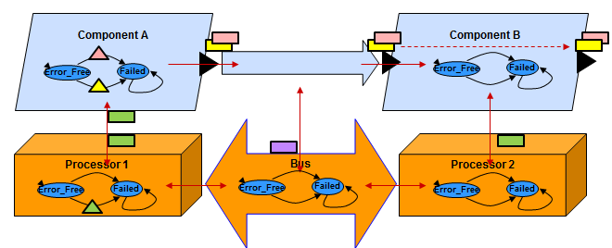
Error Propagation Contracts
Legend
Propagation
of Error Types
P1
Port
Direction
Processor
HW Binding
Propagated Error Type
Not propagated
Incoming
NoData
Component C
BadValue
Error Flow through component
Path P1.NoData->P2.NoData
Source P2.BadData
Path processor.NoResource -> P2.NoData
ValueError
P1
NoData
P3
Outgoing
NoData
LateData
BadValue
P2
Processor
Memory Bus
NoResource
“Not“ on propagated indicates that this error type is intended to be contained.
This allows us to determine whether propagation specification is complete.
Binding
Incoming/Assumed
Error Propagation Propagated errors
Error Containment: Errors not propagated
Outgoing/Contract
Error Propagation
Error Containment
Bound resources
Error Propagation
Error Containment
Propagation to resource

Slide 27
Original Preliminary System Safety Analysis (PSSA)
EGI
Anticipated: No EGI data
Anticipated: NoService
Flight Mgnt System
Actuator
Cmd
Oper’l
NoData
NoData
Auto Pilot
Airspeed
Data
Operational
NoService
Failed
Failed
Stall
FMS
Processor
Anticipated: No Stall Propagation
Operational
Failed
FMS Power
System engineering activity with focus on failing components.

Slide 28
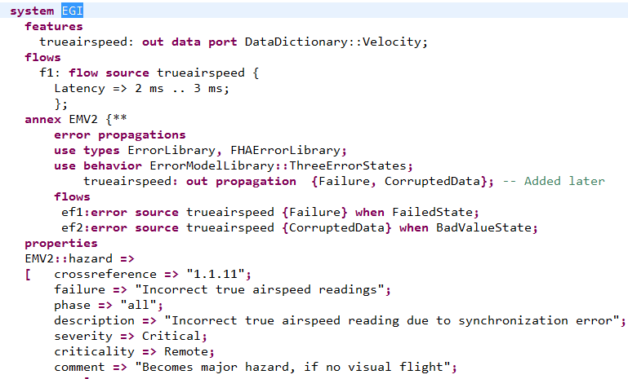
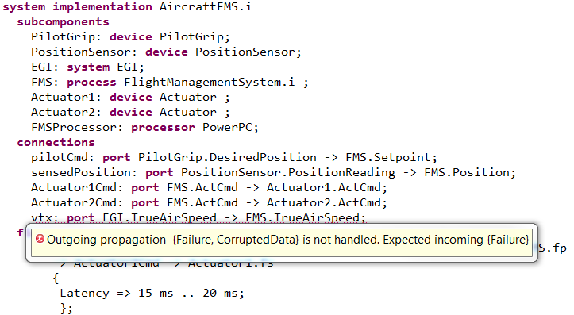
Discovery of Unexpected PSSA Hazard through Repeated Virtual Integration
EGI
Anticipated: No EGI data
Anticipated: NoService
Flight Mgnt System
EGI Logic
Actuator
Cmd
Oper’l
NoData
Auto Pilot
Airspeed
Data
Operational
NoService
Failed
CorruptedData
Failed
Stall
Corrupted
FMS
Processor
EGI HW
Unexpected propagation of corrupted Airspeed data results in Stall due to miss-correction
Anticipated: No Stall Propagation
Oper’l
Operational
Failed
Failed
Vibration causes boards to touch which causes EGI data corruption
FMS Power
EGI maintainer adds corrupted data hazard to model.
Error Model analysis of integrated model detects unhandled propagation.

Slide 29
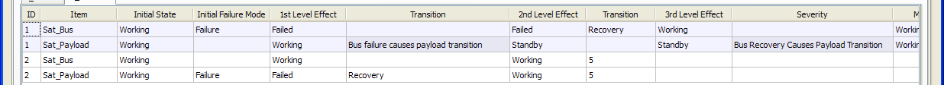
Recent Automated FMEA Experience
Failure Modes and Effects Analyses are rigorous and comprehensive reliability and safety design evaluations
  Required by industry standards and Government policies
  When performed manually are usually done once due to cost and schedule
  If automated allows for
    multiple iterations from conceptual to detailed design
    Tradeoff studies and evaluation of alternatives
    Early identification of potential problems
Largest analysis of satellite to date consists of 26,000 failure modes
  Includes detailed model of satellite bus
  20 states perform failure mode
  Longest failure mode sequences have 25 transitions (i.e., 25 effects)
Myron Hecht, Aerospace Corp.
Safety Analysis for JPL, member of DO-178C committee
Notes:
From Myron Hecht

Slide 30
Outline
Challenges in Safety-critical Software-intensive systems
An Architecture-centric Virtual Integration Strategy with SAE AADL
Improving the Quality of Requirements
Architecture Fault Modeling and Hazard Analysis
Incremental Life-cycle Assurance of Systems
Summary and Conclusion
Notes:
Suggested Agenda Format
As a format for an Agenda, inactive agenda items can be made grey if creating builds.

Slide 31

Quality & Certification Improvement Strategy
2010 SEI Study for AMRDEC Aviation Engineering Directorate
Architecture-led Requirement Specification
Architecture-centric Virtual System Integration
Static Analysis & Compositional Verification
Incremental Assurance Plans & Cases throughout Life Cycle
Model Repository
Operational & failure modes
Mission Requirements
Function
Behavior
Performance
Architecture Model
Component Models
Resource, Timing & Performance Analysis
Survivability Requirements
Reliability
Safety
Security
System Implementation
Reliability, Safety, Security Analysis
System configuration
Four pillars for Improving Quality of Critical Software-reliant Systems
Notes:
The framework is an integration of technology concepts from architecture-centric model-based engineering (SAE AADL & SEI MBE), system theoretic approach to safety analysis (Leveson MIT), safety cases & software assurance (Kelly U. York, Goodenough SEI), model checking & static analysis of models and code (Miller Rockwell Collins, Gurfinkel SEI, European efforts), requirements formalization (CalTech/JPL, GORE Lambsweerde).
Requirements expressed in the context of an intended system. Both mission and reliability requirements must be validated for completeness and soundness.
The requirements are mapped onto the system architecture and its decomposition as claims. The system model and implementation must be verified against these mission and reliability claims (requirements). The confidence in this verification is determined by the by the coverage of the claims, the effectiveness of the verification methods, and the validity of assumptions made by the models and the verification methods.
Parts of this framework are embodied in the Aerospace Vehicle Systems Institute (AVSI) System Architecture Virtual Integration (SAVI) industry initiative.

Slide 32
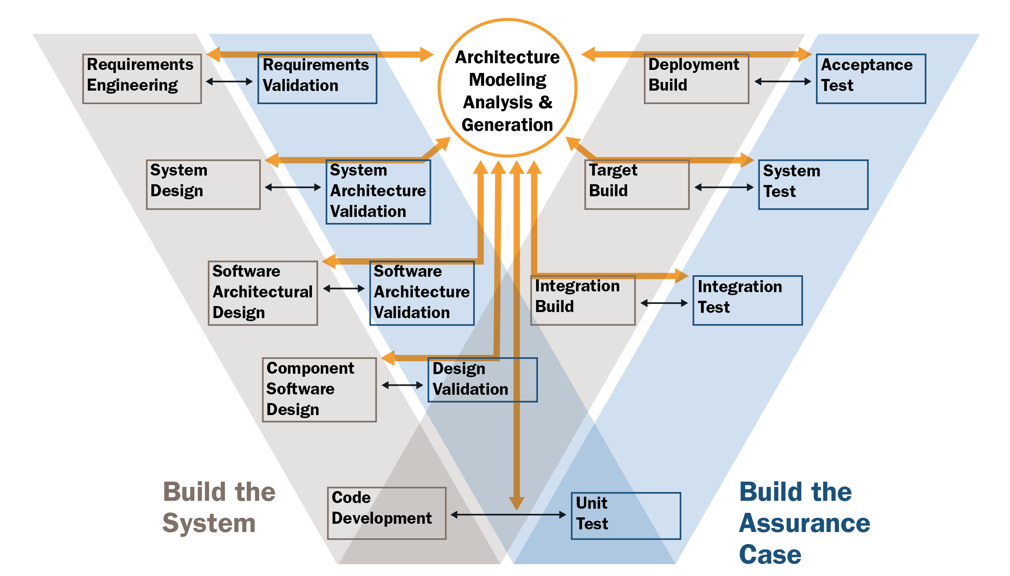
Building the Assurance Case throughout the Life Cycle

Slide 33
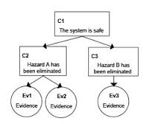
Virtual System Integration & Compositional Verification
Continuous Confidence Measure throughout Life Cycle that a System Meets its Requirements
Incremental Evolution and Execution of Assurance Plans
Architecture-centric Virtual Integration
Incremental Architecture & Requirement Evolution
Architecture Led
Requirements Specification
Requirements
Verification
Requirements
Engineering
Acceptance
Test
Deployment
Build
Flight Test
Requirement
Coverage
Early Discovery through Architecture Analysis
leads to Assurance Related Rework Reduction
RS
System&SW
Architecture
Verification
System & SW
Architectural
Design
System Integration
Lab Testing
Design & Req
Refinement
Compositional
Verification
Target
Build
System
Test
Virtual Architecture
Integration & Analysis
RS
VA
RS
VA
RS
VA
Design
Verification
Component
Software
Design
Integration
Build
Integration
Test
Code Coverage
Testing
Design & Req
Refinement
Compositional
Verification
Design Validation by
Virtual Integration
Code
Development
Unit
Test
Code
Verification
RS
VA
RS
VA
RS
VA
Auto-generation from verified models
AADL&SCADE/Simulink
Ada SPARK/Ravenscar
MISRA C
Increased
Confidence
Cost-effective
Tests
Incremental Contract-based Compositional Verification
Build the System
Auto-generated Assurance Cases
Build the Assurance Case
Notes:
We evolve from predictive models to increased validation.
We do so as system design evolve down the V to more detail, and as implementations of pieces become available. Analyses of lower level models feed back to higher level models to revisit the analysis, and as component implementations become available results of their test measurements are fed back to increase confidence that predictions converge with actual behavior of system implementations.

Slide 34

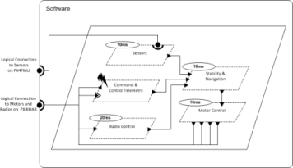
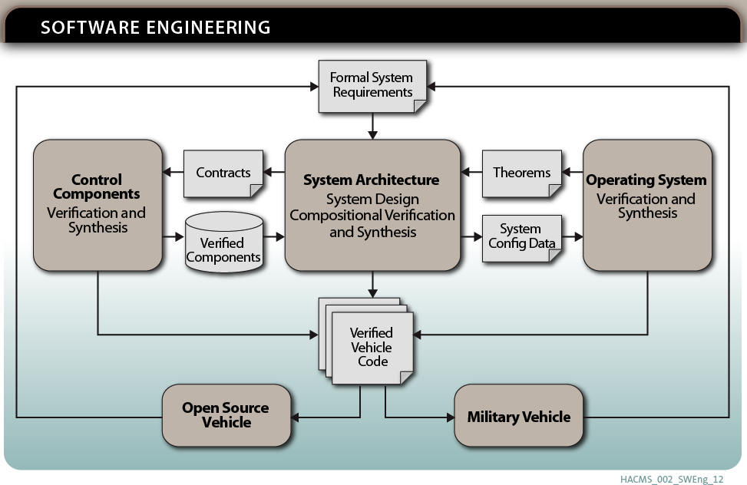
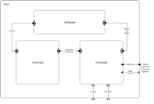
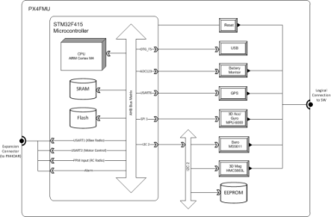
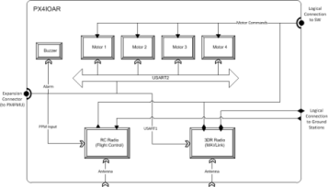
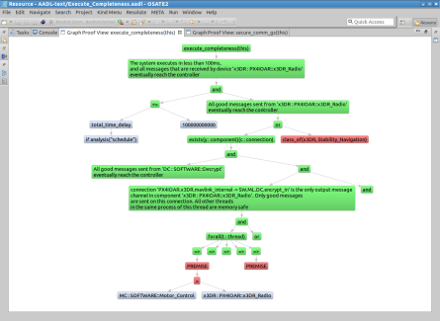
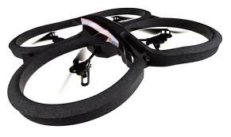
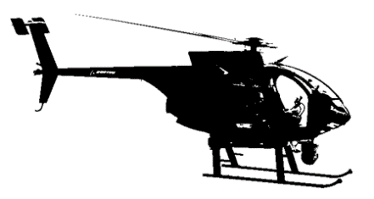
Secure Mathematically-Assured Composition of Control Models
Contract-based Compositional Verification
Key Problem
Many vulnerabilities occur at component interfaces.
How can we use formal methods to detect these vulnerabilities and build provably secure systems?
TA4 – Research Integration and
Formal Methods Workbench
Rockwell Collins and
University of Minnesota
16 months into the project
Draper Labs could not hack into the system in 6 weeks
Had access to source code
ARCHITECTURE-CENTRIC PROOF
Accomplishments
Created AADL model of vehicle hardware & software architecture
Identified system-level requirements to be verified based on input from Red Team evaluations
Developed Resolute analysis tool for capturing and evaluating assurance case arguments linked to AADL model
Developed example assurance cases for two security requirements
Developed synthesis tool for auto-generation of configuration data and glue code for OS and platform hardware
Technical Approach
Develop a complete, formal architecture model for UAVs that provides robustness against cyber attack
Develop compositional verification tools driven from the architecture model for combining formal evidence from multiple sources, components, and subsystems
Develop synthesis tools to generate flight software for UAVs directly from the architecture model, verified components, and verified operation system
Open source tools available at github.com/smaccm

Slide 35
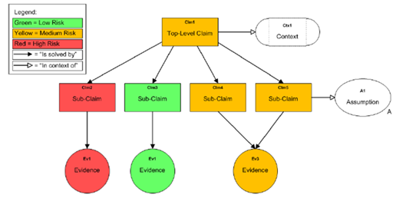
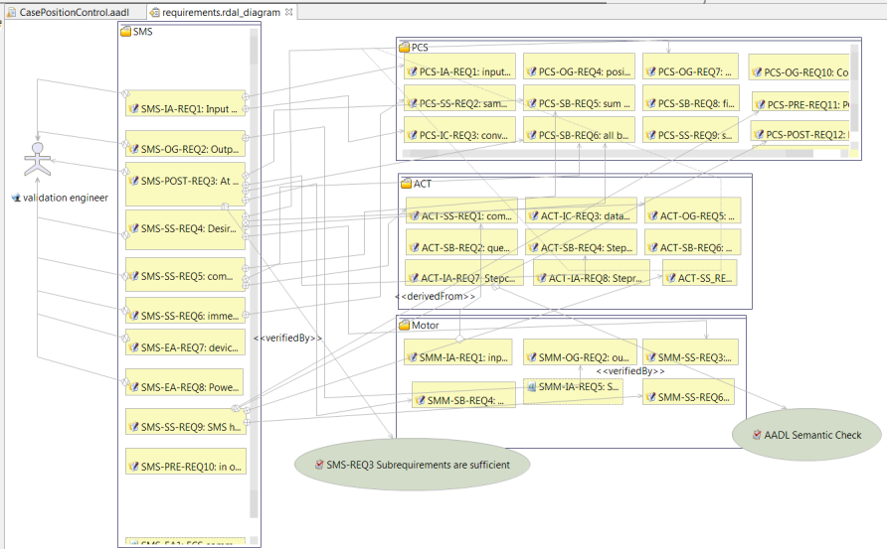
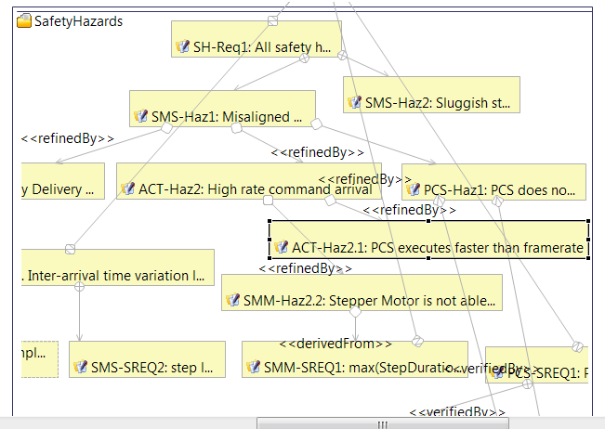
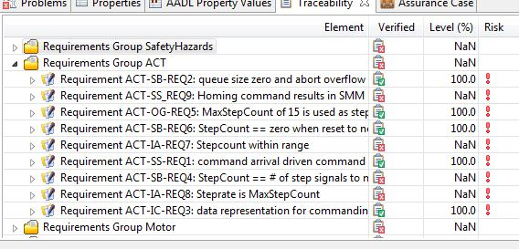
Integrated Approach to Requirement V&V through Assurance Automation
Generated assurance cases
Requirement coverage Assumption evidence
Safety hazards are part of the picture
Evidence records in terms of claims that requirements have been met
Linkage to automated test harnesses

Slide 36
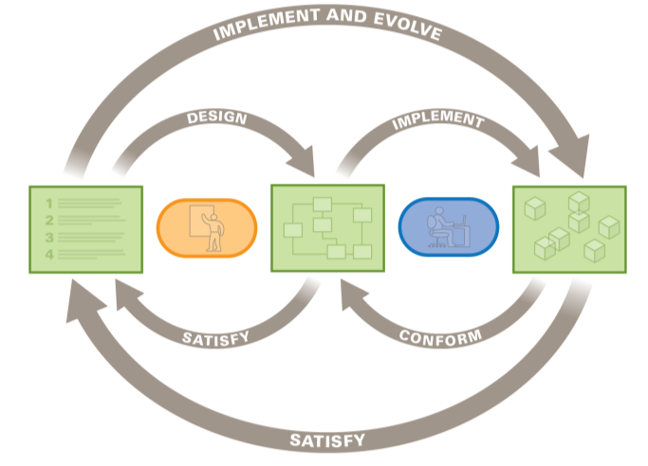
Incremental Development and Assurance Practice
Iterative architecture design, safety analysis, and requirement decomposition
Transformation and code generation based on verified architecture specifications
Model-based architecture specifications & multi-dimensional QA analysis
Stakeholder and Quality Attribute (QA) driven architecture-centric requirement specification
BUSINESS
AND
MISSION GOALS
ARCHITECTURE
SYSTEM
Testing against verified specifications and models
Architecture-centric virtual integration and compositional verification of requirements
Assurance plan and execution

Slide 37
Outline
Challenges in Safety-critical Software-intensive systems
An Architecture-centric Virtual Integration Strategy with SAE AADL
Improving the Quality of Requirements
Architecture Fault Modeling and Hazard Analysis
Incremental Life-cycle Assurance of Systems
Summary and Conclusion
Notes:
Suggested Agenda Format
As a format for an Agenda, inactive agenda items can be made grey if creating builds.

Slide 38
Benefits of Incremental Life Cycle Assurance through Virtual System Integration
Reduce risks
  Analyze system early and throughout life cycle
  Understand system wide impact
  Validate assumptions across system
Increase confidence
  Validate models to complement integration testing
  Validate model assumptions in operational system
  Evolve system models in increasing fidelity
Reduce cost
  Fewer system integration problems
  Fewer validation steps through use of validated generators

Slide 39
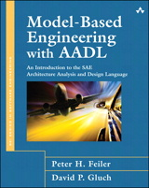
References
AADL Website www.aadl.info and AADL Wiki www.aadl.info/wiki
Blog entries and podcasts on AADL at www.sei.cmu.edu
AADL Book in SEI Series of Addison-Wesley http://www.informit.com/store/product.aspx?isbn=0321888944
On AADL and Model-based Engineering
http://www.sei.cmu.edu/library/assets/ResearchandTechnology_AADLandMBE.pdf
On an architecture-centric virtual integration practice and SAVI
http://www.sei.cmu.edu/architecture/research/model-based-engineering/virtual_system_integration.cfm
On an a four pillar improvement strategy for software system verification and qualification
http://blog.sei.cmu.edu/post.cfm/improving-safety-critical-systems-with-a-reliability-validation-improvement-framework
Webinars on system verification https://www.csiac.org/event/architecture-centric-virtual-integration-strategy-safety-critical-system-verification and on architecture trade studies with AADL https://www.webcaster4.com/Webcast/Page/139/5357
Notes:
Model-based system engineering benefits
Analyzable architecture models drive development
Predictable runtime characteristics at different modeling fidelity
Model evolution & tool-based processing
Prediction early and throughout lifecycle
Reduced integration & maintenance effort
Benefits of AADL as SAE standard
Common modeling notation across organizations
Single architecture model augmented with analysis properties
Interchange & integration of architecture models
Tool interoperability & extensible engineering environments
Aligned with UML-based engineering practices

Slide 40
Contact Information
Peter H. Feiler Principal Researcher RTSS Telephone: +1 412-268-7790 Email: phf@sei.cmu.edu | U.S. Mail Software Engineering Institute Customer Relations 4500 Fifth Avenue Pittsburgh, PA 15213-2612 USA
Web Wiki.sei.cmu.edu/aadl www.aadl.info | Customer Relations Email: info@sei.cmu.edu SEI Phone: +1 412-268-5800 SEI Fax: +1 412-268-6257

