Slide 1
UNCLASSIFIED
LL Cyber Red / Blue
Playable Simulation
Ms. Nancy Crabtree
MIT Lincoln Laboratory
Computational Cybersecurity in Compromised Environments Workshop (C3E)
10 Sept 2012
Not for public release
UNCLASSIFIED
Notes:
My name is Nancy Crabtree and I am a researcher in the Cyber Systems and Technologies group at Lincoln Laboratory. Today I’m going to tell you about our project Cyber Red/Blue.

Slide 2
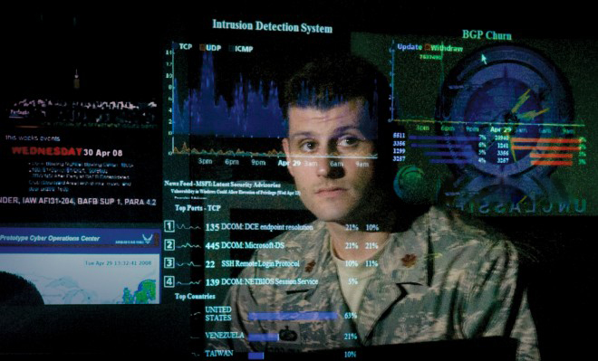
What is LL Cyber Red / Blue?
Cyber Red / Blue is a playable simulation platform that allows
a human defender to practice against an automated attacker
Cyber Challenges
Threats evolve rapidly
Large amounts of data
Need to balance mission and security
Incident Commander must synthesize and
act quickly
Notes:
Cyber Red/Blue is a playable simulation platform that allows a human defender to practice against an automated attacker. The game focuses on cyber decision support challenges.
Challenges include:
Threats evolve rapidly, and so the platform needs to handle that
Operators are presented with large amounts of uncorrelated data that can make it difficult to track threats
And at the same time, information necessary to balance mission and security may be unavailable
-The incident commander must synthesize this information and act quickly

Slide 3
LL Cyber Red / Blue Goals
Environment
Information
Technologies
Stimuli
Mission Assurance and Threat Level
Courses of Action
Decision Maker
Look at role of human-in-the-loop decision-making processes
Notes:
One of the key goals of Cyber Red/Blue has been to build a platform that helps us gain a deeper understanding of human decision processes related to cyber security.

Slide 4
LL Cyber Red / Blue Goals
Environment
  Information
    Observable Artifacts
Technologies
Stimuli
Mission Assurance and Threat Level
Courses of Action
Decision Maker
Look at role of human-in-the-loop decision-making processes
Notes:
In particular, we want to understand how the environment affects incident commander decision-making.
For example, what kinds of information makes a difference? We call these “observable artifacts”.

Slide 5
LL Cyber Red / Blue Goals
Environment
  Information
    Observable Artifacts
Technologies
  Inserted Tools
Stimuli
Mission Assurance and Threat Level
Courses of Action
Decision Maker
Look at role of human-in-the-loop decision-making processes
Notes:
What kinds of technologies make a difference? These are tools inserted into the simulation.

Slide 6
LL Cyber Red / Blue Goals
Environment
  Information
    Observable Artifacts
Technologies
  Inserted Tools
Stimuli
    Interactions
Mission Assurance and Threat Level
Courses of Action
Decision Maker
Look at role of human-in-the-loop decision-making processes
Notes:
And what kinds of stimuli make a difference? These are interactions during the game.

Slide 7
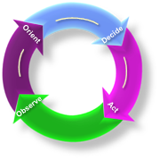
LL Cyber Red / Blue Goals
Incident Commander
Environment
  Information
    Observable Artifacts
Technologies
  Inserted Tools
Stimuli
    Interactions
Mission Assurance and Threat Level
Courses of Action
Decision Maker
OODA Loop
Look at role of human-in-the-loop decision-making processes
Notes:
The environment provides the inputs for the Incident Commander decision-making process. This process is represented by the steps of the OODA loop – observe, orient, decide and act.

Slide 8
LL Cyber Red / Blue Goals
Incident Commander
Environment
  Information
    Observable Artifacts
Technologies
  Inserted Tools
Stimuli
    Interactions
Mission Assurance and Threat Level
Courses of Action
Decision Maker
OODA Loop
Look at role of human-in-the-loop decision-making processes
Notes:
Once decisions are made, commanders take courses of action that impact mission assurance and the threat level.

Slide 9
LL Cyber Red / Blue Goals
Incident Commander
Environment
  Information
    Observable Artifacts
Technologies
  Inserted Tools
Stimuli
    Interactions
Mission Assurance and Threat Level
Courses of Action
Impact Measures
  Mission Health
  Threat Level
  Exercise Objectives
Decision Maker
OODA Loop
Look at role of human-in-the-loop decision-making processes
Notes:
These impacts are measured against the enterprise mission health, threat level, and whether the exercise objectives are being met.

Slide 10

Project Approach
Survey existing capabilities
Design and develop a human-playable red / blue
simulation platform
  Support re-usable, scalable and dynamic configurations
  Quantify decision and response processes
Create and run a cyber red / blue game
  Set up an instructive scenario
Notes:
Our approach to Cyber Red/Blue was to survey existing capabilities, design and build our platform, then use it to create and run a game using an instructive scenario.

Slide 11
Survey of Existing Capabilities
Well-developed approaches exist to address specific challenges
Continuing need for measurement of tool effectiveness for human-in-the-loop
Cyber Red / Blue Simulation Approaches (involving human interactions)
Approach | Focus | Scope | Responsiveness | Scaling Cost
LL Cyber Red / Blue
Hacker Competition
Test Range Emulation
Computer-based Training
Tabletop Exercise
Operations-based Exercise
Technical Defense
Human Decision
Making
Computer
System
Extended Enterprise Mission
Static
Dynamic
$
$$$
Notes:
When we surveyed the landscape, we found a number of well-developed approaches already exist to address particular challenges.
The niche Cyber Red/Blue fills is to provide:
strong measurement capabilities for human decision-making
evaluation of decisions in the context of the extended enterprise mission
dynamic response that has been available to test range emulations
At lower scaling cost

Slide 12
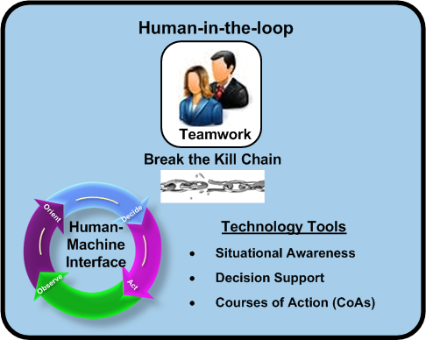
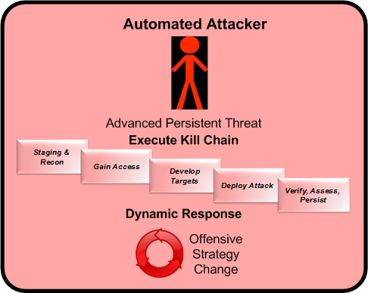
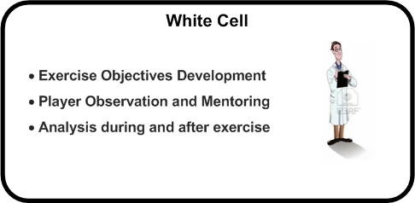
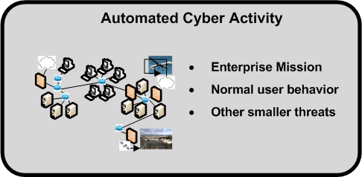
LL Red / Blue Components
Notes:
The full simulation and game consist of these four basic elements.

Slide 13
LL Red / Blue Components
Notes:
The human game players are the defenders working to break the attacker kill chain. They use technology tools available in the human-machine interface, the game GUI, to make decisions and take actions.

Slide 14
LL Red / Blue Components
Notes:
The automated attacker is executing its kill chain to reach its objectives, and is able to respond dynamically to player actions.

Slide 15
LL Red / Blue Components
Notes:
At the same time, the simulation provides automated cyber activity that includes the enterprise mission and other background traffic.

Slide 16
LL Red / Blue Components
Notes:
In the background, the white cell works with game planners to develop the exercise objectives, then observes and analyzes player activity to ensure the objectives are being met.

Slide 17
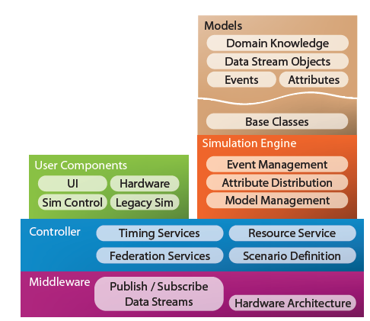
Software Architecture
Existing Functionality
Discrete event simulator
Lincoln NOMAD (java) instantiation of OASIS standard
  Timing services
  Event queuing
  Publish / subscribe events and attributes
  Communications channels
  Base class hooks
  for new models and visualizations
New Functionality
Cyber models
  Software objects
  and methods
  Attribute configuration data
  Service log ingest drives initial events
Human/Machine Interface (HMI)
Unified workflow visualization
Evaluation tools
Human CoA inject
Instrumentation for measurement
Notes:
We developed the software architecture to support these different components. We wanted to re-use existing functionality wherever it was feasible, and to make the software modular to allow for new technology to plug in when it became available.
We were able to re-use Lincoln’s NOMAD discrete event simulator to perform our underlying timing and event queuing services. We also liked that it provided publish/subscribe mechanisms that allow Cyber Red/Blue to interface either with simulated or operational environments.
We added new cyber models to drive events and a human/machine interface for the player game console.

Slide 18
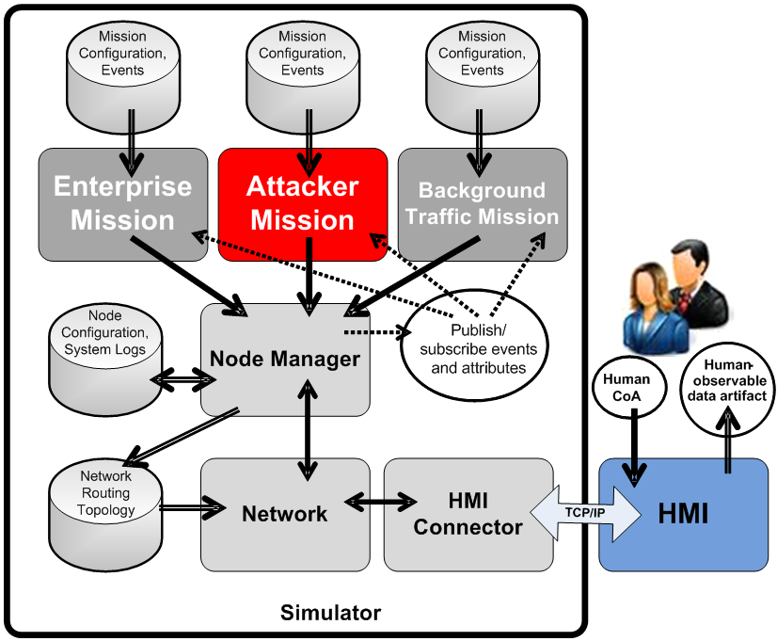
Cyber Models
Mission
Milestones ➔Tasks ➔Actions
Pre-conditions, post-conditions and probabilities
Dynamic response to events and attribute changes
(publish / subscribe)
Node Manager
Workstations
Servers
Security tools to evaluate
Network
Routing abstraction
HMI Connector
Data connector to HMI
Off-load HMI logic
Legend Network connection
Data transfer Publish/Subscribe-triggered data transfer causing dynamic software response
Event transfer
Notes:
Our cyber models simulate the functionality of key cyber activities of networks and computer systems. There are four types.
-The Mission Model drives scenario events and includes the enterprise mission, attacker mission and background traffic.
-The Node Manager handles the computer responses to the events.
-The Network is responsible for routing events to the correct nodes.
-The HMI Connector provides the data interface to the player’s game console.

Slide 19
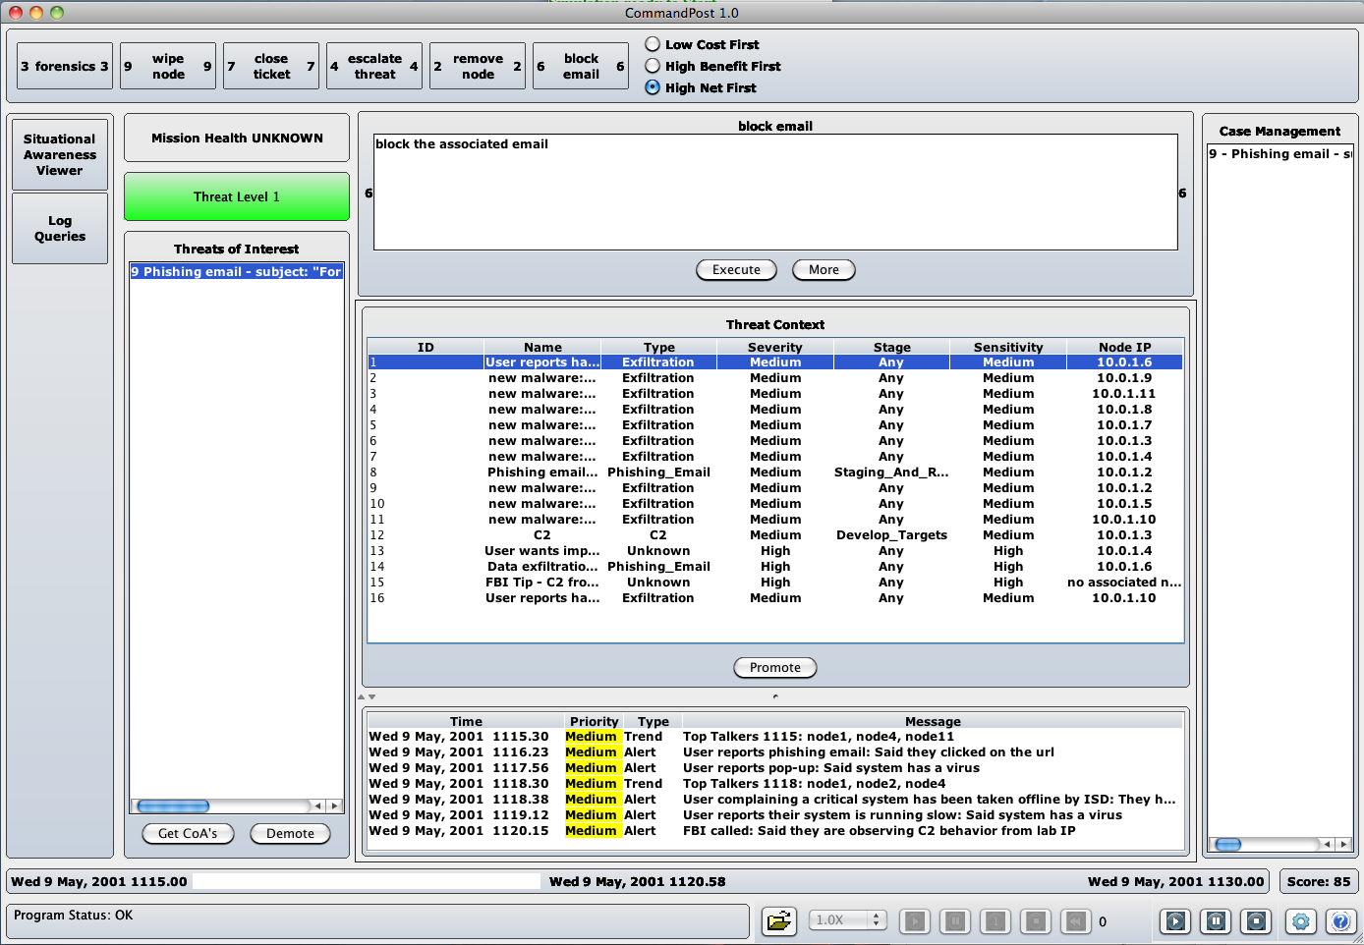
Role-Based HMI
GUI represents unified work area to make decisions
Each frame represents areas of decision-support workflow, broken out by type
Instrumentation of human behavior collects data via multiple methods
Situational Awareness
(Observe, Orient)
Messages Panel
Network Display
Log Queries
Decision Support
(Orient, Decide)
Mission Health Panel
Threat Level
Threat Context Panel
Threat of Interest
Suggested Courses of Action
Case Management Report
Courses of Action (CoAs)
(Decide, Act)
View CoA Costs and Benefits
Act by Executing
White Team Support
Replay
Pause
Game/Visualization control
Score
10
4
2
3
5
11
9
6
7
1
8
15
12
13
14
Notes:
The player is presented with a number of technologies and information sources on the game console.
The GUI presents a unified work area ensure that player behavior related to the important decision workflows can be captured.
Note that the frames are swappable between games to include technologies relevant to the operational environment.
Tools are grouped to provide:
- Situational Awareness, to help players observe and orient
Decision Support, to help players orient and decide
Courses of Action, to help players decide and act
The platform is also instrumented to capture human behavior in three different ways
Replay capability, to capture initial game play then replay back at different speeds as needed
A pause button, that allows the white cell to stop game play to ask players questions before or after critical events during the game
A Case Management Report that timestamps relevant environment and player actions, then groups them by threat

Slide 20
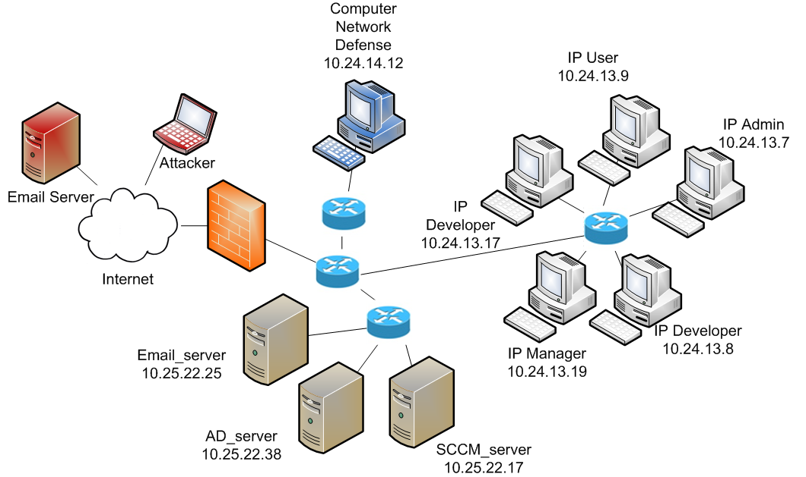
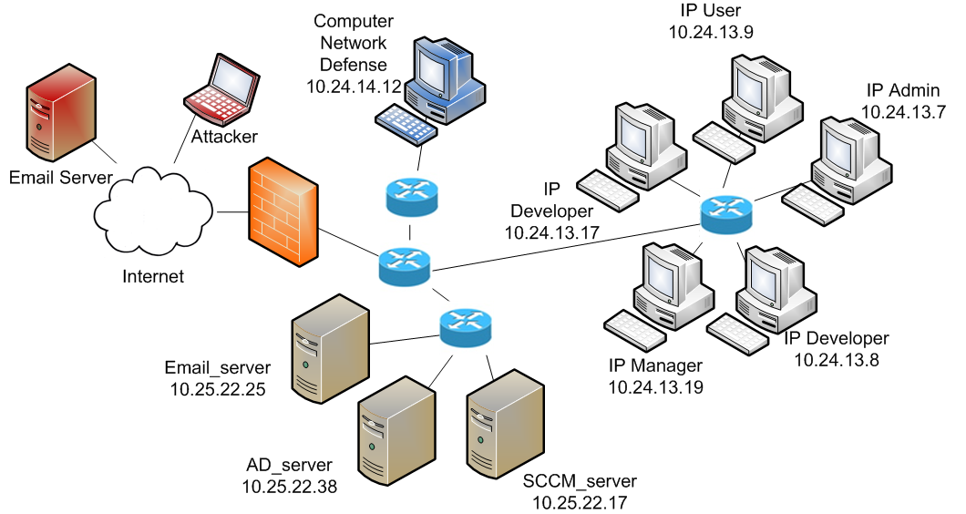
Game Scenario –
Central Nodes Involved in Attack
Enterprise mission: develop intellectual property
Notes:
For our initial game, we configured a network topology consisting of an enterprise LAN and the Internet.
User nodes and servers execute the enterprise mission by passing messages between themselves.
The player console for the blue defender is situated on the enterprise LAN to monitor and protect the organization.
The attacker is situated on the Internet and sends out phishing emails with malicious content to enterprise nodes.

Slide 21
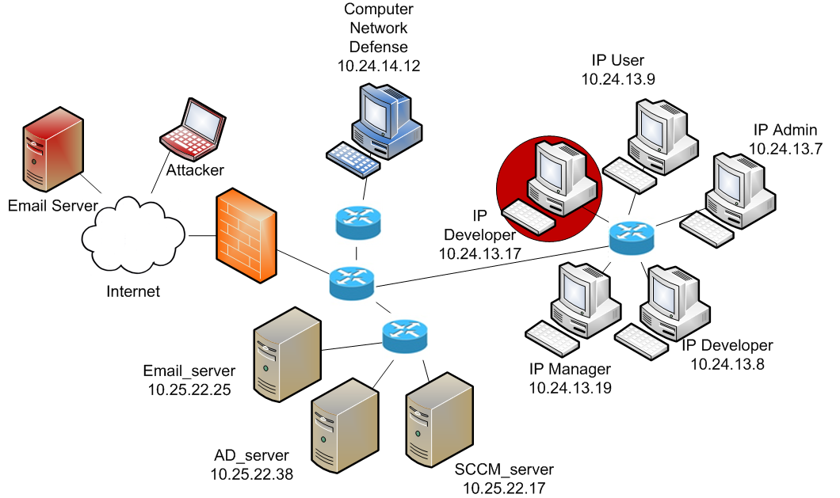
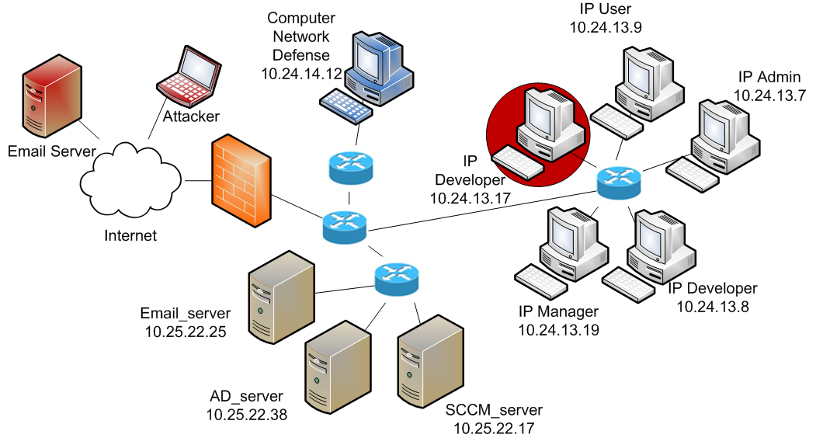
Game Scenario – Initial Attack
Attacker sends phishing emails
Notes:
Some computers will get infected from the phishing emails, like the one represented in the red circle.
When a computer gets infected it will start sending out it’s own phishing emails and will eventually begin to exfiltrate mission data to the attacker.

Slide 22
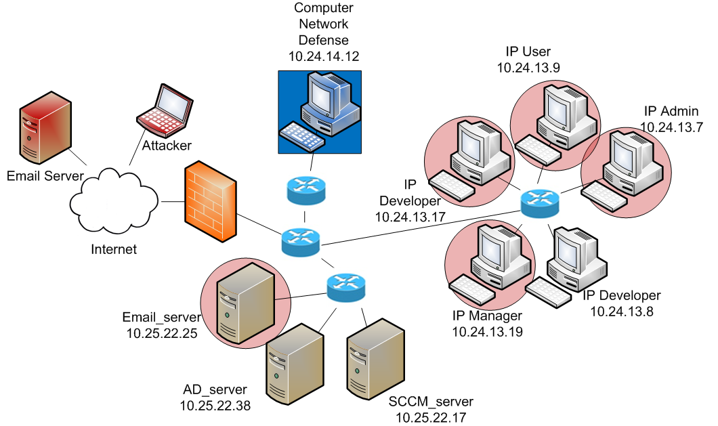
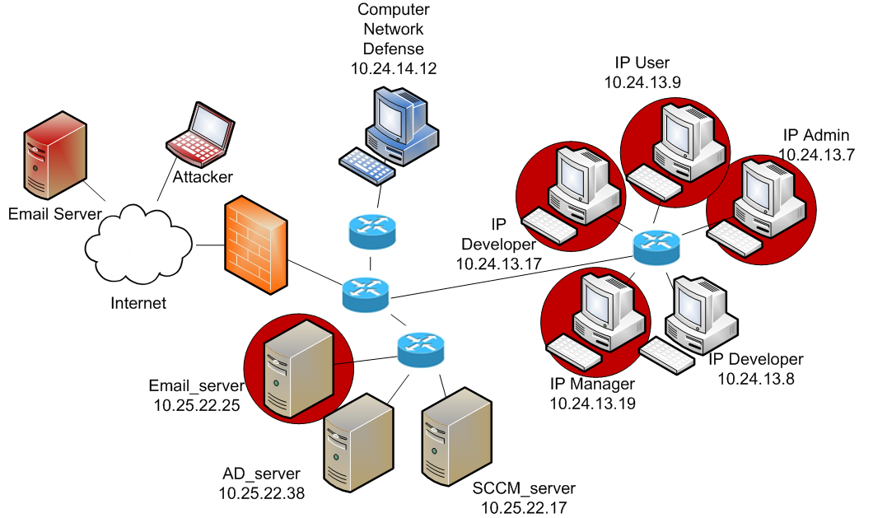
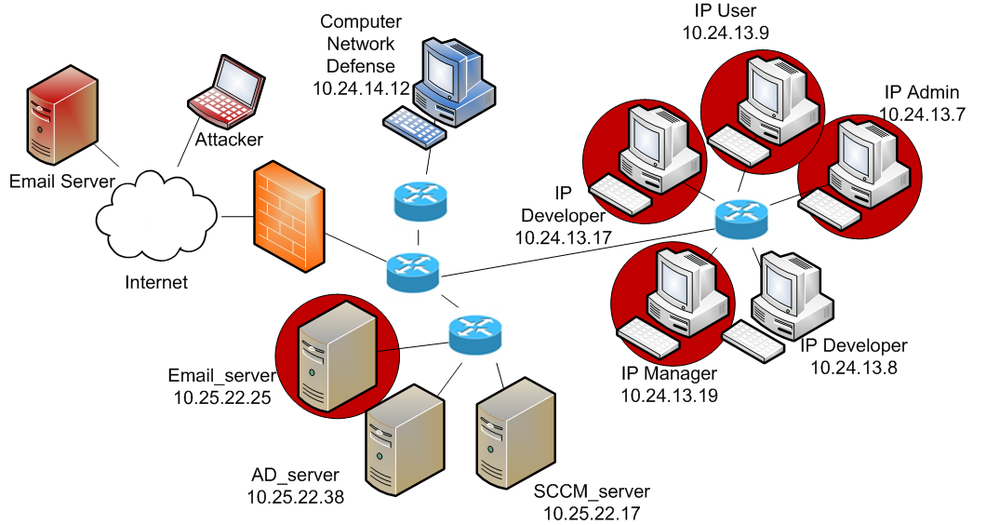
Game Scenario – Attacker Goal
Exfiltrate data, infiltrate mission servers
Notes:
The attacker’s goal is to exfiltrate data from as many nodes as it can, and to compromise the networked infrastructure.

Slide 23
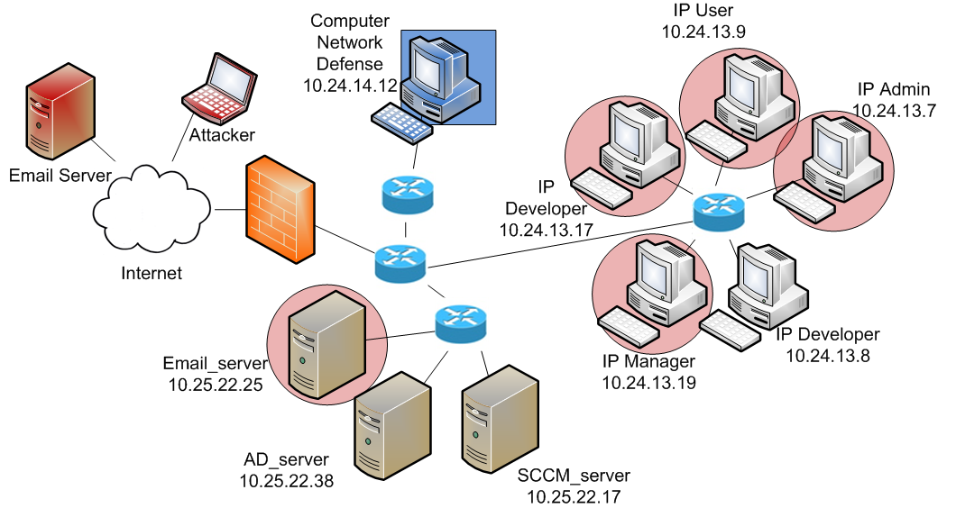
Game Scenario – Defender Responds
Defend the enterprise and assure the mission
Notes:
The player’s job as defender will be to block these attacks from being successful.

Slide 24
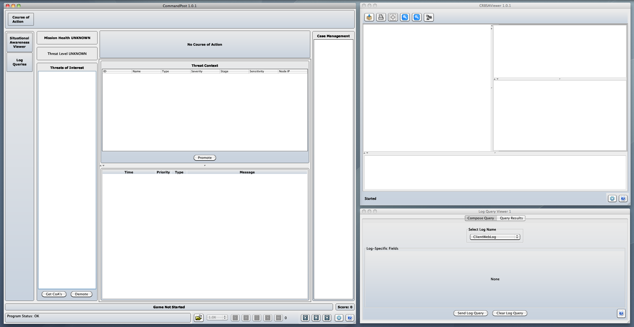

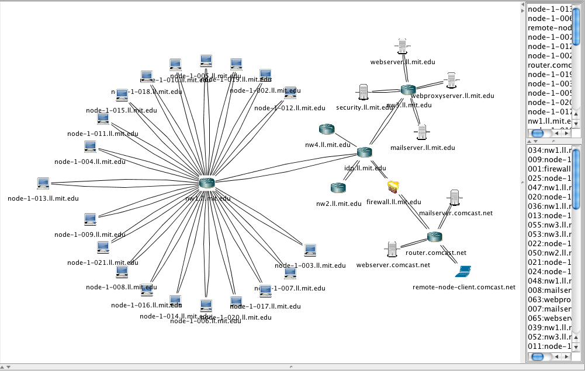

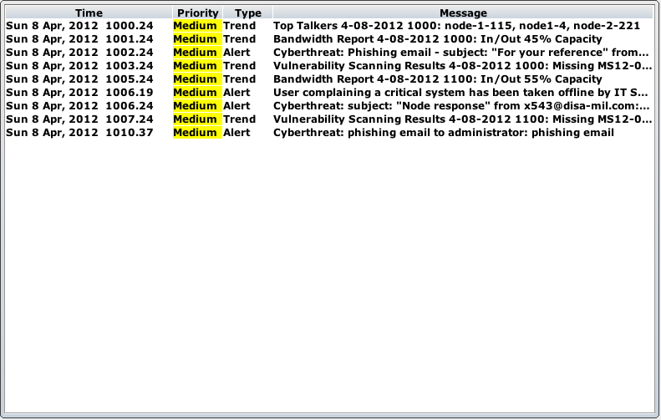
Game Demonstration
  Many messages have come in, network viewer displays the environment
Notes:
Here is a brief demonstration of game play.
The mission health and threat level indicators are always available to players, and indicate green status at the beginning of the game.
Enterprise trend and alert messages are presented to players give them context of the environmental landscape.
The network topology map has an operational overlay that indicates actions that are taken by the attacker or defender during the game.

Slide 25
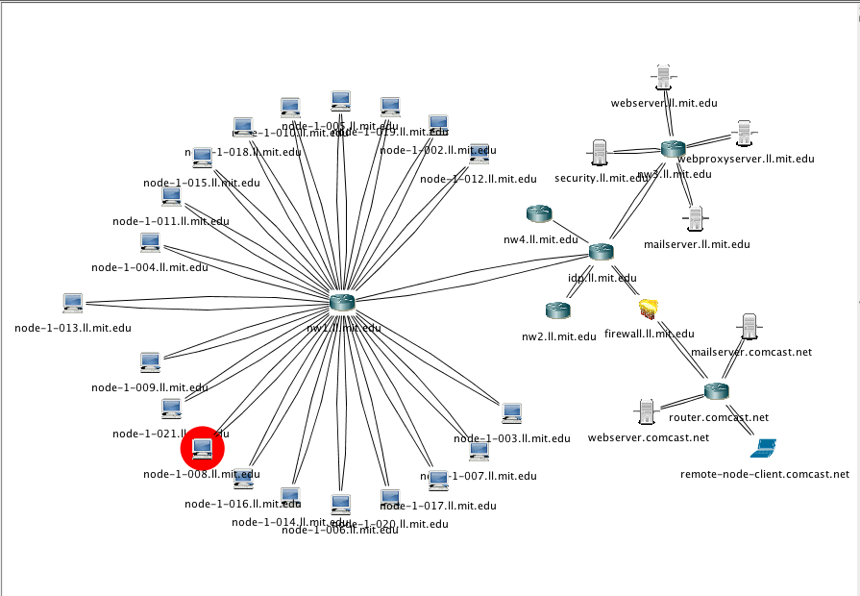
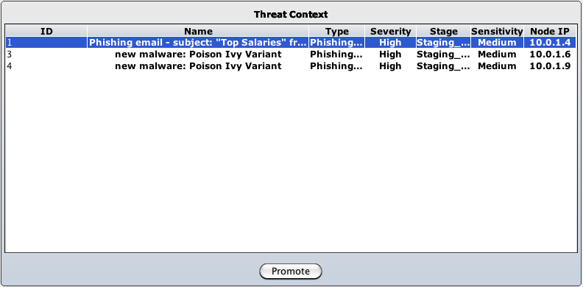
Game Demonstration
  1 phishing email in threat context (subject: “Top Salaries”), infected node in viewer
Notes:
The threat context screen prompts the player to prioritize and handle threats relevant to the game.
Here we see there is a phishing email alert, and that the associated node is highlighted in red in the network viewer.

Slide 26
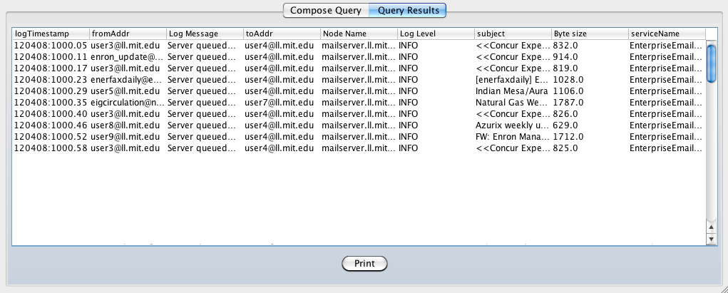
Game Demonstration
  User performs log query on “Top Salaries” subject –10 matching emails are listed
Notes:
The player works to determine the scope of the threat by performing a log query to identify any other nodes that have been infected.
The player sees that there are ten so decides to promote the threat to actively defend against it.

Slide 27
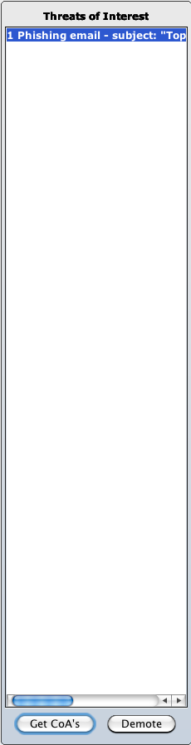
Game Demonstration
  Player has promoted the threat to review Course of Action (CoA) options
Notes:
Once a threat has been promoted, the player can view suggested courses of action and decide which actions to take next.
If the player escalates the enterprise threat level, he is effectively changing the courses of action that will be available in the future, deciding how much to lock down the environment to protect against the overall threat.
If the player blocks email with specific characteristics, he can protect against future attacks of the same type.
If the player removes a node, it from the network so it cannot communicate with other computers.

Slide 28
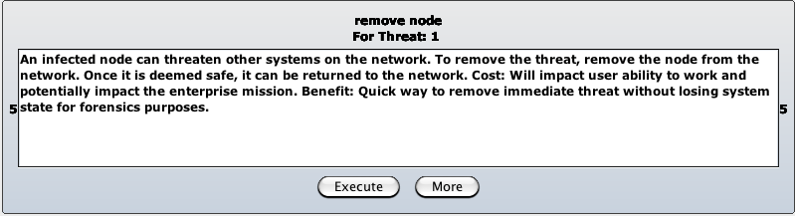
Game Demonstration
  Player is viewing the costs and benefits of the “Remove Node” CoA
Notes:
Here the player is viewing the costs and benefits associated with the “Remove Node” Course of Action.
In our demonstration the player removes the infected node but does not block any additional email traffic.

Slide 29
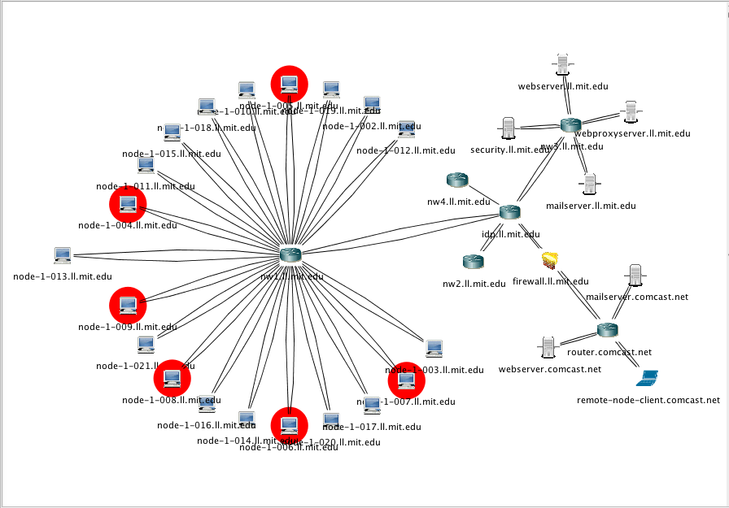


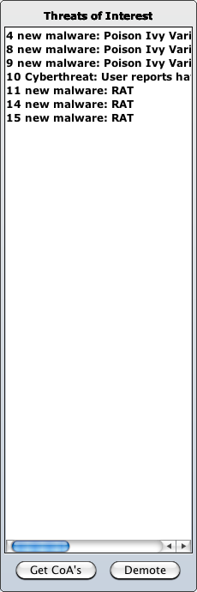
Game Demonstration
  Mission health is yellow because sensitive data is being exfiltrated
Notes:
Because the player has not blocked similar emails, additional nodes become infected and the attacker is able to exfiltrate mission data. Mission health goes to yellow to reflect that condition.
The player will need to scramble to keep up with the new level of threats.

Slide 30


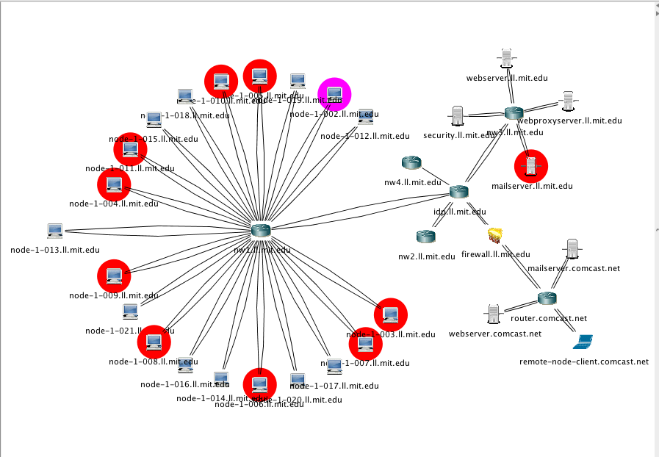

Game Demonstration
  Email server is infiltrated…game over
Notes:
And here mission health has gone to red because an email administrator became infected from the same phishing campaign and infected the email server.
So hopefully that gives you a taste of how the game can be played.

Slide 31
Conclusions
Applying Red / Blue concept to Cyber decision making process yields new understanding
Approach based upon observable artifacts, unified workflow and simulated cyber models is promising
Instrumentation of game components allows in-depth post game analysis and comparison
Observations
  Players did not spend any time on “Observe” activities
  Players focused most of the game on the “Orient” activities
  Once oriented, “Decided” quickly to “Act”
Next Steps
  Follow-up exploration of observations from first game
  Iterate on game play to compare and refine results
  Looking for white cell collaboration
Notes:
We were able to play an initial game with a team of cyber researchers and security personnel, and identified a number of useful lessons learned.
We found that applying the Lincoln Red/Blue concept to Cyber decision making processes can give us a deeper understanding in this area.
Our approach using observable artifacts, the unified workflow and simulated cyber models is promising.
By instrumenting the game components we are able to do in-depth analysis and comparisons.
We made some interesting observations during the game, including that players did not spend any time on “Observe” activities.
They focused most of the game on the “Orient” activities, and once oriented, “Decided” quickly to “Act”.
These observations raise interesting questions and the answers could help improve tools and training provided to operators.
As part of our next steps, and we would like to follow up further on these observations.
We want to continue playing the game with others to compare and refine results.
We are actively looking to collaborate with white cell teams interested in analyzing the intersection of technologies and cyber decision processes.

Slide 32
Cyber Red/Blue for C3E
Goal
  Provide an operational scenario to help attendees think about visualization and decision-making in Cyber
Approach
  Reading packet with operational threat scenario
  Cyber Incident Commander POV
  Make multiple-time based priority decisions
  Resource constraints
  All choices are useful responses, but may not be optimum
Representative artifacts
  Threats: DOS, Phishing, Beaconing
  Courses of action: mission vs. threat
  Impacts: mission vs. threat

Slide 33
Decision-Making Process
Compatible ways to look at the decision-making process
OODA Loop
Visualization
Perception
Decision
Action

Slide 34
Relevant Questions to Address
What data are needed to make effective cyber decisions?
  SA to support decisions?
Visualization
Perception
Decision
Action

Slide 35
Relevant Questions to Address
What mental models are used to go from visualization to perception?
  How are trade-offs represented?
Visualization
Perception
Decision
Action

Slide 36
Relevant Questions to Address
How do you determine realistic cost models for actions and impacts?
Visualization
Perception
Decision
Action

Slide 37
Relevant Questions to Address
How is cyber different from other domains?
What can we learn from decision-making in other domains?
What coordination processes need to be in place for cyber?
What are the workflows?
  Automated vs. manual
  Required expertise levels
Visualization
Perception
Decision
Action

Slide 38



Contact Information
Ms. Nancy Crabtree
ncrabtree@ll.mit.edu

