Slide 1
Science of Security Hard Problems: A Lablet Perspective
David M. Nicol (Univ. of Illinois at Urbana-Champaign)
William H. Sanders (Univ. of Illinois at Urbana-Champaign)
William L. Scherlis (Carnegie Mellon Univ.)
Laurie A. Williams (North Carolina State Univ.)
SoS PI Meeting
30 Nov 2012
National Harbor, MD

Slide 2
Science of Security – The Lablet concept
The Lablet model – CMU, Illinois, NC State
Focus directly on advancing scientific process
Selecting good mathematical models and analyses
Working effectively with data and empirical methods
Address specific identified technical themes
CMU: Scalability. Usability.
Illinois: Resiliency.
NC State: Analytics.
Support diverse seedling and full projects
Create a collaborative community
Partners. Workshops.

Slide 3
Science of Security – Challenges
Validity in security research
Operational
Technical
Challenges
Transition
Value assessment
Fundamental problems
Comprehensiveness

Slide 4
Our focus of study
The objects of study
Worldly physical component
Human behavior. Laws of physics.
Symbolic synthetic component
Engineering of the artifice. Realization in the physical.
The primary role of models
Models express selected salient features of the world for the purpose of prediction.
Models are also directly manifest in the symbolic design
We have a growing set of rich and powerful abstractions
The primary role of data
Data inform models. Data validate models.
We are now in a data-rich environment – engineering, ops

Slide 5
Steps to improve models to enhance validity
Five means to increase model value
Broaden scope and attribute coverage
Scale up the modeled phenomena
Enable model comparison, hybridization
Facilitate efficient analysis
Engage users with effective metaphors
Goals for the scientific process
Make criteria explicit for good models
Systematically enhance and optimize models
Better connect data-derived and mathematical models
Understand the broad diversity of methods
Identify common features of improved models
Model
?
Prediction
World

Slide 6
Five Hard Problems in the Science of Security
Scalability and composability
Policy-governed secure collaboration
Predictive security metrics
Resilient architectures
Human behavior
Our selection criteria for the questions
Level of technical challenge
Potential operational significance
Likelihood of benefiting from emphasis on scientific research methods and improved measurement capabilities

Slide 7
Hard Problem 1: Scalability and Composability
Challenge
Develop methods to enable the construction of secure systems with known security properties.
Construct from components each of which has known quality and security properties
Avoid full reanalysis of the constituent components.

Slide 8
Hard Problem 1: Scalability and Composability
Importance and difficulty
Modern reality
Scale and complexity
Rich supply chains
Socio-technical ecosystems such as framework and apps
Dynamic system structures
Need for direct evaluation of product
Sustainment is evolution
Without composition these become intractable
Experience with composition
Elusive for many gross and fine attributes
Demonstrated for a growing selection of fine attributes
Can often be attained through adjustment of abstractions

Slide 9
Hard Problem 1: Scalability and Composability
Science that is known
Motivating example: type systems
Key to modern component-based software development
Additional examples
API rules of engagement – Type states. Permissions, aliasing, effects. Nulls and exceptions. Structural rules.
Concurrency – Lock policy and compliance. Thread confinement. Thread policy.
Emerging examples
Trace properties for gross components
Structural modeling and resiliency
Common success features
Fragmentary specifications
Development value
Incremental cost and benefit

Slide 10
Hard Problem 1: Scalability and Composability
Example research to be done
Identify approaches for multiple levels of scale
From code elements to architecture and frameworks
Address particular security-related attributes
Data confidentiality and locality
Data integrity
Enabling quality attributes
Structural properties
Information access and flow
State transitions
Model usability issues
Use of fragmentary specifications, traceability tools
Costs, benefits, measurement, and timing
Identify common features of composable models

Slide 11
Hard Problem 2: Policy-Governed Secure Collaboration
Challenge
Develop methods to express and enforce normative requirements and policies for handling data with differing usage needs and among users in different authority domains

Slide 12
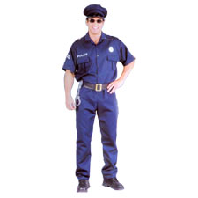
Hard Problem 2: Policy-Governed Secure Collaboration
Why important? Why hard?
Collaboration is an enabler, but …
Collaborating parties
Are autonomous
Exercise different policies
Are subject to different laws or regulations
Adopt different attitudes
Might harm each other unintentionally
Examples
HIPAA, FERPA, corporate security policy, access control policy

Slide 13
Hard Problem 2: Policy-Governed Secure Collaboration
Science that is Known
May address secure collaboration
Access control (who and what access)
Inference control and privacy protection
Does not adequately address secure collaboration
Trusted certificate chains
Incentives for honest reporting
Normative basis for trust
Insider Threat
http://vizconsult.files.wordpress.com/2011/06/insider-threat1.jpg

Slide 14
Hard Problem 2: Policy-Governed Secure Collaboration
Example research to be done
Understanding normative relationships
Representing policies for an open world
Analyzing norms and policies
Understanding trust from a normative perspective
Understanding information flow and inference
Understanding privacy in big data

Slide 15
Hard Problem 3: Predictive Security Metrics
Challenge
Develop security metrics and models capable of predicting whether or confirming that a given cyber system preserves a given set of security properties (deterministically or probabilistically), in a given context.

Slide 16
Hard Problem 3: Predictive Security Metrics
Why Important?
Solving the challenge would enable:
Decisions about system architecture and design
Prioritization of effort towards the areas of the system that indicate the highest security risk
Selection of software/hardware development processes and practices
Readiness of a system to be released

Slide 17
Hard Problem 3: Predictive Security Metrics
Why Hard?
Many reasons, including the uncertain and variable nature of:
Behavior of intelligent adversaries
Intensity of adversarial effort
Attractiveness of the target system
Impact of the composition of system development process choices
Impact of the composition of architecture and design decisions

Slide 18
Hard Problem 3: Predictive Security Metrics
Some Science that is Known in the Area
Metrics-based analysis has been used to guide the development and deployment of high-assurance systems, but at high cost, and with a focus that has more typically focused on safety and accidental faults, rather than malicious attacks.
Metrics-based analysis techniques need to be rethought (and sometimes reinvented) before being used for security assessment.

Slide 19
Hard Problem 3: Predictive Security Metrics
Examples of Scientific Progress
Characterization a system's attack surface
Statistical models to predict which files are attack- and/or vulnerability-prone
Attack tree based analysis
Attack and privilege based analysis
Adversary-based analysis (e.g., MORDA and NRAT)
State-based Stochastic Analysis (ADVISE)

Slide 20
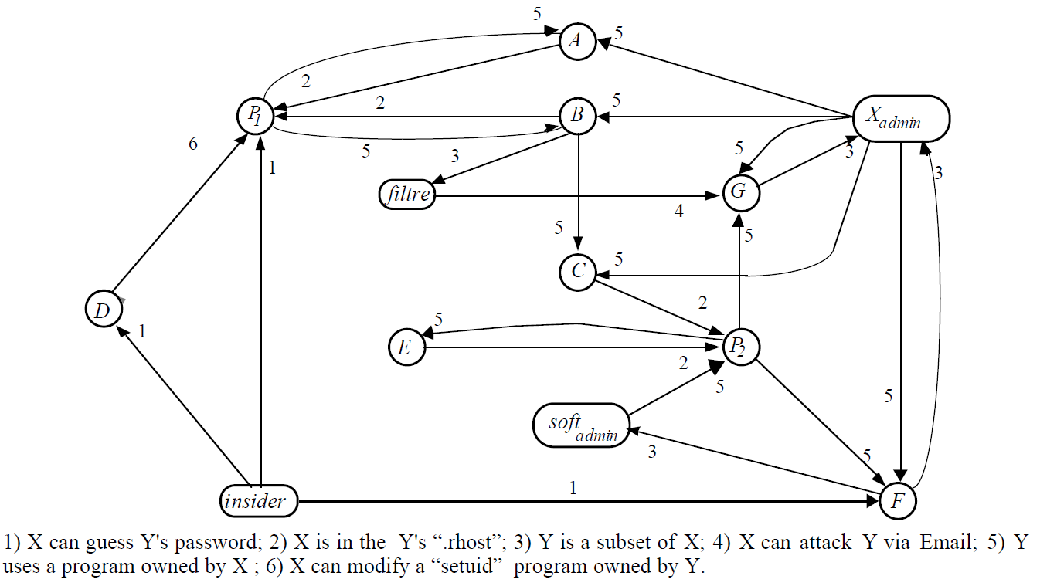
Hard Problem 3: Predictive Security Metrics
Attack graphs and privilege graphs
The nodes in a privilege graph represent privilege states
An attacker starts at one node and works toward an attack goal by transitioning to new privilege states
Contribution
Enable state-based analysis
Limitation
Do not consider the different attack goals and attack preferences of individual adversaries
From:
M. Dacier, Y. Deswartes, and M. Kaaniche. Quantitative assessment of operational security models and tools. Technical Report Research Report 96493, LAAS, May 1996.

Slide 21
Hard Problem 3: Predictive Security Metrics
Adversary-based security analysis
MORDA
MORDA assesses system risk by calculating attack scores for a set of system attacks. The scores are based on adversary attack preferences and the impact of the attack on the system mission.
A version of MORDA is commercially available as MIRROR
NRAT
NRAT assesses mission risk by computing the attack competency of potential attackers and the system vulnerability.
These computations are performed by examining attributes of the threat actors (adversaries), the attacks, and the information system protection (defense).
Contribution
Provide a security analysis informed by adversaries’ attributes
Limitation
Not designed for state-based analysis. The adversarial decision is represented as a one-time selection of a full attack vector.
Notes:
MORDA and NRAT were both developed at NSA

Slide 22
Hard Problem 3: Predictive Security Metrics
Example Research that Needs to be Done
Many low-level security metrics exist, but the challenge is to produce a quantitative assessment of the security of a system as a whole. Must consider:
the system itself
its security mechanisms (both those that avoid successful attacks and those that respond to successful attacks)
its envisioned adversaries
how its user’s behaviors can affect overall security
Create methods to perform sensitivity analyses to uncertain input values

Slide 23
Hard Problem 3: Predictive Security Metrics
Example Research that Needs to be Done, ctd.
Create overall security argument to relate business and technical security metrics to one another and provide convincing overarching evidence of system-level, end-to-end, security
Understand how to combine seemingly disparate types of evidence into an convincing overall argument
Define calculus for decomposing requirements into sub-requirements that can be validated independently
Develop method for specify relationship between different parts of evidence gathered during the assessment process
Create methods to validate metric prediction

Slide 24
Hard Problem 4: Resilient Architectures
Challenge
Develop means to design and analyze system architectures that deliver required service in the face of compromised components

Slide 25
Hard Problem 4: Resilient Architectures
Why is this important?
Given enough time, resources, and talent, an adversary will gain access
Or an insider gains access with mal intent
Important to know
Whether critical services are still sufficiently delivered through attacks
What minimum level of intrusion is needed for an attacker to gain access to particular assets

Slide 26
Hard Problem 4: Resilient Architectures
Why is this hard?
Dynamics
Reaction time
Attack(er) / defense
State of sensors
Combinatorial complexity
Diversity defeats common representations
Successful attacks/defenses involve multiple stages
Exhaustive analysis intractable
Experimental Validation
Systems to study necessarily limited to test-beds

Slide 27
Hard Problem 4: Resilient Architectures
What is science known already?
Containment
Separate privileges, give least necessary to each component
Applied to different layers, e.g., microkernels, network servers, web browers
Science: proofs of separation
Defense in depth
Work through attack: Detect intrusion, perform reconfiguration
e.g., DARPA DPASA project, others
Science: ?
Voting, replication, Byzantine fault tolerance
Notion is to tolerate breaches by having enough resources to overwhelm “wrong stuff” with “right stuff”
Science: quantify level of compromise that can be tolerated

Slide 28
Hard Problem 4: Resilient Architectures
What Science is Needed?
Predictive models of resiliency
Requires descriptions of
Software architecture
Attack capabilities
Adaptivity
Do no harm
Resiliency metrics
Definitions, means of estimation
Experimental assessment at scale
Hypotheses
Experimental design
Output analysis

Slide 29
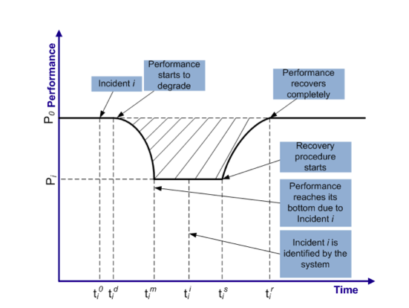
Hard Problem 4: Resilient Architectures
Example
Formulation leads to analysis of “Resilience Pit”

Slide 30
Hard Problem 4: Resilient Architectures
Example areas for research
Address combinatorial complexity (due to combinations of simultaneous “failures”) with intelligent random sampling
Resiliency metric becomes a random variable, estimate mean and variance
Challenge is in proofs of effectiveness and stability
Abstract “design-time” models to make architectural comparisons
Challenge is validation…do the models capture all important aspects
Game theoretic models of attack/defense
Challenge is gap between levels of abstractions where theorems are proved and where systems actually operate

Slide 31
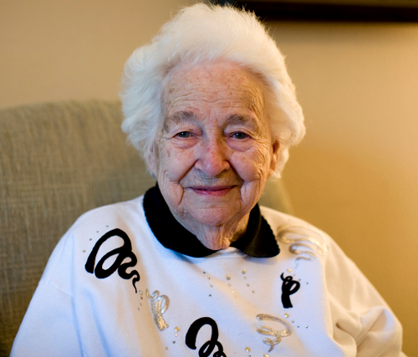
Hard Problem 4: Human Behavior
Challenge
Develop models of human behavior (of both users and adversaries) that enable the design, modeling, and analysis of systems with specified security properties
http://1000awesomethings.com/2011/02/23/302-grandma-hair/ and http://garysreflections.blogspot.com/2011/02/chinese-hackers-now-hitting-major.html

Slide 32
Hard Problem 4: Human Behavior
Why important? Why hard?
The variability of humans complicates everything.
The differences between malicious and benevolent can be subtle
Syntactically valid
Phishing
Humans will by-pass unusable security measures
http://www.101hacker.com

Slide 33
Hard Problem 4: Human Behavior
Science Known
But, generally not in the context of cyber security
Human decision making
Domain expertise
Situational awareness
Human performance
Military environment
Industrial environment
Biometrics
Mice, keyboard, touch screen movement
Willingness to share information

Slide 34
Hard Problem 4: Human Behavior
Example Research to be done
Understanding what human decisions and actions are important to system security
Behavioral and cognitive biometrics
Explore perceived trade-off between security and system usability

Slide 35
Five Hard Problems in the Science of Security
Scalability and composability
Policy-governed secure collaboration
Predictive security metrics
Resilient architectures
Human behavior
Our selection criteria
Level of technical challenge
Potential operational significance
Likelihood of benefiting from emphasis on scientific research methods and improved measurement capabilities

Slide 36
Science of Security Hard Problems: A Lablet Perspective
David M. Nicol (Univ. of Illinois at Urbana-Champaign)
William H. Sanders (Univ. of Illinois at Urbana-Champaign)
William L. Scherlis (Carnegie Mellon Univ.)
Laurie A. Williams (North Carolina State Univ.)
SoS PI Meeting
30 Nov 2012
National Harbor, MD

