Slide 1


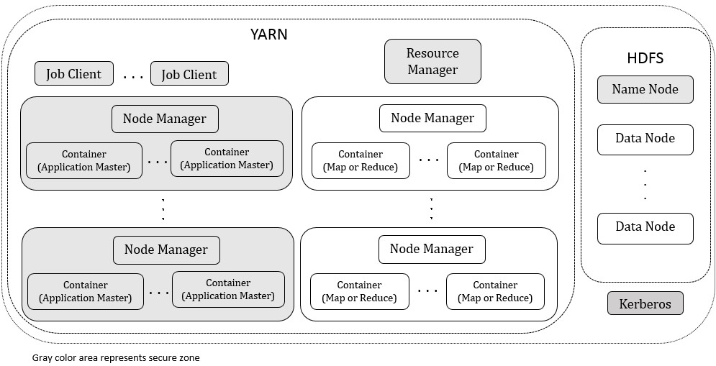



Securing Hadoop in Cloud
Xianqing Yu
xyu6@ncsu.edu
Peng Ning
pning@ncsu.edu
Mladen A. Vouk
vouk@csc.ncsu.edu
Motivation
Block Token (to address overloaded authentication keys)
  ED: expiration date of Block Token, UID: User ID, BPId: block pool ID, AM: Access Mode (e.g. read, write, replace, copy), CIP: HDFS Client's IP. SEBTID: SEHadoop Block Token ID, SEBT: SEHadoop Block Token.
  Name Node shares a unique random key with each data Node.
  Name Node Encrypts entire Block Token to avoid exposing sensitive information to third party.
  Use hash and symmetric encryption algorithm to maintain low overhead
Implementation & Evaluation
We implemented a prototype using Hadoop version 2.0.1-alpha. It ran on virtual machines (VMs) for the experiments. The guest operating system was Ubuntu 11.04. All VMs ran on Vmware ESXi 5.0.0. And VMware ESXi was installed on IBM eServer Blade Center HS21s with two Intel E5450 Xeon CPUs. Each CPU has 4 cores and the clock rate of 3 GHz. The network card was Intel Corporation 82545EM Gigabit Ethernet Controller, and network line-speed was 1 Gbit per second.
Running Hadoop in a public Cloud domain securely.
Identified that Two vulnerabilities can dramatically impact the security level of Hadoop when it runs in public Cloud.
- overload of authentication keys
- lacks in fine-grained access control
Block Token Performance
- The Table shows the time to read 1 byte file in HDFS.
- New Block Token has similar performance as original Block Token
Our Approach:
Improved Hadoop Runtime Model
  A secure zone represents a private Cloud environment which has dedicated hardware and software resources.
  Security critical processes run in a secure zone.
  Most of Hadoop processes run in a normal Cloud to maintain low-cost advantage of Cloud.
  Following are new solution elements:
Delegation Token (to address lacks of fine-grained access control)
- Parent Delegation Token
  - Child Delegation Token
  OI: owner's ID, RI: renewer's ID, MD: the maximum date which is effective time period of the Parent Delegation Token, SN: a sequence number, PDTokenID: Parent Delegation Token ID, PDTA: Parent Delegation Token authenticator, Ckey: Child Key, PDToken: Parent Delegation Token, Path: the input file path, StartOffset: the offset of first input byte in file, Length: data input's length, CDTokenID: Child Delegation Token ID, ChildDTA: Child Delegation Token authenticator, CDelegationToken stands for Child Delegation Token.
  Name Node issues Parent Delegation Token to a Client
  The Client (user) uses Parent Delegation Token to create Child Delegation Tokens which contains fine-grained access control permissions.
  Map and reduce processes are restricted to access content defined in Child Delegation Tokens.
  Name Node is able to verify these Client generated Child Delegation Token.
Delegation Token Performance
- The Table shows Hadoop job performance time excluding map and reduce computing time. It shows the overhead to generate Delegation Tokens.
- When the number of map is large, a Client needs to generate more Child Delegation Tokens for each map.
Summary
Two vulnerabilities, overloaded authentication keys and the lacks of fine-grained access control, have potentially major impact when Hadoop runs in a Cloud.
Designed and implemented new model that uses security enhanced Block Token and Delegation Token to fix these two vulnerabilities.
Block Token does not appear to inflict performance penalties, while Delegation Token has limited performance impact.
©2014 NC State University Department of Computer Science.

