Slide 1
Security Policy and Resiliency Tools and ANalysis (SPARTAN): Generating Requirements to Specify Cyber-Resilient System Designs Developed for DARPA Cyber Assured Systems Engineering (CASE) Phase 1 Program
Copyright © 2019 Systems & Technology Research
Presented by: Lindsay Holden
SPARTAN Team: Steve Jilcott, Dan Theriault, Neil Wagner, Philip Marvin, Dan Hogan
This research was developed with funding from the Defense Advanced Research Projects Agency (DARPA).
Disclaimer: The views, opinions and/or findings expressed are those of the author and should not be interpreted as representing the official views or policies of the Department of Defense or the U.S. Government.
Distribution A: Approved for Public Release, Distribution Unlimited

Slide 2
Background: SPARTAN Tools Developed to Derive Requirements to Specify Cyber Resilient Systems
Legacy DoD systems consider cyber resiliency as an afterthought, designed primarily for functionality and performance, e.g.:
Fly flight profile and execute mission plan
Operate with a flight ceiling of 50,000 ft
Need to establish cyber resiliency as inherent system property
Cyber resiliency should be taken into account as a first class stakeholder need during design and development, on par with functional and performance requirements
“Cyber resiliency means that the system is tolerant to cyberattacks in the same way that safety critical systems are tolerant to random faults – they recover and continue to execute their mission function. ” – DARPA CASE BAA
SPARTAN tools developed on DARPA CASE program to derive cyber resiliency requirements before the system is built
Leverage formal modeling languages, e.g., Systems Modeling Language (SysML), to specify desired system functionality and architecture
Model representation enables complete enumeration of intended and possible unintended system interactions and their impact critical mission functionality

Slide 3
Agenda
Motivation for Approach
SPARTAN Requirements Generation
SPARTAN Requirements Criticality Assessment
Summary & Next Steps

Slide 4
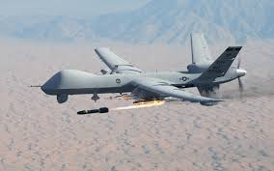
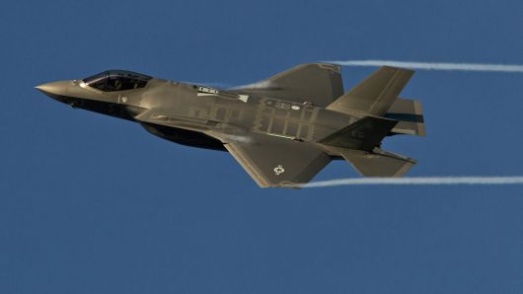
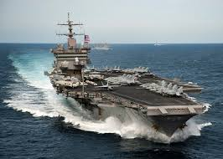
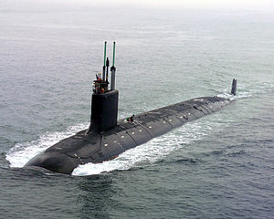
DoD Acquisition, Document Based Design: Not Equipped to Tackle Cyber Analysis
Document-based systems engineering produces disparate, inconsistent artifacts with no direct link to implementation
After thought: Is system vulnerable to cyber attack? What critical mission functions could be impacted?
Analysis is manual, painstaking and difficult to verify
“Nearly all major acquisition programs that were operationally tested between 2012 and 2017 had mission-critical cyber vulnerabilities that adversaries could compromise” – Government Accountability Office, Oct 2018

Slide 5
Model-Based Development Offers Solutions
Model-Based Systems Engineering (MBSE) practice generates digital, traceable artifacts
System requirements and design represented in formal, machine-readable language
Authoritative source of truth for system developers and stakeholders
Removes air gaps between activities, providing clear traceability
Evolving digital model throughout system lifecycle can be leveraged to inform cyber analysis at each phase of development
H/W Engineering
S/W Engineering
Simulation Development
Model: SE Artifacts
Manufacturing
Management
Users

Slide 6
SPARTAN Motivation
Leverage model-based system representations to perform cyber analysis
Build tools to help Systems Engineers identify cyber threats and design cyber resiliency into systems
Cyber resiliency is a first-class stakeholder need, it should be taken into account in the earliest conceptual design phases
Expose the cyber-related faults the system should be resilient to
Auto-generate requirements from SysML models
Focus on earliest system representations
Conceptual level understanding of required system functions and architecture can inform cyber requirements
Who are the external actors accessing system resources, what are their roles and permissions (who is allowed to do what?)
What kinds of system outcomes are bad outcomes?

Slide 7
Failures, Faults, and Attacks
System Requirements prevent:
Failure
Functional failure - “shall”
System Concept
Performance drop – “shall”
Security or safety failure – “shall not”
may cause a
Fault
Cyber Requirements prevent:
Component Concept
Unallowed component interactions – “shall not”
means of causing a
Attack
Specific adversary techniques –
usually implementation technology dependent
Cyber Requirements (CR) + System Requirements (SR) enables
Cyber Resiliency Requirements (CRR)

Slide 8
Agenda
Motivation for Approach
SPARTAN Requirements Generation
SPARTAN Requirements Criticality Assessment
Summary & Next Steps

Slide 9
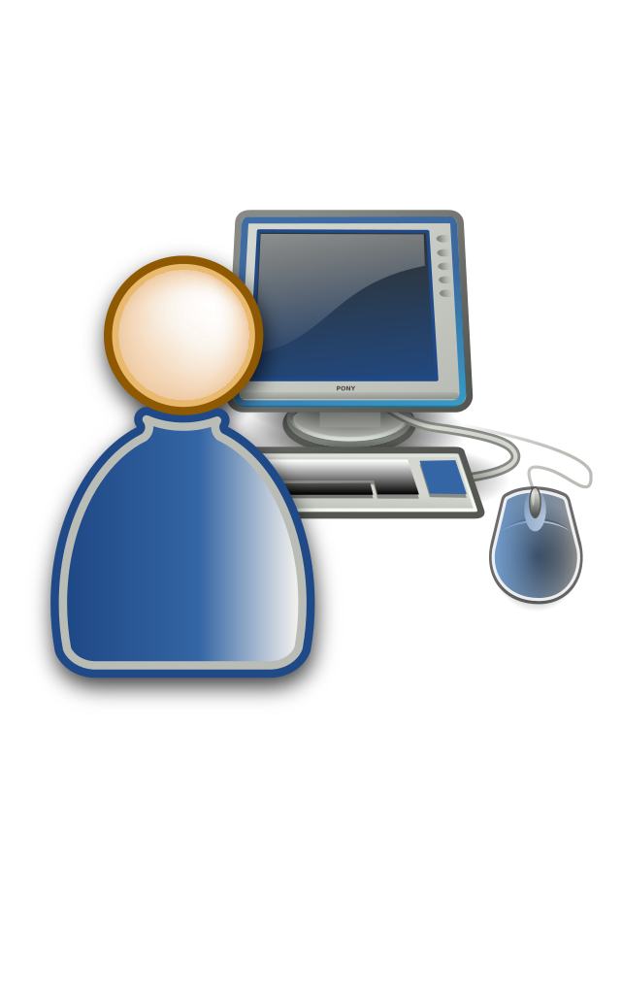
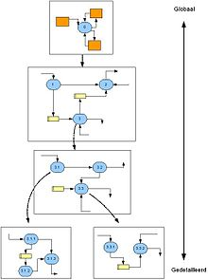
SPARTAN Architecture
SysML model is ingested in XML Metadata Interchange (XMI) form
Model Interpreter translates model connections to access control policy language
Security policy used to generate textual requirements presented to user for editing in user interface
Policy and edits made in user interface inform impact assessment
SPARTAN
SECURITY POLICY
XMI
Model Interpreter
Formal Access Control Policy Language
Cyber Requirements User Interface
SysML Model
Cyber Requirements Impact Assessment

Slide 10
Model Source Approaches
Utilized Architecture Analysis & Design Language (AADL) and SysML representations of physical architecture for requirements generation
Physical architecture already represents design contract in response to requirements
Early requirements need to incorporate desired functionality
SysML enables representation of mission context and desired system behavior for cyber resiliency requirements generation capability
Supports use case diagrams (specification of external actor interaction to perform mission/system-level function)
Supports activity diagrams (allocating desired behavior to system components)
Defines a Requirement element, which can be allocated to architectural elements defined in the model

Slide 11
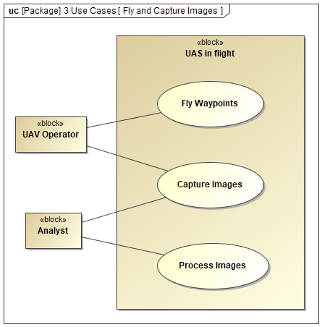
Motivating Example: Operator/Analyst Control of Unmanned Aerial System (UAS)
UAS flies flight plan and captures images
Operator responsible for UAS execution of flight plan
Operator and/or analyst initiate image capture
SysML representation precisely specifies allowed interactions:
Operator shall fly waypoints, but
Operator shall not process images
Use Case Diagram constructs specifies how external entities will use the system
External actors (block)
System context of use (block)
Functions system must perform (use cases)
External actor interaction with function (association link)

Slide 12
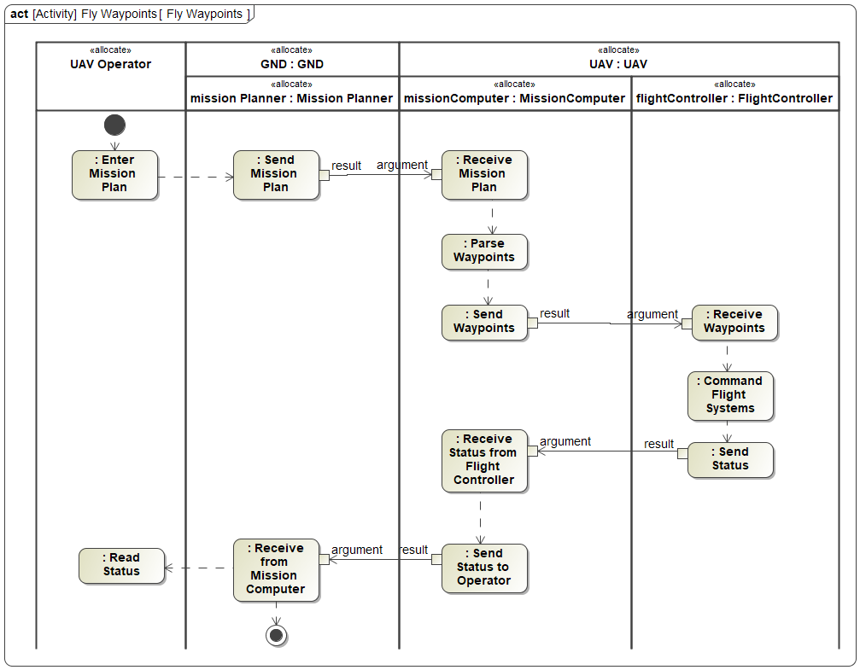
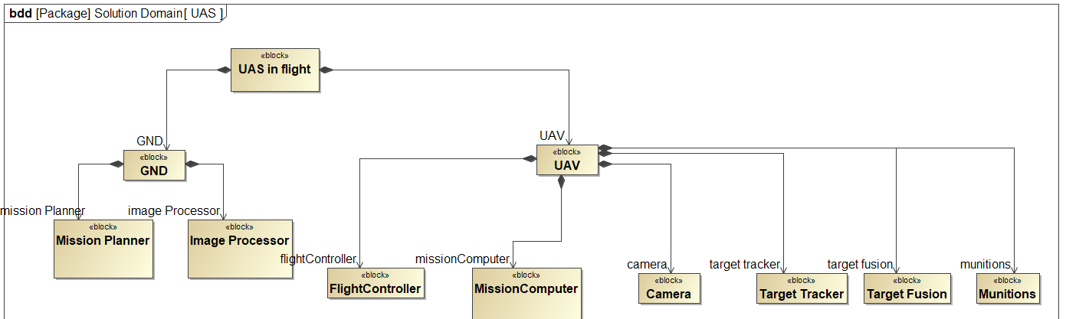
Motivating Example: SysML Use Cases + High Level Functional Allocation

Slide 13
System Requirements (SR) Generation (Failure Prevention)
SysML Use Case Diagrams:
Represent System Requirements in terms of which external actors area allowed (or not allowed) to perform which functions:
UAV operator shall Fly Waypoints
UAV operator shall Capture Images
UAV operator shall not Process Images
SPARTAN
Analyst shall Capture Images
Analyst shall Process Images
Analyst shall not Fly Waypoints

Slide 14
Cyber Requirements (CR) Generation (Fault Prevention)
SysML Activity Diagrams:
Represent Cyber Requirements in terms of which actors are not allowed to transfer data to which resources.
UAV Operator shall not be able to transfer data to Mission Computer
SPARTAN
Mission Planner shall not be able to transfer data to Flight Controller
etc.

Slide 15
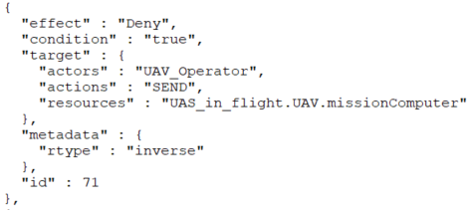
Model Interpreter
Actor =
UAV Operator
Action = SEND
Resource = Mission Computer
Effect = Deny
Generate Cyber Policy reflecting all Actor/Action/Resource triples derived from model connectivity, representing complete coverage:
eXtensible Access Control Markup Language (XACML Inspired)
Resulting Cyber Requirement (CR):
UAV Operator shall not be able to transfer data to MissionComputer

Slide 16
Cyber Resiliency Requirements (CRR) Generation
CRRs specify that faults resulting in the violation of Cyber Requirements shall not cause a failure of System Requirements:
SR: UAV Operator shall Fly Waypoints
CR: UAV Operator shall not be able to transfer data to Mission Computer
Attack: malware sitting where UAV operator accesses mission computer – enables compromise
SPARTAN
CRR: Fault violating CR shall not result in the failure of SR
Example design features to implement a CRR: redundancy, isolation, guards, enclaves

Slide 17
Agenda
Motivation for Approach
SPARTAN Requirements Generation
SPARTAN Requirements Criticality Assessment
Summary & Next Steps

Slide 18
Build Logical Architecture from Activity Diagrams
Derive component connectivity from activity diagram connections
Can form the building block for analysis to assess the impact of cyber requirements, e.g.:
Attack path analysis
Likelihood of component compromise in an attack, given early indications of component susceptibility

Slide 19
Assessing Component Susceptibility to Compromise
Properties that inform component susceptibility can be known early, e.g.:
Complexity of inputs
Number of inputs
Complexity of processing
Trust boundary crossing
Susceptibility metrics are used to inform probability of compromise spread between components
Element of subjectivity in relating properties to susceptibility
Early in formulation of mapping of susceptibility metrics to probability calculation

Slide 20
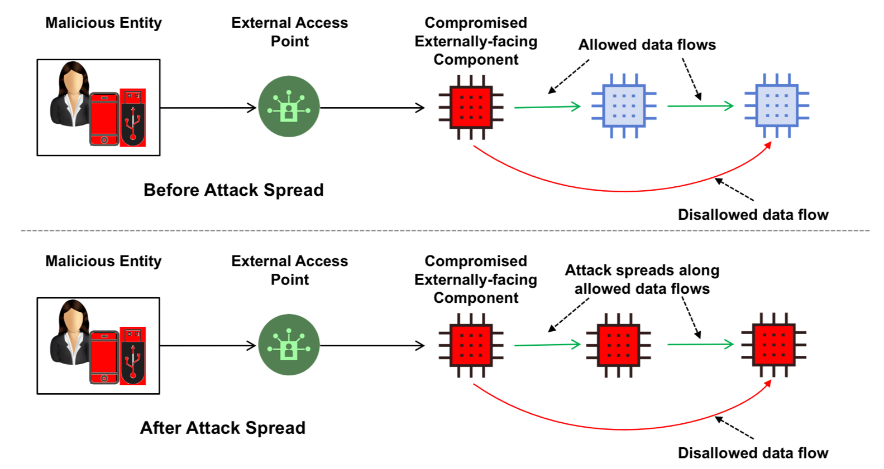
Assessment Tool Approach
Current analysis answers:
What is the impact of not implementing a subset of CRs on overall system risk?
Method:
Agent-based modeling and Monte Carlo simulation to capture system attack dynamics and spread within system
System topology gives potential attack propagation
Model probability of propagation, Monte Carlo simulation gives resulting impact on overall system failure risk

Slide 21
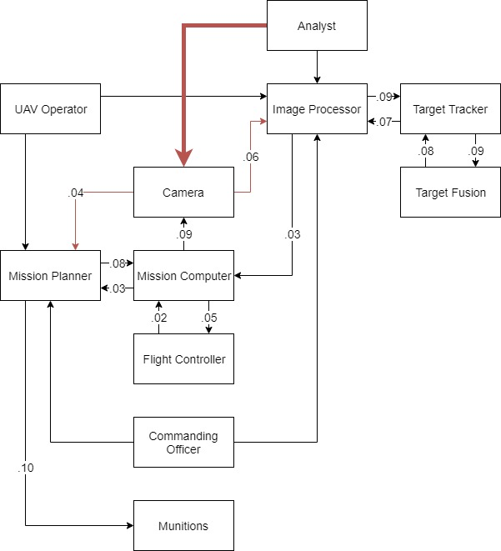
Example CR Impact Assessment
Assess scenario of CR not implemented: Analyst shall not be able to send data to Camera
Malware originates from analyst interaction, able to compromise camera and spread to other connected components
Assign probability to propagation of compromise between internal component connections

Slide 22
SPARTAN User Interface Example
Cyber Requirement not implemented (example subset):
System Requirements impacted (example subset):

Slide 23
Summary and Next Steps
SPARTAN tools demonstrate that MBSE practice can be leveraged to establish cyber resiliency as inherent system property from the earliest phases of design
Enumerate intended and possible unintended system accesses – at component and system levels
Cyber Requirements + System Requirements enables Cyber Resiliency Requirements (CRRs)
CRRs expose the mission level impacts of unintended system access
Early functional representations can be used to assess criticality of generated requirements
Functional allocation derives early sense of physical architecture, to inform attack path analysis
Demonstrated the ability to assess the relative impact of cyber requirements on overall system risk
Next steps:
Improve assessment tool to alert systems engineer to most optimal CRRs and tradeoff between security, performance, function
Improve precision of mapping CR violations to system level failures, with more detailed system models
Integrate the generated requirements with the design tool for allocation and satisfaction in the model

Slide 24
Questions?

Slide 25
Image Sources
http://www.dvdshoppingcenter.com/pile-of-documents-clipart/stack-of-documents-clipart-in-pile-of-documents-clipart/
http://clipart-library.com/document-cliparts.html
UAV: https://i-hls.com/archives/48913
F35: https://www.cnbc.com/2014/05/13/f-35-the-future-for-the-worlds-most-advanced-aircraft.html
Sub: https://en.wikipedia.org/wiki/Virginia-class_submarine
Carrier: https://www.businessinsider.com/us-aircraft-carrier-wing-every-plane-helicopter-2016-5
SE V: https://en.wikipedia.org/wiki/V-Model

