Slide 1
System-Level Co-design for CPS Security
Janos Sztipanovits
Istvan Magyari
David Lindecker
ISIS-Vanderbilt

Slide 2
Content
Systems Science of Security
Goals
The Basic Research Project (NSF FORCES)
Decentralized Label Model
Formal Framework
System-level Synthesis Framework
Experimental Study (SURE)
Application – Connected Vehicle Information Architecture

Slide 3
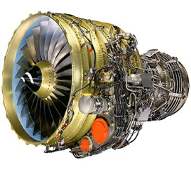
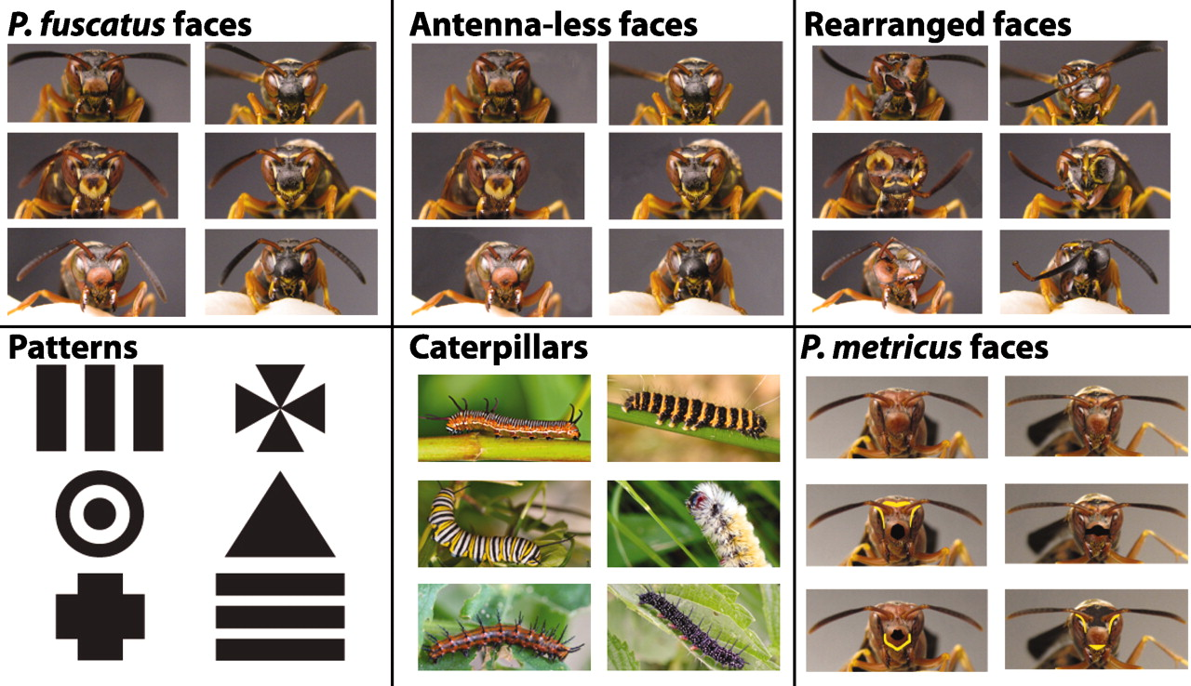
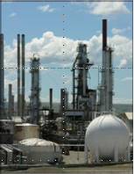
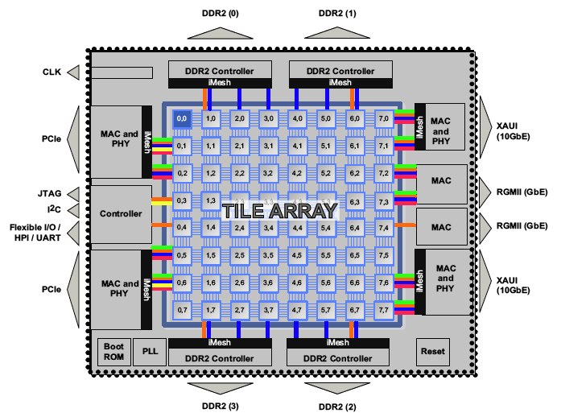
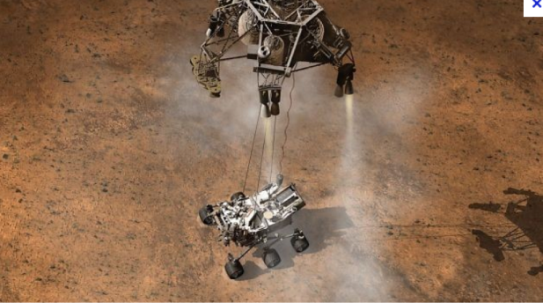
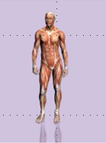
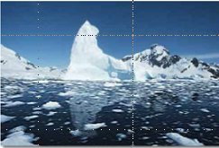
SYSTEMS

Slide 4
Engineered SYSTEMS

Slide 5
Views of Engineered SYSTEMS
The Real Thing
System Facet
Projections (Views)
Abstracted views of what we build

Slide 6
Making Engineered SYSTEMS
Engineering Facet
Engineering methods we use to design, make, operate and dispose
The Real Thing
Manufacture
Operate
Dispose
System Facet
Projections (Views)
Abstracted views of what we build
Design

Slide 7
Assuring Engineered SYSTEMS
Engineering Facet
Methods we use to design, make, operate
and dispose
System Facet
Assurance Facet
Projections (Views)
Views of what we build
Evidence that what we made will work as it should and
mechanisms that keep it that way

Slide 8
Modern Engineered SYSTEMS
Engineering Facet
Physical
Cyber
System Facet
Assurance Facet
Projections (Views)
Views of what we build
Physical
Cyber

Slide 9
Engineered CPS
Engineering Facet
Need: System Science for CPS
System Facet
Assurance Facet
Projections (Views)
Need: CPS Abstractions
Need: System Science of Security

Slide 10
What Is Our Goal?
The traditional system-level synthesis problem for the “cyber” side of CPS:
Derive specification for the behavior of the system components that will be implemented using networked computing
Derive a functional model for the information architecture and componentize the system
Select computing/networking platform
Derive deployment model assigning components of the information architecture to processing and communication platforms
Generate code for software components and derive WCET and WCCT
Perform timing analysis
Making security part of system-level co-design
Mitigation of security vulnerabilities cost performance, timing, even functionality
Our goal is to address security requirements as part of the design trades embedded in the system-level design process

Slide 11
ESMOL Design Flow Segment for Information Architecture
structure + composed beh.
Behavior Models (Hybrid Dynamics )
SW Component Architecture
Timing Model
System Platform
Model
Design Architectures
with ideal comp. dynamics
SW Component
Architecture
Synthesis
System
Architecture
Synthesis
System
Integration
Code Synthesis
Component Code
Generation
Scheduling and
Schedulability
Analysis
Component Code
WCET Anal.
Implemented Dynamics
Model Synthesis
Design Architectures
with deployed comp. dynamics
Certificates of Correctness
CAN Bus
TT bus
Event-triggered Model of Computation
Time-triggered Model of Computation

Slide 12
System-level Synthesis Steps Information Architecture
structure + composed beh.
Behavior Models (Hybrid Dynamics )
SW Component Architecture
Timing Model
System Platform
Model
Design Architectures
with ideal comp. dynamics
SW Component
Architecture
Synthesis
Deployment
Synthesis
System
Integration
Code Generation
Component Code
Generation
Scheduling and
Schedulability
Analysis
Component Code
WCET Anal.
Implemented Dynamics
Model Synthesis
Design Architectures
with deployed comp. dynamics
Certificates of Correctness
CAN Bus
TT bus
Event-triggered Model of Computation
Time-triggered Model of Computation

Slide 13
System-level Synthesis Steps Information Architecture
structure + composed beh.
Behavior Models (Hybrid Dynamics )
SW Component Architecture
Timing Model
System Platform
Model
Design Architectures
with ideal comp. dynamics
Information Flows
Security
Properties
SW Component
Architecture
Synthesis
Deployment
Synthesis
System
Integration
Code Generation
Component Code
Generation
Scheduling and
Schedulability
Analysis
Component Code
WCET Anal.
Implemented Dynamics
Model Synthesis
Design Architectures
with deployed comp. dynamics
Certificates of Correctness
CAN Bus
TT bus
Event-triggered Model of Computation
Time-triggered Model of Computation

Slide 14
Challenges
Modeling language suite (behavior, information flows, SW components, architecture, timing, platform, deployment) - reuse previous work
Security Requirement Modeling (need to be composable with other modeling aspects)
Common Semantic Domain and Formal Framework (functional, performance and security models need to be anchored to a semantic domain suitable for synthesis)
Synthesis Framework and Co-design flow (mapping system-level synthesis problem on the formal framework and tools)
Integrated Tool Suite and Validation (target domain rich enough for testing the co-design tool suite)

Slide 15
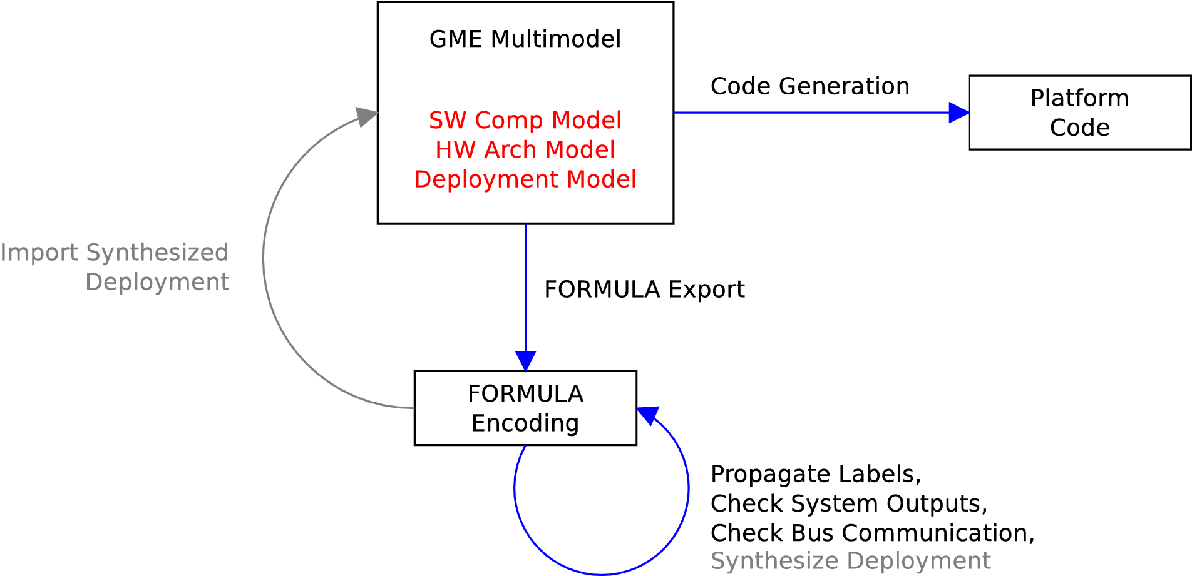
Workflow for Designing Secure Distributed Embedded Systems
Import Synthesized
Deployment Model
WCET
SDL/STRIDE Platform
Configuration
Timing
Verification
Experiments:
C2WT
Synthesize Deployment
Model

Slide 16
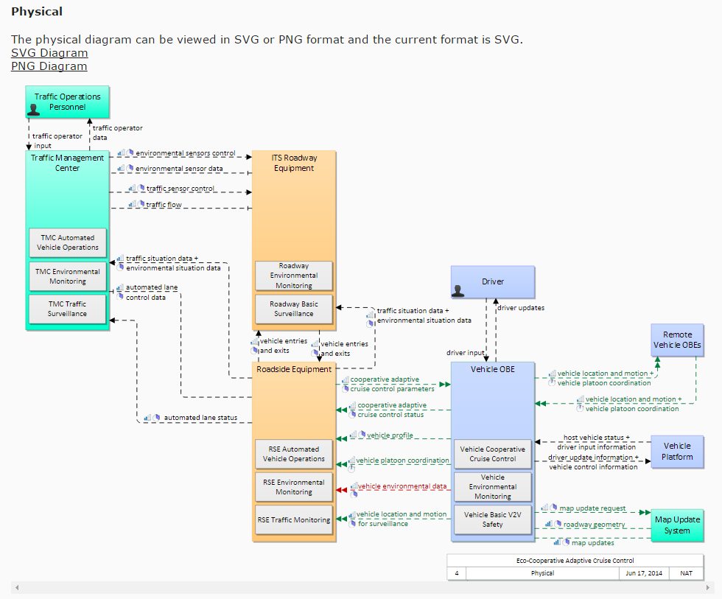
Test Case – DOT/CVRIA
Modeling Language Capture in GME
Semantics in FORMULA
DLM mapping
Analysis Studies

Slide 17
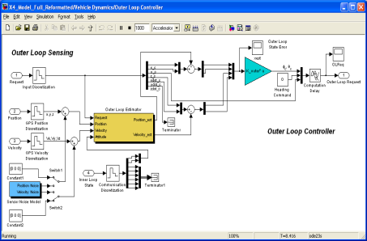
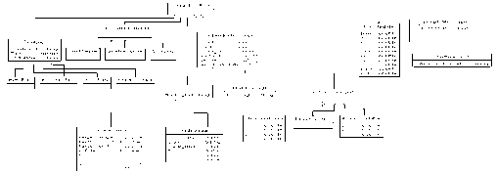
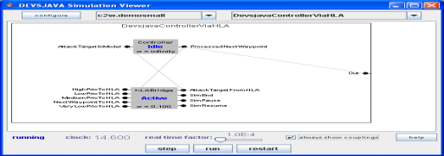
Experimental Evaluation
Cloud Deployed Simulator
Integration Models
Dataflow models
Generators
SUMO
Simulink
Interaction models
SUMO Federate
Simulink Federate
HLA-RTI
OMNet Federate
Devs Federate
Deployment models
OMNet
SystemC

