Slide 1







Slide 2
DISCLAIMER
SAS Institute is a product company
SAS Institute’s Advanced Analytics Lab and Research & Development Group employ hundreds of highly skilled PhD’s

Slide 3


Jonathan Janos
Senior Systems Engineer
Mike McCoy
Senior Analytic Consultant

Slide 4









SAS security intelligence– process flow
Operational Data Sources
Exploratory Data Analysis & Transformation
Alert Generation Process
Data
Staging
Business
Rules
Alert
Administration
SAS® Social
Network
Analysis
Transactions
Network
Rules
Analytics
Anomaly
Detection
Network
Analytics
Entities
Predictive
Modeling
Internal Data
Alert Management &
BI / Reporting
Learn and Improve Cycle
Intelligent
Repository
External Data
Case Management

Slide 5
Using a Hybrid Approach for Anomaly/Risk Detection
SAS security intelligence analytics
Enterprise Data
Suitable for known patterns
Suitable for unknown patterns
Suitable for complex patterns
Suitable for associative link patterns
SSN Data
Address Data
Rules
Detect individual and
aggregated
abnormal patterns
This compares
behaviors and
attributes to peer
groups to highlight
activity that is outside
the norm and
potentially indicative of
fraud
Predictive
assessment against
known fraud cases
These leverage
known fraud case
outcomes to
generate fraud
scenario profiles
Knowledge
discovery through
associative link
analysis
This links enterprise
data to uncover hidden
fraudulent relationships
Filter Fraudulent Behavior
These encode known
fraud schemes and
indicators and are a
good first measure for
identifying suspicious
activity
Anomaly Detection
Predictive Models
Social Network Analysis
Banking Data
Payments
Deceased Persons
IRS/ State Agency
Known Bad Lists
3rd Party Data
Proactively applies combination of all 4 approaches at entity and network levels
Hybrid Approach
Notes:
Hybrid Approach
Historically, fraud detection systems have relied primarily on business rules. This has been good for identifying reoccurrences of lessons that have already been learned. When you touch that hot pot on the stove, you learn not to touch it again. But there are three main issues with utilizing only this methodology. First, business rules create a lot of noise. Legitimate customers constantly do things that look suspicious. Deposit a check greater than average, submit a claim, change their address, add a bill pay to their online banking. False positives take time to triage and result in operational inefficiency. Second, business rules become common knowledge to the fraudsters. Either by trial and error or worse, infiltration of the organization, business rules become known. Which results in fraud loss, which results in constant tweaking of dollar thresholds, which result in more operational inefficiency. And third, business rules aren’t forward looking. They aren’t there to catch tomorrow’s fraud.
What a hybrid approach offers, what an approach utilizing advanced analytics offers, what SAS offers, is a methodology that helps counter the problems that a business rule only approach fails to address. Using the concept of risk factors we can begin to move into a world where we are dollar amount agnostic. Organizations shouldn’t be forced to only try to catch the fraud over a certain dollar amount. All fraud losses are going to the bottom line and in today’s economic climate every dollar counts. Secondly, a hybrid approach looks for true fraud anomalies. Do you want to catch tomorrow’s fraud today or wait until you burn your hand on that pot before doing something about it. And finally, Social Network Analysis brings to the table a new tool for detecting and visualizing fraud. Too often investigators are so focused on individual cases that they don’t see the forest for the trees. SNA is about discovering previously hidden relationships that are meaningful to an organization.

Slide 6
Methodology
Ingest data and decompose nodes into entities
  Person = First Name + Middle Name + Last Name
  Address = Street + City + State + Zip
  Phone
  Document ID
Determine connected components using a depth-first search algorithm
Accept the input of seed nodes and determine if seeds lie on the same connected component
  Seed 1 = 21299875XX
  Seed 2 = 4408 East Madison Ave., Bethesda, MD 20014
Source | GUID | LastName | MiddleName | FirstName | Street | City | State | Zip | Phone | ID_DOC
CCCR | CCCR-a57685ee-ba9f-4bfb-b2f6-f179b693ee12 | Brandybuck | Donnamira | Gloriana | 2719 Pin Oak Drive | Manhattan | NY | 10018 |  | 5334856597493120
 |  | Source | NodeUniqueID |  |  | NodeLabel |  |  | NodeType | EntityGroup
 |  | CCCR | N-CCCR-a57685ee-ba9f-4bfb-b2f6-f179b693ee12 |  |  | Gloriana Donnamira Brandybuck |  |  | NAME | 1
 |  | CCCR | A-CCCR-a57685ee-ba9f-4bfb-b2f6-f179b693ee12 |  |  | 2719 Pin Oak Drive, Manhattan, NY, 10018 |  |  | ADDR | 1
 |  | CCCR | D-CCCR-a57685ee-ba9f-4bfb-b2f6-f179b693ee12 |  |  | 5334856597493120 |  |  | DOC-CCCR | 1

Slide 7
Methodology
Find the near neighbors for each seed (one limit reach network)
Drop seed nodes and links from data before calculating shortest path between seeds
  Prevent paths from passing back through the seeds
Calculate the shortest path for each set of seed near neighbors using a variant of Dijkstra’s algorithm and inverse link weight to create a list of candidate paths
Merge seed information back into these path candidates
For the entire connected component, communities are then identified using the Louvian algorithm with a maximum community size set to 15
  Community membership is retained for use in network visualization, but it is not used in ranking candidate paths

Slide 8
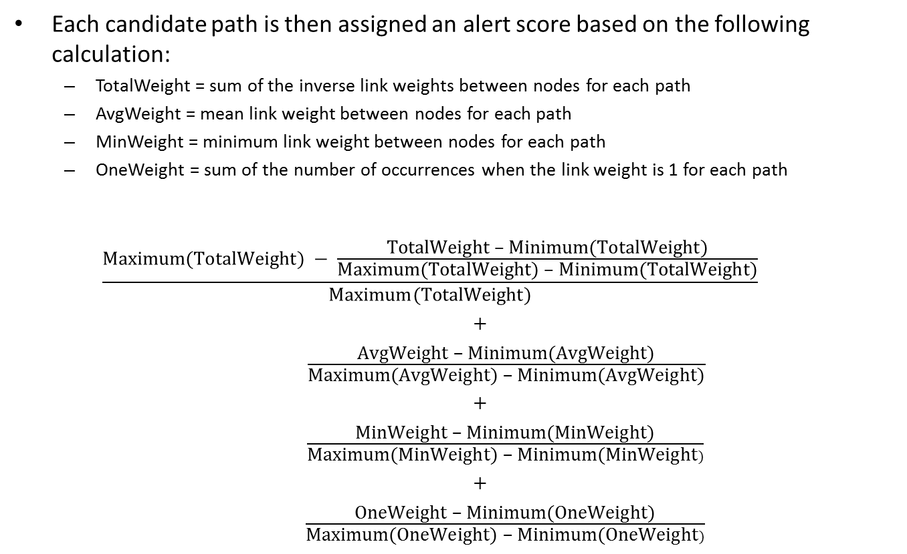
Methodology
Each candidate path is then assigned an alert score based on the following calculation:
  TotalWeight = sum of the inverse link weights between nodes for each path
  AvgWeight = mean link weight between nodes for each path
  MinWeight = minimum link weight between nodes for each path
  OneWeight = sum of the number of occurrences when the link weight is 1 for each path
  $$\frac{\text{Maximum}\text{(}\text{TotalWeight}) − \frac{\text{TotalWeight}\text{ – }\text{Minimum}\text{(}\text{TotalWeight})}{\text{Maximum}\text{(}\text{TotalWeight}\text{) – }\text{Minimum}\text{(}\text{TotalWeight}\text{)}}}{Maximum(TotalWeight)}$$
  +
  $\frac{\text{Av}\text{g}\text{Weight}\text{ – }\text{Minimum}\text{(}\text{AvgWeight}\text{)}}{\text{Maximum}\text{(}\text{AvgWeight}\text{) – }\text{Minimum}\text{(}\text{AvgWeight}\text{)}}$
  +
  $\frac{\text{Min}\text{Weight}\text{ – }\text{Minimum}\text{(}\text{Min}\text{Weight}\text{)}}{\text{Maximum}\text{(}\text{Min}\text{Weight}\text{) – }\text{Minimum}\text{(}\text{Min}\text{Weight})}$
  +
  $\frac{\text{One}\text{Weight}\text{ – }\text{Minimum}\text{(}\text{One}\text{Weight}\text{)}}{\text{Maximum}\text{(}\text{One}\text{Weight}\text{) – }\text{Minimum}\text{(}\text{One}\text{Weight})}$

Slide 9
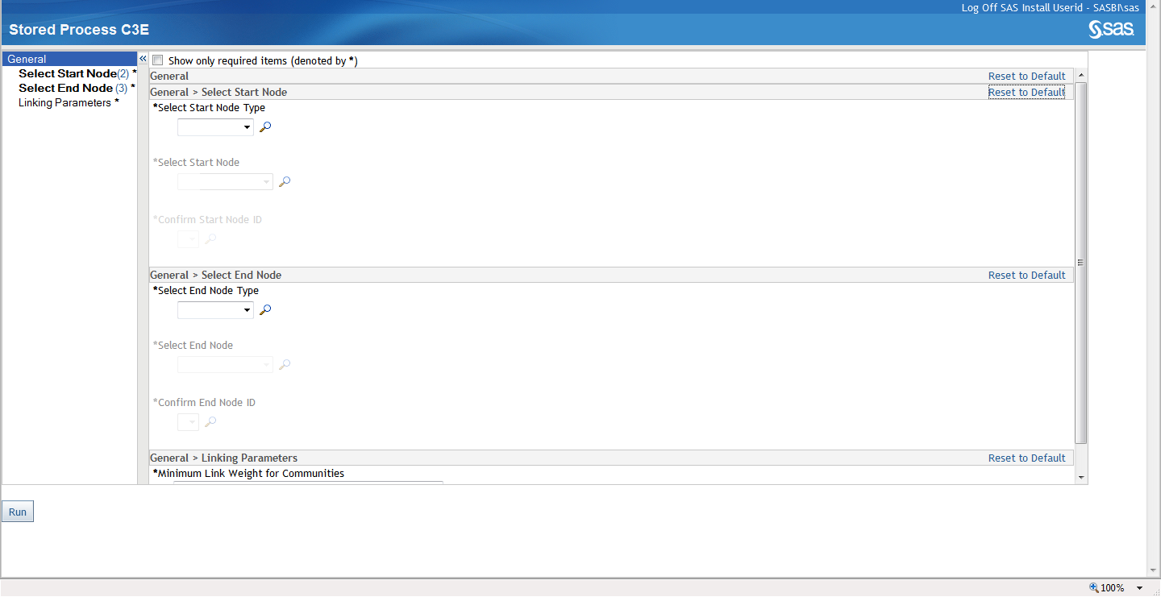
In an operational setting, users need the ability to select specific known information.

Slide 10
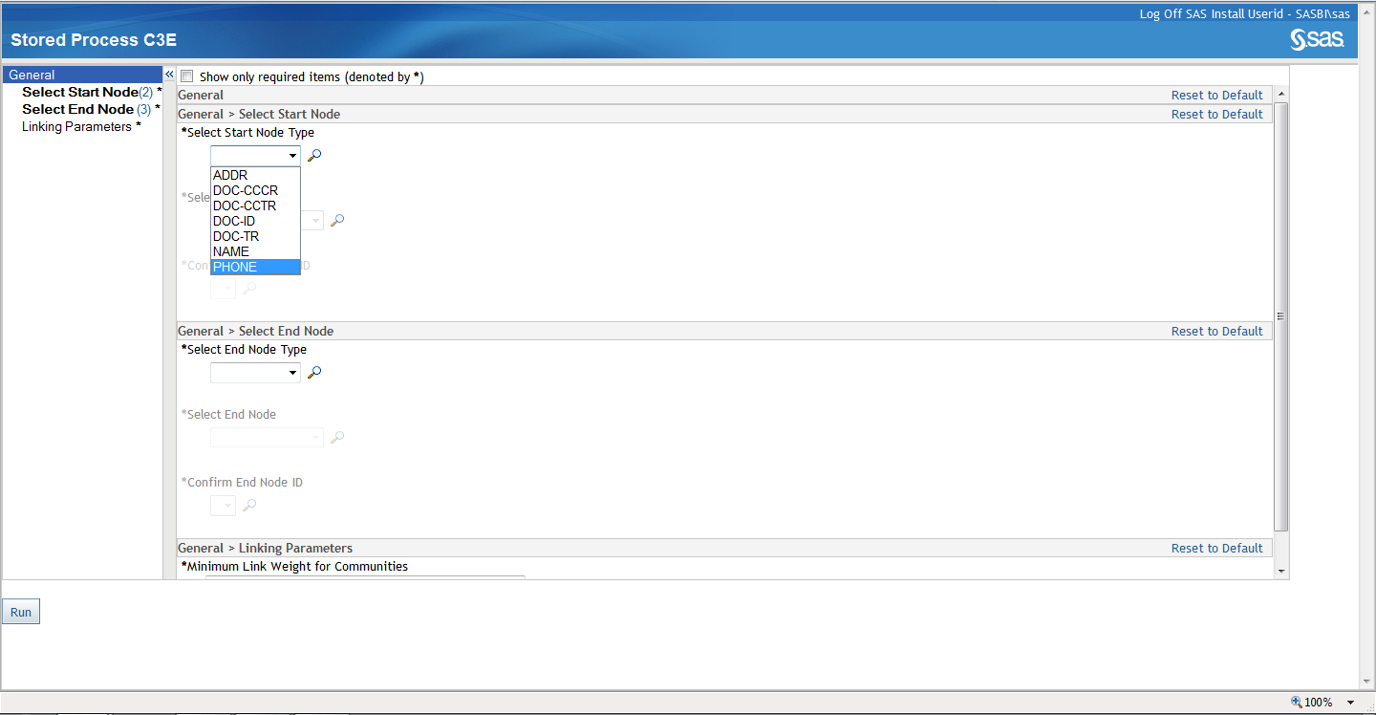

Slide 11
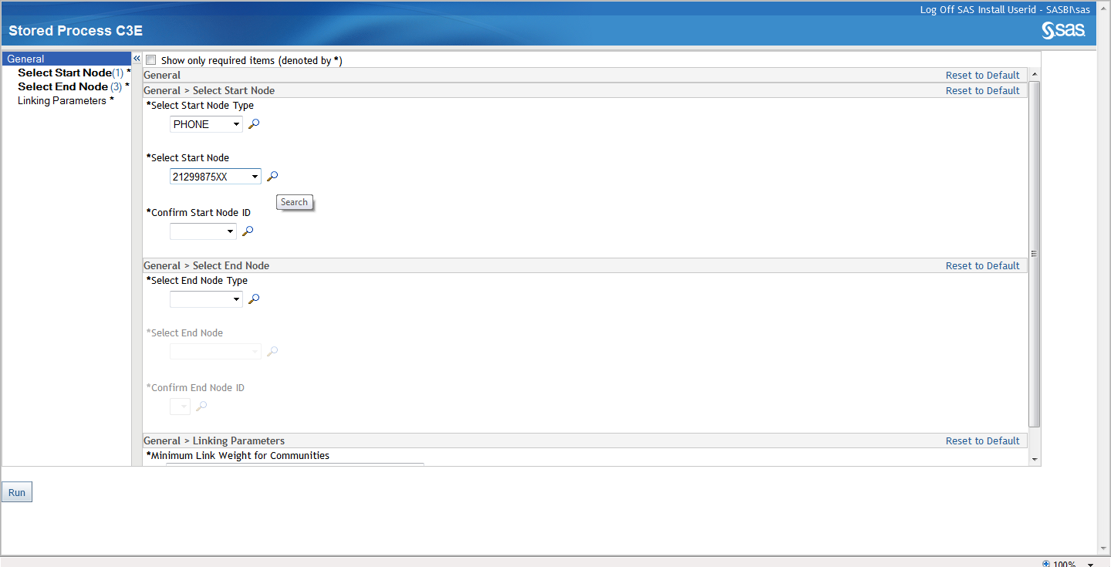

Slide 12
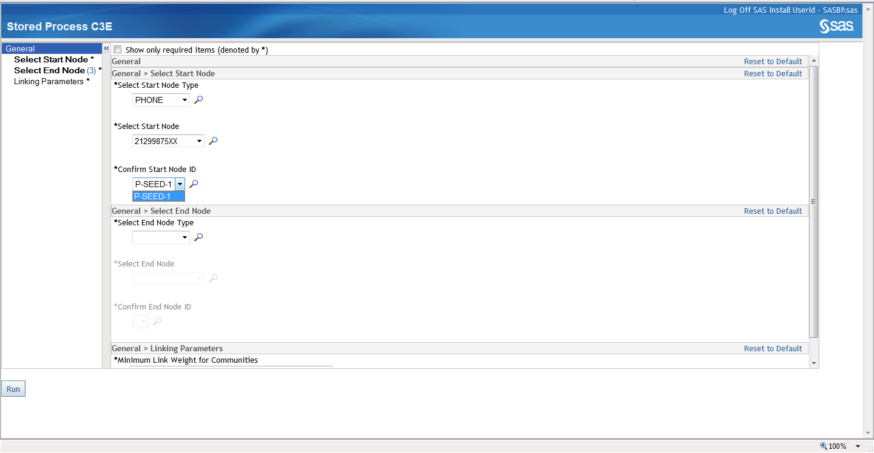

Slide 13
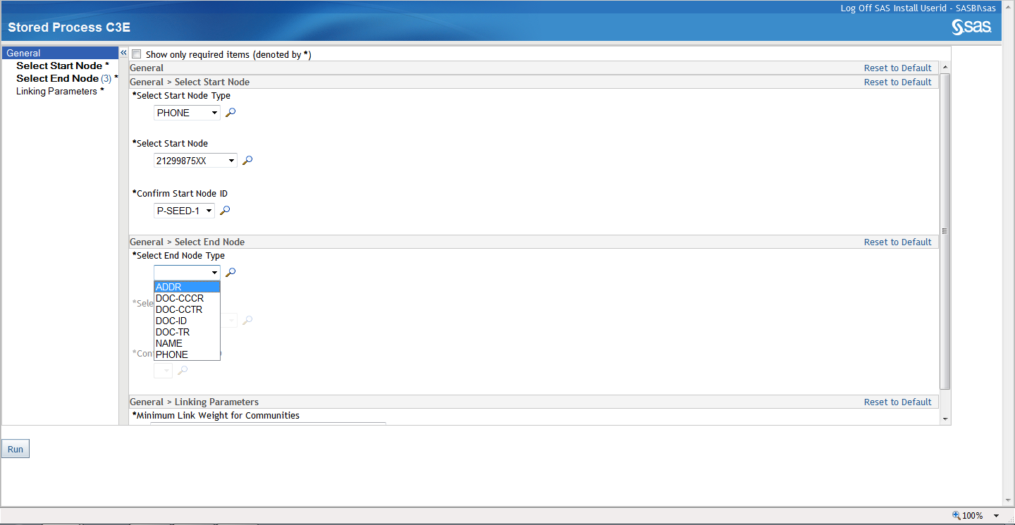

Slide 14
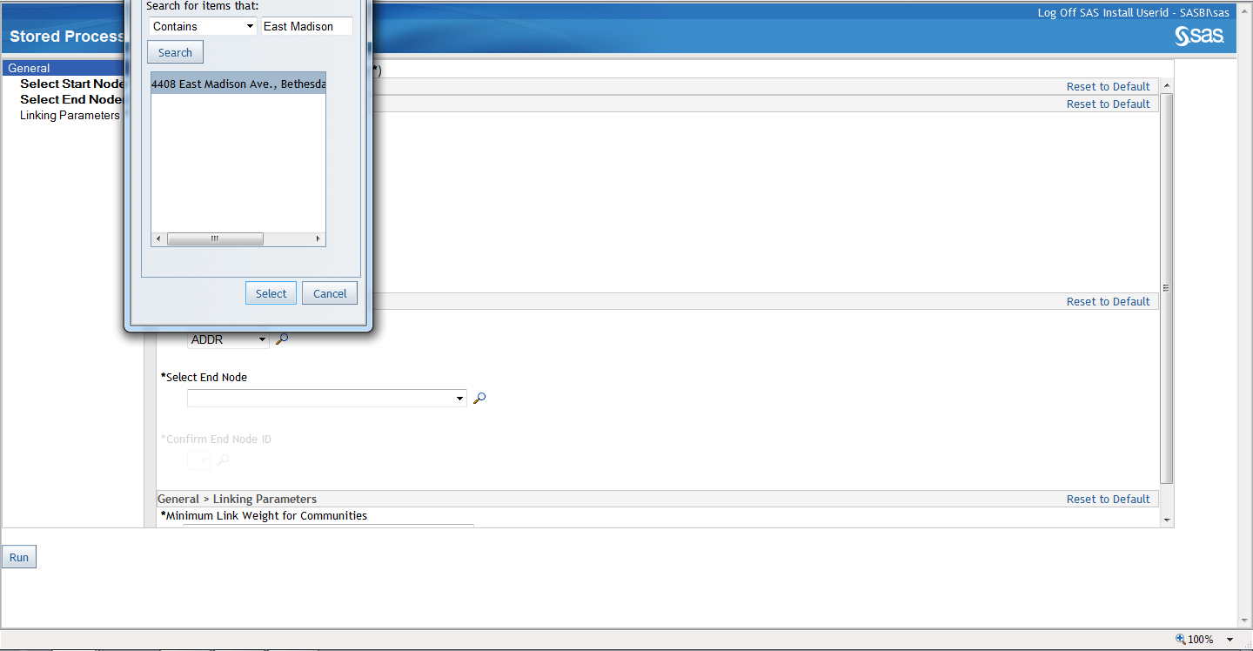

Slide 15
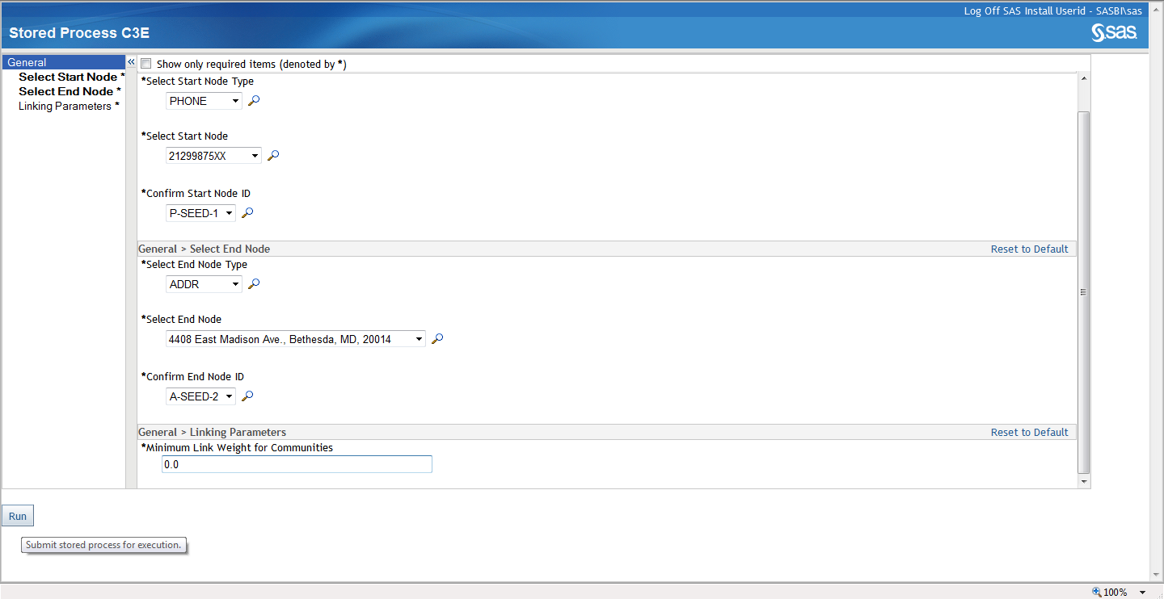

Slide 16
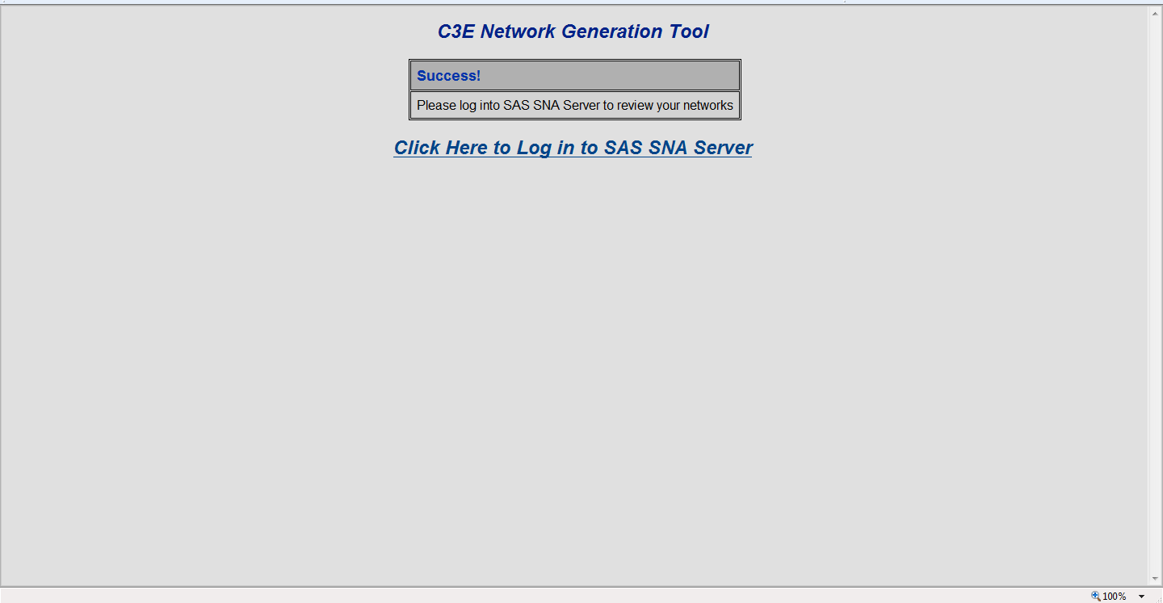
The complex algorithms and statistical procedures are run in the background which allows Intelligence Analysts (not statisticians) to leverage the power of advanced analytics in a mission/operational environment.

Slide 17
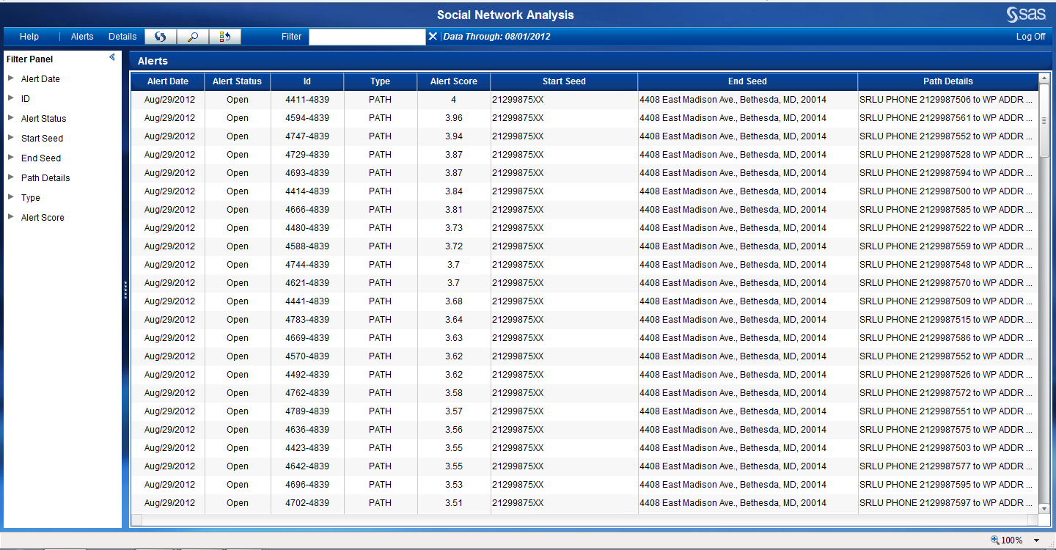
The “Alerts” listed are generated to provide analysts with a rank/scored list of the most probable targets based upon the information provided. Each attribute is scored and an overall score is applied to each network.

Slide 18
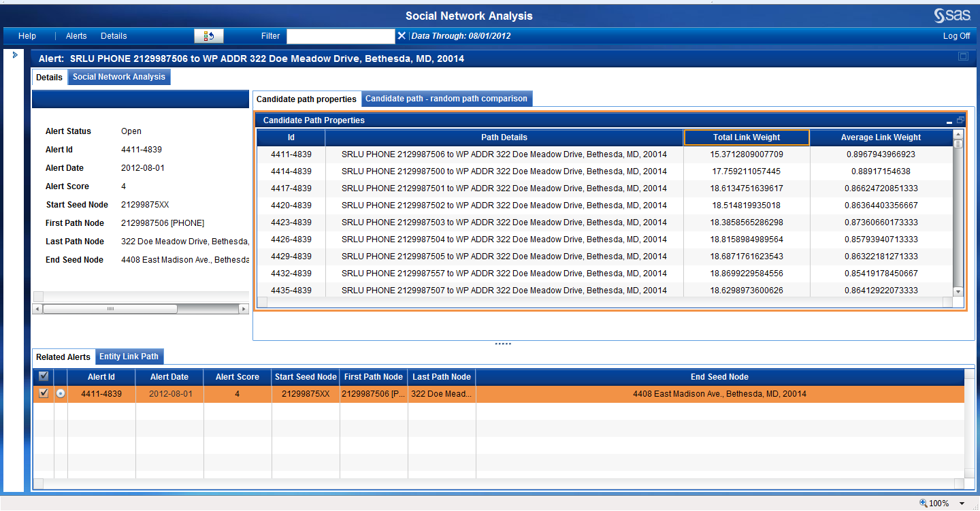
Supporting evidence is made available to the operational user for vetting the target.

Slide 19
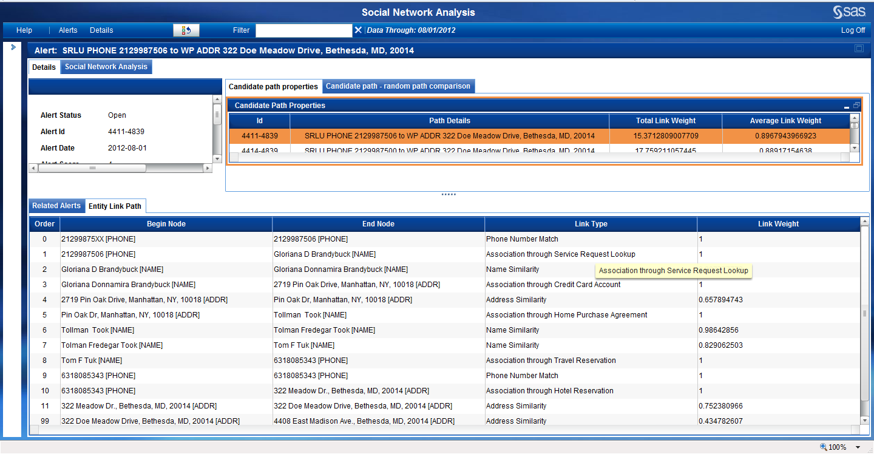
The entity link path shows a tabular overview of the nodes within the path (including the relationship/link type).

Slide 20
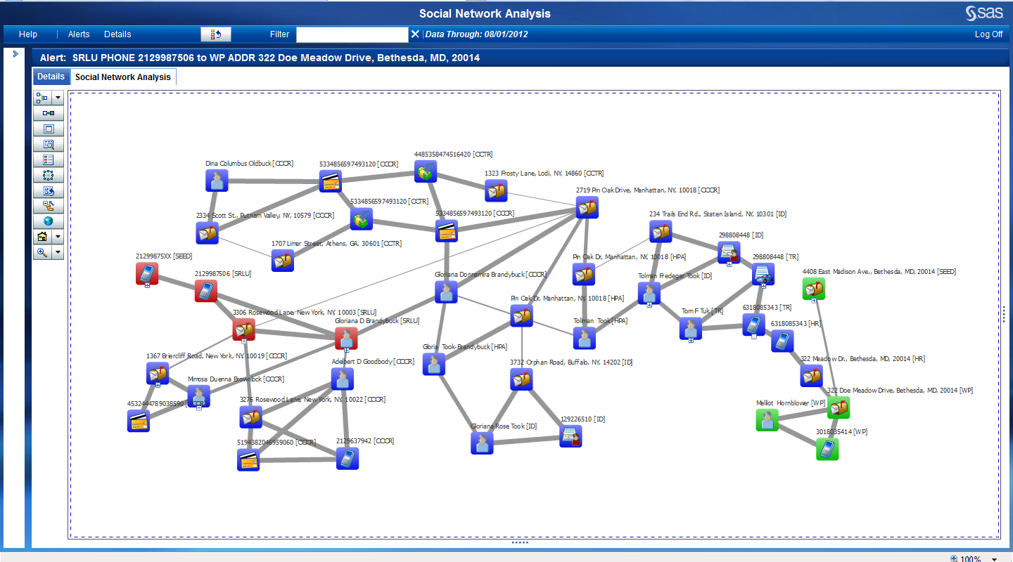
Link Charts are generated for each path for the user to review and for visual investigation.

Slide 21
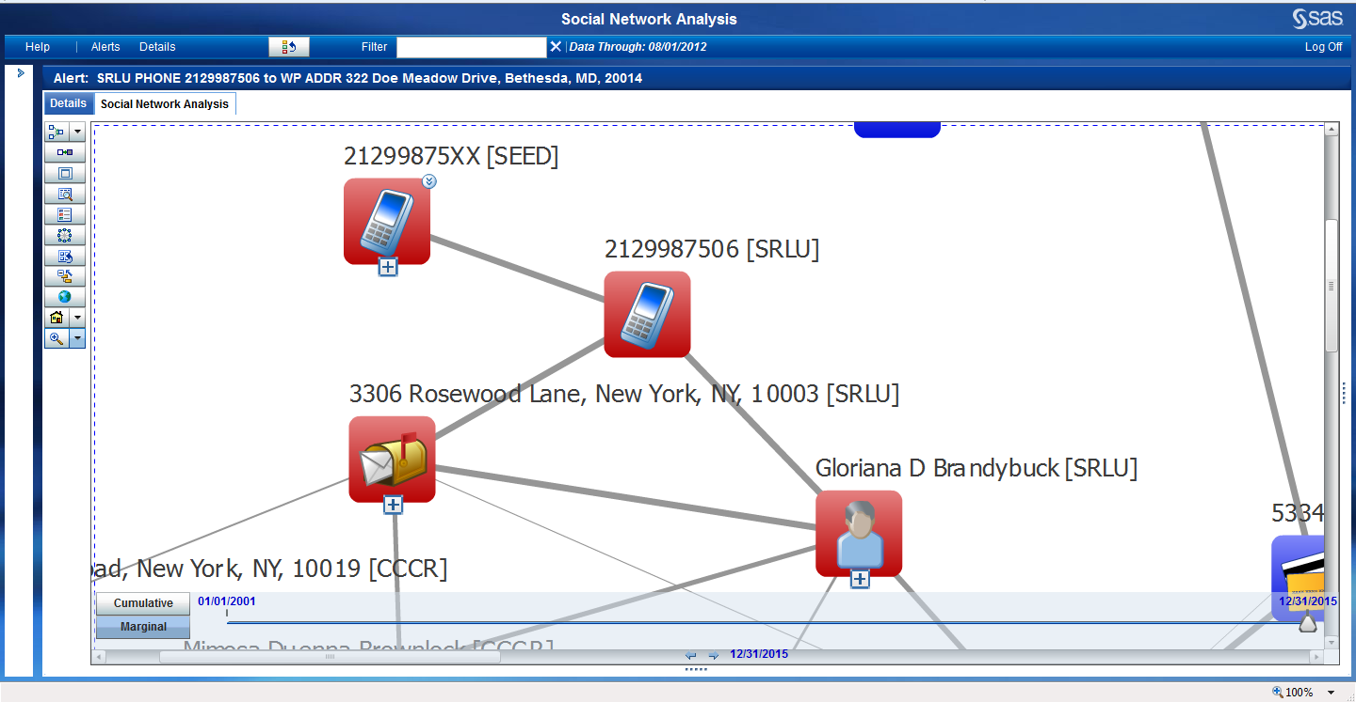
Starting nodes (seeds) are rendered in red in this example making it easy for the user to review.

Slide 22
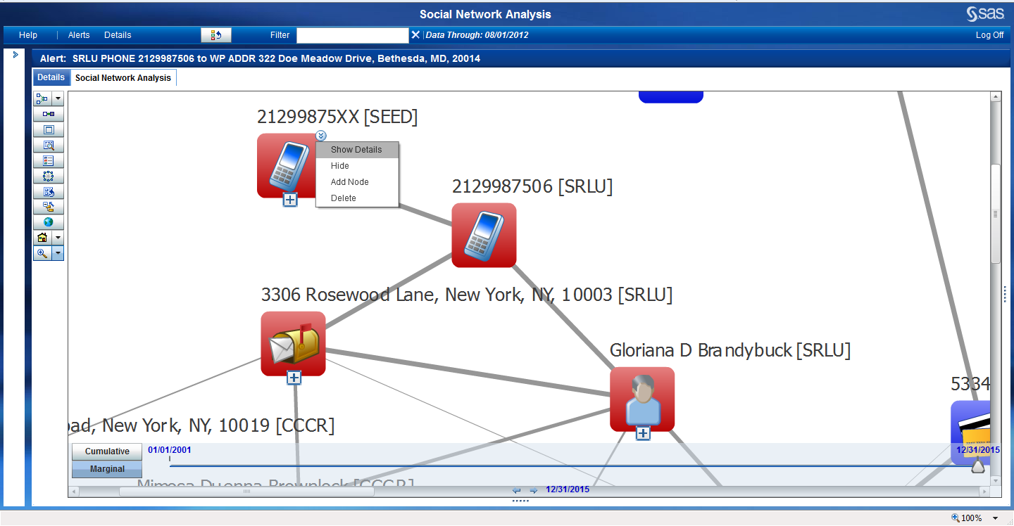
Details are available on each node and link in the social network analysis view.

Slide 23
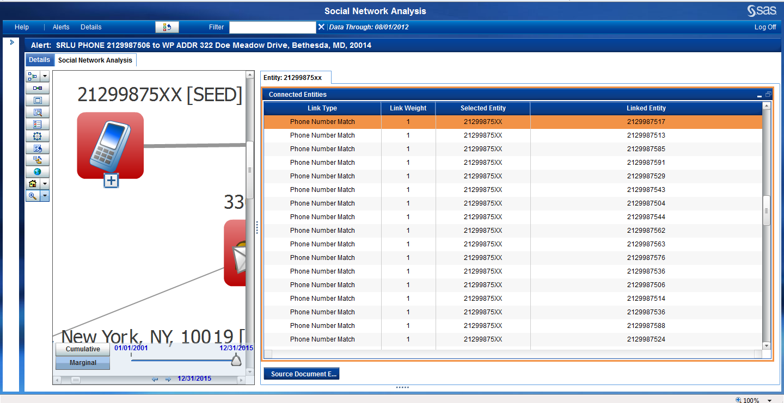
Although there are a number of nodes that “match” the seed only the one(s) applicable to the selected path are initially shown. Users can “expand” on any node to view all connections.

Slide 24
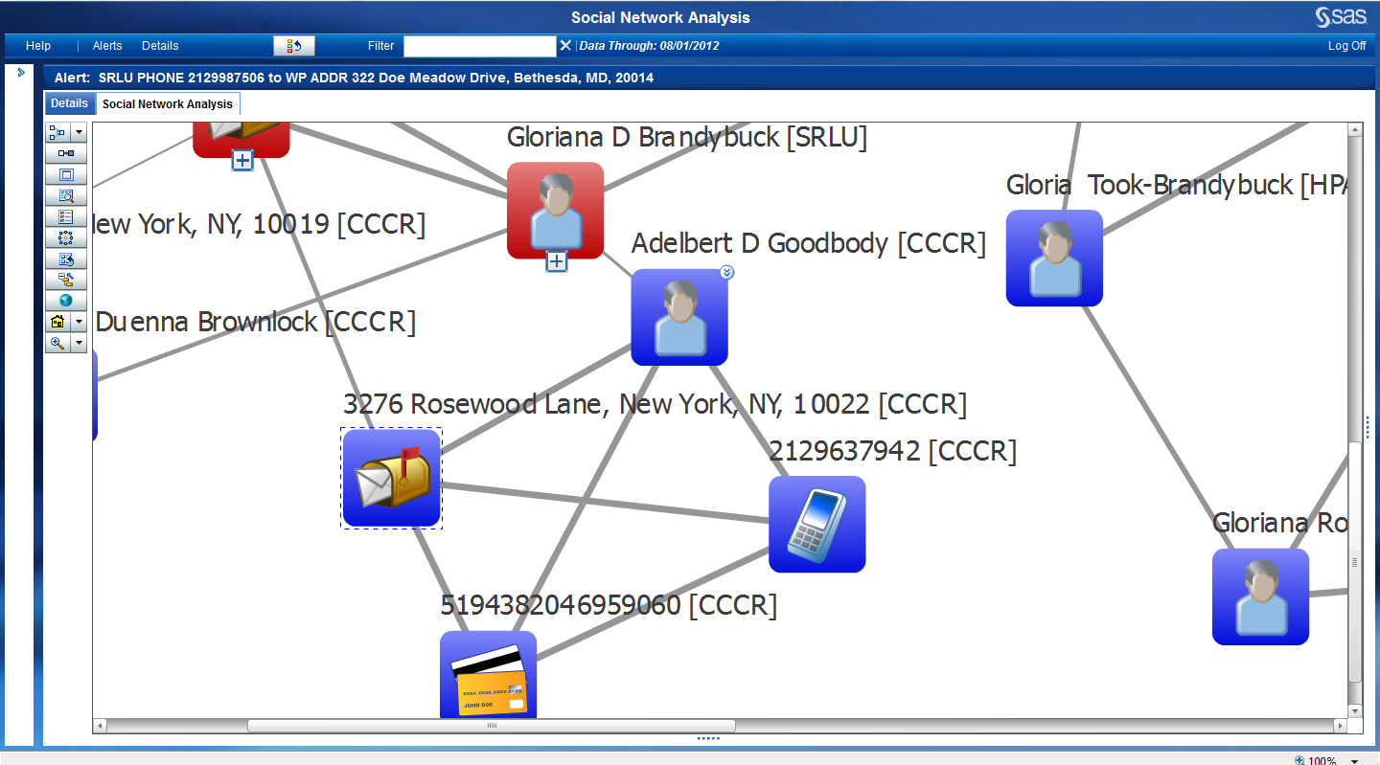
Communities of interest can be included in the initial link chart showing possible other connections that may not be part of the path, but can be influential in the group.

Slide 25
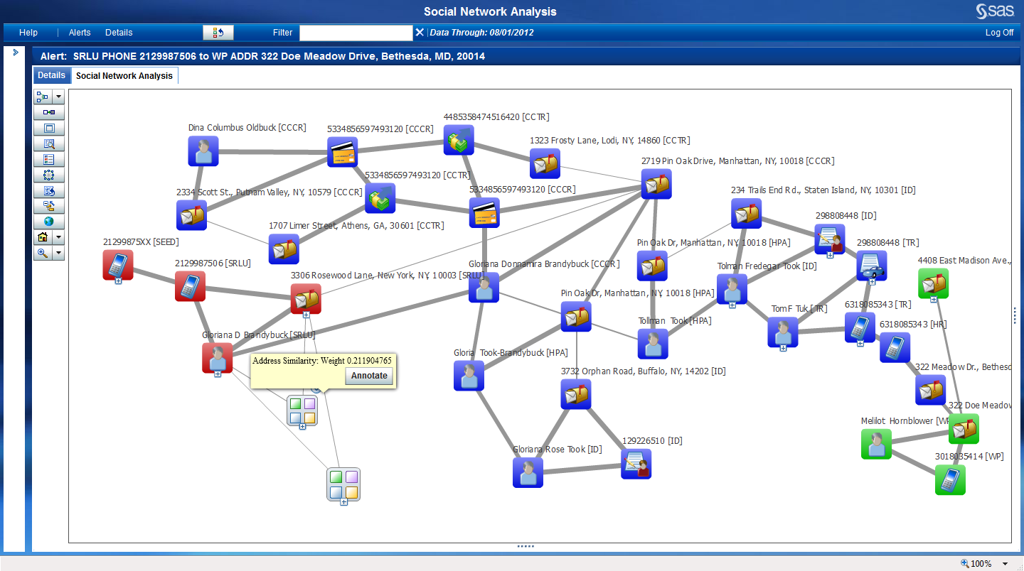
Communities of interest can be set aside but remain available for analysts to come back to.

Slide 26
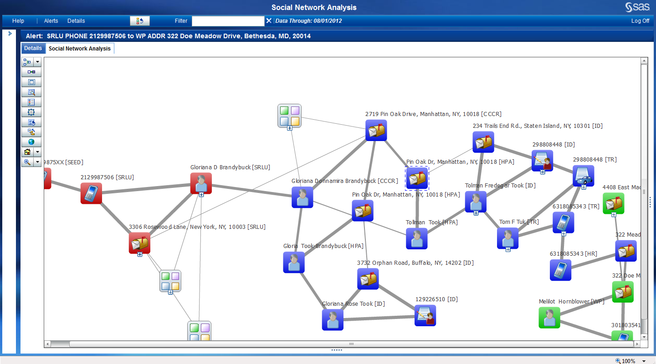
The highest scored path shows the phone number
(212) 998-7506 belonging to Gloriana D Brandybuck of Rosewood Lane, New York linked to a Gloriana Donnamira Brandybuck of Pin Oak Dr in Manhattan New York

Slide 27
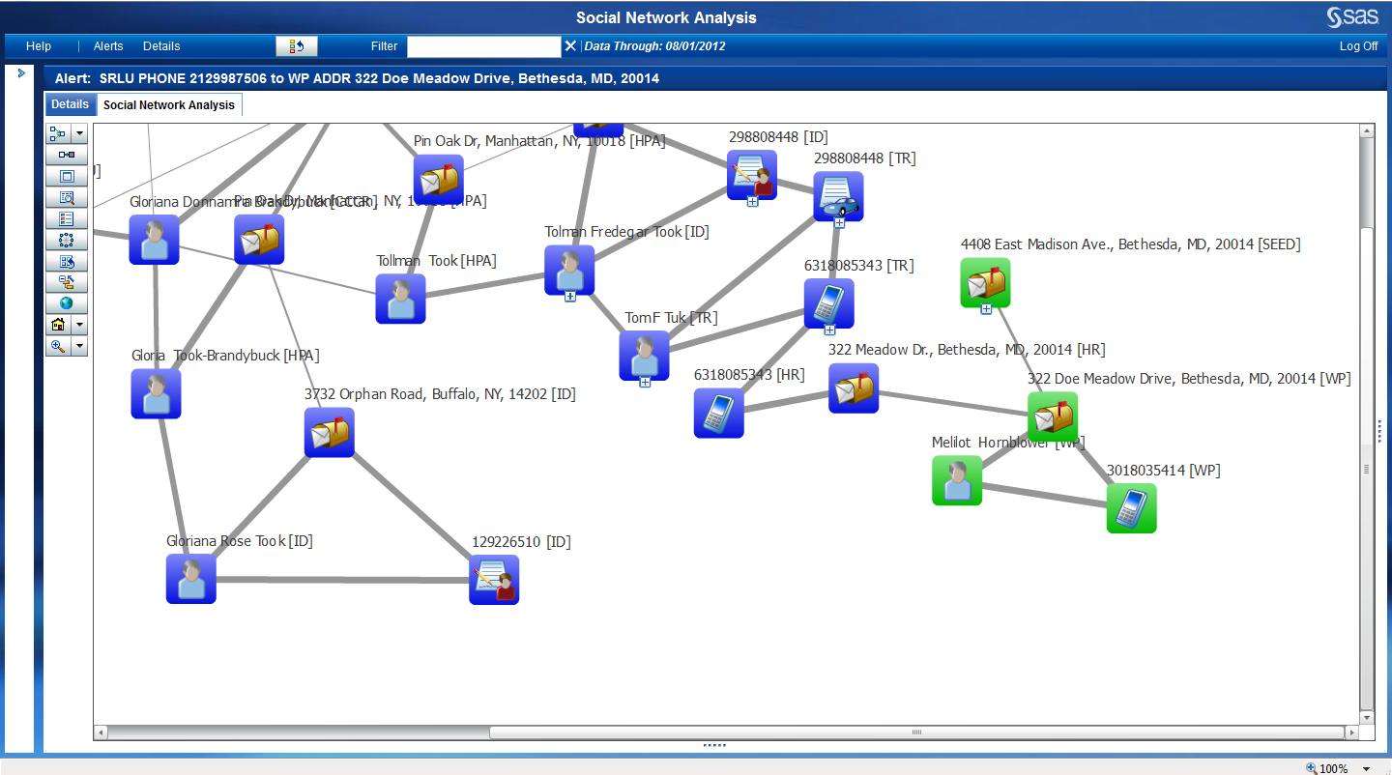
The Pin Oak Drive address links Gloriana to a Tolman Took. We also see Gloriana’s name as Took-Brandybuck as well. Tolman Took is also linked to Tom Tuk and some travel and hotel records which place him in Bethesda MD.

Slide 28
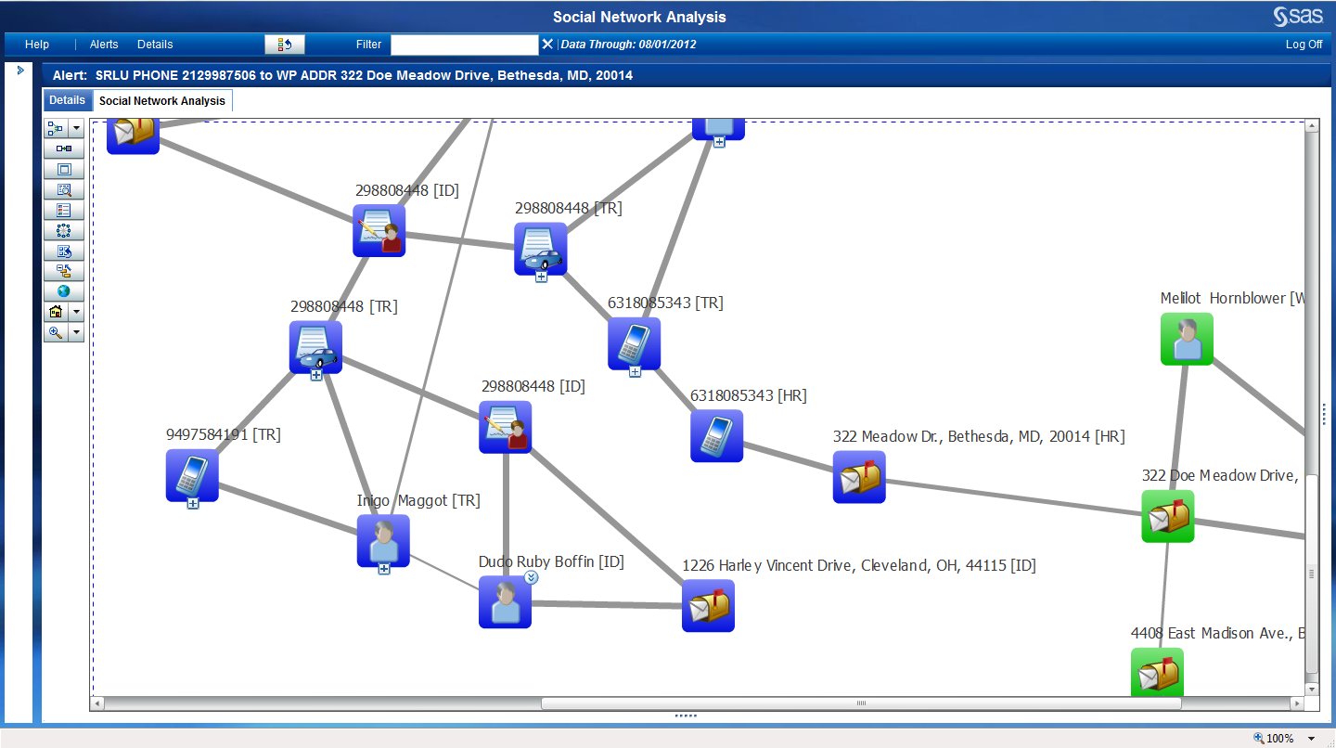
A closer look at Tolman Took and his travel reservation shows additional information which may be important to a possible contagious outbreak.

Slide 29

SAS security intelligence
Operational Data Sources
Exploratory Data Analysis & Transformation
Alert Generation Process
Data
Staging
Business
Rules
Alert
Administration
SAS® Social
Network
Analysis
Transactions
Network
Rules
Analytics
Anomaly
Detection
Network
Analytics
Entities
Predictive
Modeling
Internal Data
Alert Management &
BI / Reporting
Learn and Improve Cycle
Intelligent
Repository
External Data
Case Management

Slide 30
Jonathan Janos
jonathan.janos@sas.com
571-265-2261
Michael McCoy
michael.mccoy@sas.com
571-218-8042
Josh Mahoney
josh.mahoney@sas.com
410-703-8839
Copyright © 2011, SAS Institute Inc. All rights reserved.
Notes:
With that…. This concludes our briefing.

