Slide 1








Visualization
To
Tamas Budavari, Pat Lincoln,
Tom Longstaff, Larry Meador,
and a cast of thousands

Slide 2
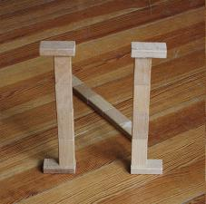
Visualization
To
Tamas Budavari
Patrick Lincoln

Slide 3


Slide 4
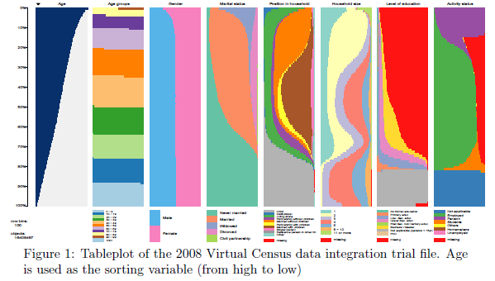

Slide 5
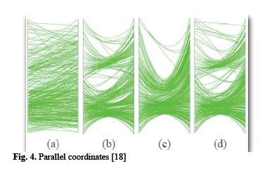

Slide 6
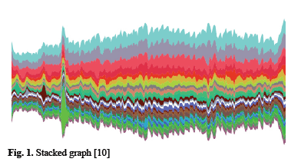

Slide 7
From Visualization to Perception from the invitation
The massive volumes of data being collected in the physical and cyber worlds are dwarfing our abilities to assess, identify, characterize, and prioritize items, objects, and issues of interest. This is the antecedent of any action designed to anticipate or respond. New visualization methods, as well as those that help humans respond more effectively, are required, especially to help analysts orient and assess large areas of data. As we discussed at C3E 2011, effective cybersecurity will have to take advantage of effective use of both humans and machines for the things that they each do best.

Slide 8
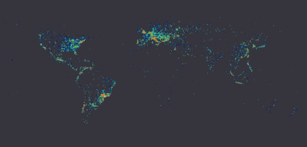
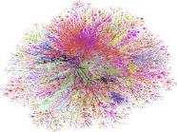
Mapping Between Spaces
Geographic, Internet Topology, Etc
Geolocated conficker-infected machines
Internet topology locations

Slide 9
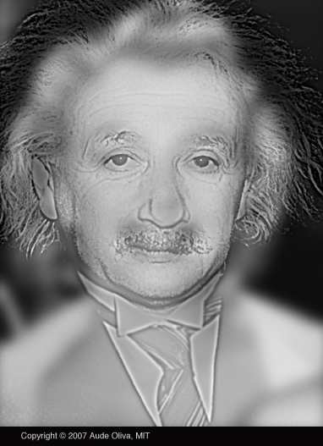
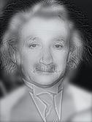

Slide 10
Questions For This Meeting
What are the emerging “best practices” in visualization for the analyst? How can they orient, assess, and move around large data sets efficiently and effectively? How can visualization provide a tool for the analysts to navigate easily through large data sets to explore potential relationships and to develop or validate hypotheses?
What is the role of streaming analytics and other techniques in enhancing perception of cyberspace threats?
What is our current scientific understanding of the relationship between visualization and perception in both the human and machine-learning worlds?
How can we distinguish between anomalies recognized by machines – often the result of incomplete data or computational errors – and anomalies that merit further investigation or immediate response?

Slide 11
Additional Questions
How can the accuracy/validity of a visualization be assessed?
What confidence/uncertainty can be assigned to a visualization? What descriptors or classifiers of uncertainty are there?
What are the sources of data used for visualization? Are some better than others? Why?
What should we learn from Jason’s problem?
  In particular, what lessons can we learn regarding cyber security from this type of analysis, visualization, and interaction?

Slide 12

Visualization to Perception in the Presence of Intentional Disguise or
Malicious Data Manipulation

Slide 13
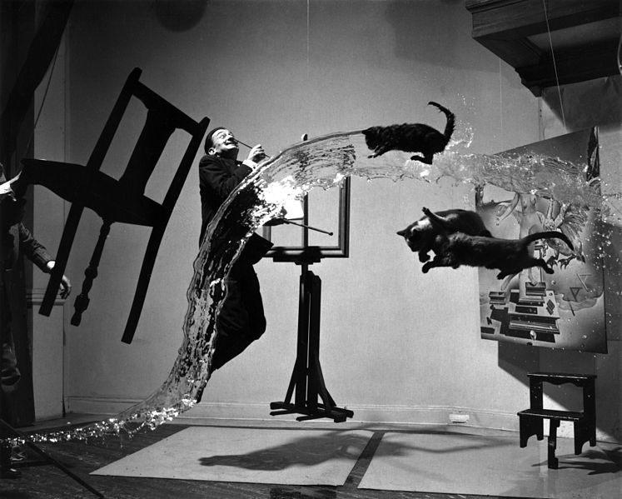

Slide 14
Visualization
To
Tamas Budavari, Pat Lincoln,
Tom Longstaff, Larry Meador,
and a cast of thousands

Slide 15
Process
Monday Afternoon:
  Introductions, brief overview, frank exchange of views, curmudgeons vs technology optimists
Tuesday Morning:
  Speed dating: 4-5 minute 1-on-1 discussion of key questions
Tuesday Afternoon:
  Cool demonstrations of visualization tools
  Gathering input on key questions in breakouts
Wednesday:
  Magic happens

Slide 16
Goal Products
New insights and understanding
New human connections and beginnings of new collaborations
Powerpoint outbrief
Shakespearean quality writeup

Slide 17
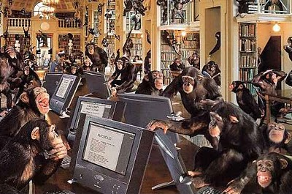

Slide 18
Visualization
To
Tamas Budavari, Pat Lincoln,
Tom Longstaff, Larry Meador,
and a cast of thousands

Slide 19
Process
Monday Afternoon:
  Introductions, brief overview, frank exchange of views, curmudgeons vs technology optimists
Tuesday Morning:
  Speed dating: 4-5 minute 1-on-1 discussion of key questions
Tuesday Afternoon:
  Cool demonstrations of visualization tools
  Gathering input on key questions in breakouts
Wednesday:
  Magic happens

Slide 20
Goal Products
New insights and understanding
New human connections and beginnings of new collaborations
Powerpoint outbrief
Shakespearean quality writeup

Slide 21
Questions For This Meeting
What are the emerging “best practices” in visualization for the analyst? How can they orient, assess, and move around large data sets efficiently and effectively? How can visualization provide a tool for the analysts to navigate easily through large data sets to explore potential relationships and to develop or validate hypotheses?
What is the role of streaming analytics and other techniques in enhancing perception of cyberspace threats?
What is our current scientific understanding of the relationship between visualization and perception in both the human and machine-learning worlds?
How can we distinguish between anomalies recognized by machines – often the result of incomplete data or computational errors – and anomalies that merit further investigation or immediate response?

Slide 22
Additional Questions
How can the accuracy/validity of a visualization be assessed?
What confidence/uncertainty can be assigned to a visualization? What descriptors or classifiers of uncertainty are there?
What are the sources of data used for visualization? Are some better than others? Why?
What should we learn from Jason’s problem?
  In particular, what lessons can we learn regarding cyber security from this type of analysis, visualization, and interaction?

Slide 23
Topics
Viz for communication vs exploration
Different viz for analysts?
Hierarchy of analysts?
Role of human vs machine?
Channels of human-machine interaction?

Slide 24
Topics
Viz in high dimensions on a screen
Viz in 2D or 3D screens
Viz of graphs
What features to look for?
How to start exploring?

Slide 25
Topics
Role of statistics
Role of machine learning
Role of databases
Domain knowledge

Slide 26
Topics
Observed correlations vs human understanding
Decision making: machine or human
Multiplier of human performance

Slide 27
Topics
Current problems of streaming viz
Wanted features for streaming viz
Diff of stream and high dim viz
Temporal: link events for dynamics

Slide 28
Topics
Anomalies
Dirty data
Computer errors

Slide 29
Topics
Scale: from toy problems to big data
What is big?

Slide 30
Topics
How to build a storyline?
What viz tools?
Are story board tools appropriate for cyber?

Slide 31
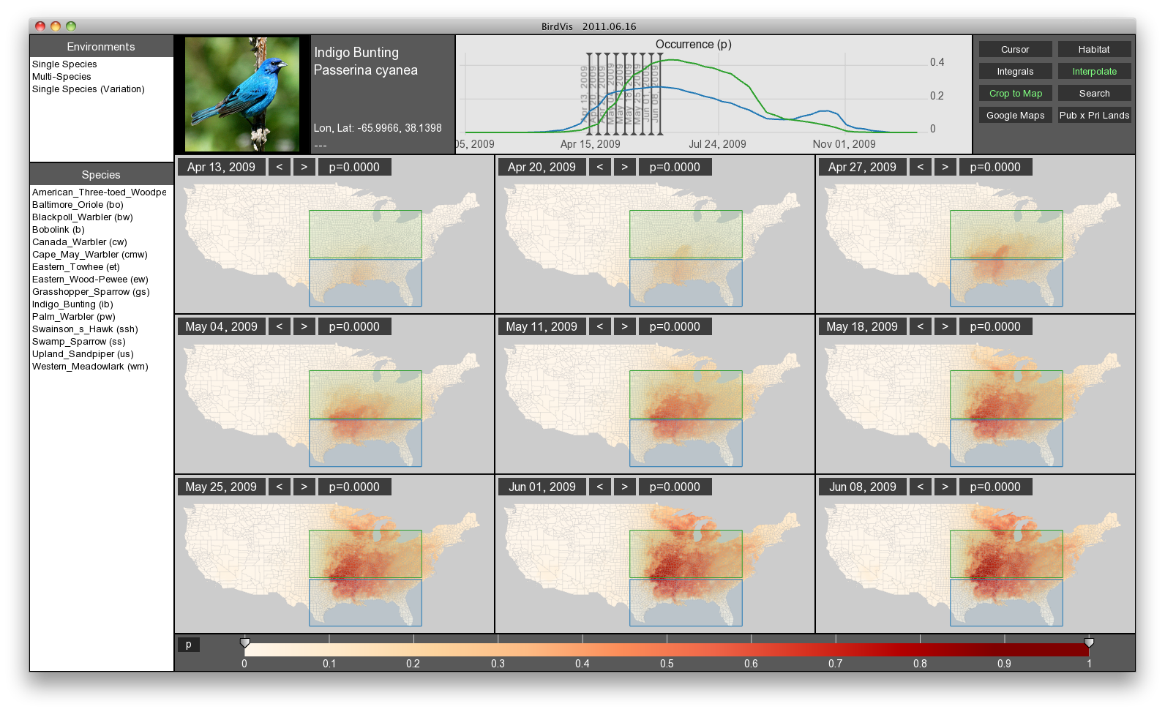
Demonstrations
Very cool demonstrations of the state of the art in visualizations of complex systems

Slide 32
High level summary
Story
Context
Process
Purpose: communicate & explore
Federation, aggregation
Weakest part of automation support for flow now is hypothesis generation and story telling

Slide 33
Main Points
Roll of visualization to communicate key story lines
Use context to get reality check
  External DB, domain knowledge
Tailoring visualization to different roles: tiers,
  T1, T2, T3, …plus Management, Legal, PR
Visualization should support a crowd sourcing function
Attack response and visualization are in need of substantial improvement
Leverage end-users as part of the incident response team
Timelines
  Careful of timelines faster than humans can perceive
  Present timeline in terms of end user
Younger generation should be leveraged
  Interaction styles are changing to include gesture, touch
Need a way to capture and present things that reflect gut feel
  Intuition: My gut tells me that Took is related to Glorianna

Slide 34

Possibly New Areas
Crowdsourcing within an organization
  Stream of hypotheses, users give quick feedback
Pushing visualization farther, beyond analyst to end use
New visualization systems require practice:
  How do we roll out new tech and develop expertise?
Timelines presented at different levels of granularity
Detection and highlight of anomalies
Visualization of weak links in story
Changing ways younger generation expects to use computers and visualization: touch screens
Novel ways to interact and visualize
  Pick 4 pictures from this large set that tell the story

Slide 35
Let’s Tell a Story
Communication vs Exploration
Storyline: who what when where why?
  Why is most important: motivations of actors
    Disruption, Stealing IP, establishing foothold to enable future actions
    But why is the most difficult to support with tools
Alternate storylines
  Multiple, possibly conflicting truths

Slide 36
Task-Oriented Visualization
Task oriented visualization
  Success in Geospatial, Business intelligence, avionics, financial decision making areas
  But in networking and cyber, not so much
Visualization should be driven from what decisions face the analyst, or what actions the analyst may take
  What is the minimum they need to know to orient, decide, act
How to visualize the logical process vs visualization of process analysts are using

Slide 37
Augmentation
Augmentation of humans with hypothesis generators
  Combined with story generation
Highlighting differences of opinion
Highlighting what different some small set of data makes
Visual representation of uncertainty
  How much uncertainty when we connect the Fuzzy dots?

Slide 38
Reemphasizing
Does the visualization tell the story
  Does it provide: who what where when why?
  Does it provide basis for collaboration
  Can we present one or more storylines though visuals?
  How can we best support the analyst in sensemaking, situational awareness?

Slide 39
Thank you
To the co-chairs
  Tamas Budavari, Pat Lincoln,
  Tom Longstaff, Larry Meador
To the participants
  Shane Morris, Matt Sottile:, Tamari You, Chris Oehmen, Angelos Karemedis, Ivan Sutherland, Mark , Sanjay Narain, Grit Denker, Chris Healy, Jeremey, Victoria, Rick Hotchkiss, Hugh Strain. Mike McCoy, Jonathan Jonas, Carol Brush, Alex Wissner-Gross, Dan Wolf, Jason, Sven, Rafi
To the reporters: special thanks
To the support staff
To the organizers

Slide 41
Tamas Points
Different viz for communication and exploration
Machines are faster than humans (duh)
Machines are better at making decisions (!?)
High-dim viz needs projection tools, e.g., PCA
Streaming for embedding not always available, e.g., LLE
Perhaps brain devices for interaction?
Vendors provide feeds that need to be federated
Event matching / correlation: latency, probability
Taxonomy of threats/events for merging and filtering
Automated hypothesis generators (replace humans?)

